Slide 1



The Challenging Landscape of Critical Information Infrastructure:
Are We Ready?
Leonard Bailey
Senior Counsel
Computer Crime &
Intellectual Property Section
US Department of Justice
March 9, 2007

Slide 2
Agenda
Define the challenge.
Outline the response.
Propose ways forward.

Slide 3
Define the challenge.

Slide 4
The Complicated Landscape of Critical Information Infrastructure Protection:
Are We Ready?

Slide 5
Private v. Public
International
Physical v. Cyber
The Complicated Landscape of Critical Information Infrastructure Protection:
Are We Ready?
Military v. Non-Military Systems
Wartime v. Peacetime

Slide 6
Cyber Disaster Planning
Federal Incident Response Community
  DHS, National Cyber Security Division
  Law Enforcement/Intel
  Department of Defense
Information Sharing and Analysis Centers
Sector Coordinating Councils
Government Coordinating Council
International Entities

Slide 7
The Complicated Landscape of Critical Information Infrastructure Protection:
Are We Ready?

Slide 8
13 Critical Infrastructure Sectors
The Complicated Landscape of Critical Information Infrastructure Protection:
Are We Ready?
Communications and IT Sectors

Slide 9
What is “Critical”?
Executive Order 13010
  “Infrastructures so vital that their incapacitation or destruction would have a debilitating impact on defense or economic security.”
USA PATRIOT Act (P.L. 107-56)
  “[S]ystems and assets, whether physical or virtual, so vital to the United States that the incapacity or destruction of such systems and assets would have a debilitating impact on security, national economic security, national public health and safety, or any combination of those matters.”

Slide 10
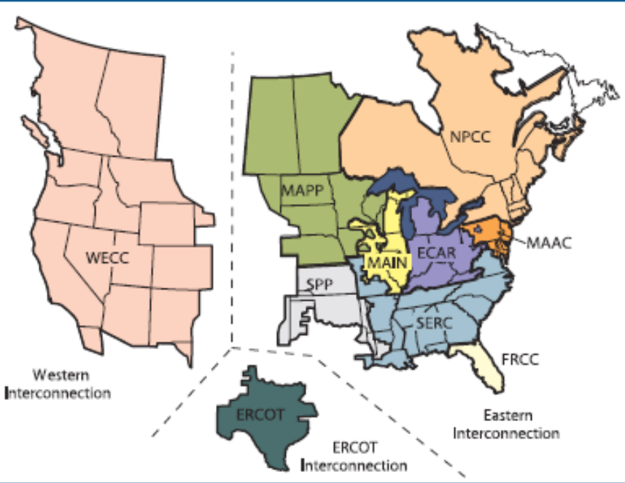
What is “Critical”?
Interdependencies between Sectors
  Known, unknown and unknowable.
Interconnected systems
  “The North American power grid is one large, interconnected machine.”

Slide 11
What is “Critical”?
Convergence
  Progress toward integrated IP Network.
  Increased opportunity for cascading failure.
  New “critical” functions.

Slide 12
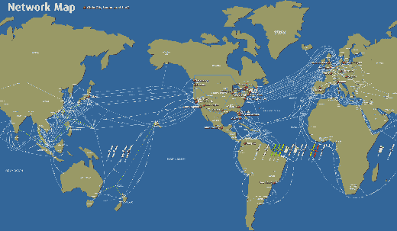
International

Slide 13
Outline the response.

Slide 14
The Complicated Landscape of Critical Information Infrastructure Protection:
Are We Ready?

Slide 15
International Partners
Private Industry
Academia
The Complicated Landscape of Critical Information Infrastructure Protection:
Are We Ready?
State, Local & Tribal Authorities
Federal Government

Slide 16
Natural Disaster
The Complicated Landscape of Critical Information Infrastructure Protection:
Are We Ready?
Attack
Accident

Slide 17
Incident Response
Stop the bleeding – repair and mitigate damage.
Identify the source of the incident.
Take directed action against the cause.
Assessment
Response
Restoration Remediation

Slide 18
Incident Response
Remediation Community
International
Law Enforcement Community
Intelligence Community
War-Fighter Community
Assessment
Response
Restoration Remediation

Slide 19

Tripwires
National Response Plan
  The National Response Plan establishes a comprehensive approach to enhance the ability of the United States to manage domestic incidents.
  Homeland Security Policy Directive 5
  Signed December 2004.

Slide 20
Tripwires
“Incident of national significance”
  An actual or potential high-impact event that requires a coordinated and effective response by and appropriate combination of Federal, State, local, tribal, nongovernmental, and/or private-sector entities in order to save lives and minimize damage, and provide the basis for long-term community recovery and mitigation activities.
  Cyber Annex specifically addresses management of cyber incidents.

Slide 21



National Cyber Response Coordination Group

Slide 22
Origin of the NCRCG
Department of Homeland Security
  Effectuate responsibilities under HSPDs 5 and 7 and the National Response Plan (NRP).
Department of Justice
  Replace the IRC with an operational group that could help coordinate investigative response activities during a cyber incident.
National Security Council
  Provide a central interagency group for addressing cyber issues implicating national and homeland security.

Slide 23
Structure of the NCRCG
Steering Committee
  Co-chaired by DHS/NCSD, DOJ/CCIPS, and DOD/OSD-NII.
  Includes:
    CIA
    DHS
    Director of National Intelligence (DNI)
    DOD
    DOE
    DOJ
    HSC
    NCIX
    NSA
    NSC
    OMB

Slide 24
Propose ways forward.

Slide 25
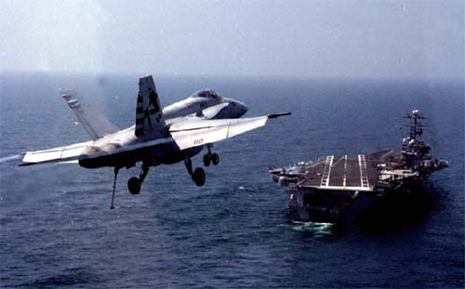
What you can do
Encourage your leadership to undertake the challenge.

Slide 26
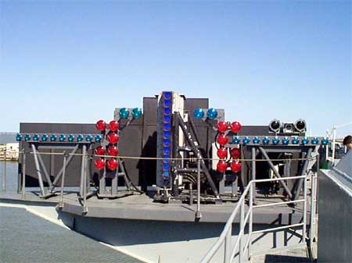
What you can do
Challenge your leadership.
  Help them focus on what matters in a manner that is helpful to them.

Slide 27
What you can do
Align words and deeds
  Are your entity’s actions consistent with the perception of the threat?
  If not, why not?

Slide 28
What you can do
Prepare and practice.
  Do you have an incident response plan?
  Is it up-to-date?
  Has it been socialized in your organization?
  Are you confident that it will be followed?

Slide 29
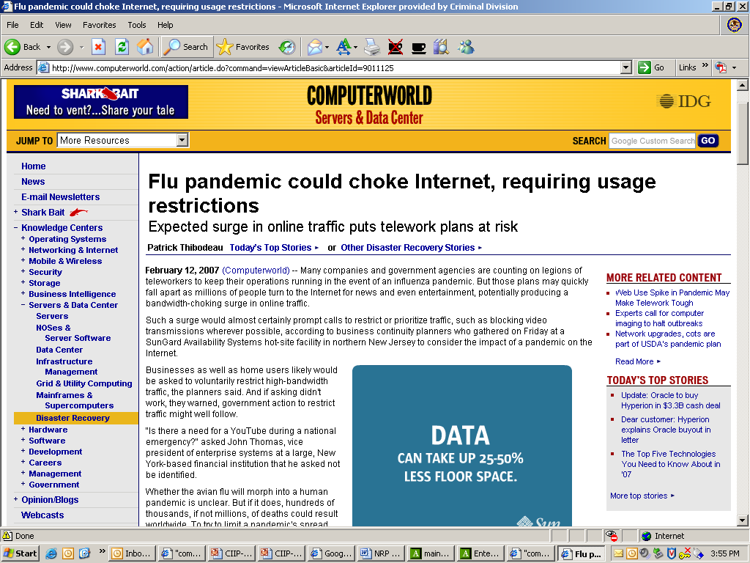

Slide 30

Getting more info
Contact Us
  Main: (202) 514-1026
  E-Mail: leonard.bailey@usdoj.gov
Web:

