Slide 1
Knowledge Random Walker (KRW)
Is a RW that can be tailored for the specific knowledge on a certain topic
It assigns user defined weights to Edges leading to specific node classes

Slide 2
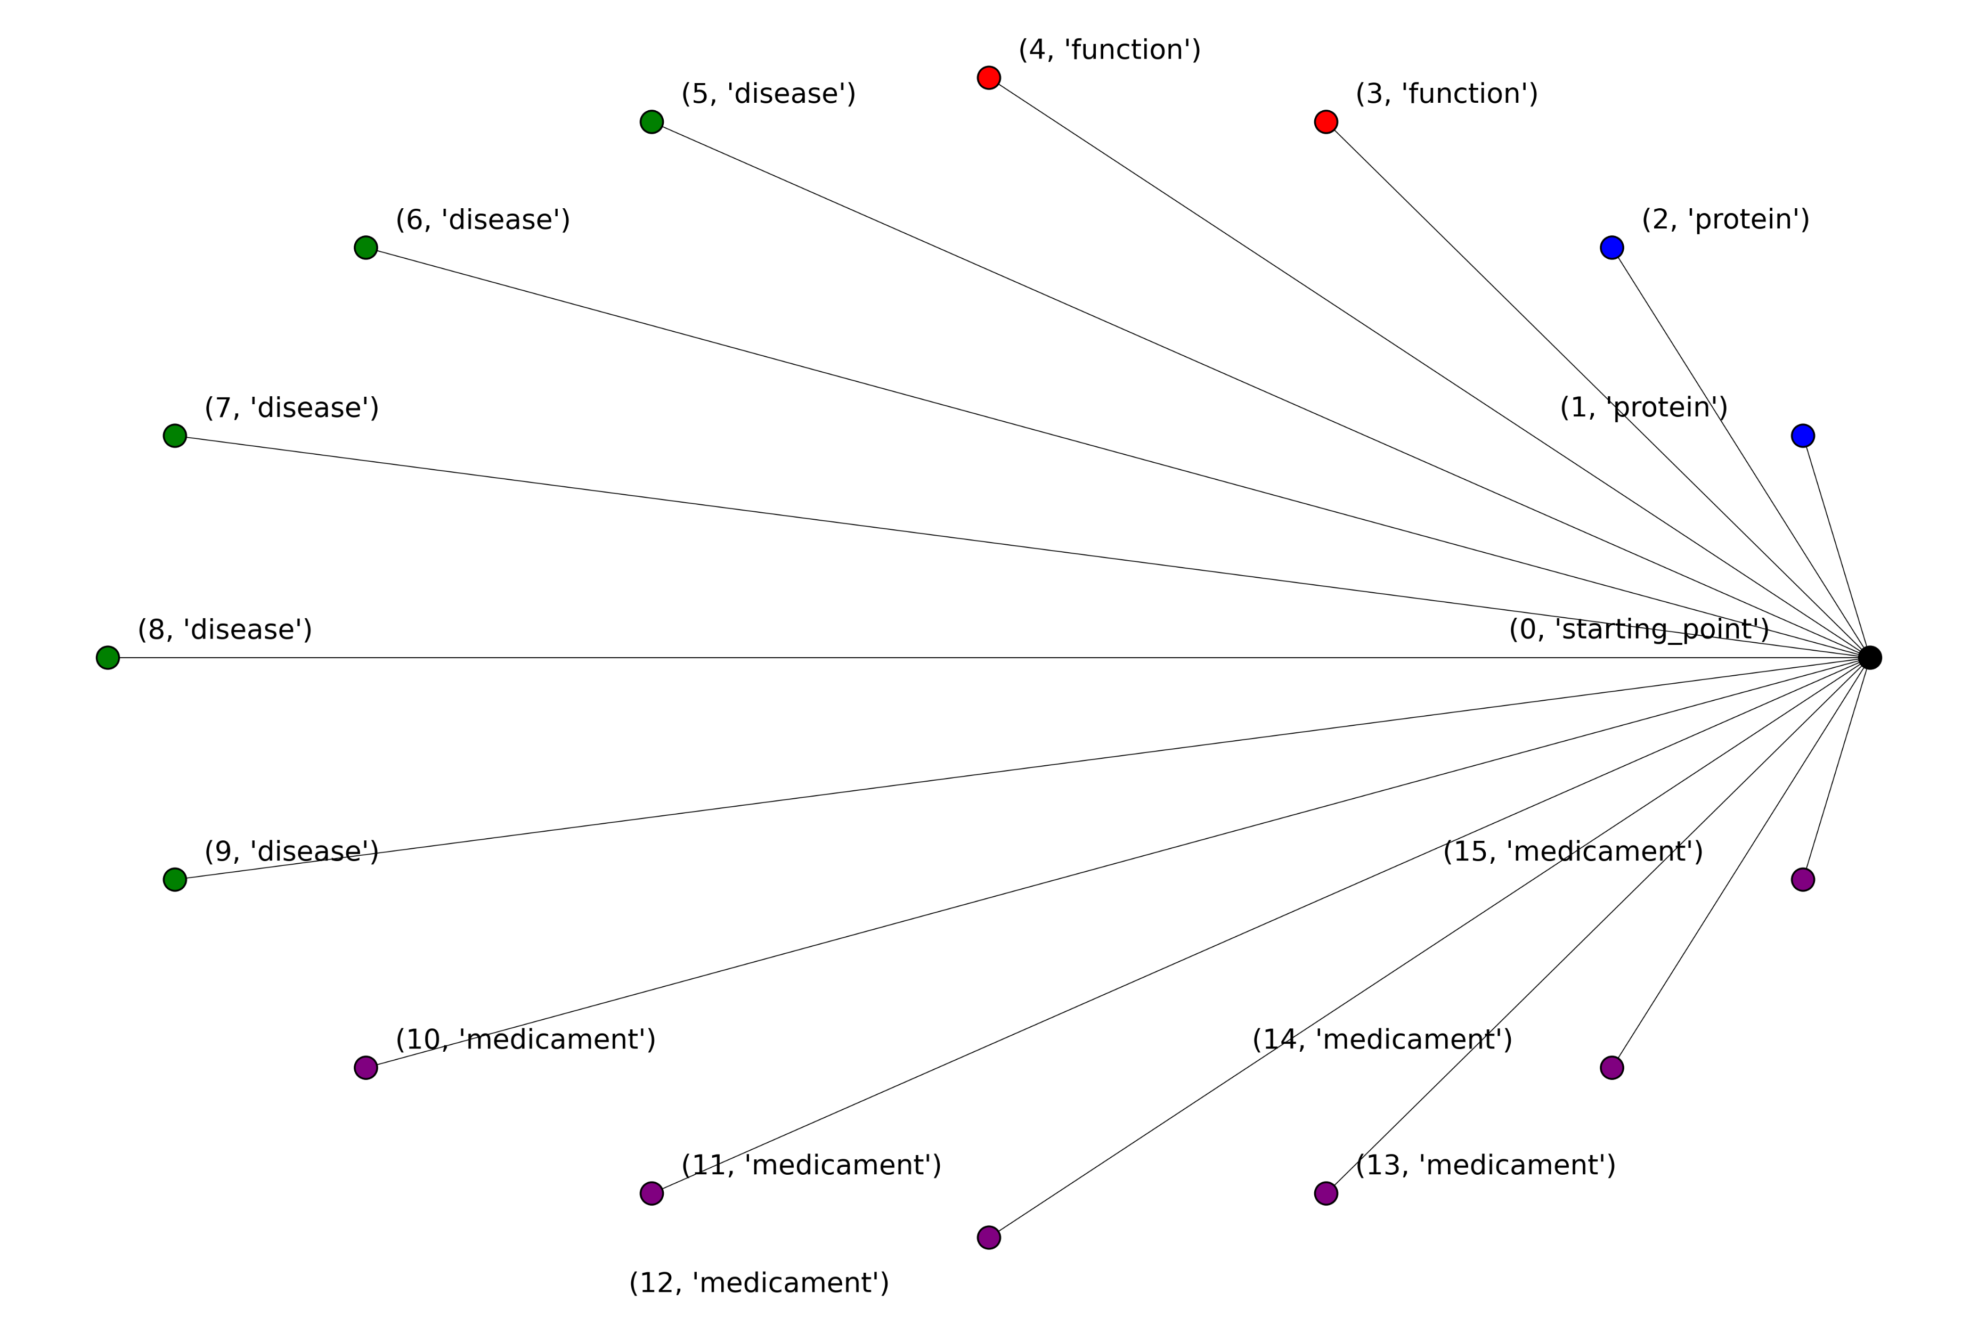
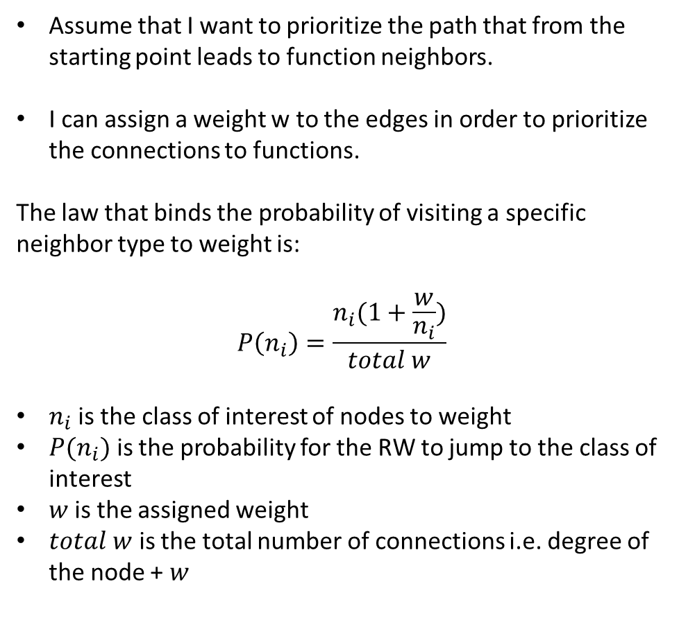
Let’s consider the following example
Assume that I want to prioritize the path that from the starting point leads to function neighbors.
I can assign a weight w to the edges in order to prioritize the connections to functions.
The law that binds the probability of visiting a specific neighbor type to weight is:
$$P\left(n_{i}\right)=\frac{n_{i}(1+\frac{w}{n_{i}})}{total w}$$
$n_{i}$ is the class of interest of nodes to weight
$P(n_{i})$ is the probability for the RW to jump to the class of interest
$w$is the assigned weight
$total w$ is the total number of connections i.e. degree of the node + $w$

Slide 3

Let’s consider the following example
We want to assign a weight w in order to weight the jump from starting node to “function” node type
If $w=0$:
$$P\left(n_{f}\right)=\frac{2 (1+\frac{0}{2})}{15+0}= \frac{2}{15}=0,13$$
If w = 5:
$$P\left(n_{f}\right)=\frac{2 (1+\frac{5}{2})}{15+5}= \frac{7}{20}=0,35$$
If w = 1000:
$$P\left(n_{f}\right)=\frac{2 (1+\frac{1000}{2})}{15+1000}= \frac{1002}{1015}=0,98$$

Slide 4
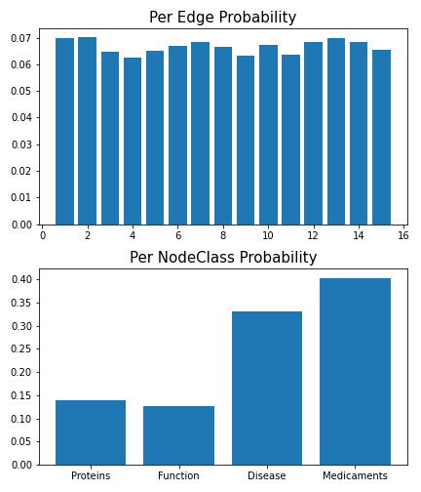
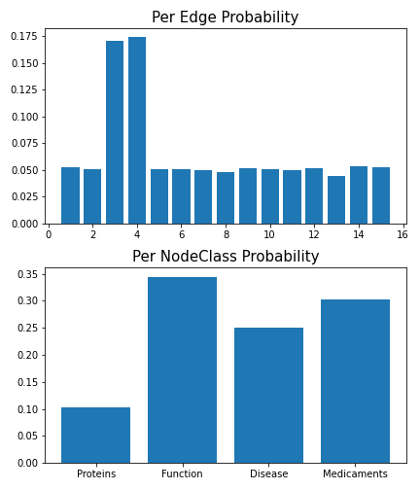
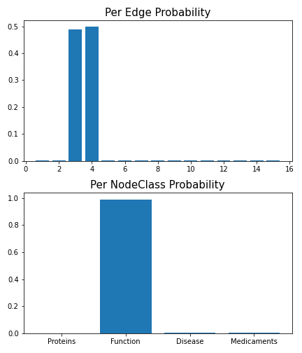
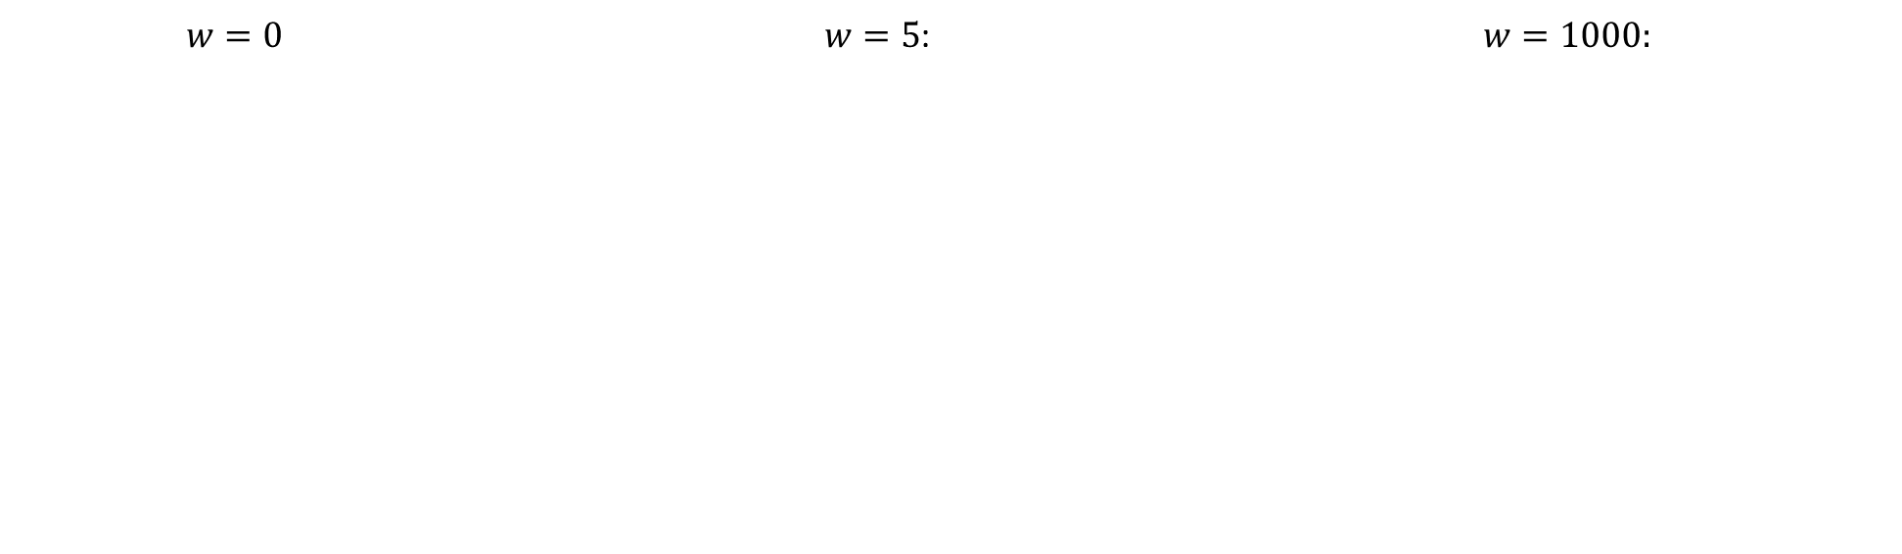
10000 Simulation with different weights comparison
$w=0$ $w=5$: $w=1000:$

