Slide 1
Test generator & managing resource dependencies
Frank Rehberger
fr@frehberg.com
Software/Security & Rust enthusiast

Slide 2

Use test-generators for...
Creation of many and many different test functions
Based on Proc-Macros generating multiple parameterized tests
Crate test-case-derive: one body with different input parameter values
Crate test-generator: one body with different input files
Crate build-deps: conditional rebuild 3party source-files

Slide 3
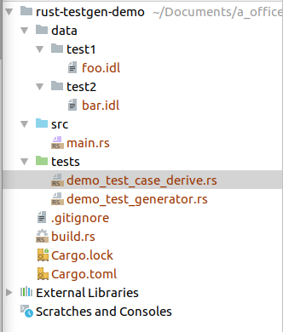
Package Layout

Slide 4
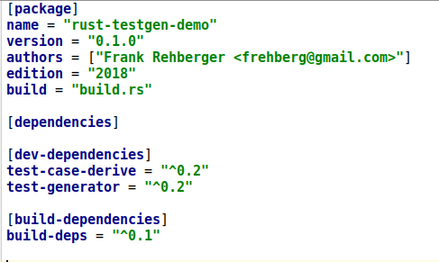
Package Manifest Cargo.toml

Slide 5
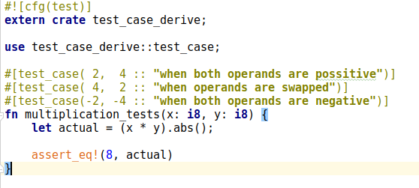
demo_test_case_derive.rs

Slide 6
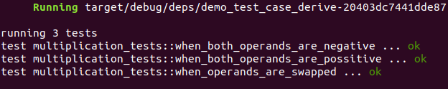
Out: demo_test_case_derive.rs
$ cargo test multiplication_tests

Slide 7
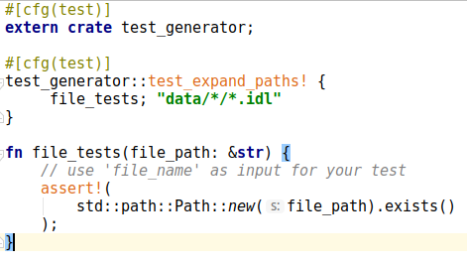
demo_test_generator.rs

Slide 8
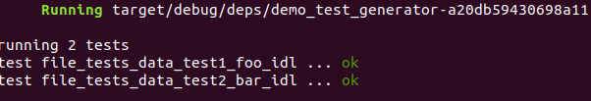
Out: demo_test_generator.rs
$ cargo test file_tests
Enumeration defined at compilation-time
Adding a new file, does not trigger re-compilation
==> Need for dependency management

Slide 9
Cargo/Rustc Dependency Management
Compilation rerun if changed:
Rs-files
External crates
Include! macro sourced files
Build-Script dependencies
  Source/Header-files, etc.
  Other files

Slide 10
Build-Script
Commands printed to stdout are interpreted by cargo
  cargo:rustc-link-lib=static=foo
  cargo:rustc-link-search=native=/path/to/foo
  cargo:rustc-env=FOO=bar
  …
  cargo:rerun-if-changed=PATH
==> Combine with GLOB in crate build-deps

Slide 11
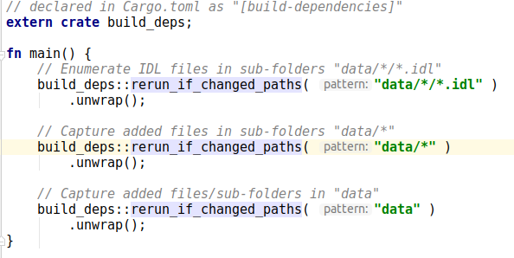
build.rs

Slide 12
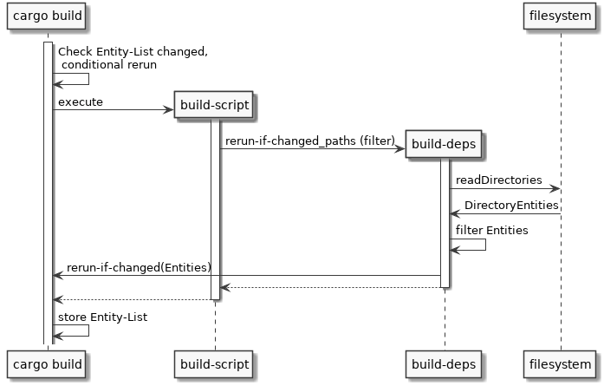
build-deps

Slide 13
Achievement
Proc-Macros generating parameterized tests over
  VALUES
  FILES-ENTITIES
Enforce Rerun compilation depending on
  Adding FILE-ENTITIES
  Modifying FILE-ENTITIES
  Deleting FILE-ENTITIES

Slide 14
References
https://crates.io/crates/test-case-derive
https://crates.io/crates/test-generator
https://crates.io/crates/build-deps
https://github.com/frehberg/rust-testgen-demo
THANK YOU!

