Slide 1
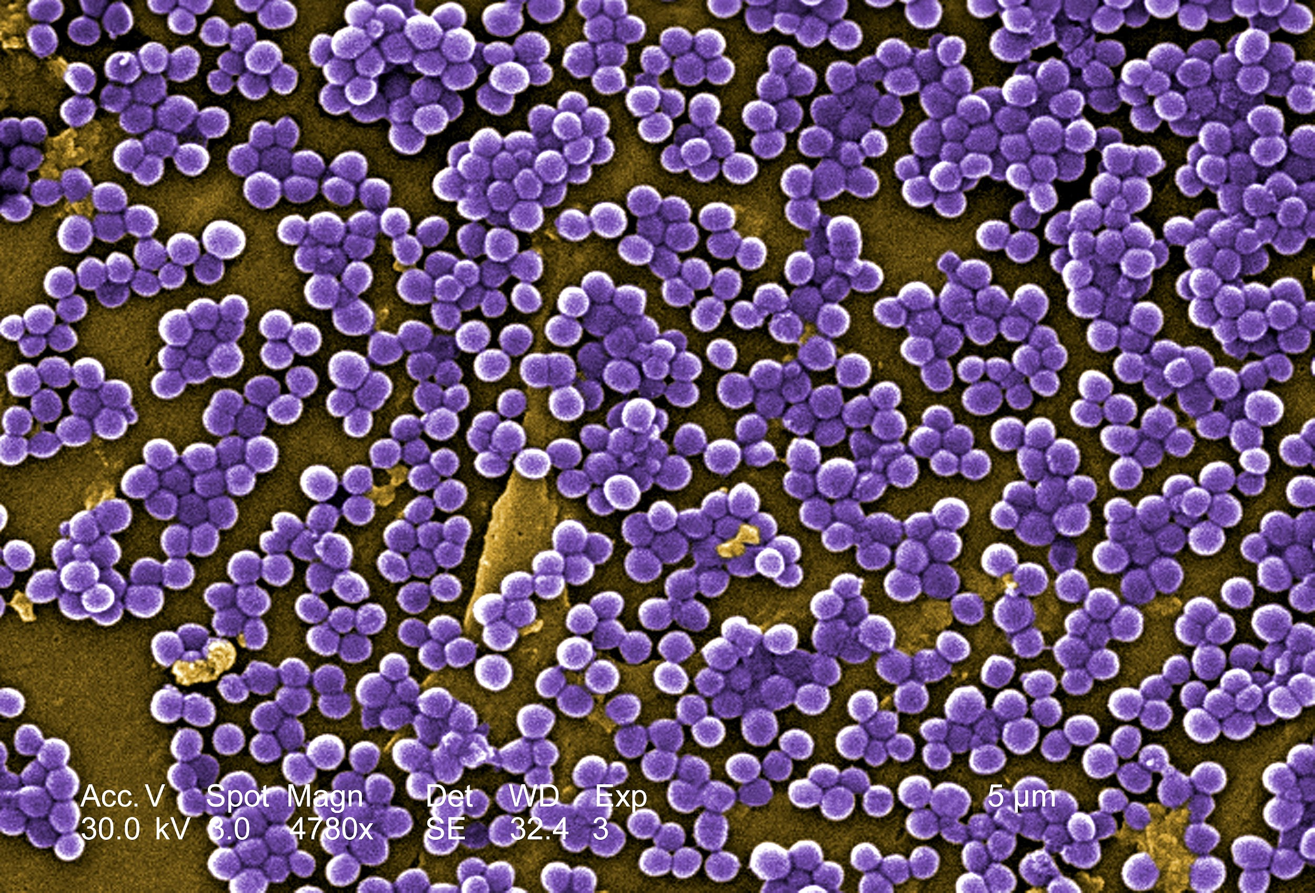
Staphylococcus substrate utilization
Andrew freiburger
Chem_Eng 422
2025

Slide 2
Motivation: I simulate bacterial behaviors in diverse media, which involves uptake phenomena
Hypothesis: Steady-state glucose concentrations is the cytoplasm can be described by a relatively simple mass transport formula, entailing both flux intake and reaction consumption. More specifically, exploring
active versus passive transport of glucose
Michaelis-Menten versus 1st-order glucose consuming reaction rates
Spherical versus Cartesian geometries
Approach:
Staphylococcus aureus, because it is a model organism and spherical
Compare the transport model with uptake from Flux Balance Analysis models and experiments
Assumptions:
Homogeneous extracellular environment to simplify the problem on the cell
Radial homogeneity inside the cell
Experimentally derived D = 3000 um^2/min; R = 1 um; and Km = 0.3 mM & Vmax = 4e6 mmol/(cm^3*min) for PFK (the rate-limiting enzyme for glucose metabolism).

Slide 3
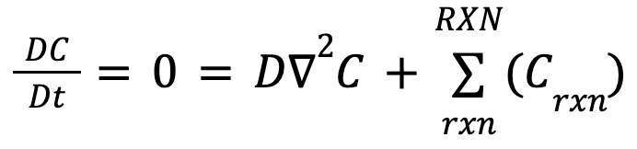

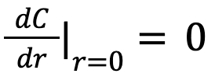


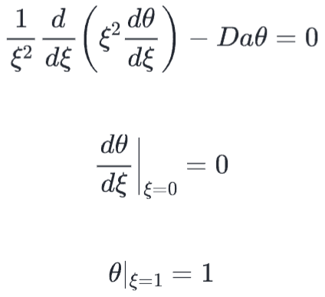
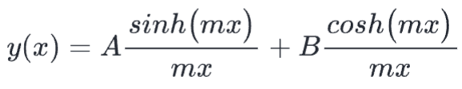
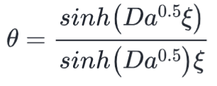
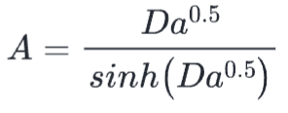
Methods
Experimentally sourced values:
A Python Notebook encodes these equations, solves the Diff eqs, visualizes the outputs, and will compare these results to FBA and experimental values.
A symmetry and a bulk BC are employed to solve for the Bessel relationship from Lecture 5:
Notes:
Include more elaboration and screenshots from the solution method Include the preliminary concentration figure, and comment on preliminary differences between the model geometries of the system

Slide 4
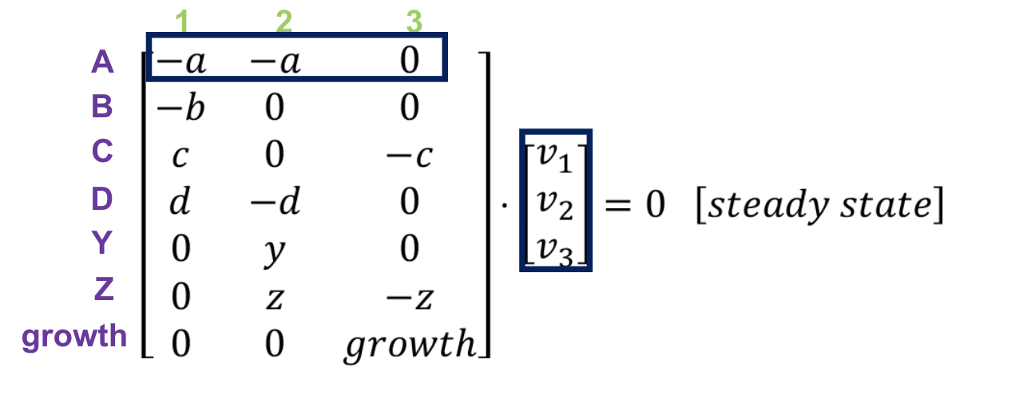
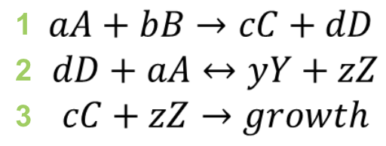
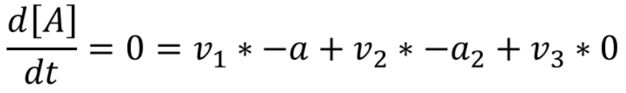
Validation
FBA: Simulate S. aureus through FBA and acquire the consumed flux of glucose
Currently predicts 99 mmol glucose per gDw consumed
Experimental literature: Data of glucose consumption will be referenced. Specifically, studies that examine the rate and maximum consumption of glucose in S. aureus will be sought for comparison to both the mass transport model and the FBA simulation results.

Slide 5
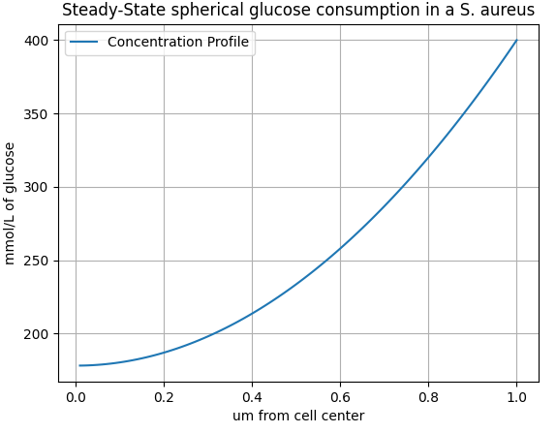
Suggestions for improvement
Currently shows 2.5e-10 mmol glucose per cell => 250 mmol glucose per gDw consumed
Use MatLab or another language that has more package support for succinctly solving these engineering problems
Explore different bacterial geometries beyond just spherical at right
Compare with MM kinetics
Compare active (constant) flux versus passive (gradient-driven) flux

Slide 6
