Slide 1
prFBA
Probabilistic flux balance analysis for amplicon-resolved metabolic modeling
One amplicon, end to end
16S and MAGs on 3 × 10,000 organisms
Like for like, PICRUSt2 leads
Andrew Freiburger · Tyo & Henry labs · Condensed update, October–November 2026
Notes:
A condensed version of the October–November update deck: the method, each slide built on one figure, then the validation results. Every benchmark number is at the standard record depth of 100 hits under the shipped exact-tie union selection rule, and every value is read from the pipeline's result files by the same loader the full deck uses. The full deck carries the alignment engineering, the C12 diagnosis, the depth and rule decisions, the MAG build details and the audit trail. The 'New since Nov 1' slide, added on 2026-11-12, lists the results since the deck of 2026-11-01.

Slide 2
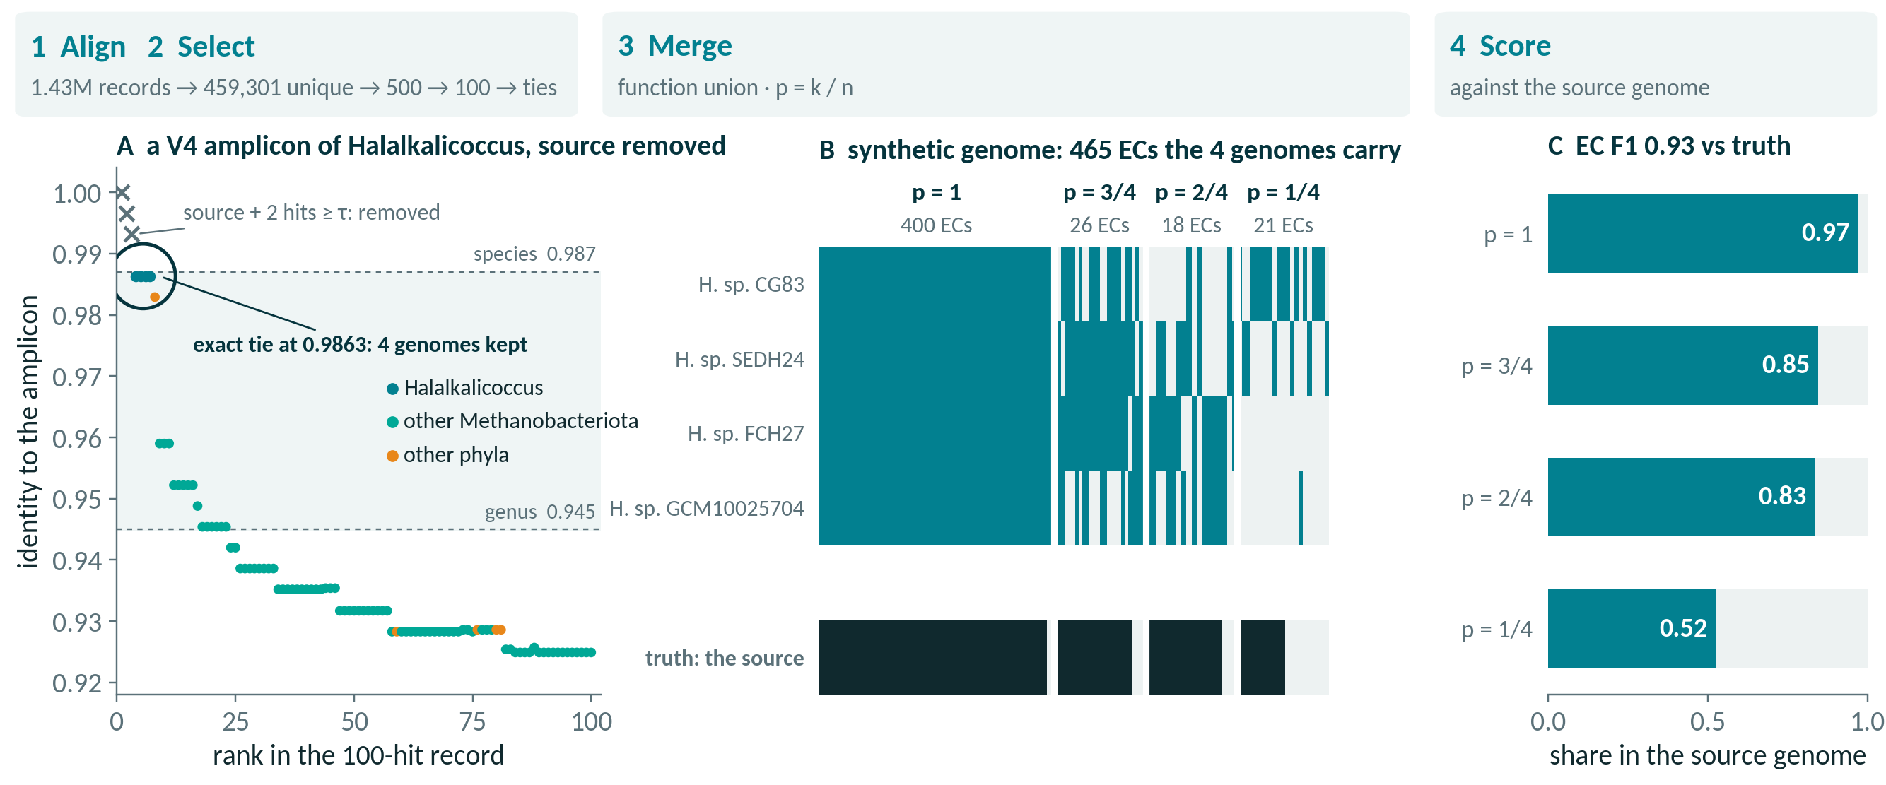
One amplicon, from 16S read to weighted genome
A real V4 benchmark amplicon, source removed, through every stage
1008153.3__V4 · 100-hit record · exact-tie union · self-exclusion at τ = 0.987 · ECs from BV-BRC PGFams
Notes:
The workflow on one real benchmark amplicon, chosen by a fixed rule rather than by hand (extract_worked_example.py: the first V4 amplicon whose source is its own single selection, and which falls to a 4-genome genus-tier tie once the source is removed). The amplicon is a V4 product of a Halalkalicoccus genome (Halalkalicoccaceae, Methanobacteriota). Step 1: an edlib prefilter keeps the 500 closest of 459,301 unique BV-BRC 16S sequences, the GPU Smith-Waterman kernel ranks them, and Biopython aligns the top 100 to give identity and coordinates (panel A). Step 2: self-exclusion removes the source genome and every hit at identity 0.987 or above (3 hits here), then the exact-tie rule keeps every reference tied at the best surviving identity, 0.9863, one genome per species: 4 Halalkalicoccus genomes. A Bacillus 16S sits in the record just below the tie at rank 8, an off-phylum sequence the identity tie leaves out. Step 3: the selected genomes' functions are merged into one synthetic genome of 465 ECs (panel B), each weighted by p = k/n, the share of the 4 genomes carrying it: 21 at p = 1/4, 18 at p = 2/4, 26 at p = 3/4, 400 at p = 4/4. Step 4: scored against the source genome's own ECs (panel C), the union reaches EC F1 0.93 (precision 0.94, recall 0.92, against 476 true ECs). Within this one amplicon the share of ECs truly present falls with p: 0.52 at p = 1/4, 0.83 at p = 2/4, 0.85 at p = 3/4, 0.97 at p = 4/4. That is the ranking the full deck's calibration study finds across the benchmark. In prFBA the weight then enters the flux objective, where a low-p reaction costs more flux; the weight never gates or removes a reaction. This example is typical in kind, not in outcome: most answered benchmark amplicons select one genome, so p = 1 throughout.

Slide 3
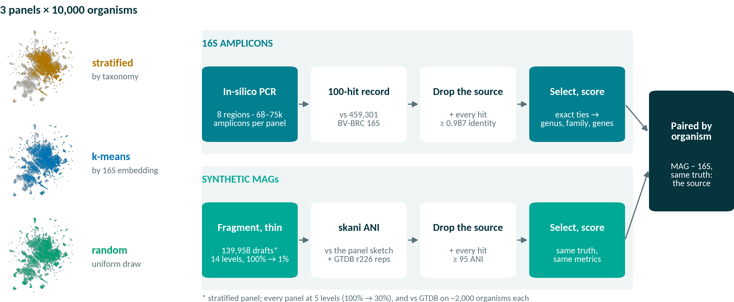
16S and MAGs on the same 10,000-organism panels
Three panels, two ways to query each organism, one truth: its own genome
Panels in the BV-BRC 16S embedding (UMAP) · 16S at record depth 100, exact-tie union · MAGs by skani ANI
Notes:
Every validation in this part starts from a panel of 10,000 BV-BRC organisms whose genomes are known, so each prediction can be scored against the organism's own lineage and gene content. Three panels are sampled on different principles (left, each panel's picks in the UMAP projection of the 16S embedding): the original panel is taxonomy-stratified (seed 1729); the k-means panel takes one organism per cluster of the 16S embedding; and the random panel draws uniformly (seed 1729) from the 140,197 admissible organisms, so it carries the database's own skew toward densely sequenced species. 16S lane: in-silico PCR cuts 8 regions of each organism's 16S, from V1–V2 to V7–V9 with full-length 16S as the control (67,991, 74,704 and 75,328 amplicons on the stratified, k-means and random panels). Each amplicon is aligned to all 459,301 unique BV-BRC 16S sequences and keeps a 100-hit record. Self-exclusion then removes the source genome, its taxon and every hit at 0.987 identity or above, as if the organism were new to the database, and the exact-tie union selects from what is left; the anchor's lineage is scored at genus and family, and the union's gene families against the source's. MAG lane: each stratified-panel genome is cut into ~50 kb fragments (a 2.5 kb floor) and whole fragments are dropped, giving 139,958 drafts at 14 completeness levels from 100% down to 1%; every panel is also rerun at 5 levels (100% to 30%). Drafts are matched by skani whole-genome ANI against a sketch of the panel itself and, on 1,989–2,000 organisms per panel, against the 143,614 GTDB r226 species representatives. Self-exclusion removes the source genome, its taxon and every hit at 95 ANI or above, the species boundary and the analogue of the 16S lane's 0.987. Both lanes use the same truth and the same conditional and whole-population metrics, so MAG and 16S can be compared organism by organism.

Slide 4
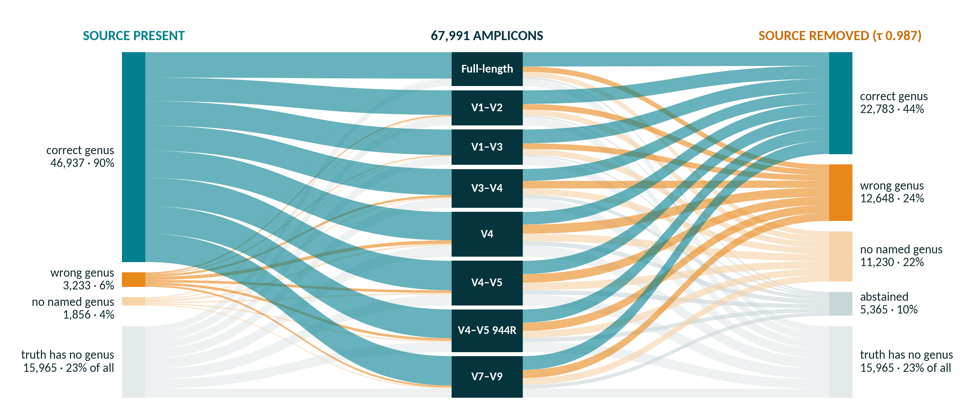
Where every amplicon's genus call lands
67,991 amplicons by region · source present (left) vs removed (right)
Anchor predictor · exact-tie union · 100-hit records · shares of the 52,026 genus-scoreable amplicons
Notes:
Every one of the 67,991 benchmark amplicons flows from its region (middle) to its genus outcome, with the source organism present (left) and removed (right, self-exclusion at τ = 0.987). 15,965 amplicons (23% of all) come from a source whose own truth has no named genus; they are unscoreable in both modes and leave every denominator. Of the remaining 52,026: with the source present 46,937 (90%) get the right genus, 3,233 (6%) a wrong one and 1,856 (4%) a reference with no named genus, and none abstains. With the source removed, 22,783 (44%) are still right, 12,648 (24%) wrong, 11,230 (22%) land on an unnamed genus and 5,365 (10%) abstain: for 5,141 of them self-exclusion removed all 100 hits of the record, and the rest had nothing at the family floor or past the reliability gate. Ribbon colour is the outcome, so the change in colour from left to right is what novelty costs, region by region. These counts reproduce the full deck's denominator slide (asv_region_concordance.csv and benchmark_truth.json, classified identically).

Slide 5
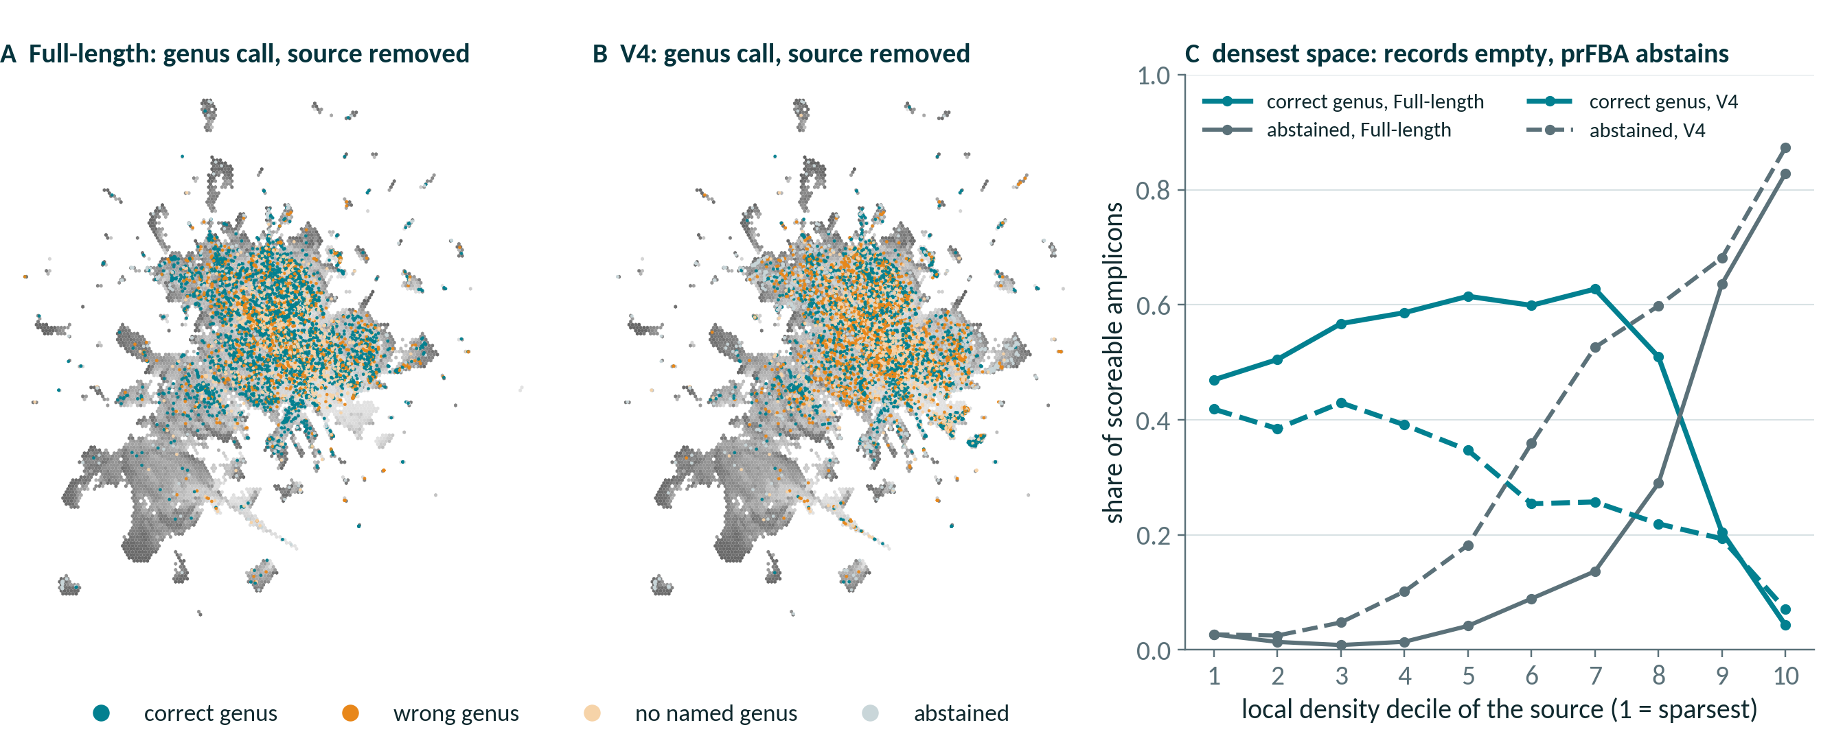
Failures map to where the 16S space is crowded
Original panel's sources in the BV-BRC 16S embedding · source removed
UMAP of 1024-d 16S embeddings; density = 21st-neighbour distance in the full space · exact-tie union · 100-hit records
Notes:
Each dot is one of the 9,097 original-panel source genomes that sit on the embedding frame, placed at its representative 16S in the UMAP projection of all clusterable BV-BRC 16S sequences, and coloured by its amplicon's genus call once the source is removed (A full-length 16S, B V4); grey shading is local density measured in the full 1024-dimensional embedding. Panel C bins the sources by that density. In the sparsest decile full-length 16S still calls the right genus 47% of the time and abstains 3%; in the densest it abstains 83% (V4: 87%) and is right only 4%. That is not a failure to find relatives: in densely sequenced species every one of the record's 100 hits is the source's own taxon or within 0.987 identity of it, so self-exclusion empties the record and nothing is left to select (5,141 of the 5,365 abstentions over all regions; the full deck's emptied-records slide). The densest deciles hold few panel sources (88 and 70 for full-length 16S), because the taxonomy-stratified panel under-samples crowded space. V4 is right less often than full-length 16S at every density. Coverage figures under self-exclusion are therefore lower bounds set by the record depth, not by the organisms.

Slide 6
Coverage falls on the random panel; quality holds
Phylum-standardized, 113 shared phyla · self-exclusion at τ = 0.987
−0.20 to −0.29
coverage, random − stratified, every region
≤ 0.07
conditional genus accuracy, either direction
≤ 0.028
conditional gene-capture F1, any two panels
Chart: V4 · record depth 100 · exact-tie union · 1,000 phylum-stratified bootstrap replicates
Notes:
Every rate here is phylum-standardized over the 113 phyla present in all three panels, restricted to organisms with a full-length best 16S, under self-exclusion at τ = 0.987, with all three panels scored at record depth 100 under the exact-tie union; intervals are 1,000 phylum-stratified bootstrap replicates. The chart shows V4: genus coverage is 0.615, 0.431 and 0.358 on the stratified, k-means and random panels, a random-minus-stratified difference of −0.257 (−0.276 to −0.238) against −0.330 crude. In every region, genus and gene-capture coverage fall by 0.20 to 0.29 on the random panel, every interval excludes zero, and the standardized gap keeps 76–92% of the crude one, so composition is a minority of it. Quality given an answer moves far less. Conditional genus accuracy is higher on both alternative panels than on the stratified one in every region, by up to 0.07 (random minus stratified excludes zero in 2 of 8 regions). Conditional family accuracy differs by at most 0.05 between any two panels, and conditional gene-capture F1 by at most 0.028: it is lower on the random panel by 0.013 to 0.028, an order of magnitude below the coverage gap; the MAG arm, scored against each panel as its own reference, stays within the same bound.

Slide 7
No completeness at which the amplicon catches up
Paired within organism, from complete genomes down to 1% drafts
+0.103 to +0.212
lead over all 8 regions at 100%
0.308 → 0.253
resolve rate, 100% → 1%: coverage degrades
0.248 vs 0.605
whole-population F1, MAG vs full-length 16S
Amplicon cells: depth-100 records, exact-tie union · conditional on both arms answering, n = 1,603–2,311 per point
Notes:
Paired within organism against the amplicon arm's own cells (depth-100 records, exact-tie union, as in tab:main), the MAG arm leads full-length 16S by +0.103 in gene-capture F1 at full completeness and still by +0.077 at 1%, fifty-fold below MIMAG's medium-quality floor and not a bin any study would keep; against V4 the lead is +0.212 and +0.190. At 1% the MAG arm still wins 1,129 organisms to 473 against full-length 16S, and every one of the 28 paired tests has Wilcoxon p ≤ 1e-79. Across all 8 regions at full completeness the lead follows the variable region, not amplicon length: +0.103 to +0.116 against full-length 16S and the two V1-anchored regions, +0.168 to +0.212 against the five that start at V3 or later, with V4 the widest gap. The reason is structural: the prediction is the gene content of the selected reference genome, not of the MAG, so completeness matters only if it changes which reference is chosen, and ANI is robust enough that it rarely does. What degrades is coverage, not quality: the resolve rate falls from 0.308 to 0.253 as the remaining sequence stops clearing skani's screen, while conditional F1 drops by only 0.024. All of this is conditional on both arms answering; over the whole population, scoring an abstention as zero, the amplicon arm wins, 0.605 against 0.248 for full-length 16S, because the MAG arm answers for only about 31% of organisms (see the full update deck's MAG abstention slide).

Slide 8
Under a neutral answer key, the ranking reverses
Population EC F1 · leave-genus-out · one shared reference
−0.092
prFBA − PICRUSt2 · 95% CI −0.107 to −0.081
−0.031
forced to answer: still behind
PASS
C2 include-self ceiling
source recovery 1.00
PASS
C12 gapfill validity
amended · EC unchanged
prFBA = legacy rule, chosen in every fold · cluster bootstrap, 2,376 groups
Notes:
Every arm is scored on the same 63,871 cells against the same answer key, with abstentions counted as zero. prFBA reaches population EC F1 0.687 against PICRUSt2's 0.779 (−0.092, 95% CI −0.107 to −0.081); forced to answer it reaches 0.747 and still trails by 0.031, so about two thirds of the deficit is abstention and the rest is in the answers. The bar the design registered is nn1, copying the single top-ranked surviving reference: forced prFBA only ties it (0.747 against 0.745, a margin with no paired test), the abstaining arm falls 0.058 below it, and PICRUSt2 clears it by 0.034. At leave-family-out the gap widens to −0.124 (forced −0.040) and prFBA's skill score falls to −0.14, a point estimate whose interval against the prevalence floor spans zero; clade-max is an oracle chosen against the truth, a ceiling and not a method to beat. These numbers do not depend on the as-shipped record depth: each fold ran its own alignment at k2 = 200, and 'prFBA' is the legacy rule that leave-one-fold-out selection picked in every fold (the shipped exact-tie rule scores 0.685). Validity: the include-self ceiling control C2 passes (prFBA source recovery 1.00, PICRUSt2 0.899 against a soft 0.85 flag; data_c2/summary_incself.json and data/controls.json), and the gapfill validity gate C12 passes under amendments A-C12 and A-C13 (post hoc and disclosed: corrected templates, the gapfiller's reversals and an updated ModelSEEDpy), so the leave-genus-out artefact is valid; rescoring changed no EC number, and the full update deck shows why C12 failed in the pre-registered run and how the fix cleared it. Sources: shared_reference/data/summary_genus.json and data_family/summary_family.json.

Slide 9
New since Nov 1
Five results since the last update; details in the full deck
Result | Headline number
Self-exclusion at 0.995 beside 0.987 | No call (all amplicons) 9.5% → 6.0% · gene capture +4.1–5.5 pts
E3 + tuned objective, shipped | Brier 0.209 → 0.127 · wrong flux −1.72 pts (n ≥ 2)
Seven-reaction template fix | ATP-leaking drafts 865 → 95 · 0 gated
Depth-100 builds in KBase | 3,225 + 3,755 genomes · 0 failed
PICRUSt2 on MAGs: only via a 16S | 25% of real MAGs carry one
Full update deck: presentations/prFBA_updates_2026-10.pptx · depth-100 records, exact-tie union
Notes:
What has been finished since the deck of 2026-11-01, one row per result; the full update deck covers each, the first, second, third and fifth on slides of their own and the KBase upload in its notes and closing slide. First, self-exclusion re-run at 0.995 beside the headline 0.987 (0.987 is the full-length species boundary; for a short amplicon the identity that best matches species is nearer 100%, Edgar 2018): 6,482 of 67,991 amplicons get no taxonomic call at 0.987 and 4,101 at 0.995 (shares of every amplicon; the 10% abstention elsewhere in this deck counts only the genus-scoreable amplicons of the genus-call slide), and whole-population gene capture rises by 4.1–5.5 points in every region (region_validation_d100/data/taxacc_region_summary.json and gene_capture_tau_compare.json). Second, Stage E's estimator E3 (the first 100 hits shrunk toward a family prior) lowers the Brier score on the union's ECs from 0.209 for k/n to 0.127 (AUROC 0.543 to 0.816); about half of that Brier gain is recalibration k/n could have without new information, since the out-of-fold isotonic map of k/n alone reaches 0.168, so E3 against recalibrated k/n is −0.041. Stage O's objective tuned on it changes truth-absent flux by −1.72 points against the shipped objective on held-out amplicons with two or more genomes selected [−2.21, −1.18], past the SESOI of 1 point, 69% of an oracle's headroom; it is not established for one-genome selections (−0.48, interval spanning 0). Both are post hoc (PFUNC_ESTIMATORS_RESULTS.md, OBJECTIVE_TUNING_RESULTS.md). E3 and the tuned objective are now in the shipped pipeline (integrated 2026-11-12). The synthetic-genome builders default to E3 for selections of two or more genomes, where Stage O established the flux gain, and keep k/n (= 1) for single-genome selections; --pfunc kn reproduces the earlier builds byte for byte. Production E3 matches functions by BV-BRC protein family (PGFam); about 55% of features have no family and keep k/n, because the genome query returns RefSeq- and PATRIC-annotated features together. It keeps one neighbour per species and builds the family prior from the gene-family cache. Before it became the default it had to beat k/n on the 10,000-organism panel at self-exclusion 0.987 and n ≥ 2, a criterion declared before the run: union Brier −0.053 [−0.055, −0.051], AUROC +0.054 [+0.052, +0.056] (passed 2026-11-12; region_validation_d100/data/pfunc_e3_gate.json), about 45% of the Brier gain being recalibration that k/n could have alone (gate review). The tuned objective ships as prFBA's recommended call, prfba_objective.run_prfba (exchange weight 1, gapfilled reactions at p = 0, biomass bio1; it needs the ModelSEEDpy branch fix-prfba-single-model), which reproduces Stage O's tuned copy exactly on 8 of 8 amplicons (wrapper_equivalence.json). ModelSEEDpy's own default stays at exchange weight 100, because the lower weight raises total exchange flux and has not been tested on measured exchange data. Still open: re-weighting the two deployed depth-100 builds (reweight_build_e3.py writes a new directory; a KBase re-upload needs a new workspace or new object names). On the Stage E and Stage O slides, 'shipped' means the pipeline before this integration. Third, seven more reversible template reactions made forward-only (ModelSEEDTemplates branch fix-draft-atp-loops) cut the raw drafts that make ATP from nothing from 865 to 95 of 1,181; run through ATP correction and gapfilling, 0 of 8,614 rows fail the C12 gate and all 2,362 gapfilled models still grow (C12_SCOPE.md section 2b). Fourth, both depth-100 deployment builds are in KBase since 2026-11-04: codiffusion (3,225 genomes) as GenomeSet 261948/6467/1, beside the 20-hit build, and EmilyKin (3,755 genomes) as GenomeSet 275568/3757/1 in a new narrative, with 0 failed uploads (deployment_d100/logs/kbase_upload_d100.log). Fifth, PICRUSt2 cannot take a MAG except through the MAG's own 16S, and across GTDB r232 only 25.5% of 450,594 real MAGs carry any 16S (15.4% a full-length one), so on real MAGs PICRUSt2 could answer for about one in four; complete synthetic MAGs overstate its coverage 2.8–4.0-fold against real MAGs of 95–100% completeness (region_validation/picrust2_comparison/README.md, 'PICRUSt2 and MAGs'; data/mag_gtdb_ssu_summary.json and mag_retention_summary.json).

Slide 10
What the validations say
0.76–0.85
family accuracy, novel organisms
−0.20 to −0.29
random-panel coverage; quality within 0.07
+0.103 to +0.212
MAG − 16S F1, both answering
−0.092
prFBA − PICRUSt2, like for like
Open
Re-weight d100 builds (E3)
MSProbability fix: PR to open
Seven-reaction fix: PR to open
GTDB map: deferred
github.com/freiburgermsu/prFBA · full update deck: presentations/prFBA_updates_2026-10.pptx
Notes:
Four things to take away. First, the selection transfers at family level even for organisms absent from the database (0.76–0.85 family accuracy across regions, among amplicons that answer), and genus is where short amplicons pay. Second, it abstains rather than guess: 10% of scoreable amplicons get no call once the source is removed, 5,141 of 5,365 because every hit in the record was the source's own close kin, removed with it. Third, as shipped prFBA is more precise when it answers, but on the controlled benchmark, with one shared reference and a neutral answer key, PICRUSt2 predicts EC content better: population EC F1 differs by −0.092 (95% CI −0.107 to −0.081), beyond the pre-registered 0.02. Fourth, the phenotype arm's gapfill validity gate passes after the disclosed template amendments, so the leave-genus-out run is valid; no EC number depended on it. In this version the second and third rows replace the abstention and gate rows: across the three 10,000-organism panels, self-exclusion coverage changes with how the panel was sampled while the quality of the answers given does not; and where both answer, a synthetic MAG matched by ANI predicts gene content better than any 16S region, though it answers for far fewer organisms. Done since the deck of 2026-11-01: the revised manuscript is pushed to the prFBA_paper main branch, with the 0.995 results and the Stage E and Stage O sections written in; both depth-100 deployment builds are in KBase since 2026-11-04 (codiffusion, 3,225 genomes, GenomeSet 261948/6467/1, beside the 20-hit build; EmilyKin, 3,755 genomes, GenomeSet 275568/3757/1 in a new narrative; 0 failed uploads); self-exclusion is scored at 0.995 beside 0.987; and the collaborators gave permission to use the 291 real MAGs. Open, the strip along the bottom. The tuned objective is E3's p, the linear cost, gapfilled reactions at p = 0 and exchange weight 1. E3 and the tuned objective are now in the shipped pipeline (integrated 2026-11-12). The synthetic-genome builders default to E3 for selections of two or more genomes, where Stage O established the flux gain, and keep k/n (= 1) for single-genome selections; --pfunc kn reproduces the earlier builds byte for byte. Production E3 matches functions by BV-BRC protein family (PGFam); about 55% of features have no family and keep k/n, because the genome query returns RefSeq- and PATRIC-annotated features together. It keeps one neighbour per species and builds the family prior from the gene-family cache. Before it became the default it had to beat k/n on the 10,000-organism panel at self-exclusion 0.987 and n ≥ 2, a criterion declared before the run: union Brier −0.053 [−0.055, −0.051], AUROC +0.054 [+0.052, +0.056] (passed 2026-11-12; region_validation_d100/data/pfunc_e3_gate.json), about 45% of the Brier gain being recalibration that k/n could have alone (gate review). The tuned objective ships as prFBA's recommended call, prfba_objective.run_prfba (exchange weight 1, gapfilled reactions at p = 0, biomass bio1; it needs the ModelSEEDpy branch fix-prfba-single-model), which reproduces Stage O's tuned copy exactly on 8 of 8 amplicons (wrapper_equivalence.json). ModelSEEDpy's own default stays at exchange weight 100, because the lower weight raises total exchange flux and has not been tested on measured exchange data. Still open: re-weighting the two deployed depth-100 builds (reweight_build_e3.py writes a new directory; a KBase re-upload needs a new workspace or new object names). On the Stage E and Stage O slides, 'shipped' means the pipeline before this integration. The ModelSEEDpy fix for MSProbability.prFBA is pushed on branch fix-prfba-single-model, but its pull request is not opened yet. The five-reaction template fix and the two curated direction branches are open upstream as ModelSEED/ModelSEEDTemplates pull requests #11–#13 (filed 2026-10-27, awaiting review); the seven-reaction branch fix-draft-atp-loops is pushed to the fork, and its upstream pull request is not opened yet. The GTDB accession map stays deferred to future work, because wiring it in changes which genomes a GTDB hit selects.

