Slide 1
prFBA
Probabilistic flux balance analysis for amplicon-resolved metabolic modeling
One amplicon, end to end
Five validation arms
Like for like, PICRUSt2 leads
Andrew Freiburger · Tyo & Henry labs · Condensed update, October 2026
Notes:
A condensed version of the October update deck: the method, each slide built on one figure, then the validation results. Every benchmark number is at the standard record depth of 100 hits under the shipped exact-tie union selection rule, and every value is read from the pipeline's result files by the same loader the full deck uses. The full deck carries the alignment engineering, the C12 diagnosis, the depth and rule decisions, the MAG build details and the audit trail.

Slide 2
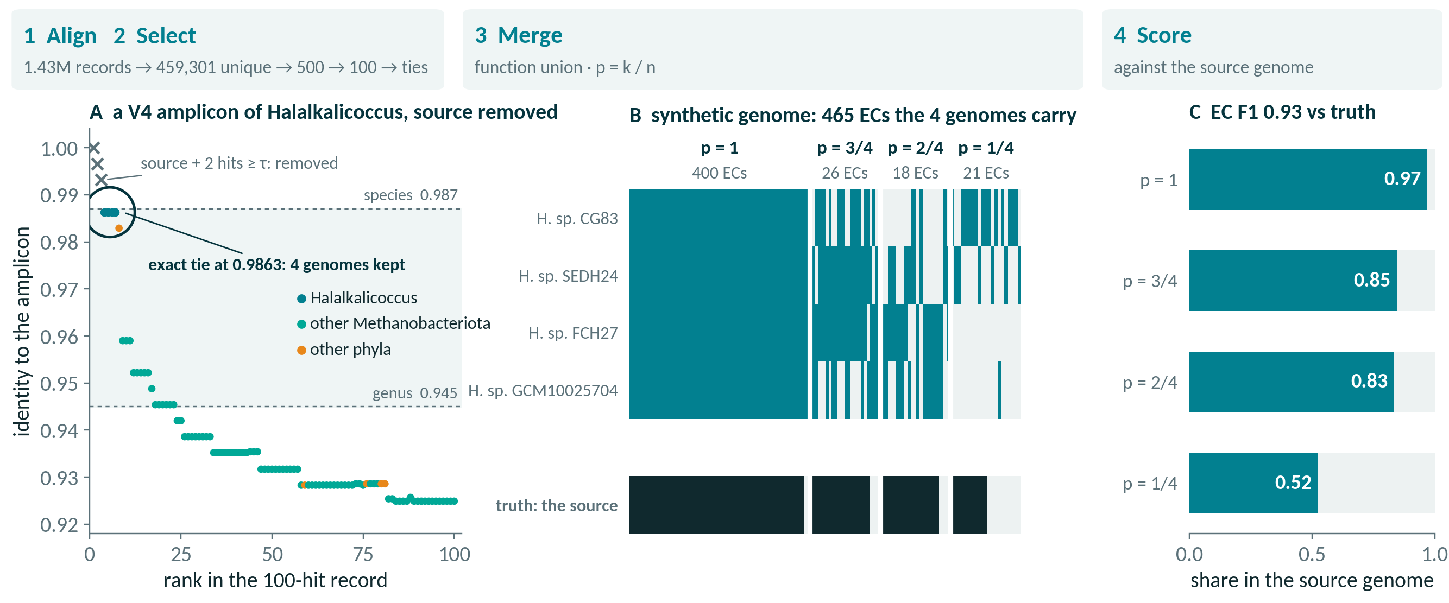
One amplicon, from 16S read to weighted genome
A real V4 benchmark amplicon, source removed, through every stage
1008153.3__V4 · 100-hit record · exact-tie union · self-exclusion at τ = 0.987 · ECs from BV-BRC PGFams
Notes:
The workflow on one real benchmark amplicon, chosen by a fixed rule rather than by hand (extract_worked_example.py: the first V4 amplicon whose source is its own single selection, and which falls to a 4-genome genus-tier tie once the source is removed). The amplicon is a V4 product of a Halalkalicoccus genome (Halalkalicoccaceae, Methanobacteriota). Step 1: an edlib prefilter keeps the 500 closest of 459,301 unique BV-BRC 16S sequences, the GPU Smith-Waterman kernel ranks them, and Biopython aligns the top 100 to give identity and coordinates (panel A). Step 2: self-exclusion removes the source genome and every hit at identity 0.987 or above (3 hits here), then the exact-tie rule keeps every reference tied at the best surviving identity, 0.9863, one genome per species: 4 Halalkalicoccus genomes. A Bacillus 16S sits in the record just below the tie at rank 8, an off-phylum sequence the identity tie leaves out. Step 3: the selected genomes' functions are merged into one synthetic genome of 465 ECs (panel B), each weighted by p = k/n, the share of the 4 genomes carrying it: 21 at p = 1/4, 18 at p = 2/4, 26 at p = 3/4, 400 at p = 4/4. Step 4: scored against the source genome's own ECs (panel C), the union reaches EC F1 0.93 (precision 0.94, recall 0.92, against 476 true ECs). Within this one amplicon the share of ECs truly present falls with p: 0.52 at p = 1/4, 0.83 at p = 2/4, 0.85 at p = 3/4, 0.97 at p = 4/4. That is the ranking the calibration slide finds across the benchmark. In prFBA the weight then enters the flux objective, where a low-p reaction costs more flux; the weight never gates or removes a reaction. This example is typical in kind, not in outcome: most answered benchmark amplicons select one genome, so p = 1 throughout.

Slide 3
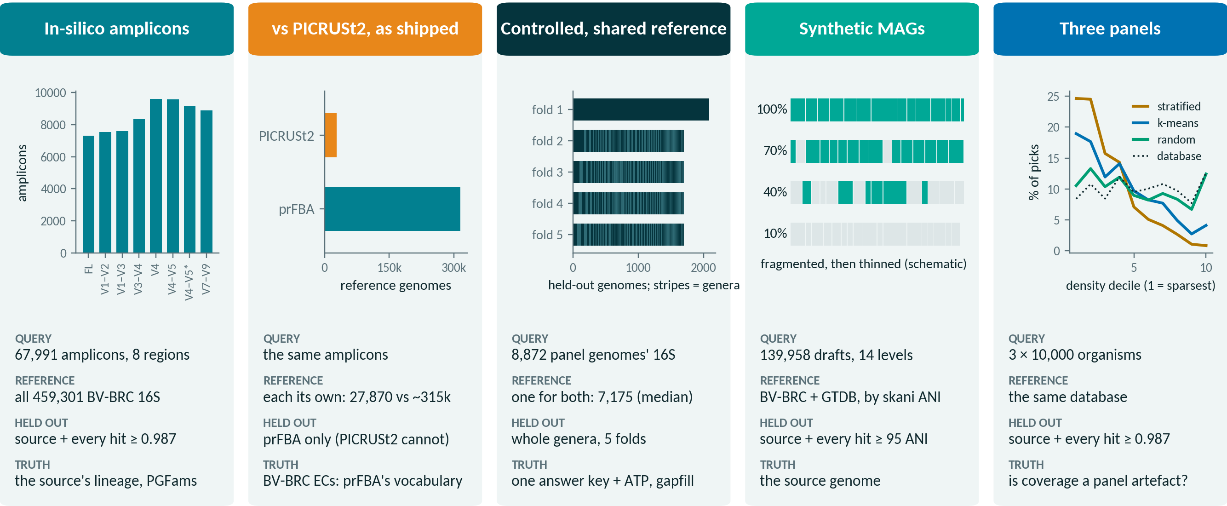
Five validation arms, one unaltered pipeline
Each changes what is searched, what is held out, and what counts as truth
Every arm runs the shipped code; only the inputs and the scoring differ
Notes:
The validations share one pipeline and differ in four things: the query, the reference it is searched against, what is withheld, and the truth it is scored against. In-silico amplicons: 67,991 amplicons cut by in-silico PCR from 10,000 taxonomy-stratified BV-BRC genomes in 8 regions (chart: amplicons per region), searched against the full reference; each is scored with its source present and with the source and every hit at 0.987 identity or above removed, against the source's NCBI lineage and gene families. As shipped against PICRUSt2: the same amplicons, each system with its own reference (27,870 genomes for PICRUSt2 against about 315,000 for prFBA), scored in BV-BRC's EC vocabulary, which is prFBA's own; PICRUSt2 has no way to exclude the source. Controlled: 8,872 dereplicated panel genomes split into 5 folds with whole genera held out (chart: held-out genomes per fold, each stripe a genus group; one connected group fills fold 1), both methods confined to one shared reference (7,175 genomes, median per fold) and one answer key, plus ATP and gapfill phenotypes. Synthetic MAGs: 139,958 drafts made by fragmenting each panel genome and dropping whole pieces down to 1% completeness (schematic), matched by skani whole-genome ANI. Three panels: the same pipeline on three 10,000-organism panels sampled on different principles (chart: share of each panel's picks per density decile of the 16S embedding), to ask whether coverage is a property of the method or of the panel.

Slide 4
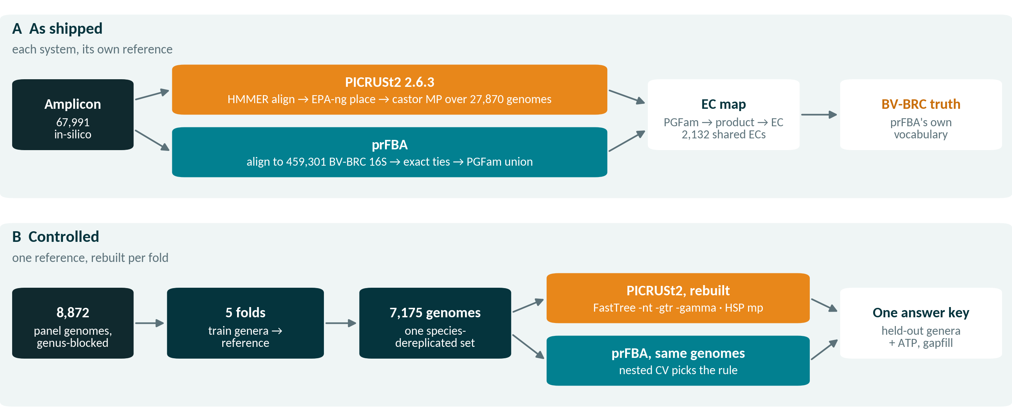
PICRUSt2 run twice: as shipped, then like for like
The comparison removes each built-in advantage in turn
PICRUSt2 2.6.3 · installed without conda (uv venv, castor, EPA-ng, gappa, HMMER from source)
Notes:
A, as shipped: PICRUSt2 2.6.3 aligns each amplicon to its reference with HMMER profiles, places it in a fixed reference phylogeny with EPA-ng and gappa, and infers gene content by MP (maximum-parsimony) ancestral-state reconstruction with castor over 27,870 reference genomes; it always answers. prFBA aligns the same amplicon to 459,301 BV-BRC 16S sequences, keeps the exact ties and unions their gene families. prFBA predicts PGFam families and PICRUSt2 EC numbers, so the truth and both predictions pass through one map, family to BV-BRC product string to EC, and are scored on the 2,132 ECs both can express (7,042 ModelSEED reactions). Two asymmetries are built in: the references differ about tenfold, and the truth is BV-BRC annotation, prFBA's own vocabulary. B, controlled: 8,872 panel genomes in 5 genus-blocked folds; for each fold, the training genera become one species-dereplicated reference (7,175 genomes, median), and PICRUSt2's alignment, tree and trait table are rebuilt from it with its own tooling (FastTree -nt -gtr -gamma, HSP mp, edge exponent 0.5, minimum alignment 0.8), while prFBA searches exactly the same genomes, with its selection rule chosen by nested cross-validation inside each training fold. Both are scored on the held-out genera against one answer key, and the gapfilled models are compared on ATP production and growth. The effect size that counts was fixed in advance at 0.02 in population EC F1.

Slide 5
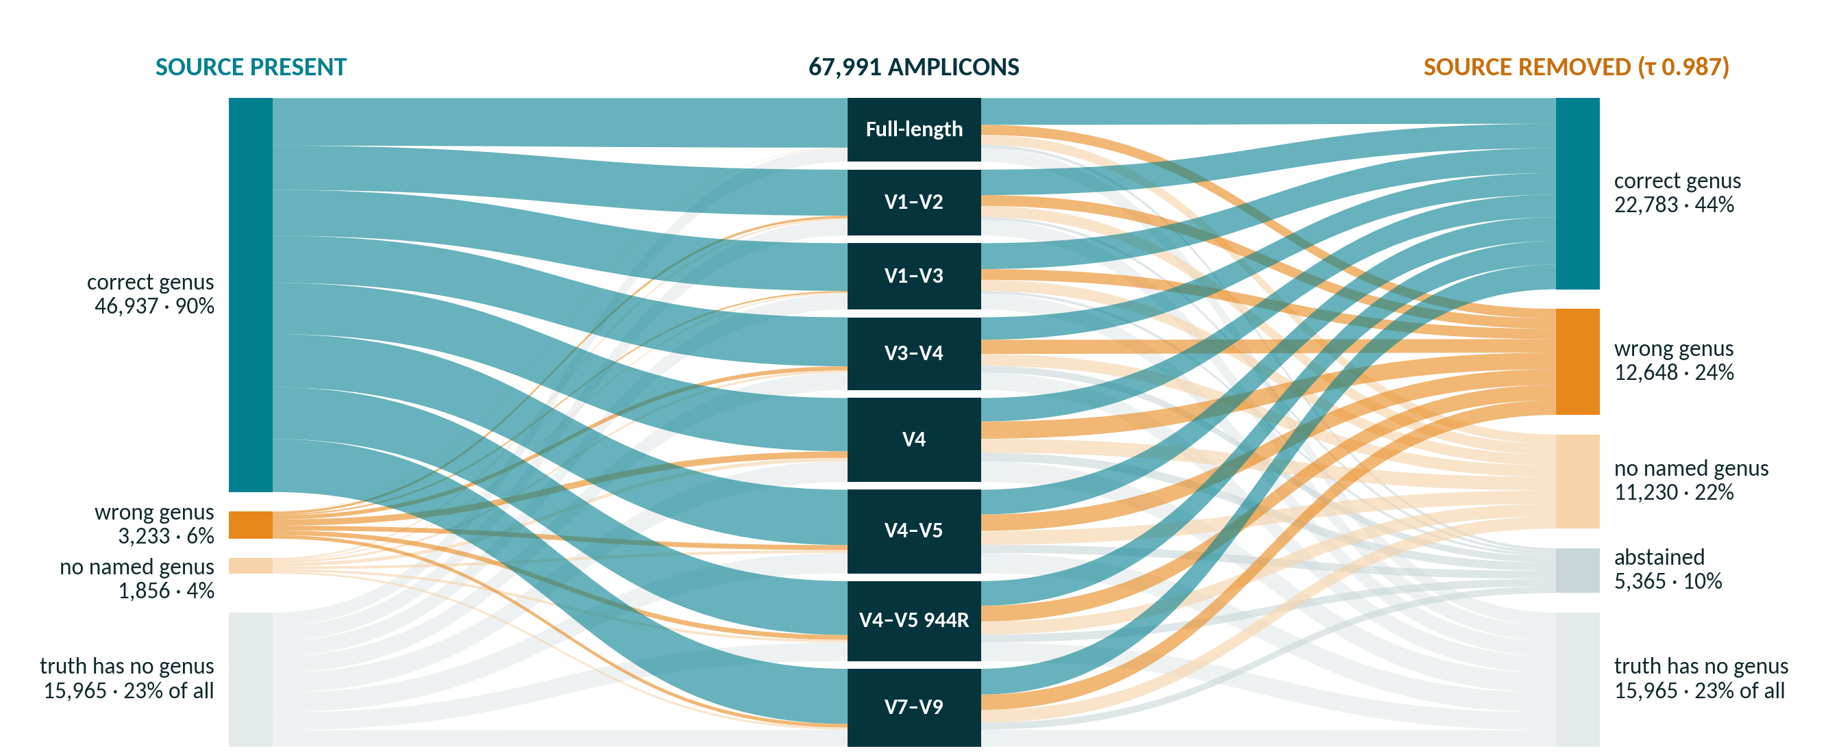
Where every amplicon's genus call lands
67,991 amplicons by region · source present (left) vs removed (right)
Anchor predictor · exact-tie union · 100-hit records · shares of the 52,026 genus-scoreable amplicons
Notes:
Every one of the 67,991 benchmark amplicons flows from its region (middle) to its genus outcome, with the source organism present (left) and removed (right, self-exclusion at τ = 0.987). 15,965 amplicons (23% of all) come from a source whose own truth has no named genus; they are unscoreable in both modes and leave every denominator. Of the remaining 52,026: with the source present 46,937 (90%) get the right genus, 3,233 (6%) a wrong one and 1,856 (4%) a reference with no named genus, and none abstains. With the source removed, 22,783 (44%) are still right, 12,648 (24%) wrong, 11,230 (22%) land on an unnamed genus and 5,365 (10%) abstain: for 5,141 of them self-exclusion removed all 100 hits of the record, and the rest had nothing at the family floor or past the reliability gate. Ribbon colour is the outcome, so the change in colour from left to right is what novelty costs, region by region. These counts reproduce the full deck's denominator slide (asv_region_concordance.csv and benchmark_truth.json, classified identically).

Slide 6
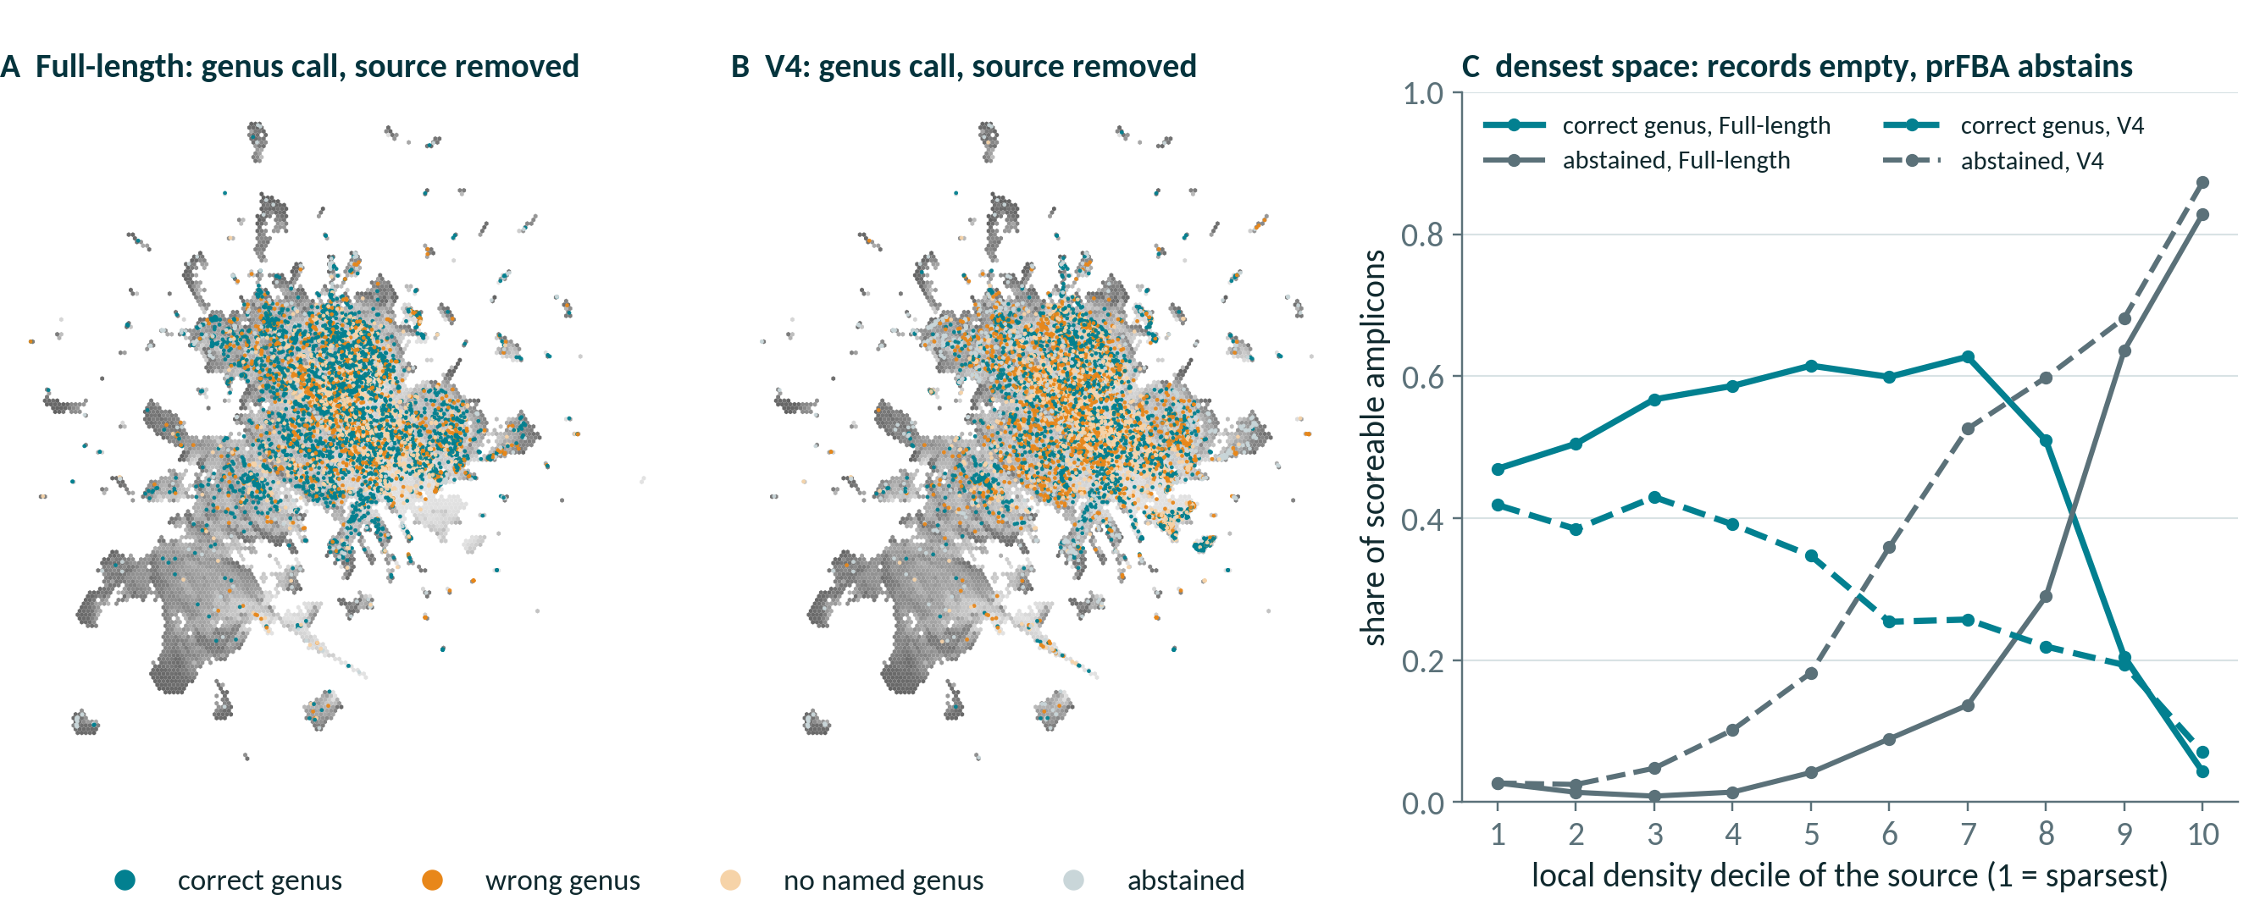
Failures map to where the 16S space is crowded
Original panel's sources in the BV-BRC 16S embedding · source removed
UMAP of 1024-d 16S embeddings; density = 21st-neighbour distance in the full space · exact-tie union · 100-hit records
Notes:
Each dot is one of the 9,097 original-panel source genomes that sit on the embedding frame, placed at its representative 16S in the UMAP projection of all clusterable BV-BRC 16S sequences, and coloured by its amplicon's genus call once the source is removed (A full-length 16S, B V4); grey shading is local density measured in the full 1024-dimensional embedding. Panel C bins the sources by that density. In the sparsest decile full-length 16S still calls the right genus 47% of the time and abstains 3%; in the densest it abstains 83% (V4: 87%) and is right only 4%. That is not a failure to find relatives: in densely sequenced species every one of the record's 100 hits is the source's own taxon or within 0.987 identity of it, so self-exclusion empties the record and nothing is left to select (5,141 of the 5,365 abstentions over all regions; the full deck's emptied-records slide). The densest deciles hold few panel sources (88 and 70 for full-length 16S), because the taxonomy-stratified panel under-samples crowded space. V4 is right less often than full-length 16S at every density. Coverage figures under self-exclusion are therefore lower bounds set by the record depth, not by the organisms.

Slide 7
Under a neutral answer key, the ranking reverses
Population EC F1 · leave-genus-out · one shared reference
−0.092
prFBA − PICRUSt2 · 95% CI −0.107 to −0.081
−0.031
forced to answer: still behind
PASS
C2 include-self ceiling
source recovery 1.00
PASS
C12 gapfill validity
amended · EC unchanged
prFBA = legacy rule, chosen in every fold · cluster bootstrap, 2,376 groups
Notes:
Every arm is scored on the same 63,871 cells against the same answer key, with abstentions counted as zero. prFBA reaches population EC F1 0.687 against PICRUSt2's 0.779 (−0.092, 95% CI −0.107 to −0.081); forced to answer it reaches 0.747 and still trails by 0.031, so about two thirds of the deficit is abstention and the rest is in the answers. The bar the design registered is nn1, copying the single top-ranked surviving reference: forced prFBA only ties it (0.747 against 0.745, a margin with no paired test), the abstaining arm falls 0.058 below it, and PICRUSt2 clears it by 0.034. At leave-family-out the gap widens to −0.124 (forced −0.040) and prFBA's skill score falls to −0.14, a point estimate whose interval against the prevalence floor spans zero; clade-max is an oracle chosen against the truth, a ceiling and not a method to beat. These numbers do not depend on the as-shipped record depth: each fold ran its own alignment at k2 = 200, and 'prFBA' is the legacy rule that leave-one-fold-out selection picked in every fold (the shipped exact-tie rule scores 0.685). Validity: the include-self ceiling control C2 passes (prFBA source recovery 1.00, PICRUSt2 0.899 against a soft 0.85 flag; data_c2/summary_incself.json and data/controls.json), and the gapfill validity gate C12 passes under amendments A-C12 and A-C13 (post hoc and disclosed: corrected templates, the gapfiller's reversals and an updated ModelSEEDpy), so the leave-genus-out artefact is valid; rescoring changed no EC number, and the next three slides show why C12 failed in the pre-registered run and how the fix cleared it. Sources: shared_reference/data/summary_genus.json and data_family/summary_family.json.

Slide 8
Where prFBA answers, ATP barely registers the gap
Media called wrong per genome · EC F1 gap here only −0.028
+0.13
more media wrong than PICRUSt2 · p = 0.49
−0.15
fewer than the nearest copy · q = 0.028
C11 identity
reproducible builds
C12 gapfill validity
0 of 8,614 rows gated · 49 before the amendments
PASS
PASS
755 ATP-informative of 1,000 genomes · prFBA = shipped exact-tie rule · Wilcoxon signed-rank; BH-adjusted McNemar
Notes:
Each arm's predicted EC set goes through one fixed ModelSEED reconstruction, and the model is asked on which of 54 media it can make ATP; only 22 ever carry signal, and the score is the number of media called wrong against the model built from the truth genome's own annotation (which, rebuilt, scores 0.00). Over the 755 ATP-informative genomes (prFBA answers all 1,000 assayed), where its EC-F1 gap to PICRUSt2 is only −0.028, prFBA calls 0.13 more media wrong than PICRUSt2 (Wilcoxon p = 0.49, BH q = 0.49): no detectable mean difference, a null and not an equivalence. Per medium, PICRUSt2 is ahead on 2 of 22 testable media (Ac.NO, Etho.O2; McNemar q = 0.002), and against copying the nearest reference prFBA calls 0.15 fewer media wrong (q = 0.028), the baseline it ties on ECs. PICRUSt2's drafts share more of the truth's reactions (median reaction Jaccard 0.737 against 0.707); on reaction Jaccard, essentiality and growth prFBA is indistinguishable from the nearest-reference baseline, and those readouts are unpaired medians with no paired test specified. The identity control C11 passes: one EC set built twice gives identical models. The validity gate C12 passes under amendments A-C12 and A-C13 (templates 21a8084 with the gapfiller's reversals applied, on ModelSEEDpy c2e31a0, post hoc and disclosed): no gapfilled model of any arm makes ATP or biomass from water and protons (0 of 8,614 rows, against 49 in the pre-registered run, 10 of them truth rows), so every genome stays in every arm's gapfilled comparison; the ATP pass on the corrected templates reproduced the pre-registered pass row for row, so the ATP numbers here are unchanged, and the next two slides show the pre-registered failure's cause and the fix. The phenotype arm uses the shipped exact-tie rule on 1,000 pre-specified genomes (ATP) and a 200-genome gapfilled subsample; sources: shared_reference/data/phenotype_atp_c13/ and phenotype_gf_c13/phenotype_summary.json, data/controls.json.

Slide 9
What the validations say
0.76–0.85
family accuracy for novel organisms, among answered
10%
abstain once the source is removed: no false metabolism
−0.092
prFBA − PICRUSt2, like for like · CI −0.107 to −0.081
PASS
gapfill validity (C12), after the template fixes
github.com/freiburgermsu/prFBA · full update deck: presentations/prFBA_updates_2026-10.pptx
Notes:
Four things to take away. First, the selection transfers at family level even for organisms absent from the database (0.76–0.85 family accuracy across regions, among amplicons that answer), and genus is where short amplicons pay. Second, it abstains rather than guess: 10% of scoreable amplicons get no call once the source is removed, 5,141 of 5,365 because every hit in the record was the source's own close kin, removed with it. Third, as shipped prFBA is more precise when it answers, but on the controlled benchmark, with one shared reference and a neutral answer key, PICRUSt2 predicts EC content better: population EC F1 differs by −0.092 (95% CI −0.107 to −0.081), beyond the pre-registered 0.02. Fourth, the phenotype arm's gapfill validity gate passes after the disclosed template amendments, so the leave-genus-out run is valid; no EC number depended on it.

