Slide 1
prFBA
Probabilistic flux balance analysis for amplicon-resolved metabolic modeling
One amplicon, end to end
Five validation arms
Like for like, PICRUSt2 leads
Andrew Freiburger · Tyo & Henry labs · Condensed update, October 2026
Notes:
A condensed version of the October update deck: the method, each slide built on one figure, then the validation results. Every benchmark number is at the standard record depth of 100 hits under the shipped exact-tie union selection rule, and every value is read from the pipeline's result files by the same loader the full deck uses. The full deck carries the alignment engineering, the C12 diagnosis, the depth and rule decisions, the MAG build details and the audit trail.

Slide 2
Methods
Align · select · merge · validate

Slide 3
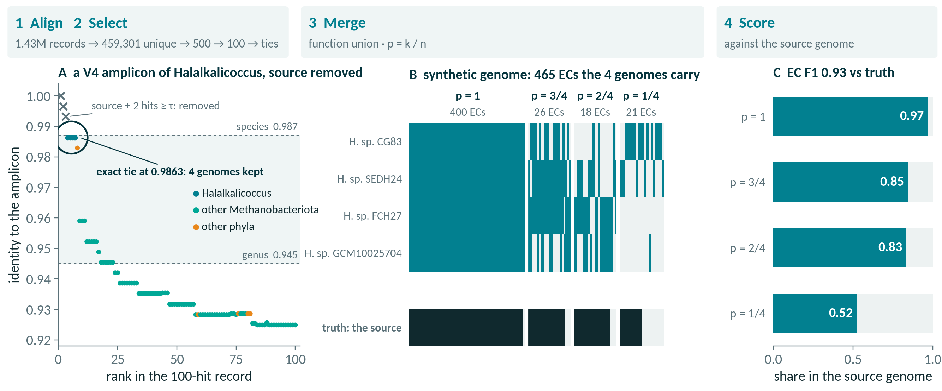
One amplicon, from 16S read to weighted genome
A real V4 benchmark amplicon, source removed, through every stage
1008153.3__V4 · 100-hit record · exact-tie union · self-exclusion at τ = 0.987 · ECs from BV-BRC PGFams
Notes:
The workflow on one real benchmark amplicon, chosen by a fixed rule rather than by hand (extract_worked_example.py: the first V4 amplicon whose source is its own single selection, and which falls to a 4-genome genus-tier tie once the source is removed). The amplicon is a V4 product of a Halalkalicoccus genome (Halalkalicoccaceae, Methanobacteriota). Step 1: an edlib prefilter keeps the 500 closest of 459,301 unique BV-BRC 16S sequences, the GPU Smith-Waterman kernel ranks them, and Biopython aligns the top 100 to give identity and coordinates (panel A). Step 2: self-exclusion removes the source genome and every hit at identity 0.987 or above (3 hits here), then the exact-tie rule keeps every reference tied at the best surviving identity, 0.9863, one genome per species: 4 Halalkalicoccus genomes. A Bacillus 16S sits in the record just below the tie at rank 8, an off-phylum sequence the identity tie leaves out. Step 3: the selected genomes' functions are merged into one synthetic genome of 465 ECs (panel B), each weighted by p = k/n, the share of the 4 genomes carrying it: 21 at p = 1/4, 18 at p = 2/4, 26 at p = 3/4, 400 at p = 4/4. Step 4: scored against the source genome's own ECs (panel C), the union reaches EC F1 0.93 (precision 0.94, recall 0.92, against 476 true ECs). Within this one amplicon the share of ECs truly present falls with p: 0.52 at p = 1/4, 0.83 at p = 2/4, 0.85 at p = 3/4, 0.97 at p = 4/4. That is the ranking the calibration slide finds across the benchmark. In prFBA the weight then enters the flux objective, where a low-p reaction costs more flux; the weight never gates or removes a reaction. This example is typical in kind, not in outcome: most answered benchmark amplicons select one genome, so p = 1 throughout.

Slide 4
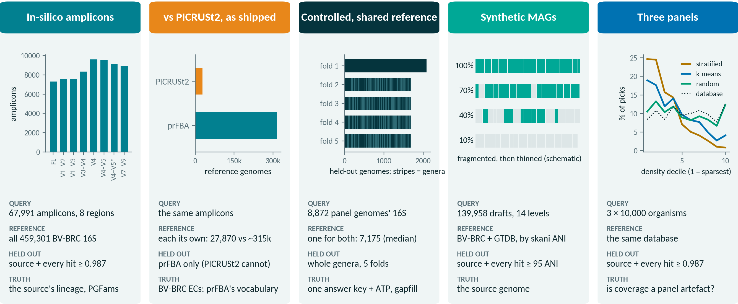
Five validation arms, one unaltered pipeline
Each changes what is searched, what is held out, and what counts as truth
Every arm runs the shipped code; only the inputs and the scoring differ
Notes:
The validations share one pipeline and differ in four things: the query, the reference it is searched against, what is withheld, and the truth it is scored against. In-silico amplicons: 67,991 amplicons cut by in-silico PCR from 10,000 taxonomy-stratified BV-BRC genomes in 8 regions (chart: amplicons per region), searched against the full reference; each is scored with its source present and with the source and every hit at 0.987 identity or above removed, against the source's NCBI lineage and gene families. As shipped against PICRUSt2: the same amplicons, each system with its own reference (27,870 genomes for PICRUSt2 against about 315,000 for prFBA), scored in BV-BRC's EC vocabulary, which is prFBA's own; PICRUSt2 has no way to exclude the source. Controlled: 8,872 dereplicated panel genomes split into 5 folds with whole genera held out (chart: held-out genomes per fold, each stripe a genus group; one connected group fills fold 1), both methods confined to one shared reference (7,175 genomes, median per fold) and one answer key, plus ATP and gapfill phenotypes. Synthetic MAGs: 139,958 drafts made by fragmenting each panel genome and dropping whole pieces down to 1% completeness (schematic), matched by skani whole-genome ANI. Three panels: the same pipeline on three 10,000-organism panels sampled on different principles (chart: share of each panel's picks per density decile of the 16S embedding), to ask whether coverage is a property of the method or of the panel.

Slide 5
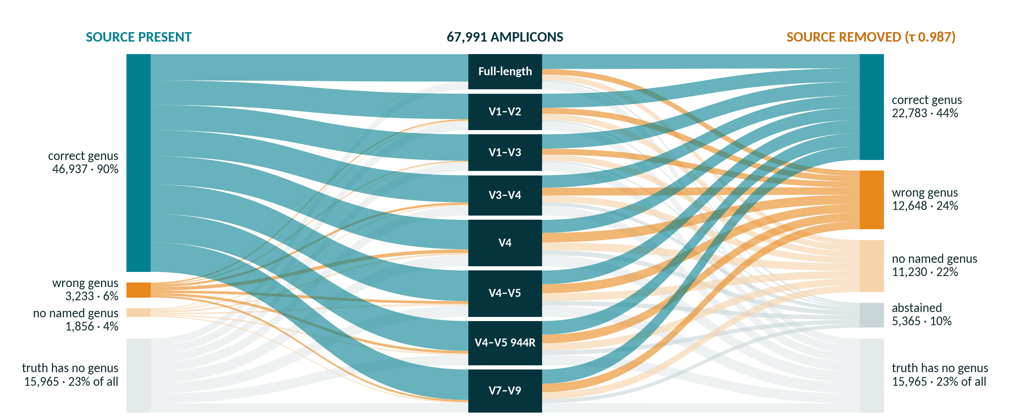
Where every amplicon's genus call lands
67,991 amplicons by region · source present (left) vs removed (right)
Anchor predictor · exact-tie union · 100-hit records · shares of the 52,026 genus-scoreable amplicons
Notes:
Every one of the 67,991 benchmark amplicons flows from its region (middle) to its genus outcome, with the source organism present (left) and removed (right, self-exclusion at τ = 0.987). 15,965 amplicons (23% of all) come from a source whose own truth has no named genus; they are unscoreable in both modes and leave every denominator. Of the remaining 52,026: with the source present 46,937 (90%) get the right genus, 3,233 (6%) a wrong one and 1,856 (4%) a reference with no named genus, and none abstains. With the source removed, 22,783 (44%) are still right, 12,648 (24%) wrong, 11,230 (22%) land on an unnamed genus and 5,365 (10%) abstain: for 5,141 of them self-exclusion removed all 100 hits of the record, and the rest had nothing at the family floor or past the reliability gate. Ribbon colour is the outcome, so the change in colour from left to right is what novelty costs, region by region. These counts reproduce the full deck's denominator slide (asv_region_concordance.csv and benchmark_truth.json, classified identically).

Slide 6
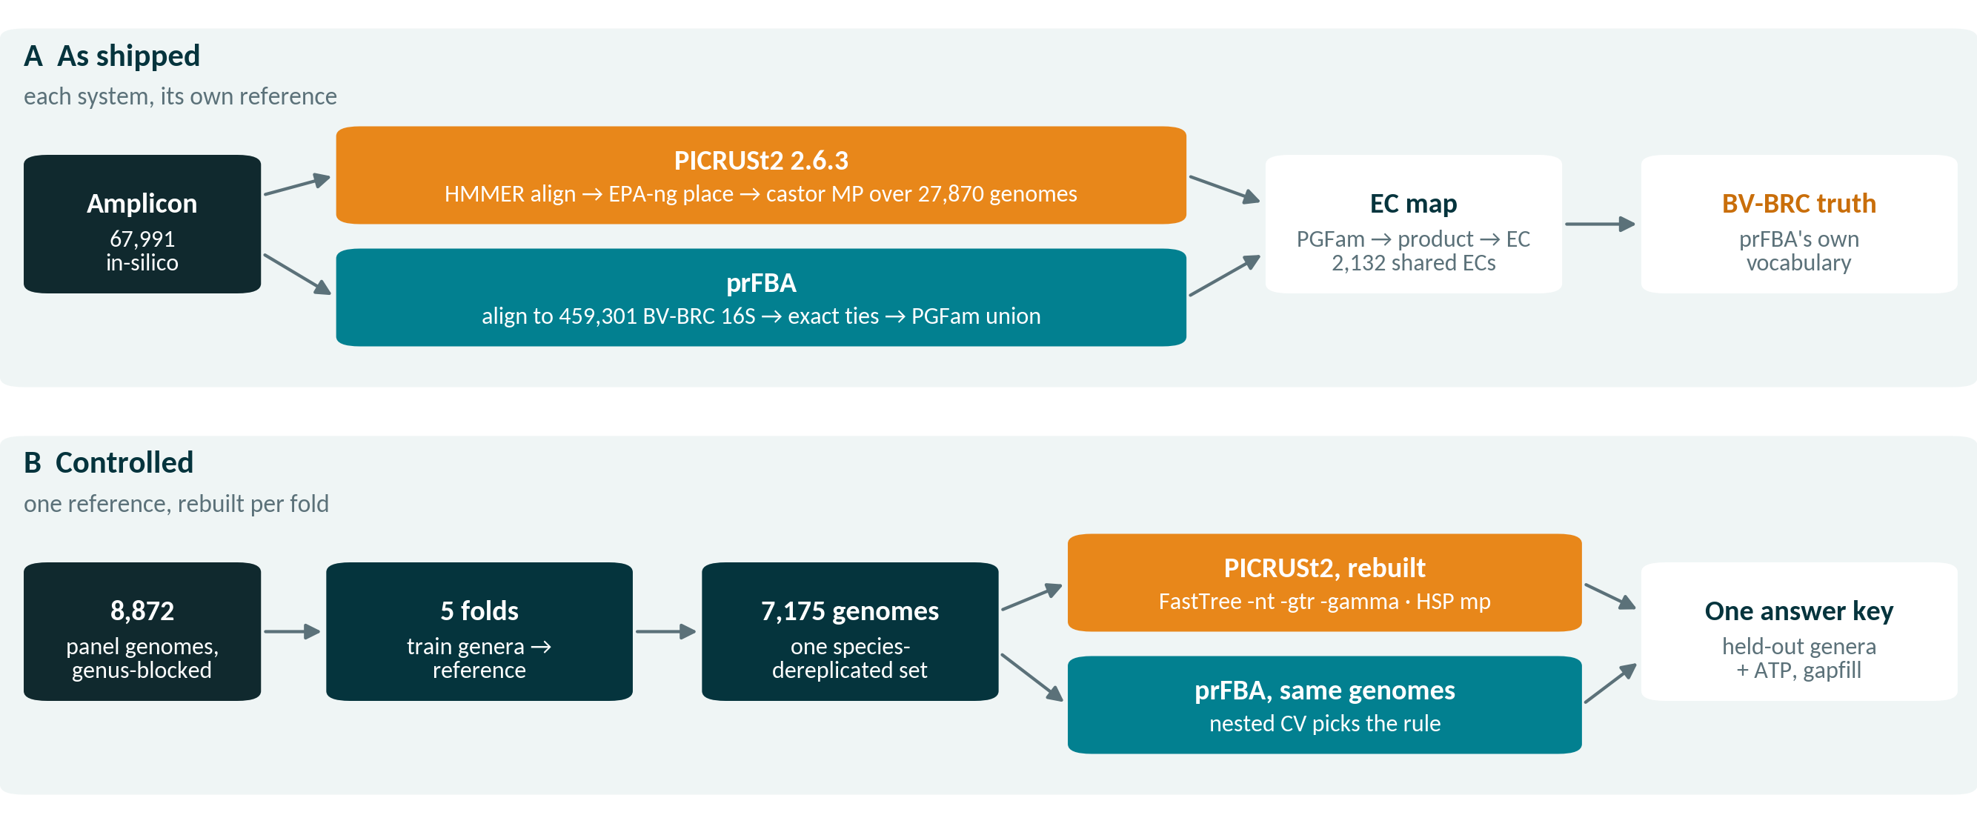
PICRUSt2 run twice: as shipped, then like for like
The comparison removes each built-in advantage in turn
PICRUSt2 2.6.3 · installed without conda (uv venv, castor, EPA-ng, gappa, HMMER from source)
Notes:
A, as shipped: PICRUSt2 2.6.3 aligns each amplicon to its reference with HMMER profiles, places it in a fixed reference phylogeny with EPA-ng and gappa, and infers gene content by MP (maximum-parsimony) ancestral-state reconstruction with castor over 27,870 reference genomes; it always answers. prFBA aligns the same amplicon to 459,301 BV-BRC 16S sequences, keeps the exact ties and unions their gene families. prFBA predicts PGFam families and PICRUSt2 EC numbers, so the truth and both predictions pass through one map, family to BV-BRC product string to EC, and are scored on the 2,132 ECs both can express (7,042 ModelSEED reactions). Two asymmetries are built in: the references differ about tenfold, and the truth is BV-BRC annotation, prFBA's own vocabulary. B, controlled: 8,872 panel genomes in 5 genus-blocked folds; for each fold, the training genera become one species-dereplicated reference (7,175 genomes, median), and PICRUSt2's alignment, tree and trait table are rebuilt from it with its own tooling (FastTree -nt -gtr -gamma, HSP mp, edge exponent 0.5, minimum alignment 0.8), while prFBA searches exactly the same genomes, with its selection rule chosen by nested cross-validation inside each training fold. Both are scored on the held-out genera against one answer key, and the gapfilled models are compared on ATP production and growth. The effect size that counts was fixed in advance at 0.02 in population EC F1.

Slide 7
Results
What survives when the source is removed

Slide 8
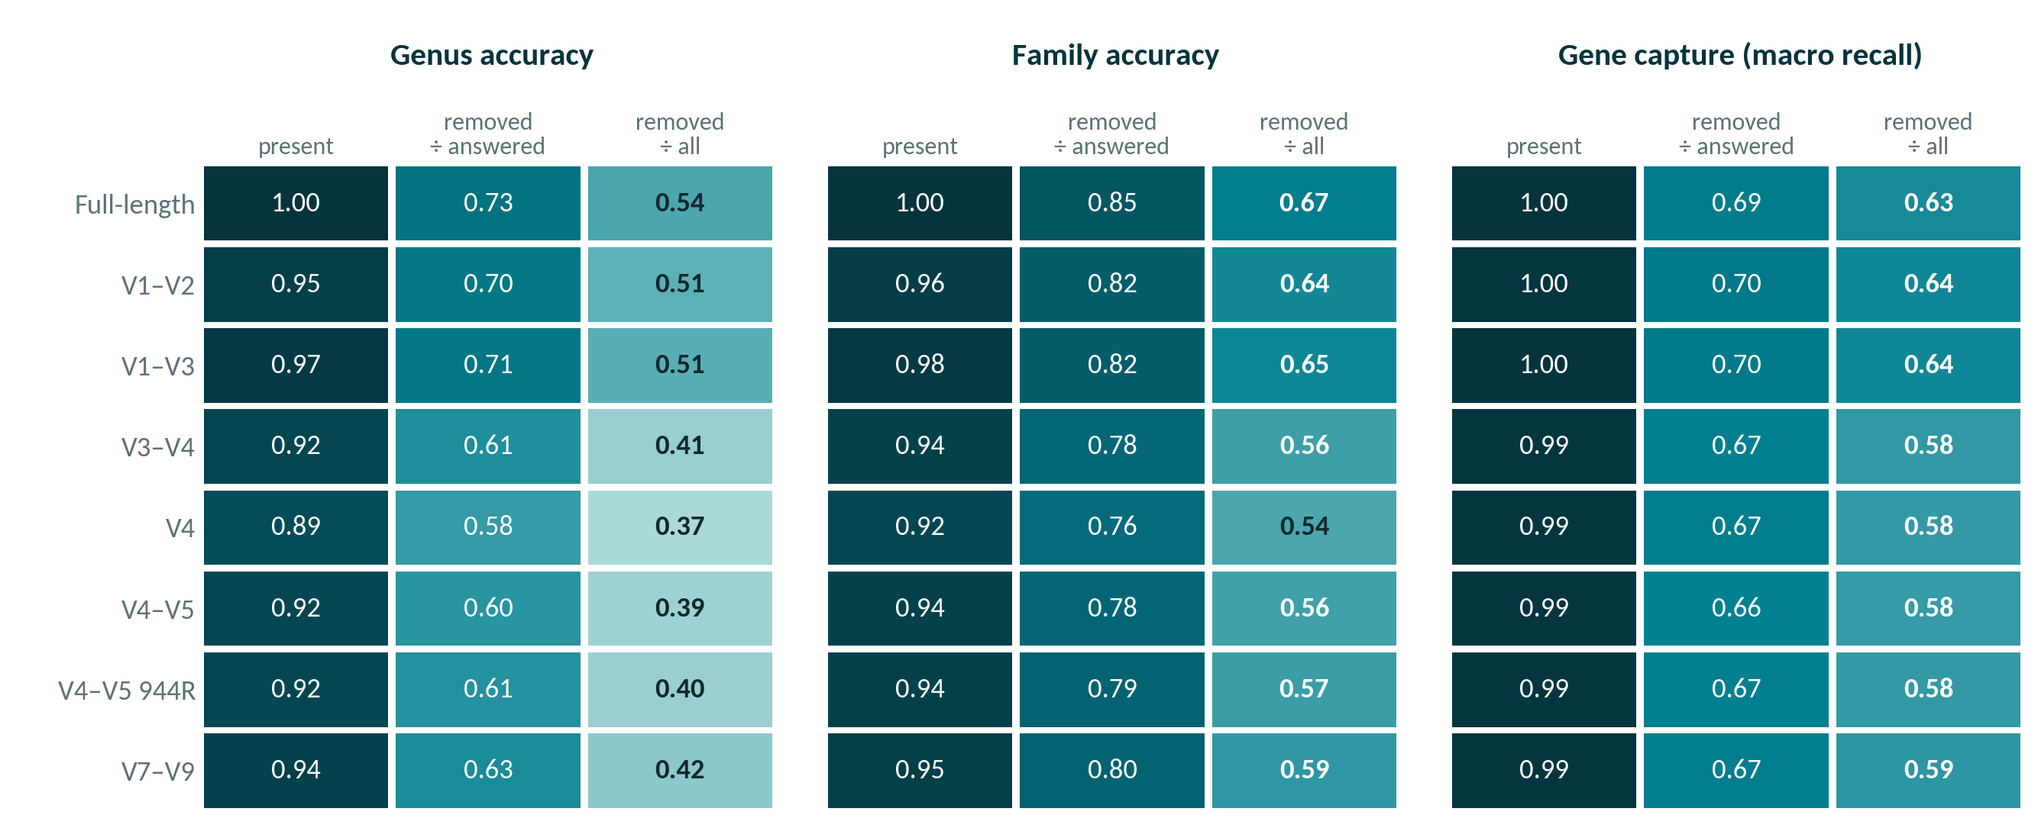
Without the source, family transfers best
Every region × measure · source present vs removed
Anchor predictor · exact-tie union · 100-hit records · ÷ answered = among amplicons that answer; ÷ all = every non-answer a miss
Notes:
Each row is a 16S region and each cell a measure, with the source organism present, removed and scored among amplicons that still answer, and removed and scored over every scoreable amplicon (a non-answer counts as a miss; bold). With the source present, almost everything is recovered. Removed, conditional genus accuracy falls to 0.58–0.73, family accuracy holds at 0.76–0.85, and gene capture to 0.66–0.70; over the whole population genus accuracy is 0.37–0.54. Full-length 16S and the two V1-anchored regions lose least; the regions starting at V3 or later lose a few points more genus accuracy, while gene capture barely depends on the region. Source: taxacc_region_summary.json and gene_capture_by_region.json (manuscript tab:main).

Slide 9
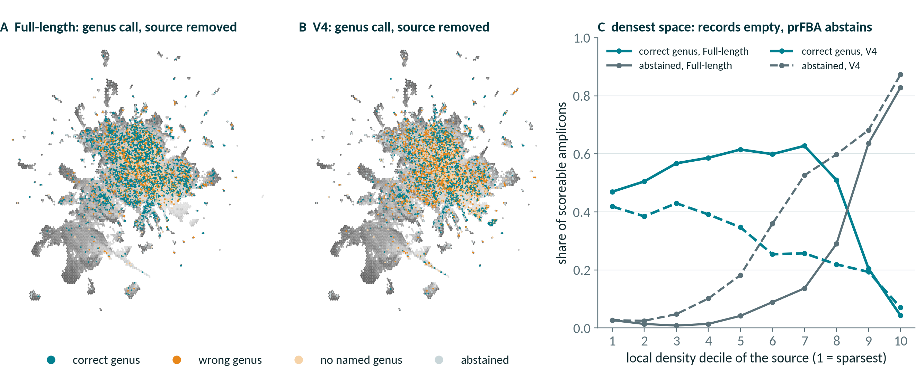
Failures map to where the 16S space is crowded
Original panel's sources in the BV-BRC 16S embedding · source removed
UMAP of 1024-d 16S embeddings; density = 21st-neighbour distance in the full space · exact-tie union · 100-hit records
Notes:
Each dot is one of the 9,097 original-panel source genomes that sit on the embedding frame, placed at its representative 16S in the UMAP projection of all clusterable BV-BRC 16S sequences, and coloured by its amplicon's genus call once the source is removed (A full-length 16S, B V4); grey shading is local density measured in the full 1024-dimensional embedding. Panel C bins the sources by that density. In the sparsest decile full-length 16S still calls the right genus 47% of the time and abstains 3%; in the densest it abstains 83% (V4: 87%) and is right only 4%. That is not a failure to find relatives: in densely sequenced species every one of the record's 100 hits is the source's own taxon or within 0.987 identity of it, so self-exclusion empties the record and nothing is left to select (5,141 of the 5,365 abstentions over all regions; the full deck's emptied-records slide). The densest deciles hold few panel sources (88 and 70 for full-length 16S), because the taxonomy-stratified panel under-samples crowded space. V4 is right less often than full-length 16S at every density. Coverage figures under self-exclusion are therefore lower bounds set by the record depth, not by the organisms.

Slide 10
More precise when it answers, narrowly behind overall
As shipped, scored against BV-BRC truth: prFBA's own annotation
0.802 vs 0.727
EC F1 when both answer, n = 59,607
11.1%
get no EC prediction; 9.6% abstain
−0.016
whole-population F1 gap to PICRUSt2
Whole population: ahead in Full-length, V1–V2, V1–V3 only
Shipped exact-tie union · 100-hit records · EC space, n = 67,038 scoreable amplicons
Notes:
As the two systems ship, scored in the shared EC space against BV-BRC truth (n = 67,038 scoreable amplicons), they trade coverage against precision. PICRUSt2 answers all but 26 amplicons, at EC precision 0.669; prFBA, under its shipped exact-tie union with the source organism excluded, gives an EC prediction for 88.9% at precision 0.787: 11.1% get none, 9.6% because the selection abstains outright. On the 59,607 amplicons both answer, conditional EC F1 is 0.802 against 0.727, prFBA leads in all 8 regions (paired Wilcoxon, median ΔF1 +0.072 to +0.095, Holm p ≈ 0) and wins 3 to 7 amplicons per loss, depending on the region. Over the whole population, scoring prFBA's non-answers as zero, PICRUSt2's mean F1 is narrowly higher (0.729 against 0.713, a gap of −0.016; under the legacy reducer prFBA reaches 0.726, within resampling noise), while the median amplicon still favours prFBA. By region the population mean favours prFBA in full-length 16S (0.768 against 0.745), V1–V2 (0.760 against 0.731), V1–V3 (0.766 against 0.732), and PICRUSt2 elsewhere. ModelSEED reaction space tracks EC space within 0.01 (conditional F1 0.805 against 0.721). Both built-in asymmetries, a tenfold larger reference and a truth in prFBA's own vocabulary, favour prFBA here, so this measures the systems as shipped rather than the method; the controlled comparison removes both and the ranking reverses. Source: comparison_summary.json, comparison_cells.csv.gz and prfba_selection.json, 100-hit records.

Slide 11
Under a neutral answer key, the ranking reverses
Population EC F1 · leave-genus-out · one shared reference
−0.092
prFBA − PICRUSt2 · 95% CI −0.107 to −0.081
−0.031
forced to answer: still behind
PASS
C2 include-self ceiling
source recovery 1.00
PASS
C12 gapfill validity
amended · EC unchanged
prFBA = legacy rule, chosen in every fold · cluster bootstrap, 2,376 groups
Notes:
Every arm is scored on the same 63,871 cells against the same answer key, with abstentions counted as zero. prFBA reaches population EC F1 0.687 against PICRUSt2's 0.779 (−0.092, 95% CI −0.107 to −0.081); forced to answer it reaches 0.747 and still trails by 0.031, so about two thirds of the deficit is abstention and the rest is in the answers. The bar the design registered is nn1, copying the single top-ranked surviving reference: forced prFBA only ties it (0.747 against 0.745, a margin with no paired test), the abstaining arm falls 0.058 below it, and PICRUSt2 clears it by 0.034. At leave-family-out the gap widens to −0.124 (forced −0.040) and prFBA's skill score falls to −0.14, a point estimate whose interval against the prevalence floor spans zero; clade-max is an oracle chosen against the truth, a ceiling and not a method to beat. These numbers do not depend on the as-shipped record depth: each fold ran its own alignment at k2 = 200, and 'prFBA' is the legacy rule that leave-one-fold-out selection picked in every fold (the shipped exact-tie rule scores 0.685). Validity: the include-self ceiling control C2 passes (prFBA source recovery 1.00, PICRUSt2 0.899 against a soft 0.85 flag; data_c2/summary_incself.json and data/controls.json), and the gapfill validity gate C12 passes under amendments A-C12 and A-C13 (post hoc and disclosed: corrected templates, the gapfiller's reversals and an updated ModelSEEDpy), so the leave-genus-out artefact is valid; rescoring changed no EC number, and the next three slides show why C12 failed in the pre-registered run and how the fix cleared it. Sources: shared_reference/data/summary_genus.json and data_family/summary_family.json.

Slide 12
Where prFBA answers, ATP barely registers the gap
Media called wrong per genome · EC F1 gap here only −0.028
+0.13
more media wrong than PICRUSt2 · p = 0.49
−0.15
fewer than the nearest copy · q = 0.028
C11 identity
reproducible builds
C12 gapfill validity
0 of 8,614 rows gated · 49 before the amendments
PASS
PASS
755 ATP-informative of 1,000 genomes · prFBA = shipped exact-tie rule · Wilcoxon signed-rank; BH-adjusted McNemar
Notes:
Each arm's predicted EC set goes through one fixed ModelSEED reconstruction, and the model is asked on which of 54 media it can make ATP; only 22 ever carry signal, and the score is the number of media called wrong against the model built from the truth genome's own annotation (which, rebuilt, scores 0.00). Over the 755 ATP-informative genomes (prFBA answers all 1,000 assayed), where its EC-F1 gap to PICRUSt2 is only −0.028, prFBA calls 0.13 more media wrong than PICRUSt2 (Wilcoxon p = 0.49, BH q = 0.49): no detectable mean difference, a null and not an equivalence. Per medium, PICRUSt2 is ahead on 2 of 22 testable media (Ac.NO, Etho.O2; McNemar q = 0.002), and against copying the nearest reference prFBA calls 0.15 fewer media wrong (q = 0.028), the baseline it ties on ECs. PICRUSt2's drafts share more of the truth's reactions (median reaction Jaccard 0.737 against 0.707); on reaction Jaccard, essentiality and growth prFBA is indistinguishable from the nearest-reference baseline, and those readouts are unpaired medians with no paired test specified. The identity control C11 passes: one EC set built twice gives identical models. The validity gate C12 passes under amendments A-C12 and A-C13 (templates 21a8084 with the gapfiller's reversals applied, on ModelSEEDpy c2e31a0, post hoc and disclosed): no gapfilled model of any arm makes ATP or biomass from water and protons (0 of 8,614 rows, against 49 in the pre-registered run, 10 of them truth rows), so every genome stays in every arm's gapfilled comparison; the ATP pass on the corrected templates reproduced the pre-registered pass row for row, so the ATP numbers here are unchanged, and the next two slides show the pre-registered failure's cause and the fix. The phenotype arm uses the shipped exact-tie rule on 1,000 pre-specified genomes (ATP) and a 200-genome gapfilled subsample; sources: shared_reference/data/phenotype_atp_c13/ and phenotype_gf_c13/phenotype_summary.json, data/controls.json.

Slide 13
p(function) ranks well but is overconfident
Is p a calibrated probability that the function is present?
0.78
calibration slope (1 = calibrated)
0.010
skill over a constant, 2-way ties: CI spans 0
+0.0007
macro F1 gain from p ≥ 0.5 (bar: 0.02)
Use p to rank, not as a probability
Controlled genus-blocked benchmark · exact-tie rule, full reference density · EC level · intervals in the notes
Notes:
This asks whether p(function) = k/n behaves as a probability that the function is present in the organism the amplicon came from, scored against the truth genomes of the controlled genus-blocked benchmark (shipped exact-tie selector, full reference density, EC level; the 7,973 multi-genome selections among 57,021 scored cells). It ranks correctly: within selections of two, three and four genomes, observed presence rises strictly with p (for three genomes 0.317, 0.560, 0.854 at p = 1/3, 2/3 and 1). It is overconfident: the probability-scale calibration slope is 0.78 [0.76, 0.79], a function at p = 1/2 is present only 0.449 of the time, and p = 1 from two or more agreeing references is present 0.837, against 0.787 from a single reference. Over a constant confidence, p adds skill only for ties of three or more genomes (0.132 for three, 0.201 for more); for two-way ties, 71% of multi-genome cells, the Brier skill is 0.010 [−0.009, 0.024], an interval that includes zero. Keeping only functions with p ≥ 0.5 changes the benchmark's macro F1 by +0.0007 [0.0005, 0.0009], far below the pre-registered 0.02. Caveats: the folds are genus-blocked, so every number is cross-genus transfer and pessimistic for deployment; intervals are cluster bootstraps over holdout groups, one of which carries 32% of the multi-genome points; every join, invariant and leakage check in assertions.json passes. The revised manuscript draft reports this calibration.

Slide 14
The weight breaks ties; so does any gradation
Does p steer flux toward the true organism's functions?
−0.61 pts
truth-absent flux, % of gene-backed, real p vs two-tier [−0.97, −0.25]; SESOI 1 pt
24%
of what an oracle weighting achieves
Exchange term dominates: the weights only pick among ties
Declared post hoc · 300 multi-genome + 60 single-genome amplicons, leave-genus-out benchmark · pooled n ≥ 2, 95% group-cluster CI
Notes:
A declared, post-hoc in-silico test of the prFBA objective (design and results: region_validation/shared_reference/WEIGHTED_OBJECTIVE_TEST.md and WEIGHTED_OBJECTIVE_RESULTS.md). Each amplicon's union is built into a gapfilled ModelSEED model, and the objective is solved with real p, with every gene-backed p = 1 (what a single-genome selection gives), with p shuffled among the gene-backed reactions, with plain parsimony, and with an oracle that prices only the reactions the source genome's own draft lacks. Flux is measured over the whole optimal face, as a fraction of the two-tier arm's gene-backed flux. Real p lowers truth-absent flux by −0.61 points [−0.97, −0.25] at the face midpoint, below the 1-point smallest effect of interest; at the face minimum the interval includes 0 (−0.25 [−0.53, +0.11]). Real minus shuffled p is −1.20 points; the oracle reaches −2.49 points, so p achieves 24% of what the oracle weighting achieves. Degeneracy falls from 41.5 to 32.7 variable gene-backed reactions (−8.9 [−10.3, −7.5]), but shuffled p leaves fewer still (27.9; real minus shuffled +4.8), so the tie-breaking comes from any gradation of the costs, not from p's information. The exchange term is about 99% of the objective and is the same under every weighting on 357 of 360 amplicons, so the internal weights only choose among solutions of equal exchange flux. At n = 1 the weighted and two-tier objectives return identical solutions (60 of 60). The released single-model path of MSProbability.prFBA does not run as shipped; the test used a corrected copy, checked on every amplicon against the released source run with its two failing lines corrected (360 of 360); a fix is committed on ModelSEEDpy branch fix-prfba-single-model (b6857a0). Truth is an annotation-level proxy; the decision rules were amended after a 10-amplicon smoke, before the full run.

Slide 15
No completeness at which the amplicon catches up
Paired within organism, from complete genomes down to 1% drafts
+0.103 to +0.212
lead over all 8 regions at 100%
0.308 → 0.253
resolve rate, 100% → 1%: coverage degrades
0.248 vs 0.605
whole-population F1, MAG vs full-length 16S
Amplicon cells: depth-100 records, exact-tie union · conditional on both arms answering, n = 1,603–2,311 per point
Notes:
Paired within organism against the amplicon arm's own cells (depth-100 records, exact-tie union, as in tab:main), the MAG arm leads full-length 16S by +0.103 in gene-capture F1 at full completeness and still by +0.077 at 1%, fifty-fold below MIMAG's medium-quality floor and not a bin any study would keep; against V4 the lead is +0.212 and +0.190. At 1% the MAG arm still wins 1,129 organisms to 473 against full-length 16S, and every one of the 28 paired tests has Wilcoxon p ≤ 1e-79. Across all 8 regions at full completeness the lead follows the variable region, not amplicon length: +0.103 to +0.116 against full-length 16S and the two V1-anchored regions, +0.168 to +0.212 against the five that start at V3 or later, with V4 the widest gap. The reason is structural: the prediction is the gene content of the selected reference genome, not of the MAG, so completeness matters only if it changes which reference is chosen, and ANI is robust enough that it rarely does. What degrades is coverage, not quality: the resolve rate falls from 0.308 to 0.253 as the remaining sequence stops clearing skani's screen, while conditional F1 drops by only 0.024. All of this is conditional on both arms answering; over the whole population, scoring an abstention as zero, the amplicon arm wins, 0.605 against 0.248 for full-length 16S, because the MAG arm answers for only about 31% of organisms (see the abstention slide).

Slide 16
Coverage falls on the random panel; quality holds
Phylum-standardized, 113 shared phyla · self-exclusion at τ = 0.987
−0.20 to −0.29
coverage, random − stratified, every region
≤ 0.07
conditional genus accuracy, either direction
≤ 0.028
conditional gene-capture F1, any two panels
Chart: V4 · record depth 100 · exact-tie union · 1,000 phylum-stratified bootstrap replicates
Notes:
Every rate here is phylum-standardized over the 113 phyla present in all three panels, restricted to organisms with a full-length best 16S, under self-exclusion at τ = 0.987, with all three panels scored at record depth 100 under the exact-tie union; intervals are 1,000 phylum-stratified bootstrap replicates. The chart shows V4: genus coverage is 0.615, 0.431 and 0.358 on the stratified, k-means and random panels, a random-minus-stratified difference of −0.257 (−0.276 to −0.238) against −0.330 crude. In every region, genus and gene-capture coverage fall by 0.20 to 0.29 on the random panel, every interval excludes zero, and the standardized gap keeps 76–92% of the crude one, so composition is a minority of it. Quality given an answer moves far less. Conditional genus accuracy is higher on both alternative panels than on the stratified one in every region, by up to 0.07 (random minus stratified excludes zero in 2 of 8 regions). Conditional family accuracy differs by at most 0.05 between any two panels, and conditional gene-capture F1 by at most 0.028: it is lower on the random panel by 0.013 to 0.028, an order of magnitude below the coverage gap; the MAG arm, scored against each panel as its own reference, stays within the same bound.

Slide 17
What the validations say
0.76–0.85
family accuracy for novel organisms, among answered
10%
abstain once the source is removed: no false metabolism
−0.092
prFBA − PICRUSt2, like for like · CI −0.107 to −0.081
PASS
gapfill validity (C12), after the template fixes
github.com/freiburgermsu/prFBA · full update deck: presentations/prFBA_updates_2026-10.pptx
Notes:
Four things to take away. First, the selection transfers at family level even for organisms absent from the database (0.76–0.85 family accuracy across regions, among amplicons that answer), and genus is where short amplicons pay. Second, it abstains rather than guess: 10% of scoreable amplicons get no call once the source is removed, 5,141 of 5,365 because every hit in the record was the source's own close kin, removed with it. Third, as shipped prFBA is more precise when it answers, but on the controlled benchmark, with one shared reference and a neutral answer key, PICRUSt2 predicts EC content better: population EC F1 differs by −0.092 (95% CI −0.107 to −0.081), beyond the pre-registered 0.02. Fourth, the phenotype arm's gapfill validity gate passes after the disclosed template amendments, so the leave-genus-out run is valid; no EC number depended on it.

