Slide 1
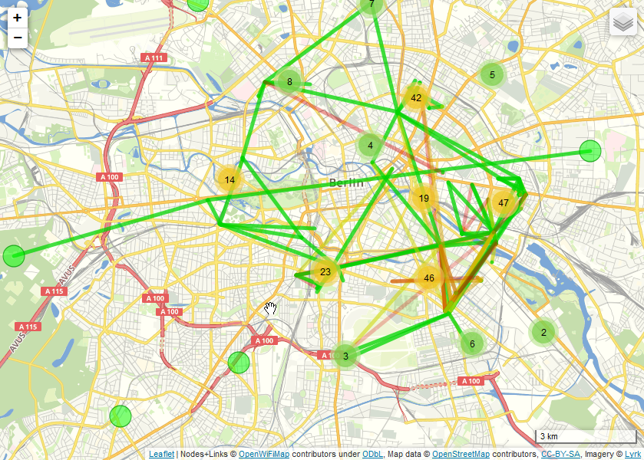
Freifunk
An open, non-commercial, non-hierarchic initiative for free wireless networks

Slide 2
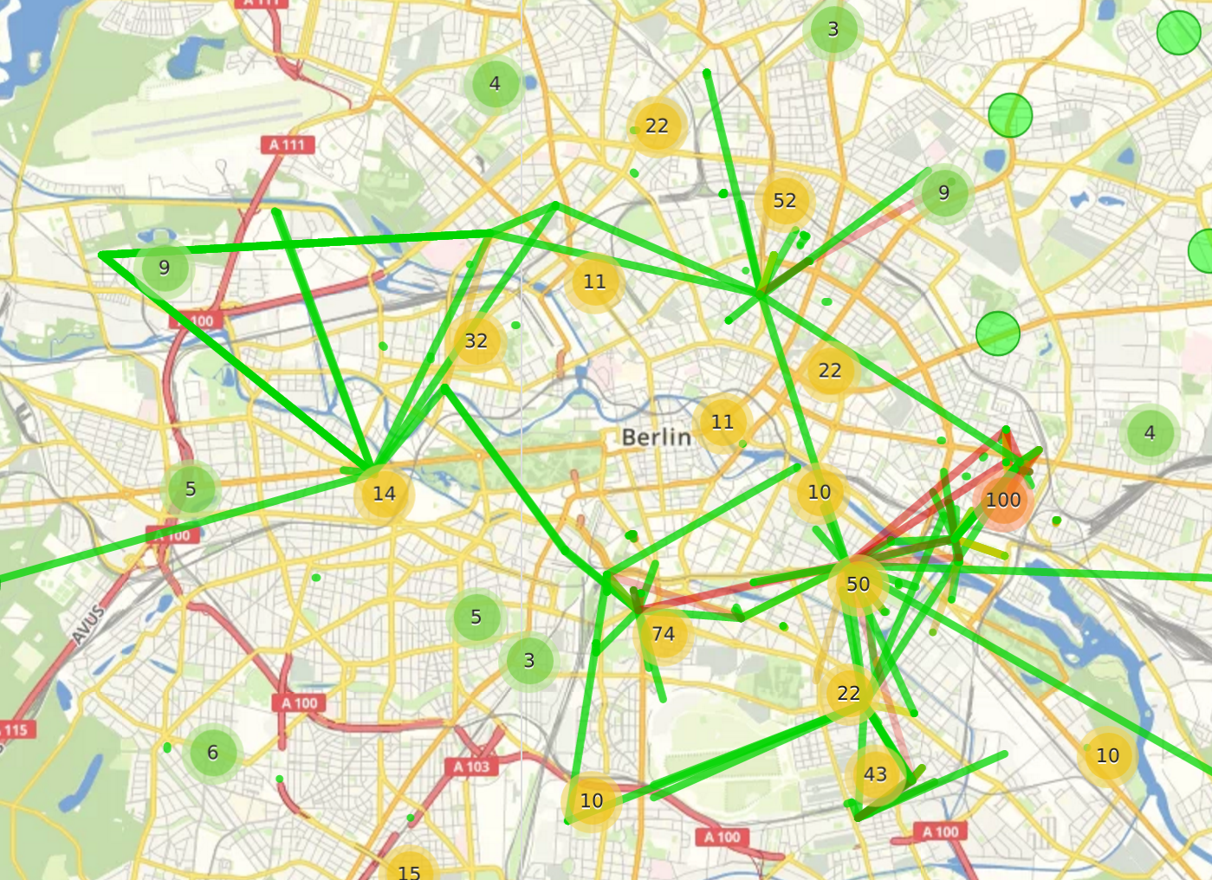
Freifunk
An open, non-commercial, non-hierarchic initiative for free wireless networks

Slide 3
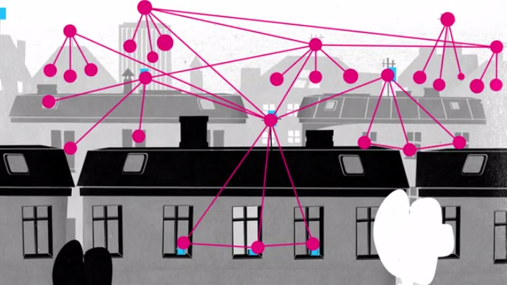
How does it work?
Every participant provides a wireless router for every other participant‘s data transmission
The wireless routers connect to each other automatically

Slide 4
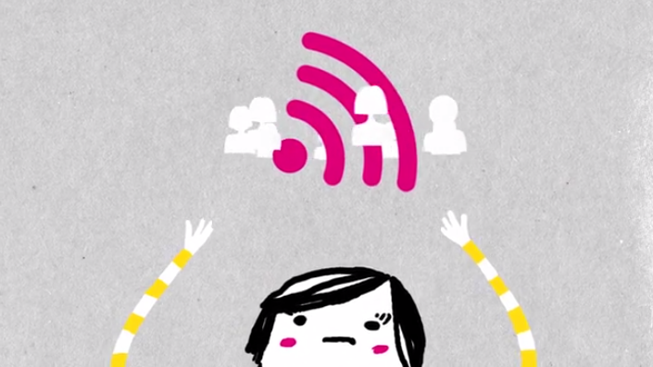
Why is Freifunk so awesome?
Everyone can get involved/have a say/participate in decisions
People get connected regardless of their status/income/background/technical knowledge
Makes internet possible in places where it would not be possible without Freifunk
The network is open, independent, uncensored and free
Notes:
Demokratisierung der Kommunikationsmedien
Förderung lokaler Sozialstrukturen
digitaler Spaltung entgegenwirken
Freie, unabhängige, unzensierte, nicht-kommerzielle Netzwerkstrukturen

Slide 5
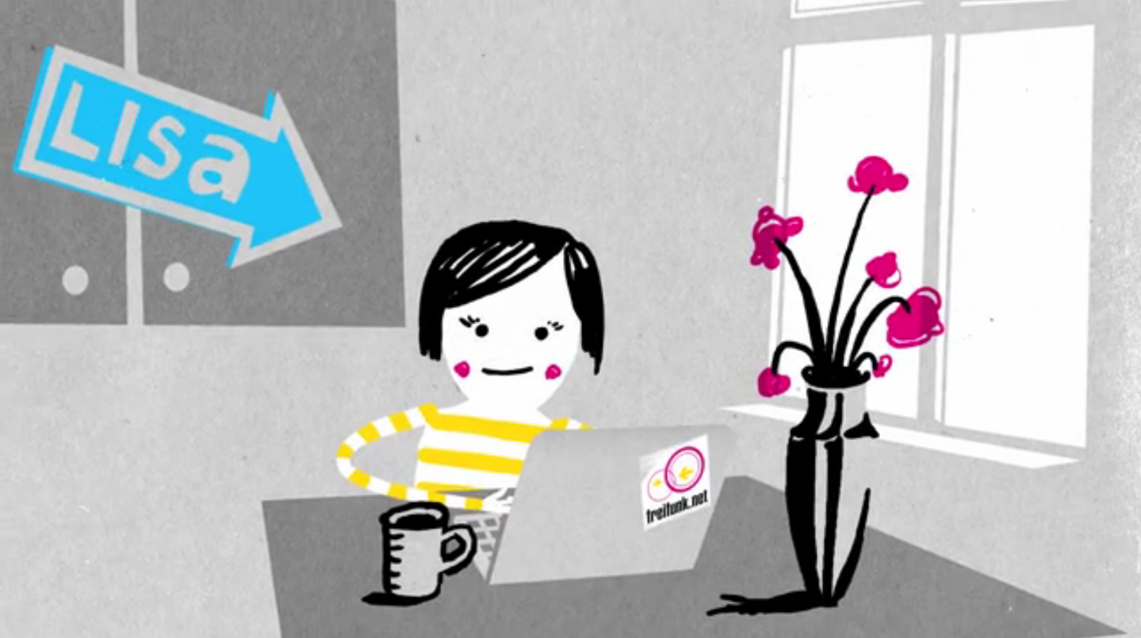
How can I participate?
Get a Freifunk router
Install our Freifunk software
Put the router next to your window

Slide 6
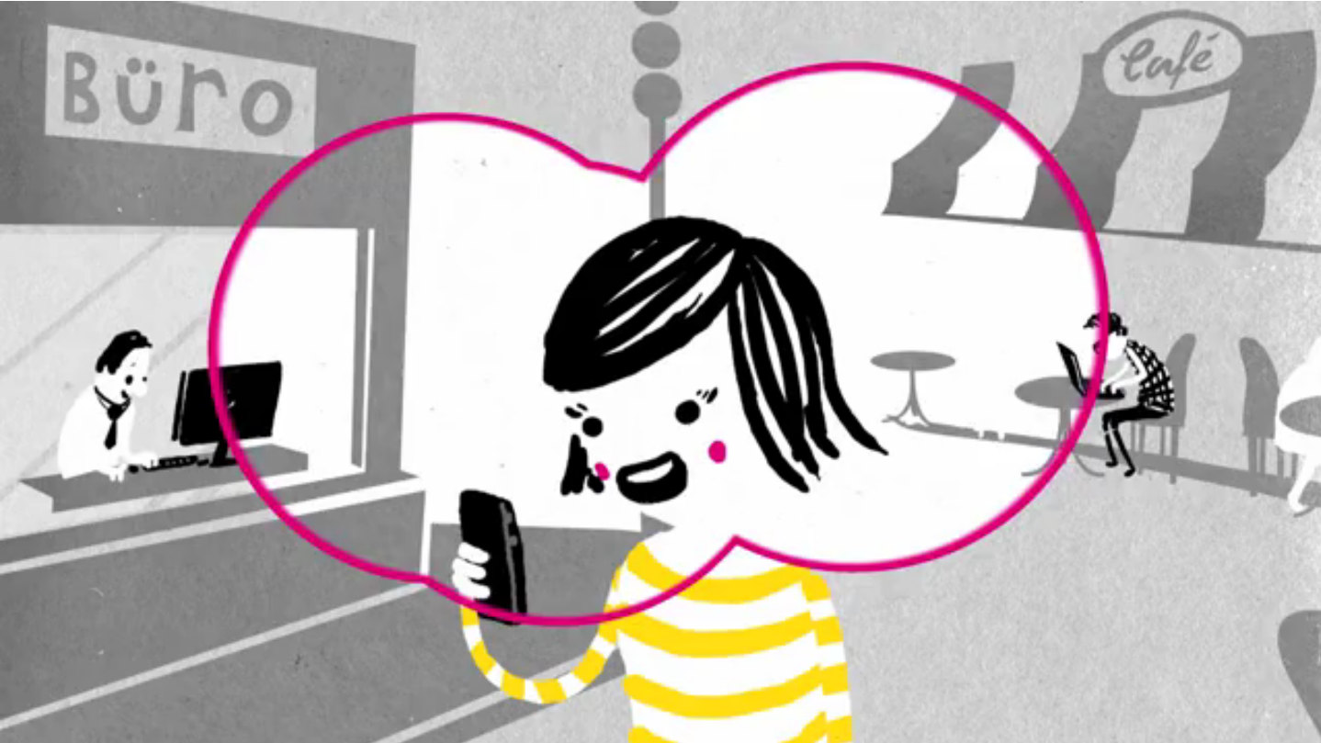
Can I do more?
Tell everyone about Freifunk
Become a part of our community
  Join our meetings
  Firmware development
  Design flyers, posters, websites
  Shape the future
Support installations on rooftops and towers
Donate on betterplace.org

Slide 7
Links
http://berlin.freifunk.net/participate/howto
https://freifunk.net
https://github.com/freifunk-berlin
https://freifunkstattangst.de
https://www.betterplace.org/de/projects/12172-freifunk-net
presented by Maria (@geirkairam)

Slide 8
?

