Slide 1
POD Surrogate Model for the Prediction of Lead Solidification Profile in a Forced Flow
Ramiro Freile

Slide 2
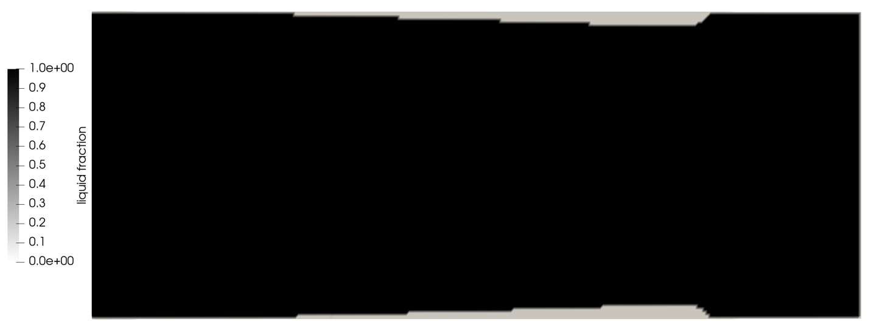
Study Case
Cooled section
Inlet
Outlet
Forced Flow condition of lead in a straight pipe.
Boundary conditions:
Inlet: Dirichlet Velocity, Dirichlet Enthlalpy (Hot).
Outlet: Dirichlet Pressure, Outflow Enthalpy.
Wall: No-Slip Condition, Dirichlet Enthalpy (Cold), Adiabatic in non-cooled sections.
Slice of the geometry along the cylinder axis

Slide 3
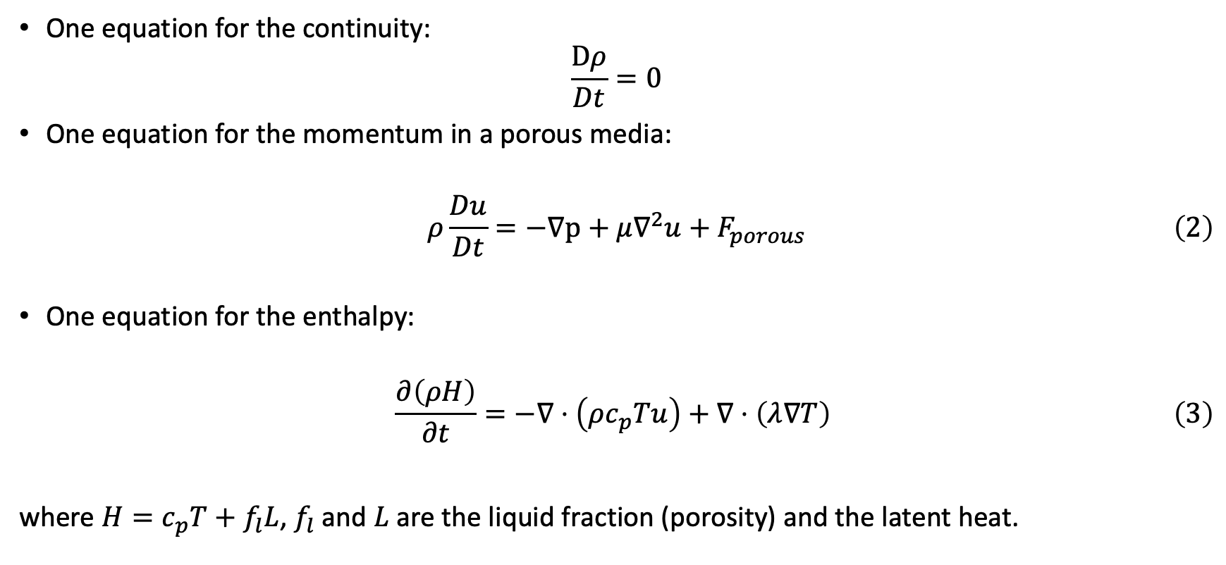
Macroscopic Equations
One equation for the continuity:
$$\frac{Dρ}{Dt}=0$$
One equation for the momentum in a porous media:
$$\begin{aligned}ρ\frac{Du}{Dt}=−∇p+μ∇^{2}u+F_{porous}\#\left(2\right) \\ \end{aligned}$$
One equation for the enthalpy:
$$\begin{aligned}\frac{∂\left(ρH\right)}{∂t}=−∇⋅\left(ρc_{p}Tu\right)+∇⋅\left(λ∇T\right) \#\left(3\right)\end{aligned}$$
where $H=c_{p}T+f_{l}L$, $f_{l}$ and $L$ are the liquid fraction (porosity) and the latent heat.

Slide 4

Macroscopic Equations
$$T=\left\{\begin{aligned}T_{s}−\frac{H_{s}−H}{c_{p,s}}, H<H_{s} \\ \frac{H_{l}−H}{H_{l}−H_{s}}T_{s}+\frac{H−H_{s}}{H_{l}−H_{s}}T_{l}, { H}_{s}<H<H_{l} \\ T_{l}+\frac{H−H_{l}}{c_{p,l}}, H>H_{l}\end{aligned}\right.$$
$$f_{l}=\left\{\begin{aligned}0, H<H_{s} \\ \frac{H−H_{s}}{H_{l}−H_{s}}, { H}_{s}<H<H_{l} \\ 1, H>H_{l}\end{aligned}\right.$$

Slide 5
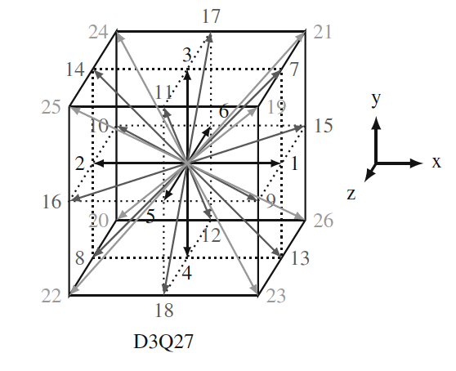
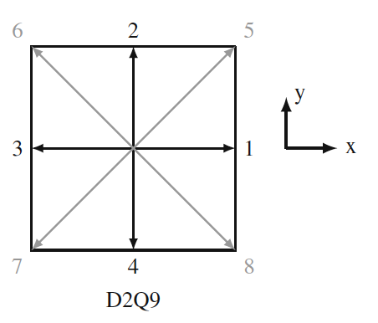
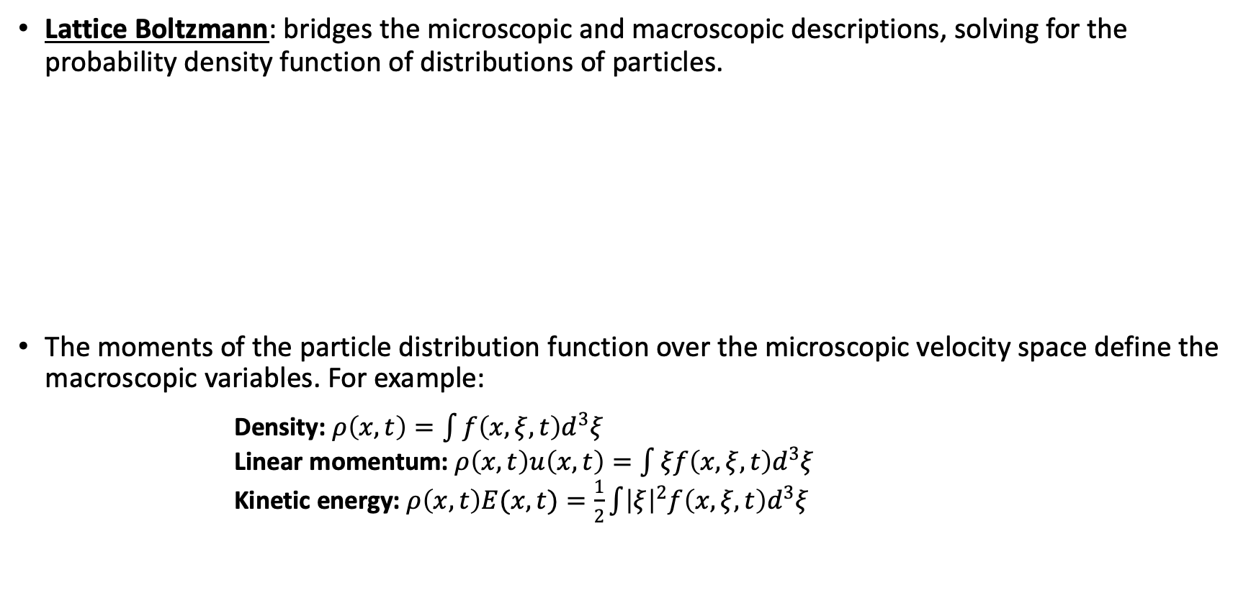
Lattice Boltzmann Formulation
Lattice Boltzmann: bridges the microscopic and macroscopic descriptions, solving for the probability density function of distributions of particles.
The moments of the particle distribution function over the microscopic velocity space define the macroscopic variables. For example:
Density: $ρ\left(x,t\right)=\int{f\left(x,ξ,t\right)d^{3}ξ}$ Linear momentum: $ρ\left(x,t\right)u\left(x,t\right)=\int{ξf\left(x,ξ,t\right)d^{3}ξ}$ Kinetic energy: $ρ\left(x,t\right)E(x,t)=\frac{1}{2}\int{{\left|ξ\right|}^{2}f\left(x,ξ,t\right)d^{3}ξ}$

Slide 6
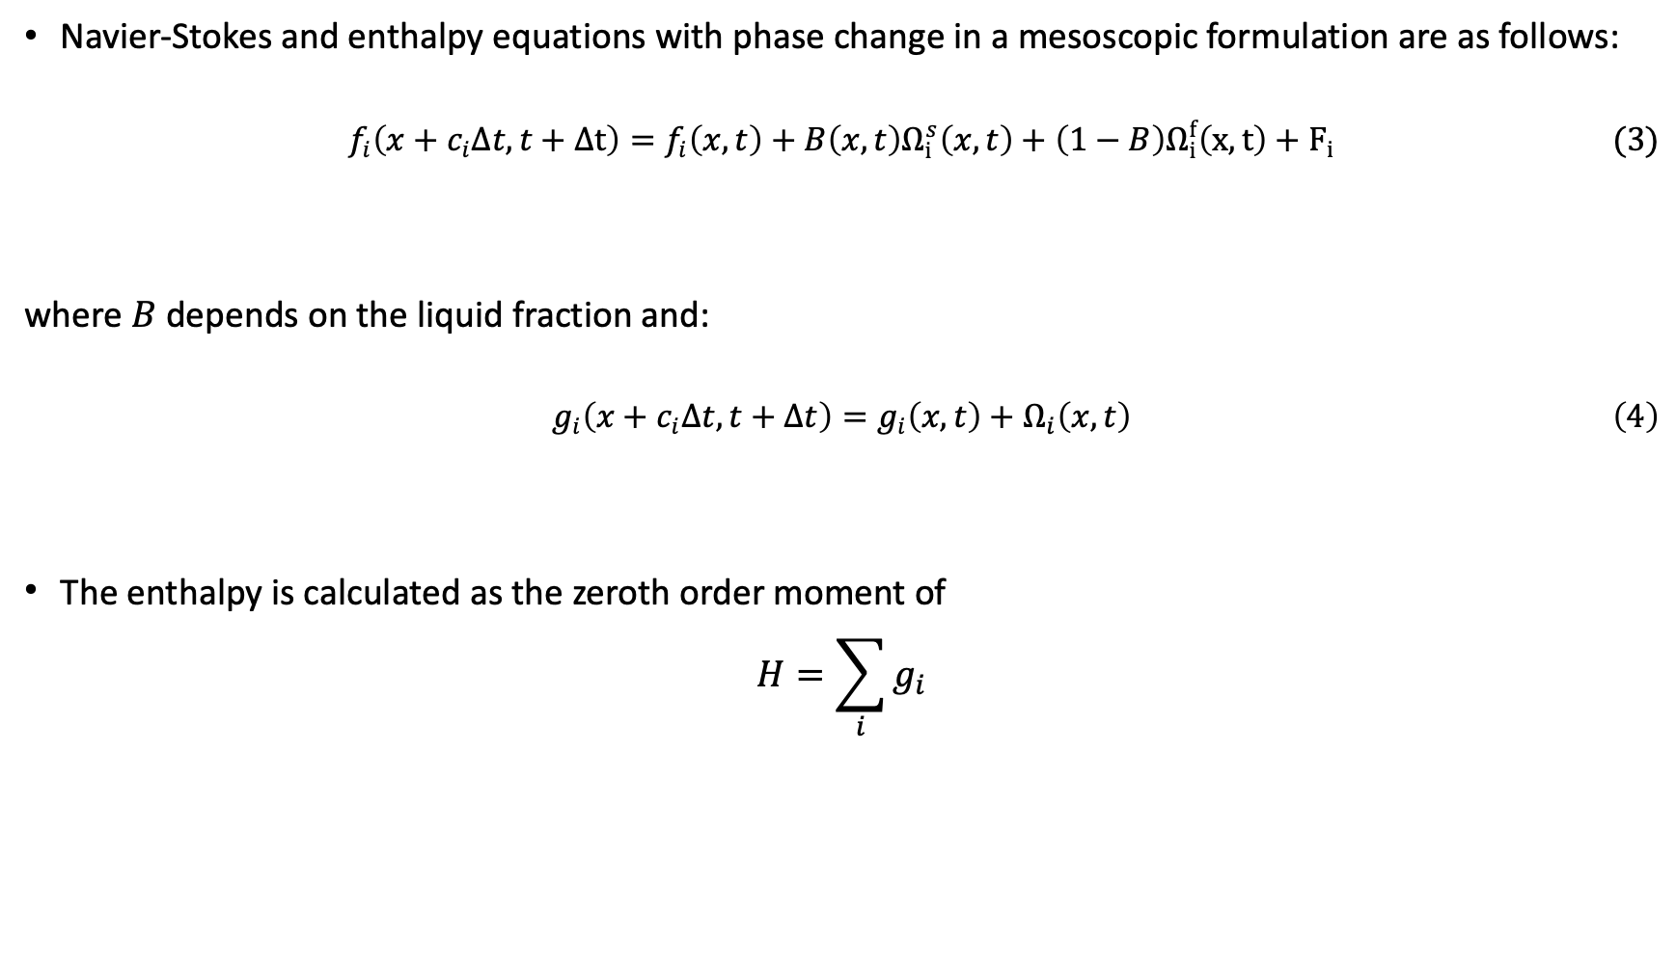
Lattice Boltzmann Equations
Navier-Stokes and enthalpy equations with phase change in a mesoscopic formulation are as follows:
$$\begin{aligned}f_{i}\left(x+c_{i}Δt,t+Δt\right)=f_{i}\left(x,t\right)+B\left(x,t\right)Ω_{i }^{s}\left(x,t\right)+\left(1−B\right)Ω_{i}^{f}\left(x,t\right)+F_{i}\#(3)\end{aligned}$$
where $B$depends on the liquid fraction and:
$$\begin{aligned}g_{i}\left(x+c_{i}Δt,t+Δt\right)=g_{i}\left(x,t\right)+Ω_{i}\left(x,t\right)\#\left(4\right)\end{aligned}$$
The enthalpy is calculated as the zeroth order moment of
$$H=\sum_{i}{g_{i}}$$

Slide 7
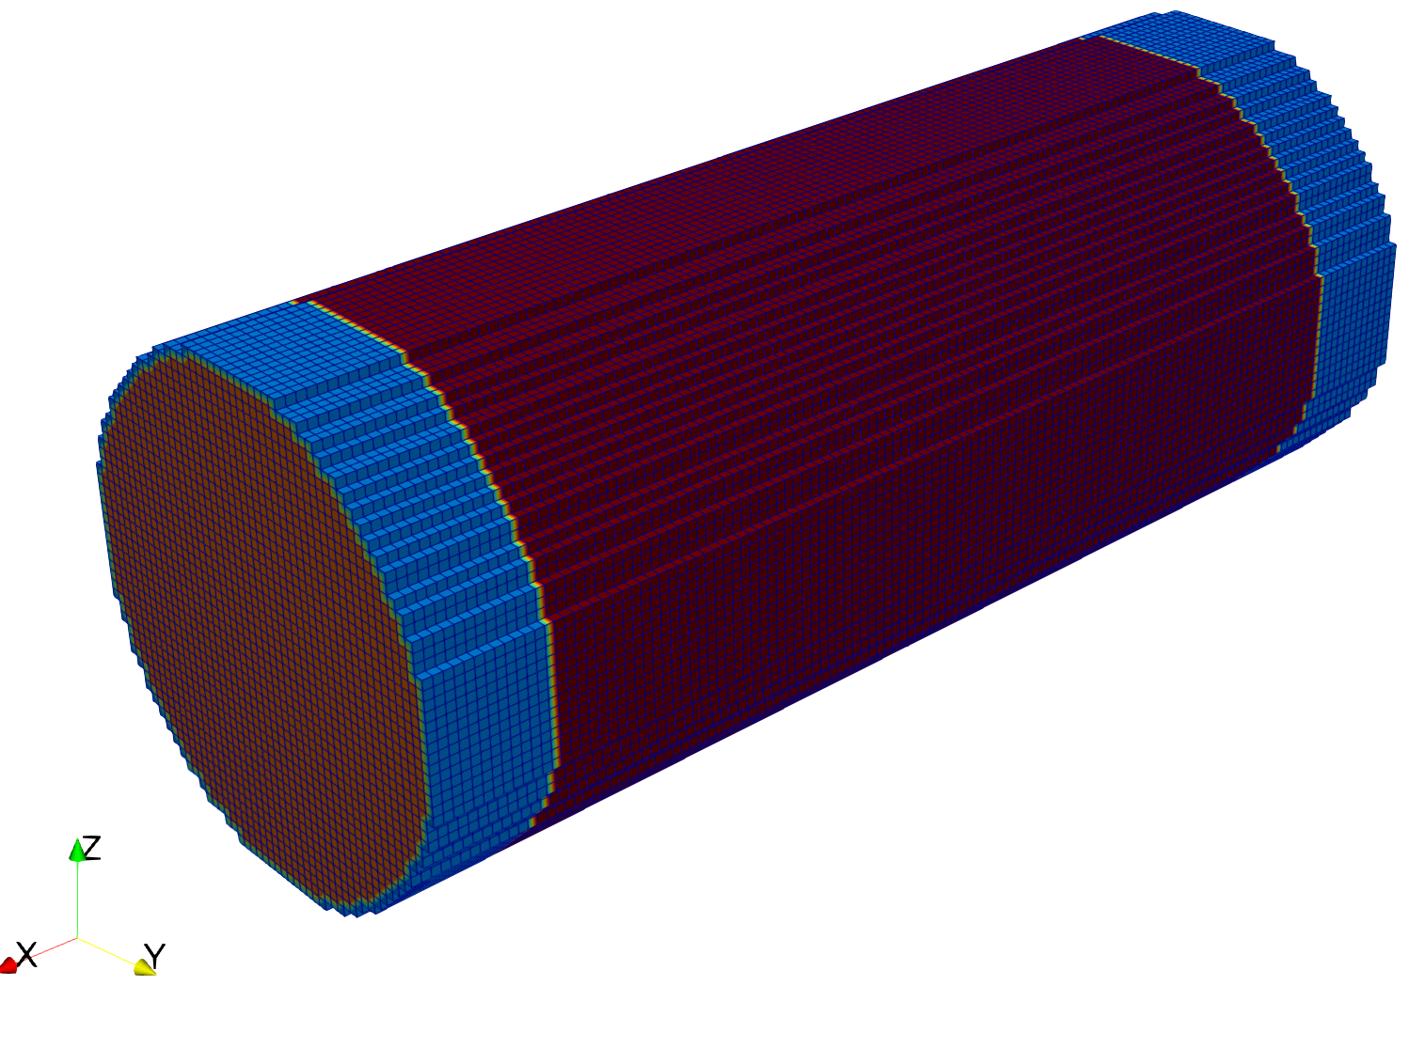
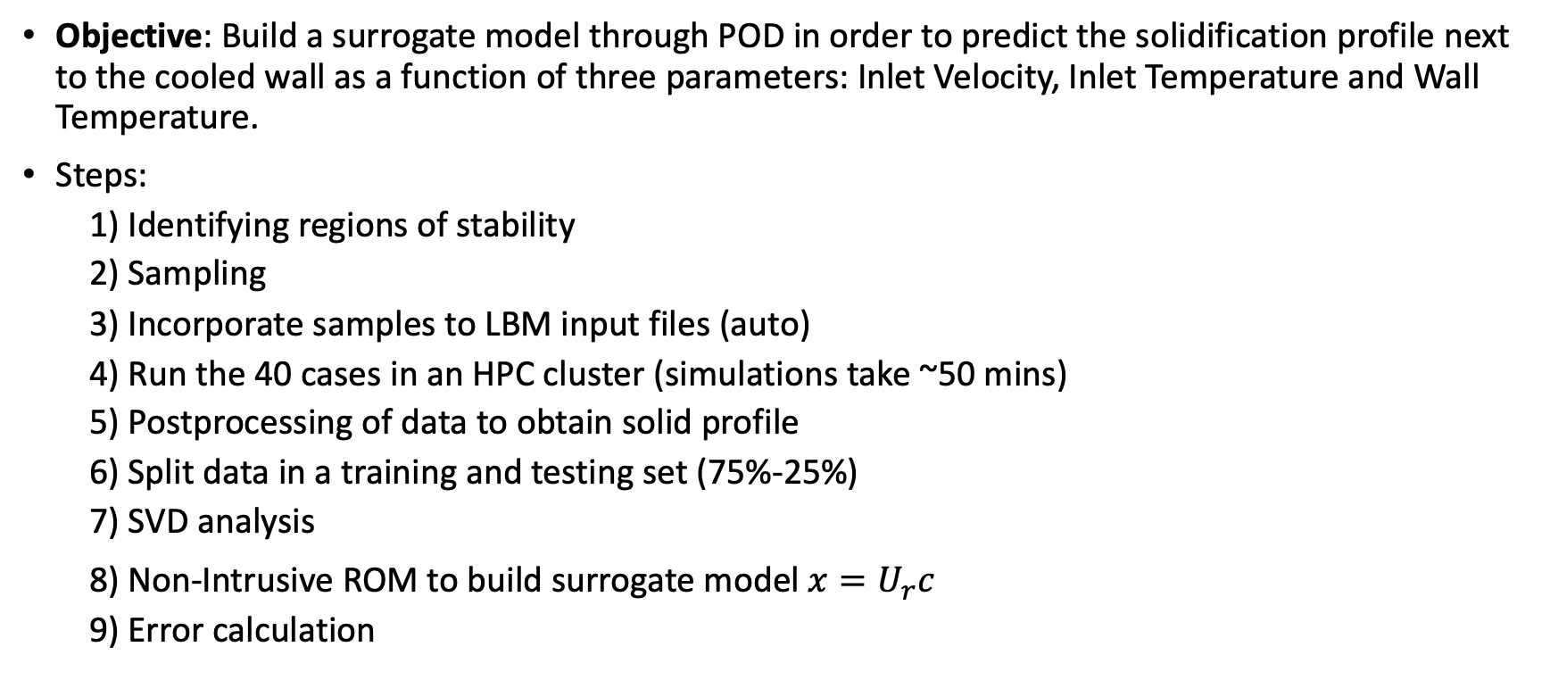
Building a surrogate model: POD analysis
Objective: Build a surrogate model through POD in order to predict the solidification profile next to the cooled wall as a function of three parameters: Inlet Velocity, Inlet Temperature and Wall Temperature.
Steps:
1) Identifying regions of stability
2) Sampling
3) Incorporate samples to LBM input files (auto)
4) Run the 40 cases in an HPC cluster (simulations take ~50 mins)
5) Postprocessing of data to obtain solid profile
6) Split data in a training and testing set (75%-25%)
7) SVD analysis
8) Non-Intrusive ROM to build surrogate model$x=U_{r}c$
9) Error calculation
Cooled section
Inlet
Outlet
~10M cells

Slide 8
ROM Part 1/3
Stabilized solid profile for all simulation cases.
We perform SVD on the 30 training cases and leave 10 for testing.
The drop-off in the eigenvalues is not great, as could be expected.
With the POD, we select 3,5,10 and 15 characteristic modes and
compute the vector of coefficients.
#Modes | Energy (%) | Testing Error(%)
3 | 80.92 | 8.36
5 | 84.4 | 8.62
10 | 90.0 | 8.80
15 | 94.1 | 8.88

Slide 9
ROM Part 1/3
The ROM cannot handle the sharp interfaces, and this should not surprise us.
#Modes | Energy (%) | Testing Error(%)
3 | 80.92 | 8.36
5 | 84.4 | 8.62
10 | 90.0 | 8.80
15 | 94.1 | 8.88
ROM prediction using 10 modes

Slide 10
ROM Part 2/3
Idea: Apply Gaussian Filter to smooth out sharp interfaces.
Now we redo SVD on the filtered training set.
A much faster drop-off is observed.
#Modes | Energy (%) | Error(%)
3 | 95.13 | 5.13
5 | 96.65 | 5.15
10 | 98.69 | 5.16
15 | 99.53 | 5.17

Slide 11
ROM Part 2/3
Observing each test case, we identify that one particular case that has a large deviation when compared with other cases.
Seeking to further improve our model, we now add this case to the training set.
#Modes | Energy (%) | Error(%)
3 | 95.13 | 5.13
5 | 96.65 | 5.15
10 | 98.69 | 5.16
15 | 99.53 | 5.17

Slide 12
ROM Part 3/3
We redo SVD with the new case and take the first 3 modes, as the difference is not considerable after the third mode.
The prediction error by our surrogate model decreases even further.
#Modes | Energy (%) | Error(%)
3 | 95.00 | 3.54
5 | 96.59 | 3.56
10 | 98.69 | 3.56
15 | 99.53 | 3.58

Slide 13
ROM Part 3/3
The final ROM predictions for the test cases are plotted next.

Slide 14
ROM Part 3/3

Slide 15
Conclusions
A surrogate model has been built in order to predict the spatial shape of the solidification profile in a cooled pipe for lead coolant.
It is important to clarify that the range of applicability of this model is limited by the magnitude of the Reynolds number, as we are now modeling laminar flow. Also, a full blockage of the pipe has not been considered in this study. This might require further analyses.
We might want to either refine the mesh further and pay the computational cost in order to train the surrogate model without the need of filtering.
The ROM could allow us to build a correlation for the maximum solid thickness blocking the pipe without the cost of a full model.

