Slide 1
Mixing Length Model + Wall function Validation in a Channel Turbulent Flow

Slide 2
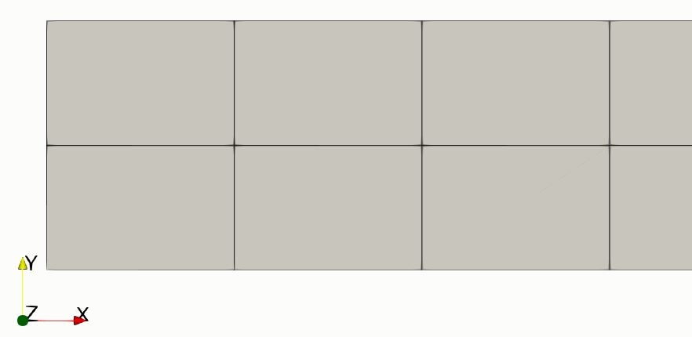
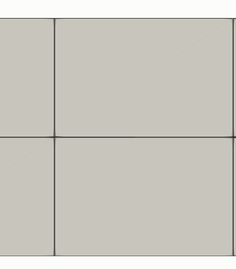
Channel Flow Boundary Conditions
Wall
Wall
Inlet
Outlet
Symmetry
Symmetry

Slide 3
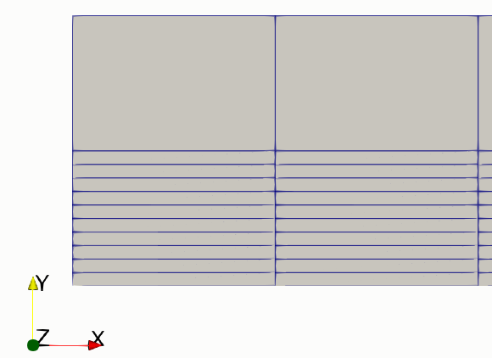
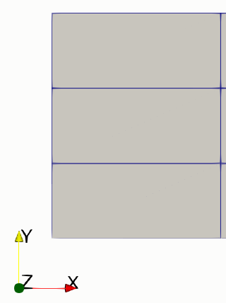
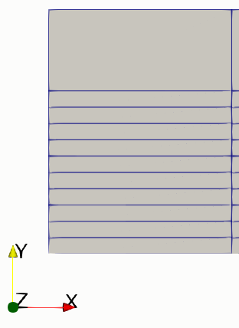
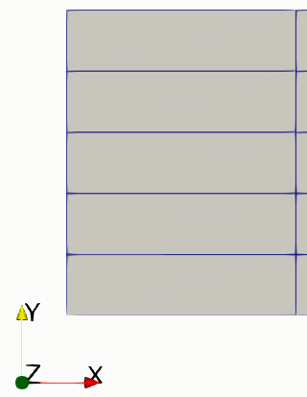
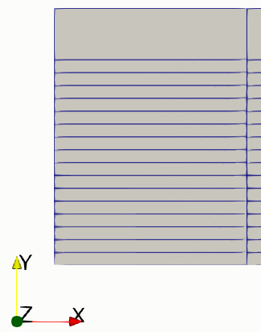
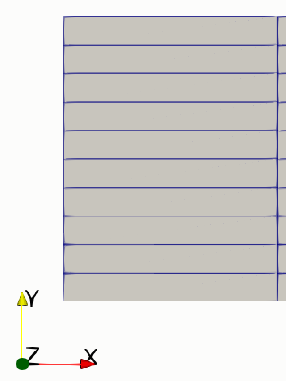
Meshes
1_Coarse
1_Fine
2_Coarse
2_Fine
3_Coarse
3_Fine
4_Coarse
4_Fine

Slide 4
Re_t 180 (Re~5600)
Mesh | Y+ | U+ | U+_DNS | Error | Tau (x1e-3) | Tau_STAR(x1e-3) | Error
1_Coarse | 43.41 | 14.43 | 14.94 | 3.4% | ﻿3.845 | 4.1634 | 7.6%
1_Fine | 44.31 | 14.48 | 14.99 | 3.4% | ﻿4.0068 | 4.1634 | 3.8%
2_Coarse | 28.63 | 13.39 | 13.71 | 2.3% | ﻿3.7709 | 4.1634 | 9.4%
2_Fine | 29.31 | 13.45 | 13.79 | 2.4% | ﻿3.9536 | 4.1634 | 5%
3_Coarse | 17.03 | 12.09 | 11.53 | 4.9% | ﻿3.698 | 4.1634 | 11.2%
3_Fine | 17.45 | 12.15 | 10.74 | 4.4% | ﻿3.8847 | 4.1634 | 6.7%

Slide 5
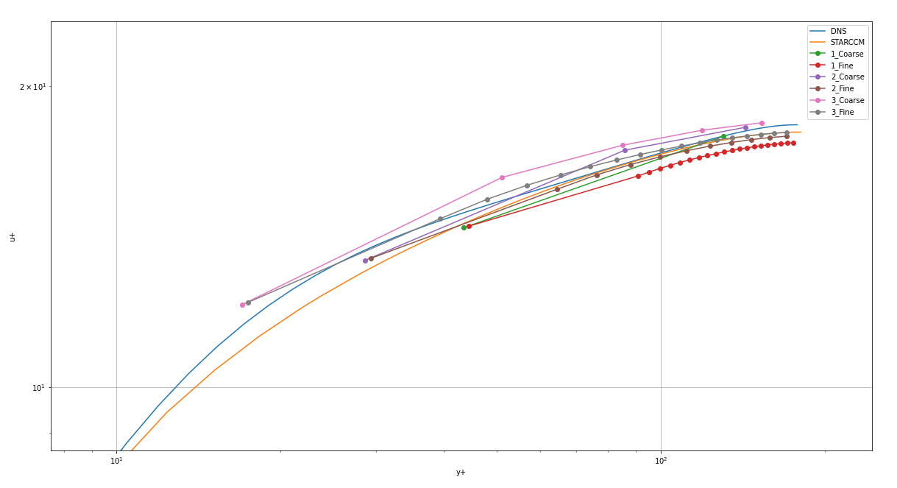
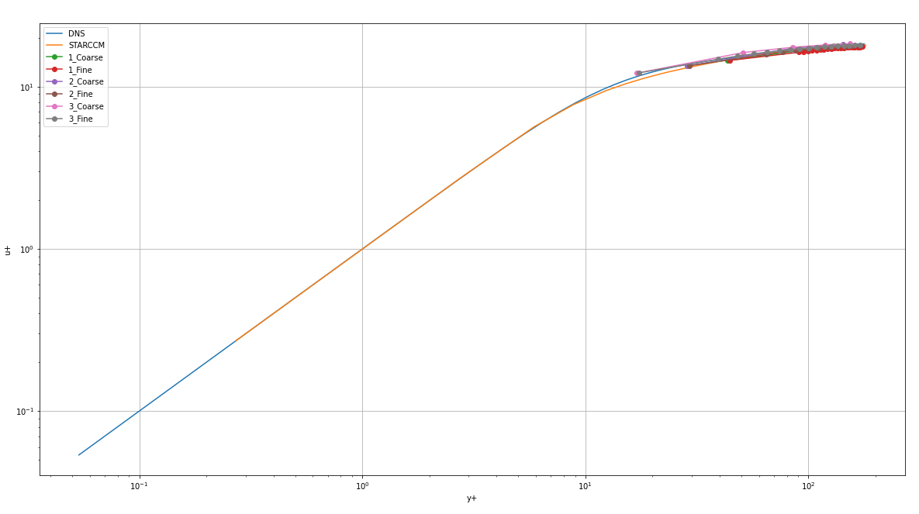
Re_t 180

Slide 6
Re_t 395 (Re~13700)
Mesh | Y+ | U+ | U+_DNS | Error | Tau (x1e-3) | Tau_STAR(x1e-3) | Error
2_Coarse | 62.3 | 15.34 | ﻿13.38 | 0.3% | ﻿2.9841 | 3.14 | 4.9%
2_Fine | 63.76 | 15.39 | 15.43 | 0.25% | ﻿3.1253 | 3.14 | 0.46%
3_Coarse | 36.94 | 14.03 | 14.09 | 0.46% | ﻿2.9089 | 3.14 | 7.35%
3_Fine | 37.86 | 14.09 | 14.17 | 0.5% | ﻿﻿3.0552 | 3.14 | 2.7%
4_Coarse | 18.31 | 12.27 | 11.62 | 5.6% | ﻿2.8564 | 3.14 | 9.03%

Slide 7
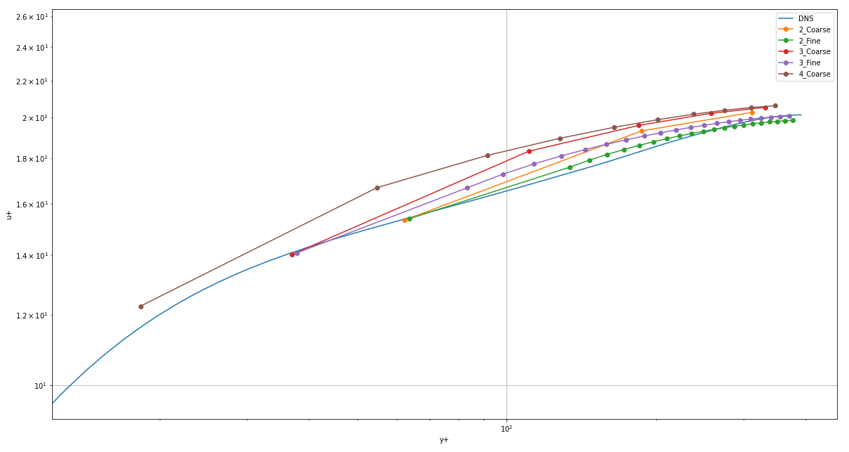
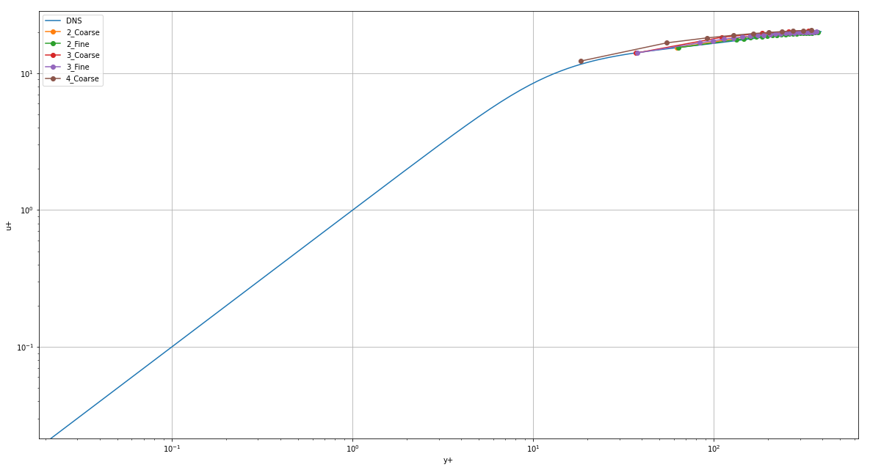
Re_t 395

Slide 8
Re_t 590 (Re ~22600)
Mesh | Y+ | U+ | U+_DNS | Error | Tau (x1e-3) | Tau_STAR(x1e-3) | Error
2_Coarse | 93.0 | 16.34 | 16.37 | 0.17% | ﻿2.6762 | 2.7439 | 2.5%
2_Fine | 95.1 | 16.39 | 16.42 | 0.16% | ﻿2.7982 | 2.7439 | 2.0%
3_Coarse | 55.1 | 15.03 | 15.14 | 0.74% | ﻿2.6061 | 2.7439 | 5.0%
3_Fine | 56.5 | 15.09 | 15.20 | 0.72% | ﻿2.7334 | 2.7439 | 0.4%
4_Coarse | 27.3 | 13.27 | 13.21 | 0.44% | ﻿2.5474 | 2.7439 | 7.2%
4_Fine | 27.8 | 13.32 | 13.27 | 0.32% | ﻿2.6434 | 2.7439 | 3.7%

Slide 9
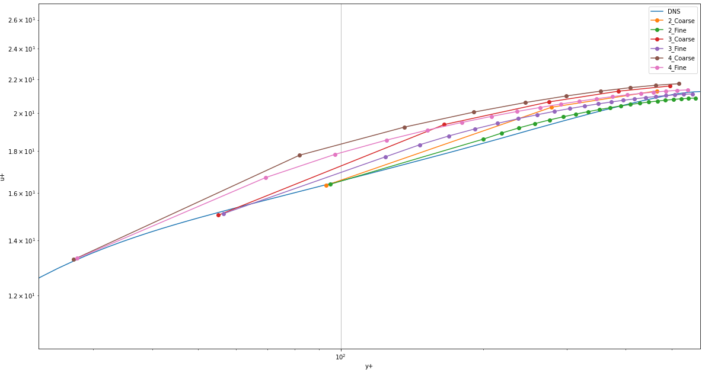
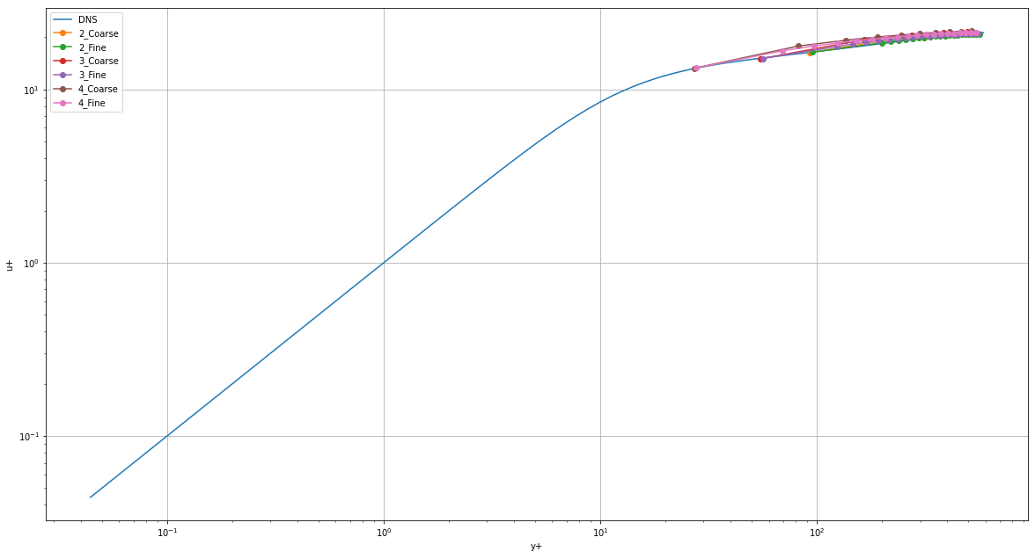
Re_t 590

Slide 10
Observations
The wall function must be used with y+>30. Failure to do so provide wrong wall shear stresses and velocity profiles.
Refining the bulk improves the prediction of the wall shear stress and slightly improves the velocity prediction.
The wall function formulation works better for high Reynolds numbers. The log law of the wall is not followed for low Reynolds numbers.

Slide 11
References
Moser, R. D., Kim, J., & Mansour, N. N. (1999). Direct numerical simulation of turbulent channel flow up to Re τ= 590. Physics of fluids, 11(4), 943-945.

