Slide 1
Gamma
A Minkowski Spacetime
Diagram Generator

Slide 2
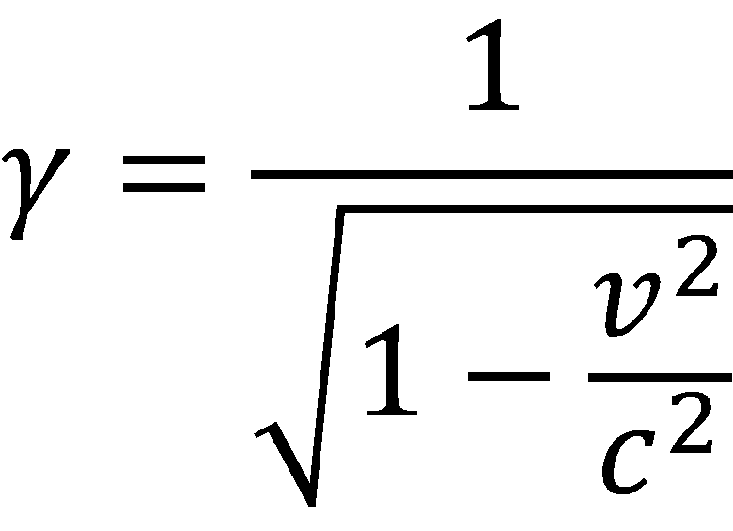
Gamma

Slide 3
Goals
Generate most spacetime diagrams
Used as a teaching and learning tool
Usable for creating diagrams for physics papers and books

Slide 4
In this video, I will
Demonstrate the basic features
Walk through a few more complex examples
Show how to create some simple diagrams

Slide 5
Twins paradox v1
obs = [observer
velocity 0 time 0,
velocity .8 distance 4,
velocity -.8 distance 4,
velocity 0];

Slide 6
Twins paradox v1
obs = [observer
velocity 0 time 0,
velocity .8 distance 4,
velocity -.8 distance 4,
velocity 0];
grid ;
axes ;
worldline obs;

Slide 7
Twins paradox v2
display origin: (10, 10), scale: 8;
obs = [observer
velocity 0 time 0,
velocity .8 distance 4,
velocity -.8 distance 4,
velocity 0];
grid ;
axes ;
worldline obs;

Slide 8
Twins paradox v3
display origin: (10, 10), scale: 8;
obs = [observer
velocity 0 time 0,
velocity .8 distance 4,
velocity -.8 distance 4,
velocity 0];
animation ;
animate t = 0 to dToT(8, obs) step .1;
grid ;
axes ;
worldline obs;
event (tToX(t, obs), t);

Slide 9
Twins paradox v4
display origin: (50, 50), scale: 4;
obs = [observer
velocity 0 time 0,
velocity .8 distance 4,
velocity -.8 distance 4,
velocity 0];
animation ;
animate t = 0 to dToT(8, obs) step .1;
grid ;
axes ;
worldline obs;
event (tToX(t, obs), t);
frame [frame observer obs at time t];

Slide 10
Alpha
I’m looking for reviewers
Feature check: what works, what doesn’t, what could be improved
Enhancements
Bug reports

Slide 11
Contact
gamma@freixas.org

