Slide 1
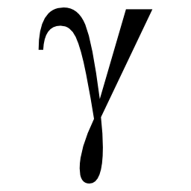
A Sneak Peak at
Gamma
A Minkowski 2D Spacetime
Diagram Generator

Slide 2
Demo of basic features
Demo of two complex diagrams
Overview of key features

Slide 3
Drawing Commands
axes
grid
hypergrid
event
line
worldline
path
label

Slide 4
Other Commands
display
frame
animation

Slide 5
Objects
path
bounds
interval
coordinate
observer
frame
line

