Slide 1

The most essential feature of the internet

Slide 2
The most essential feature of the internet is
to publish to the world
Notes:
I’ll now teach you how to publish to the world. How to make your app accessible from everywhere.

Slide 3

Notes:
You already know your development environment.

Slide 4

publish your code
git push
Notes:
You know now how publish your code, so that everybody can see it. This is what you’ve just learned from WHO.
I’m going to show how to publish your app, so that everyone can use it.
You’ll see this is similar and super easy!

Slide 5

publish your app
Production
Environment
Hosting Server
???
Notes:
You need a Service Provider, who provides you a server to host your app.
A server is just a computer that is connected to a very fast internet connection and is always on.
Sounds complicated, but isn’t!

Slide 6

publish your app
Production
Environment
git push heroku master
Notes:
With the service provider “heroku” you can deploy your app with a simple git command.
Heroku is one of the simplest way to deploy your app. (Deploy means to copy to the server)
It lets you focus on your super power – developing awesome apps – you don’t need to know anything about webservers nor clout computing!

Slide 7



get started
Prepare Gemfile
# Gemfile
group :development do
gem 'sqlite3'
end
group :production do
gem 'pg'
end
Development
Production
Dont forget to bundle install
Notes:
When getting started with heroku, you need to know that heroku uses a different database than your development environment.
Your development computer uses SQLite as database but heroku uses PostreSQL.
Rails can handle different environment by default. Like test, development and production. This way you can steer behavior.
You just need to add this to the Gemfile to let Rails know which database is used where.
Whenever you change your Gemfile - don’t forget to bundle! – I’ll show you in a minute what that means.

Slide 8
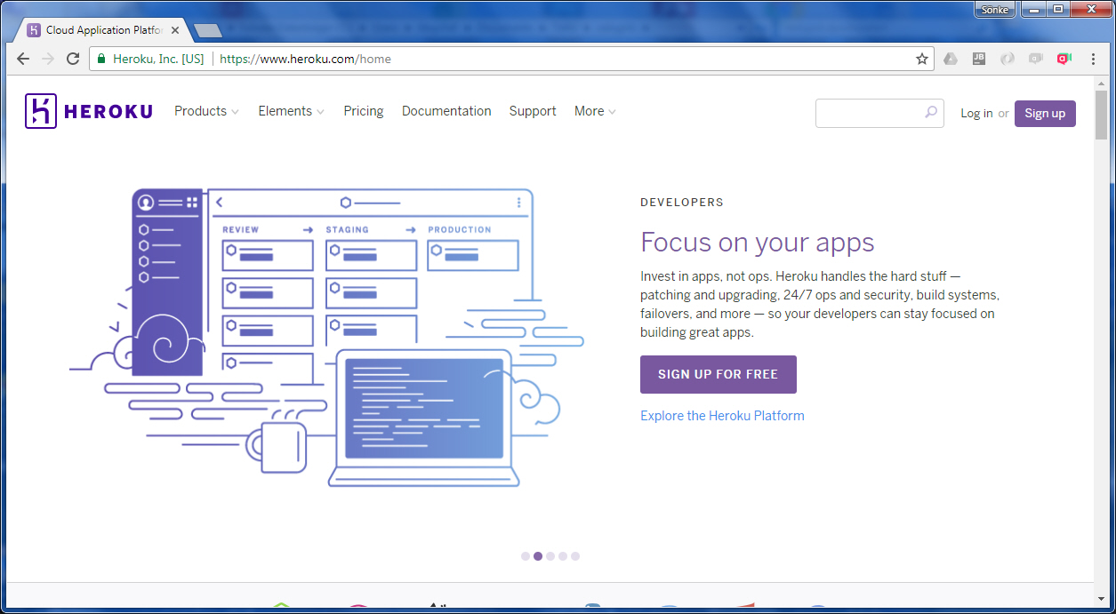
get started
Sign up at heroku.com
Notes:
To use heroku, you obviously need to signup – but don’t mind, for your purposes it is for free

Slide 9
publish your app
Production
Environment
It is just 2 steps
1. Create the app online (just once)
$> heroku create
git push heroku master
2. Push/update your app online $> git push heroku master
Notes:
After your Gemfile is updated and bundled you can create a new instance on heroku and deploy your code.

Slide 10
let me show that by live coding

Slide 11
wrap-up
Production
Environment
Sign up at heroku.com
Prepare your Gemfile
In the console: $> heroku create $> git push heroku master
git push heroku master
# Gemfile
group :development do
gem 'sqlite3'
end
group :production do
gem 'pg'
end
Notes:
How do get started?
Sign up for free at heroku.com
Prepare your Gemfile to deal with herokus PostgrSQL database (don’t forget to bundle)
Go to the console, create a new app on heroku, and push your app to heroku
Whenever you want to publish a new version of your app, just use “git push heroku master”

