Slide 1



Deep Learning
AA 2025-2026 2nd Semester
Alessio Ansuini, Area Science Park
Michele Alessi, UniTS

Slide 2
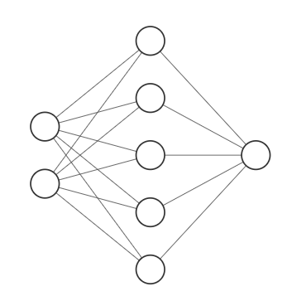
From “shallow”...

Slide 3
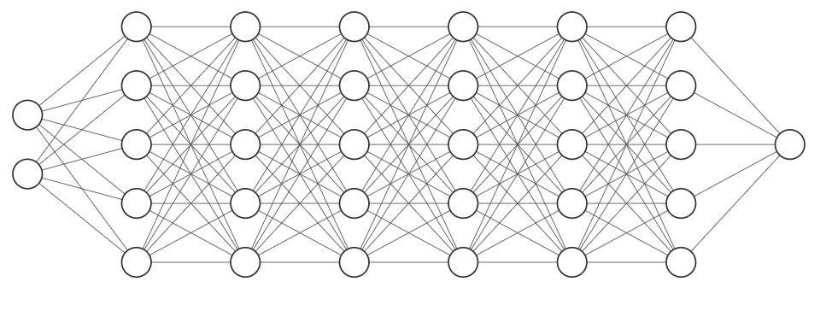
… to deep

Slide 4
Deep Networks

Slide 5
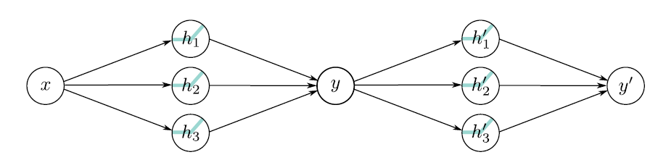
Composition of shallow networks

Slide 6
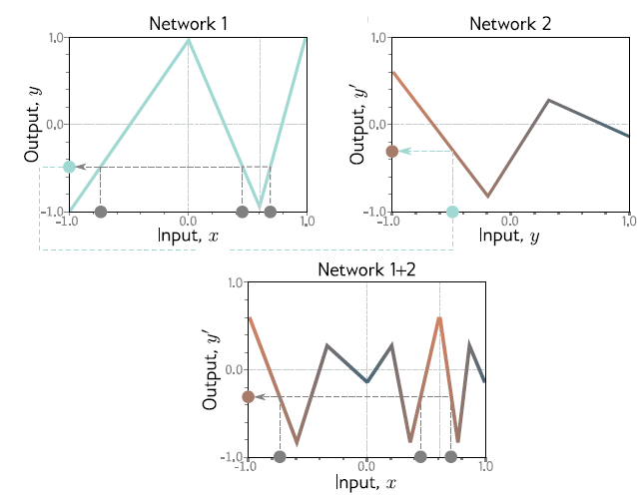
Composition of shallow networks

Slide 7
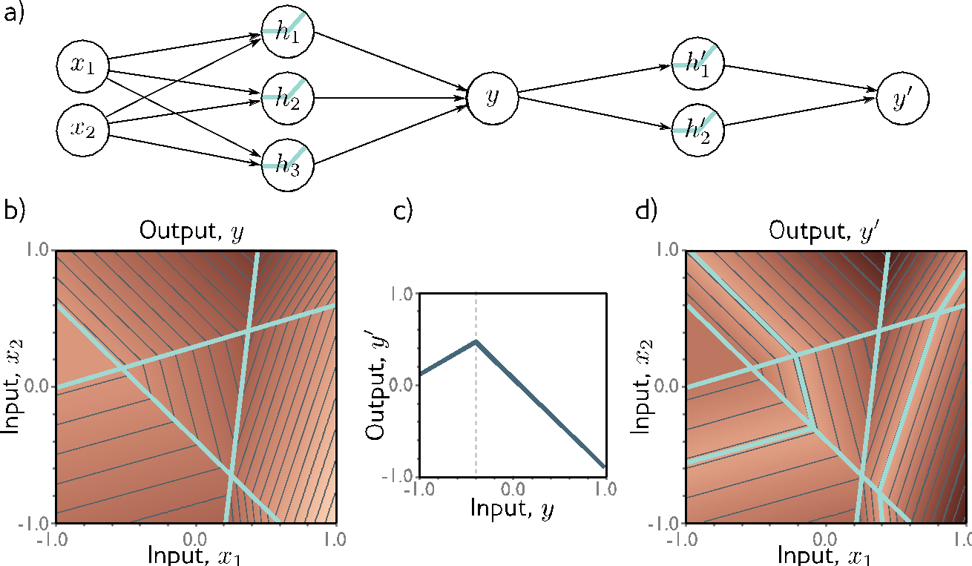
In 2-dimensions

Slide 8
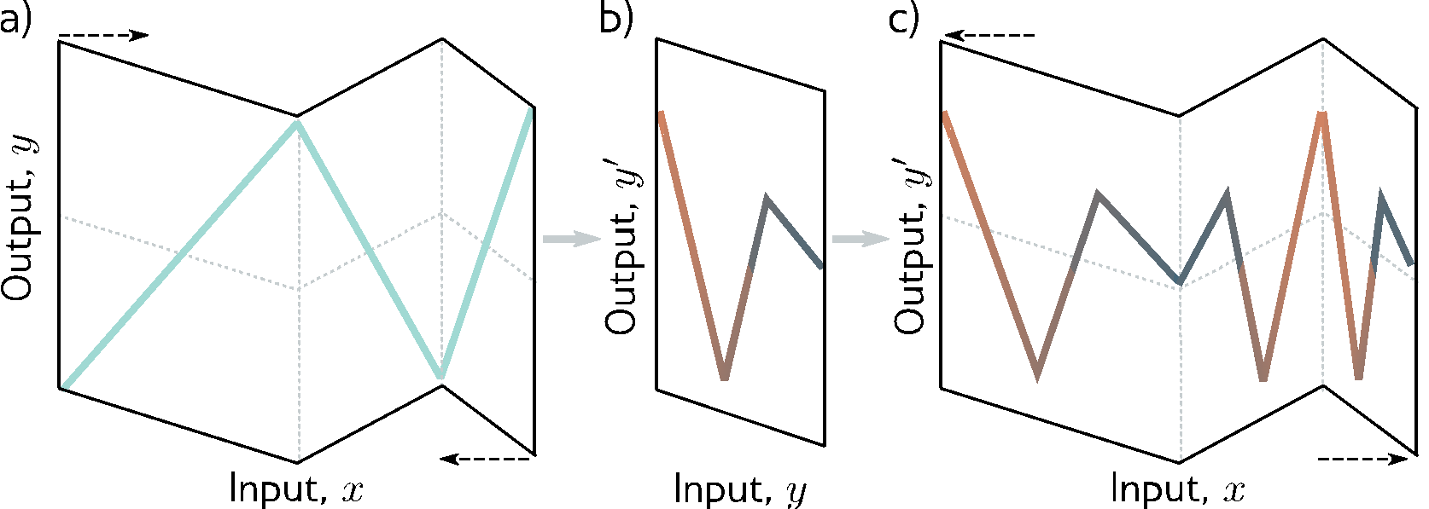
“Folding” input space

Slide 9
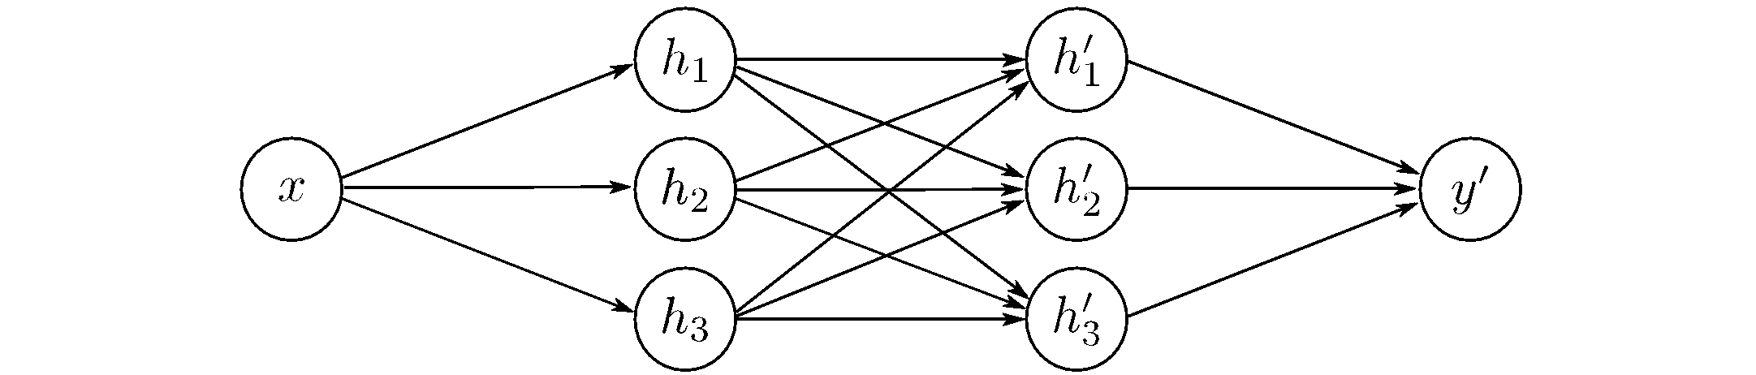
Exercise: reinterpretation of a 1-3-1-3-1 network as 2-layer deep network 1-3-3-1

Slide 10
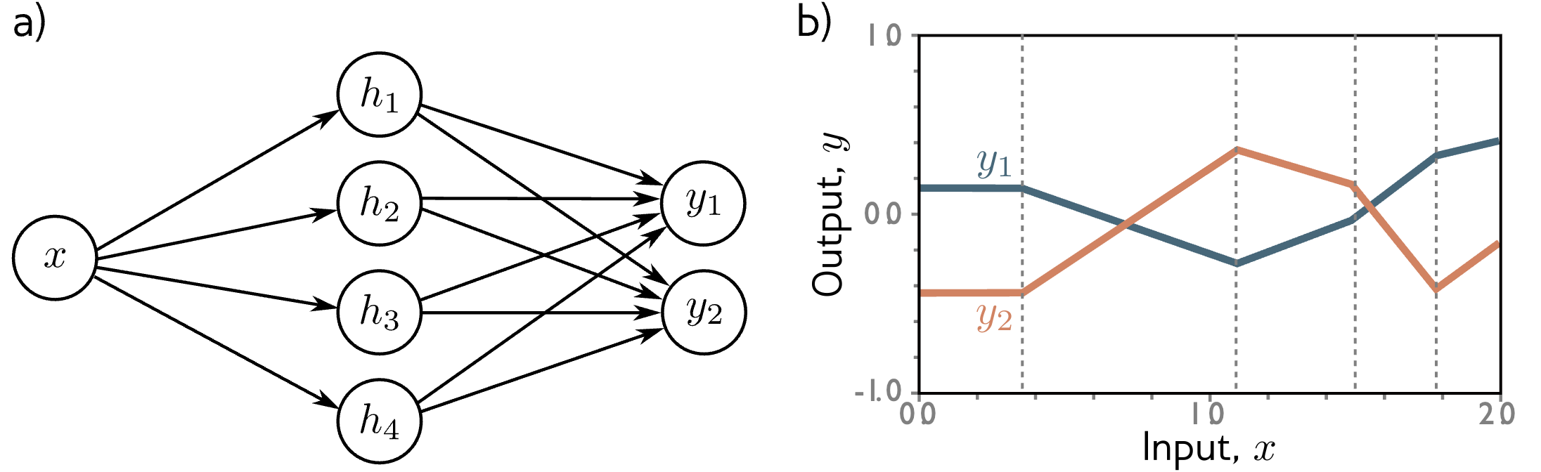
Flow of the computation in a generic deep network
Premise: piecewise linear with same joints!

Slide 11
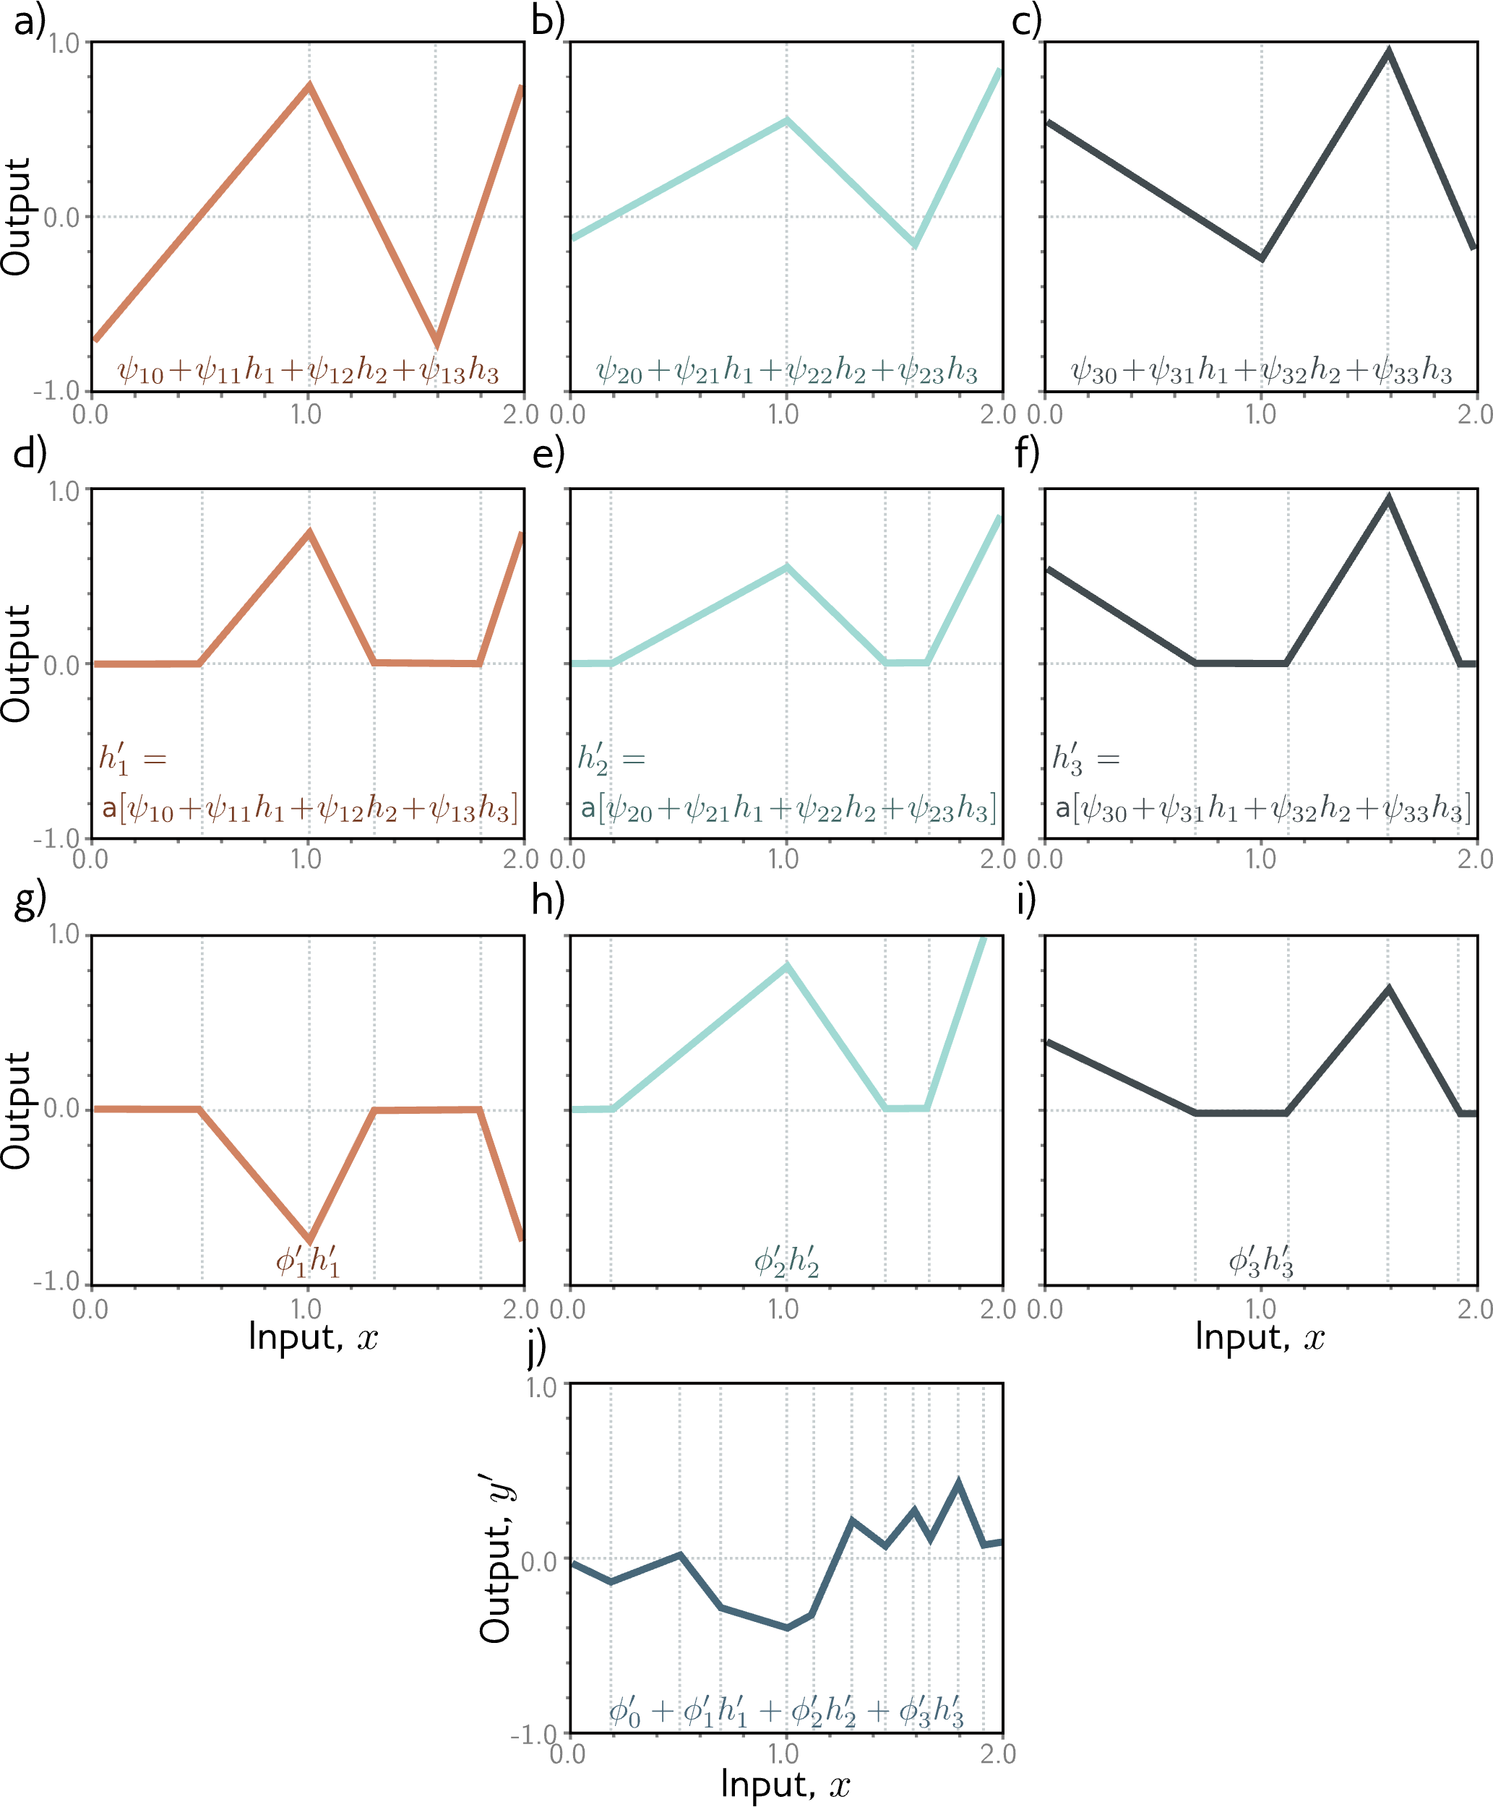

Slide 15
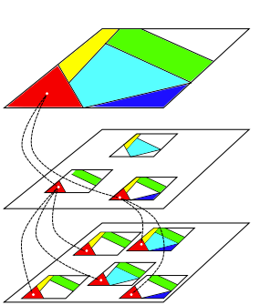
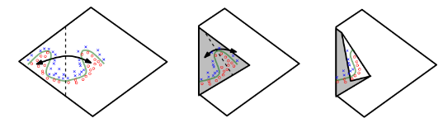
The “folding interpretation”
On the number of linear regions...

Slide 16
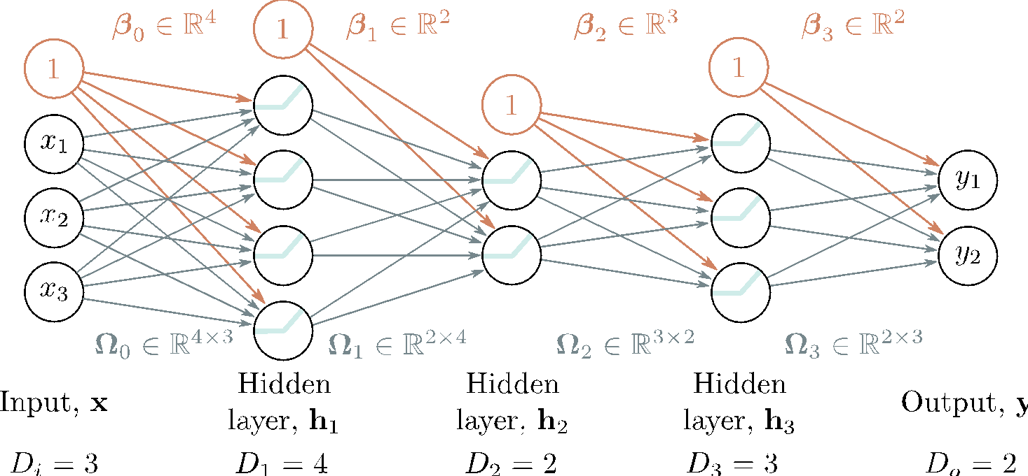
Generic MLP

Slide 17
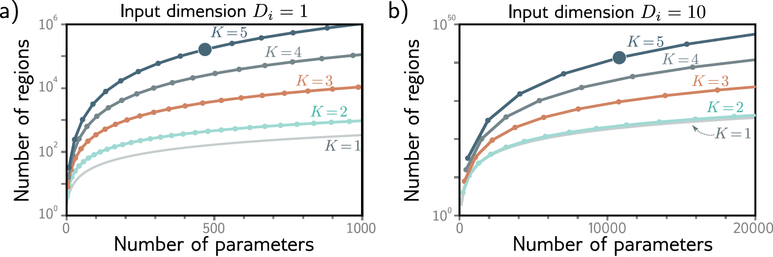
Linear regions in deep networks

Slide 18
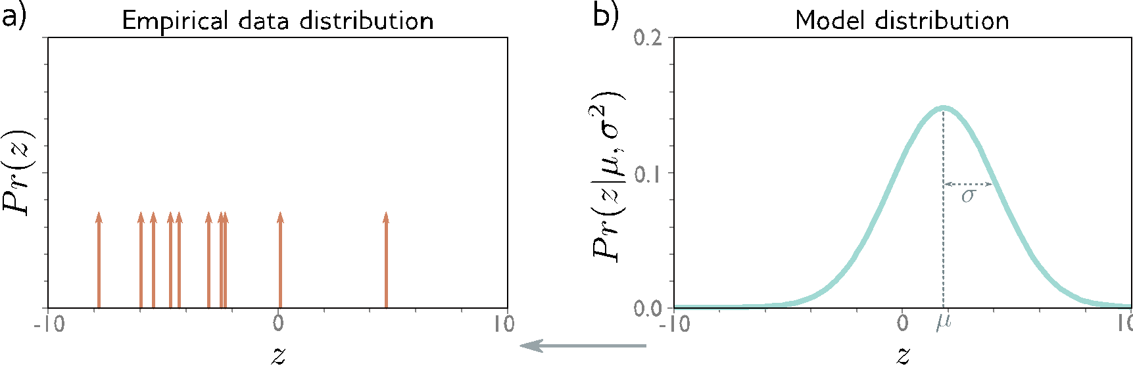
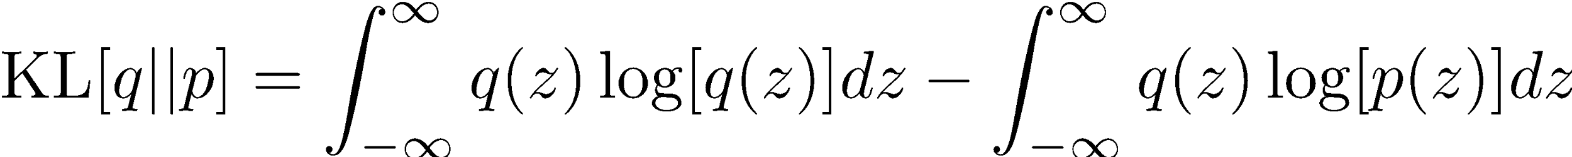
Information-theoretical perspective on MLE and loss functions
Kullback-Leibler Divergence -- a measure between probability distributions

