Slide 1
Exploring New York Airbnb

Slide 2
Introduction
Hotels have been dominating the industry
With the rise of Airbnb, the power has begun to shift
With so many Airbnb around, how do we choose?

Slide 3
Data
Data will be obtained from Kaggle
A few features will be omitted
Main features we will be using are price, room type and number of reviews

Slide 4
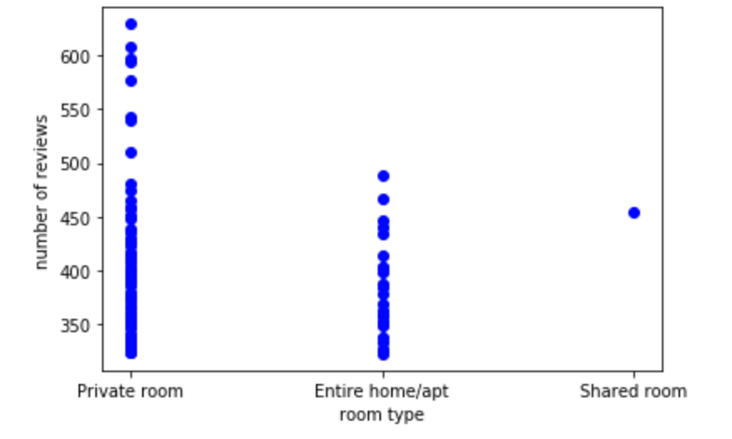
Number of reviews compared to Room type

Slide 5
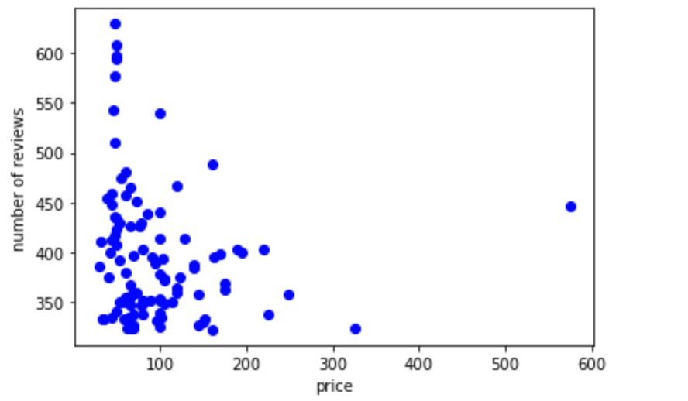
Number of reviews compared to Price

Slide 6
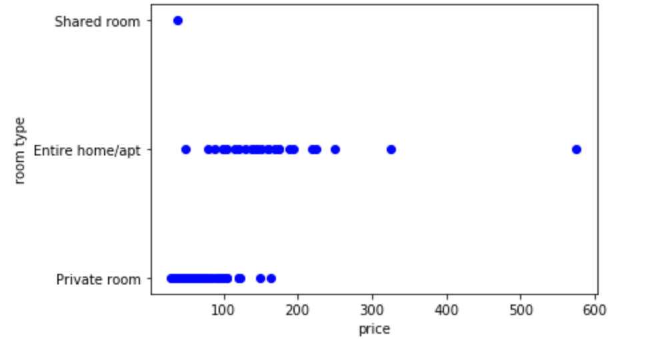
Room type compared to Price

Slide 7
Discussion
Many factors affect us when we choose an Airbnb
Variables chosen for this analysis happen to be the top few criteria we look for in an Airbnb
Distinct difference from hotels such as customer service

Slide 8
Conclusion
Airbnb will continue to rise against hotels
Airbnb is a revelation to the accommodation industry and will be here to stay
Renting a room or apartment has never been easier!

