Slide 1
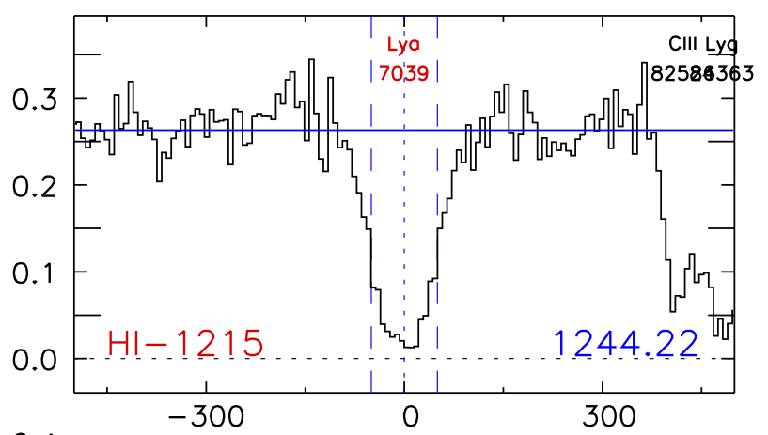
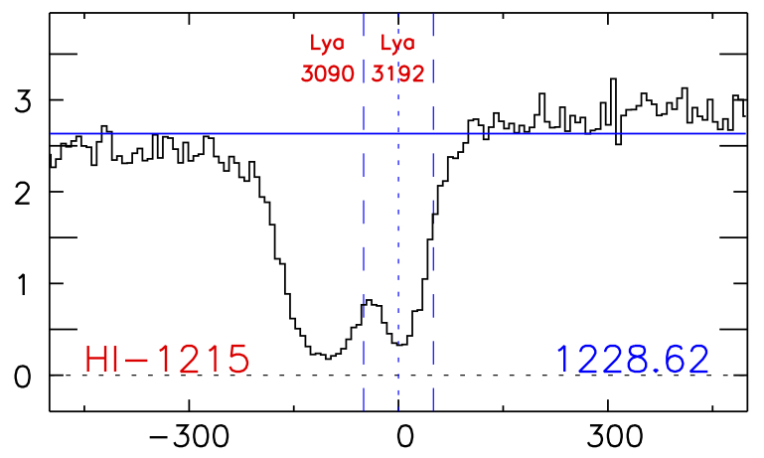
How are Lyα absorbers distributed around galaxies?
David French¹, Bart Wakker¹
Contact: frenchd@astro.wisc.edu
1. University of Wisconsin - Madison
Lya in SDSSJ130524.30+035731.0
ABSTRACT:
Lya in MRK290
The distribution of gas around galaxies provides key insights to the mechanisms of accretion and feedback, and understanding it is necessary to create a cohesive theory of galaxy evolution. We are conducting a large survey of Lyα absorbers as a function of galaxy environment in the nearby universe (cz <= 10,000 km/s) using archival QSO spectra from the Cosmic Origins Spectrograph (COS) on HST. By correlating the strength each absorber with the properties of nearby galaxies we can build a picture of the the circumgalactic medium, and the general distribution of gas in the Universe. We present results from an initial sample of 43 COS sightlines, chosen for their proximity to large (D > 25 kpc) galaxies and high signal-to-noise (S/N >11).
ABOVE: Detected absorption at v = 7039 km/s in the SDSSJ130524.30+035731.0 sightline with corresponding map of the absorber environment. TOP: All galaxies within 400 km/s of absorber and 500 kpc in physical impact parameter are included. Inclination, position angle and size of galaxies is illustrated by ellipse major/minor axis, orientation, and relative size (actual size x10).
ABOVE: Detected absorption at v =3090 and 3192 km/s in the MRK290 sightline with corresponding map of the absorber environment. TOP: All galaxies within 400 km/s of absorber and 500 kpc in physical impact parameter are included. Inclination, position angle and size of galaxies is illustrated by ellipse major/minor axis, orientation, and relative size (actual size x10).
ABOVE: Equivalent width (EW) plotted against impact parameter. No significant correlation is seen, suggesting that the larger galaxies harbor larger concentrations of circumgalactic gas.
LEFT: The EW of absorbers is plotted against the impact parameter (ρ) to each associated galaxy, normalized by the galaxy virial radius (R_{vir}). Color indicates if the absorber has lower velocity (blue) or higher velocity than the associated galaxy. Weakly absorbing systems occur at all impact parameters, however the average EW tends to increase with decreasing ρ/R_{vir}.
ABOVE: EW plotted as a function of galaxy inclination, with 50th and 90th percentile histograms shown in solid-black and dashed-purple. Most absorbers are found near highly inclined galaxies, and the highest EW absorbers occur between inclinations of 45 and 75 degrees.
LEFT: Distributions of galaxy inclinations. Red depicts galaxies nearby red shifted absorption, blue depicts galaxies nearby blue shifted absorption, and green for all galaxies with cz < 10000 km/s. Absorbers are found preferentially around more highly inclined galaxies
CONCLUSIONS:
We measure 51 Lyα absorbing systems in 35 QSO sightlines in the redshift range of 0-0.033 (cz = 0-10,000 km/s). Each has been paired with a large (diameter ≥ 25 kpc) galaxy found within a 500 kpc impact parameter and 400 km/s in velocity.
Lyα equivalent width (W) increases with decreasing impact parameter most strongly when normalized by galaxy virial radius.
71% of galaxies associated with Lyα absorption are highly inclined (>50°), compared to 56% of all galaxies in this redshift range.
Red shifted absorbers (with respect to the associated galaxies) tend toward lower W.
Average W(red shifted) = 192 mÅ
Average W(blue shifted) = 366 mÅ
Slight preference for Lyα absorption along major axis - 68% of associated galaxies have azimuth angles < 50°.
Average azimuth = 42°
Median azimuth = 39°
Acknowledgements: This research has made use of the NASA/IPAC Extragalactic Database (NED) which is operated by the Jet Propulsion Laboratory, California Institute of Technology, under contract with the National Aeronautics and Space Administration.
References: Danforth et al. 2014, arXiv1402.2655D; Kacprzak, G.G., et al. 2012, ApJL, 760, L7; McLin, K. et al. 2002, ApJL, 574, L115; Oppenheimer, B.D. et al. 2012, MNRAS, 420, 829; ; Prochaska, J.X. 2011, ApJ, 740, p.91; Rudie, G.C., et al. 2012, ApJ, 750, p.67; Shull, J.M., Smith, B.D., & Danforth, C.W. 2012, ApJ 759, 23; Tully, R.B. et al. 2013, AJ, 146, 86; Wakker B.P. & Savage B.D. 2009, ApJs, 182, p.378

