Slide 1
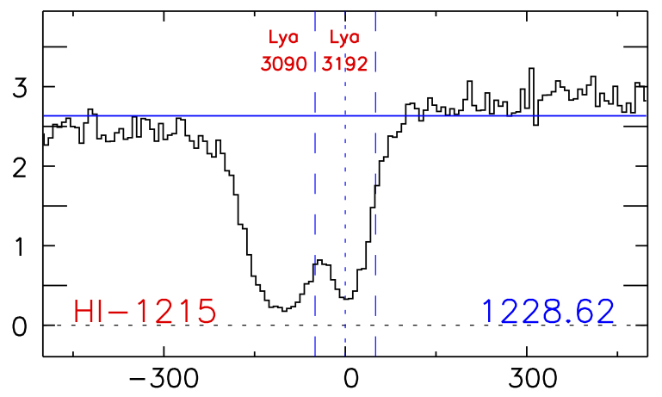
How are Lyα absorbers distributed around galaxies?
David French¹, Bart Wakker¹
Contact: frenchd@astro.wisc.edu
1. University of Wisconsin - Madison
Lyα in MRK290
Abstract:
Likelihood Method:
The distribution of gas around galaxies provides key insights to the mechanisms of accretion and feedback, and understanding it is necessary to create a cohesive theory of galaxy evolution. We are conducting a large survey of Lyα absorbers as a function of galaxy environment in the nearby universe (cz <= 10,000 km/s) using archival QSO spectra from the Cosmic Origins Spectrograph (COS) on HST. By correlating the strength each absorber with the properties of nearby galaxies we can build a picture of the the circumgalactic medium, and the general distribution of gas in the Universe. We present results from an initial sample of 35 COS sightlines, chosen for their high signal-to-noise (S/N >11) and proximity to large (D > 25 kpc) galaxies.
It is often ambiguous how or why a particular galaxy is paired with nearby absorption. In order to make this decision process more robust and reproducible, we have developed a likelihood based method defined as follows:
where ρ is the impact parameter to the galaxy, R_{vir} is the galaxy virial radius, and Δv = v_{galaxy} – v_{absorber}, the difference in heliocentric velocity between the galaxy and the absorption feature. is calculated for every galaxy within 400 km/s in Δv and 500 kpc in ρ of an absorption line. A galaxy is paired with an absorber only if ≥ 0.01 and all other galaxies have . In this initial sample, we only include systems where the associated galaxy has a diameter of 25kpc or larger.
ABOVE: Detected absorption at v =3090 and 3192 km/s in the MRK290 sightline with corresponding map of the absorber environment. TOP: All galaxies within 400 km/s of absorber and 500 kpc in physical impact parameter are included. Inclination, position angle and size of galaxies is illustrated by ellipse major/minor axis, orientation, and relative size (actual size x10).
ABOVE: Equivalent width (EW) plotted against impact parameter. Only a weak correlation is seen, suggesting that the larger galaxies harbor larger concentrations of circumgalactic gas.
LEFT: The EW of absorbers is plotted against the impact parameter (ρ) to each associated galaxy, normalized by the galaxy virial radius (R_{vir}). Color indicates if the absorber has lower velocity (blue) or higher velocity (red) than the associated galaxy. Weakly absorbing systems occur at all impact parameters, however the average EW tends to increase with decreasing ρ/R_{vir}.
ABOVE: EW plotted as a function of galaxy inclination, with 50th and 90th percentile histograms shown in solid-black and dashed-purple. Most absorbers are found near highly inclined galaxies, and the highest EW absorbers occur between inclinations of 45 and 75 degrees.
Summary:
LEFT: Distributions of galaxy inclinations. Red depicts galaxies nearby red shifted absorption, blue depicts galaxies nearby blue shifted absorption, and green for all galaxies with cz < 10000 km/s. Absorbers are found preferentially around more highly inclined galaxies
From our sample of 35 COS sightlines we find 51 Lyα absorbing systems associated with large galaxies (D ≥ 25 kpc), occupying the redshift range of 0-0.033 (cz = 0-10,000 km/s). Each has been paired with a large (diameter ≥ 25 kpc) galaxy found within a 500 kpc impact parameter and 400 km/s in velocity using our likelihood method.
Lyα equivalent width (W) increases with decreasing impact parameter most strongly when normalized by galaxy virial radius.
71% of galaxies associated with Lyα absorption are highly inclined (>50°), compared to 56% of all galaxies in this redshift range. This difference is significant at the 97% level from the two-sample KS distribution test.
We find sparse evidence of inclination dependence on the equivalent width of associated absorbers. However, the strongest absorbers do appear to occur near more highly inclined galaxies.
Conclusions:
Acknowledgements: This research has made use of the NASA/IPAC Extragalactic Database (NED) which is operated by the Jet Propulsion Laboratory, California Institute of Technology, under contract with the National Aeronautics and Space Administration.
References: Danforth et al. 2014, arXiv1402.2655D; Kacprzak, G.G., et al. 2012, ApJL, 760, L7; McLin, K. et al. 2002, ApJL, 574, L115; Oppenheimer, B.D. et al. 2012, MNRAS, 420, 829; ; Prochaska, J.X. 2011, ApJ, 740, p.91; Rudie, G.C., et al. 2012, ApJ, 750, p.67; Shull, J.M., Smith, B.D., & Danforth, C.W. 2012, ApJ 759, 23; Tully, R.B. et al. 2013, AJ, 146, 86; Wakker B.P. & Savage B.D. 2009, ApJs, 182, p.378

