Slide 1


How are Lyα absorbers distributed around galaxies?
David M. French¹ & Bart Wakker¹
1: University of Wisconsin -Madison, USA
Abstract
The distribution of gas around galaxies provides key insights to the mechanisms of accretion and feedback, and understanding it is necessary to create a cohesive theory of galaxy evolution. We are conducting a large survey of Lyα absorbers as a function of galaxy environment in the nearby universe (cz <= 10,000 km/s) using archival QSO spectra from the Cosmic Origins Spectrograph (COS) on HST. There are currently over 250 QSO sightlines available, and we present preliminary results from an initial sample of 20 target sightlines chosen for their proximity to large galaxies.

Slide 2
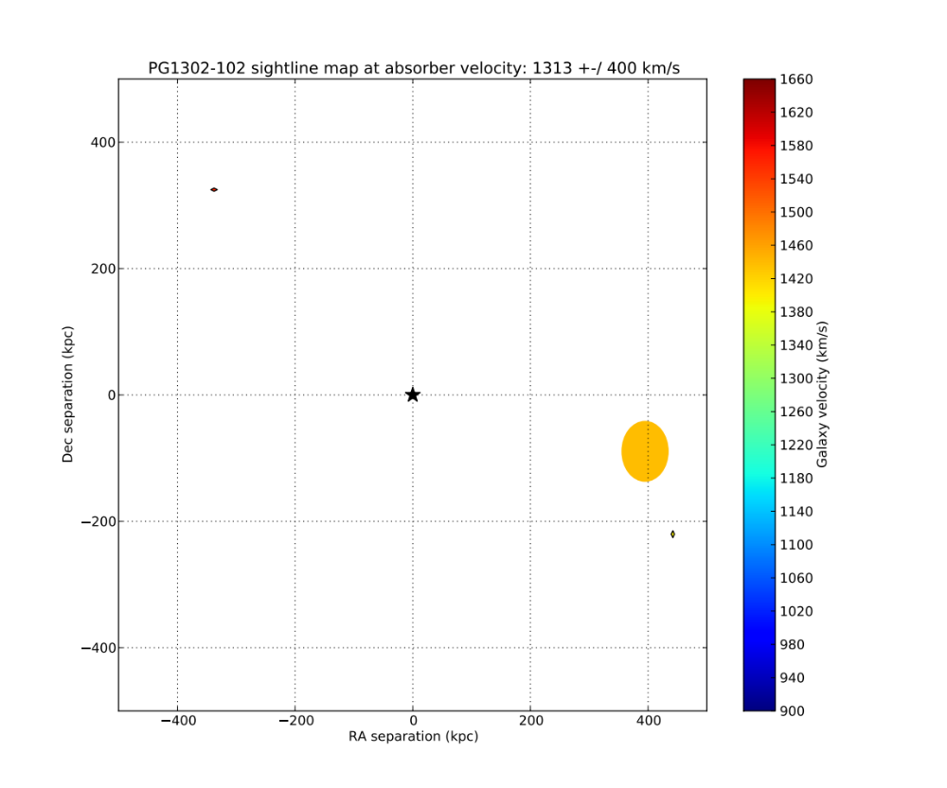
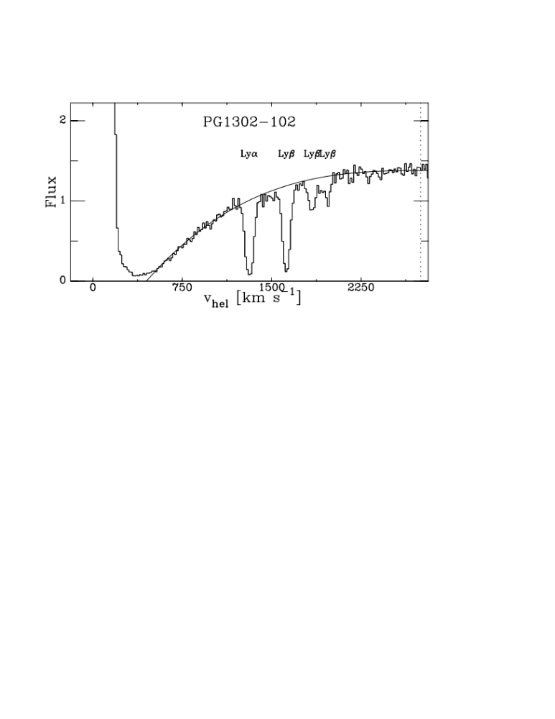
NGC4920
MCG-02-34-006
*6dFJ1310385-095554
Above: Detected absorption at v = 1313 km/s in the PG1302-102 sightline with corresponding map of the absorber environment. Top: All galaxies within 400 km/s of absorber and 500 kpc in physical impact parameter are included. Inclination, position angle and size of galaxies is illustrated by ellipse major/minor axis, orientation, and relative size (actual size x6). Spiral type galaxies are solid ellipses, elliptical type are transparent, and unknowns are diamonds.

Slide 3
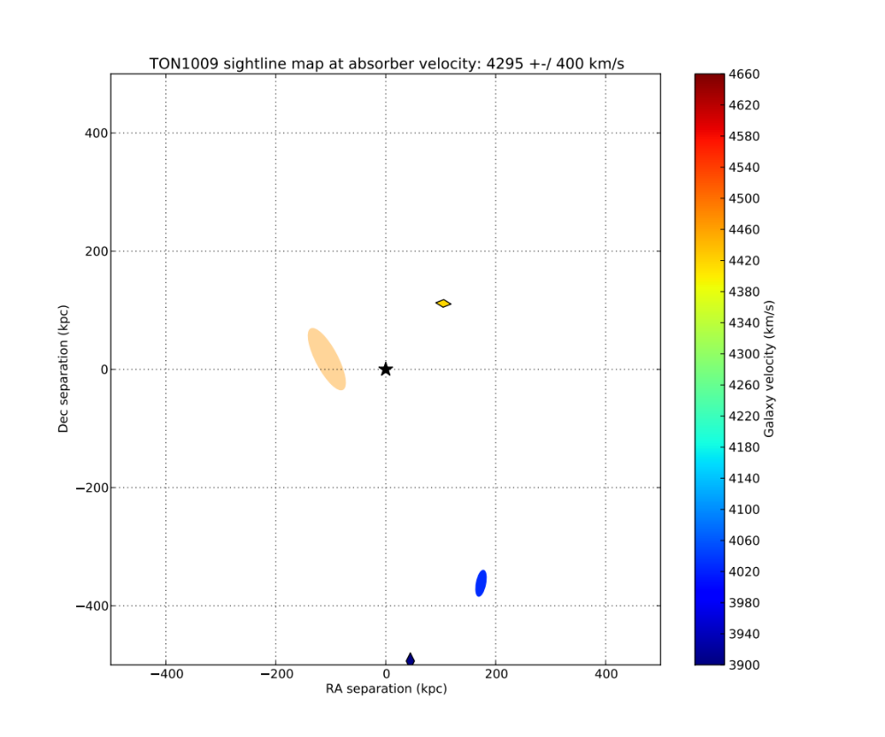
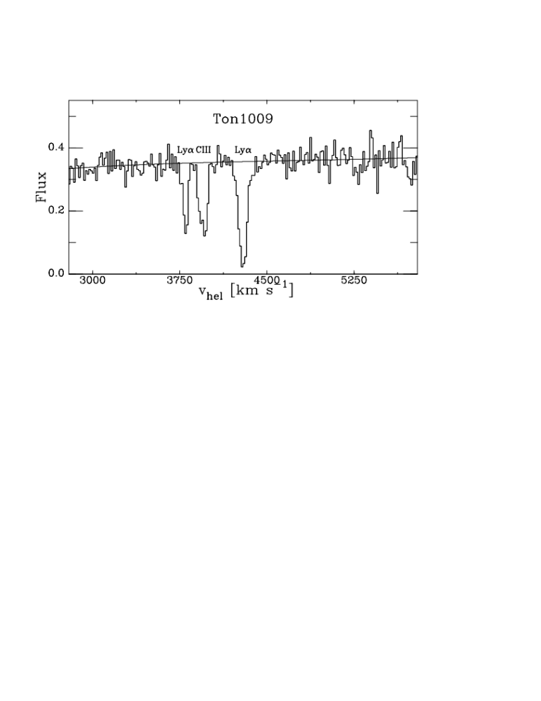
CGCG180-046
IC2439
KUG0906+331
KUG0906+333ANED01
Above: Detected absorption at v = 4295 km/s in the TON1009 sightline with corresponding map of the absorber environment. Top: All galaxies within 400 km/s of absorber and 500 kpc in physical impact parameter are included. Inclination, position angle and size of galaxies is illustrated by ellipse major/minor axis, orientation, and relative size (actual size x6). Spiral type galaxies are solid ellipses, elliptical type are transparent, and unknowns are diamonds.

Slide 4
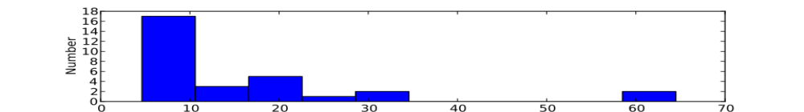
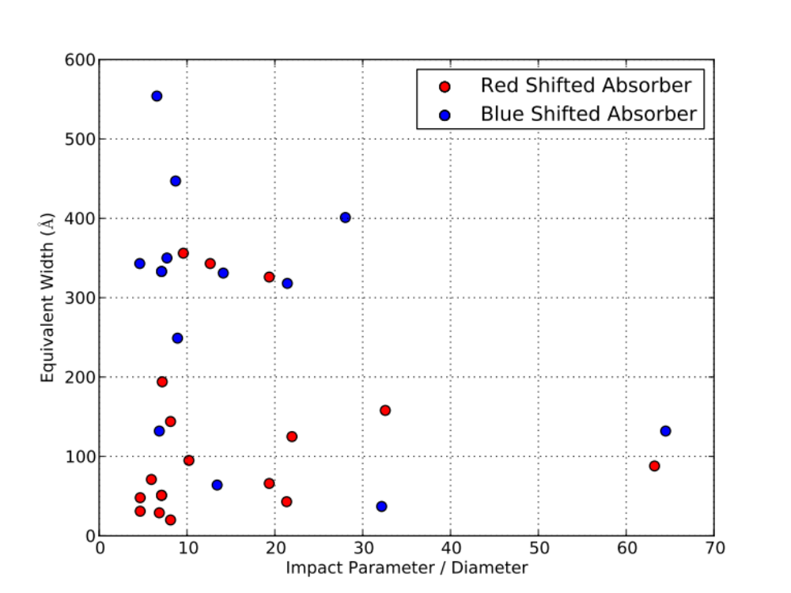
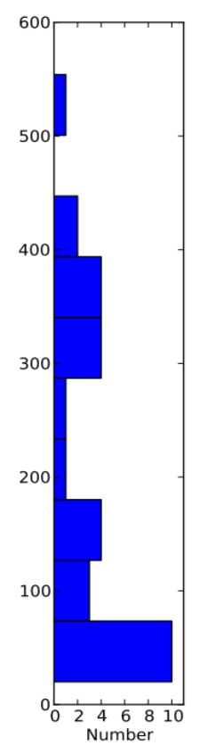
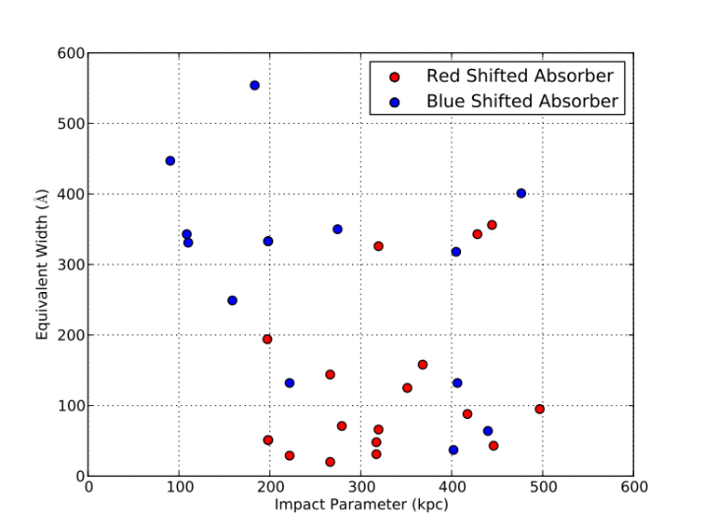
Impact Parameter
Above: The equivalent width of absorbers is plotted against the impact parameter to each associated galaxy, normalized by the galaxy size. Color indicates the velocity of each absorber relative to the galaxy. Marginal histograms show the distributions of impact parameters and equivalent widths (for all absorbers). Weakly absorbing systems occur at all impact parameters, however the average equivalent width clearly increases with decreasing impact parameter.
Above, left: Equivalent width plotted against impact parameter, not normalized by galaxy size. No significant correlation is seen, suggesting that the larger galaxies harbor larger concentrations of circumgalactic gas.

Slide 5
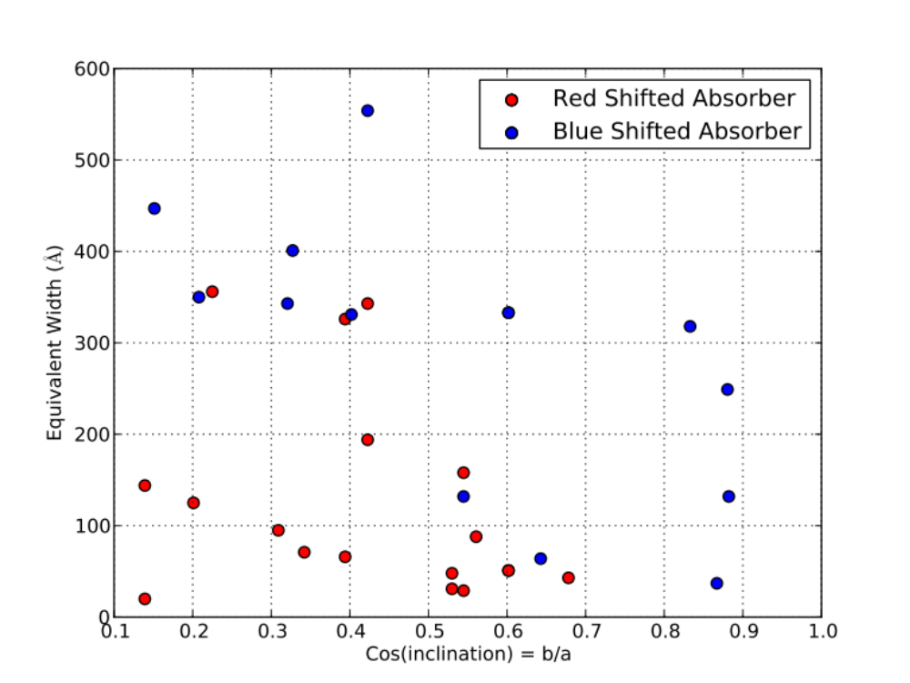
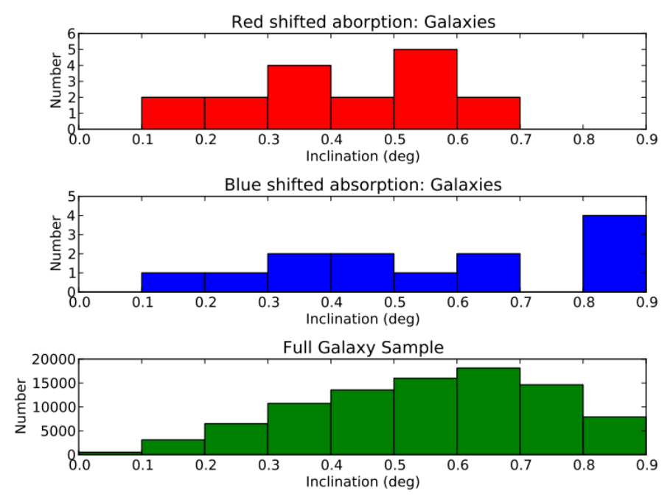
Inclination
Above: Equivalent width plotted as a function of minor/major axis ratio. 22/30 absorbers appear to be associated with small axis ratio galaxies (b/a < 0.6). This translates to 84% of absorbing systems occur near a galaxy with >50° inclination angle. We also notice a dichotomy between gas that is red vs blue shifted compared to the velocity of the associated galaxy (dashed black line). Average above line is W = 284 Å, average below is W = 129 Å.
Above (left): Distributions of galaxy inclinations. Red depicts galaxies nearby red shifted absorption, blue depicts galaxies nearby blue shifted absorption, and green for all nearby galaxies (cz < 10000 km/s)

Slide 6
Conclusions
We measure 90 Lyα absorbing systems in 20 QSO sightlines in the redshift range of 0-0.033 (cz = 0-10,000 km/s). 34% of absorbers can unambiguously be paired with a galaxy within 500 kpc and 400 km/s, and 42% reside nearby more than one galaxy.
Lyα equivalent width (W) increases with decreasing impact parameter (normalized by galaxy size).
84% of galaxies associated with Lyα absorption are highly inclined (>50°).
Red shifted absorbers (with respect to the associated galaxies) tend toward lower W.
  Average W(red shifted) = 129Å
  Average W(blue shifted) = 284Å
Slight preference for Lyα absorption along major axis - 60% of associated galaxies have azimuth angles <45°.
  Average azimuth = 40.4°
  Median azimuth = 38°

