Slide 1
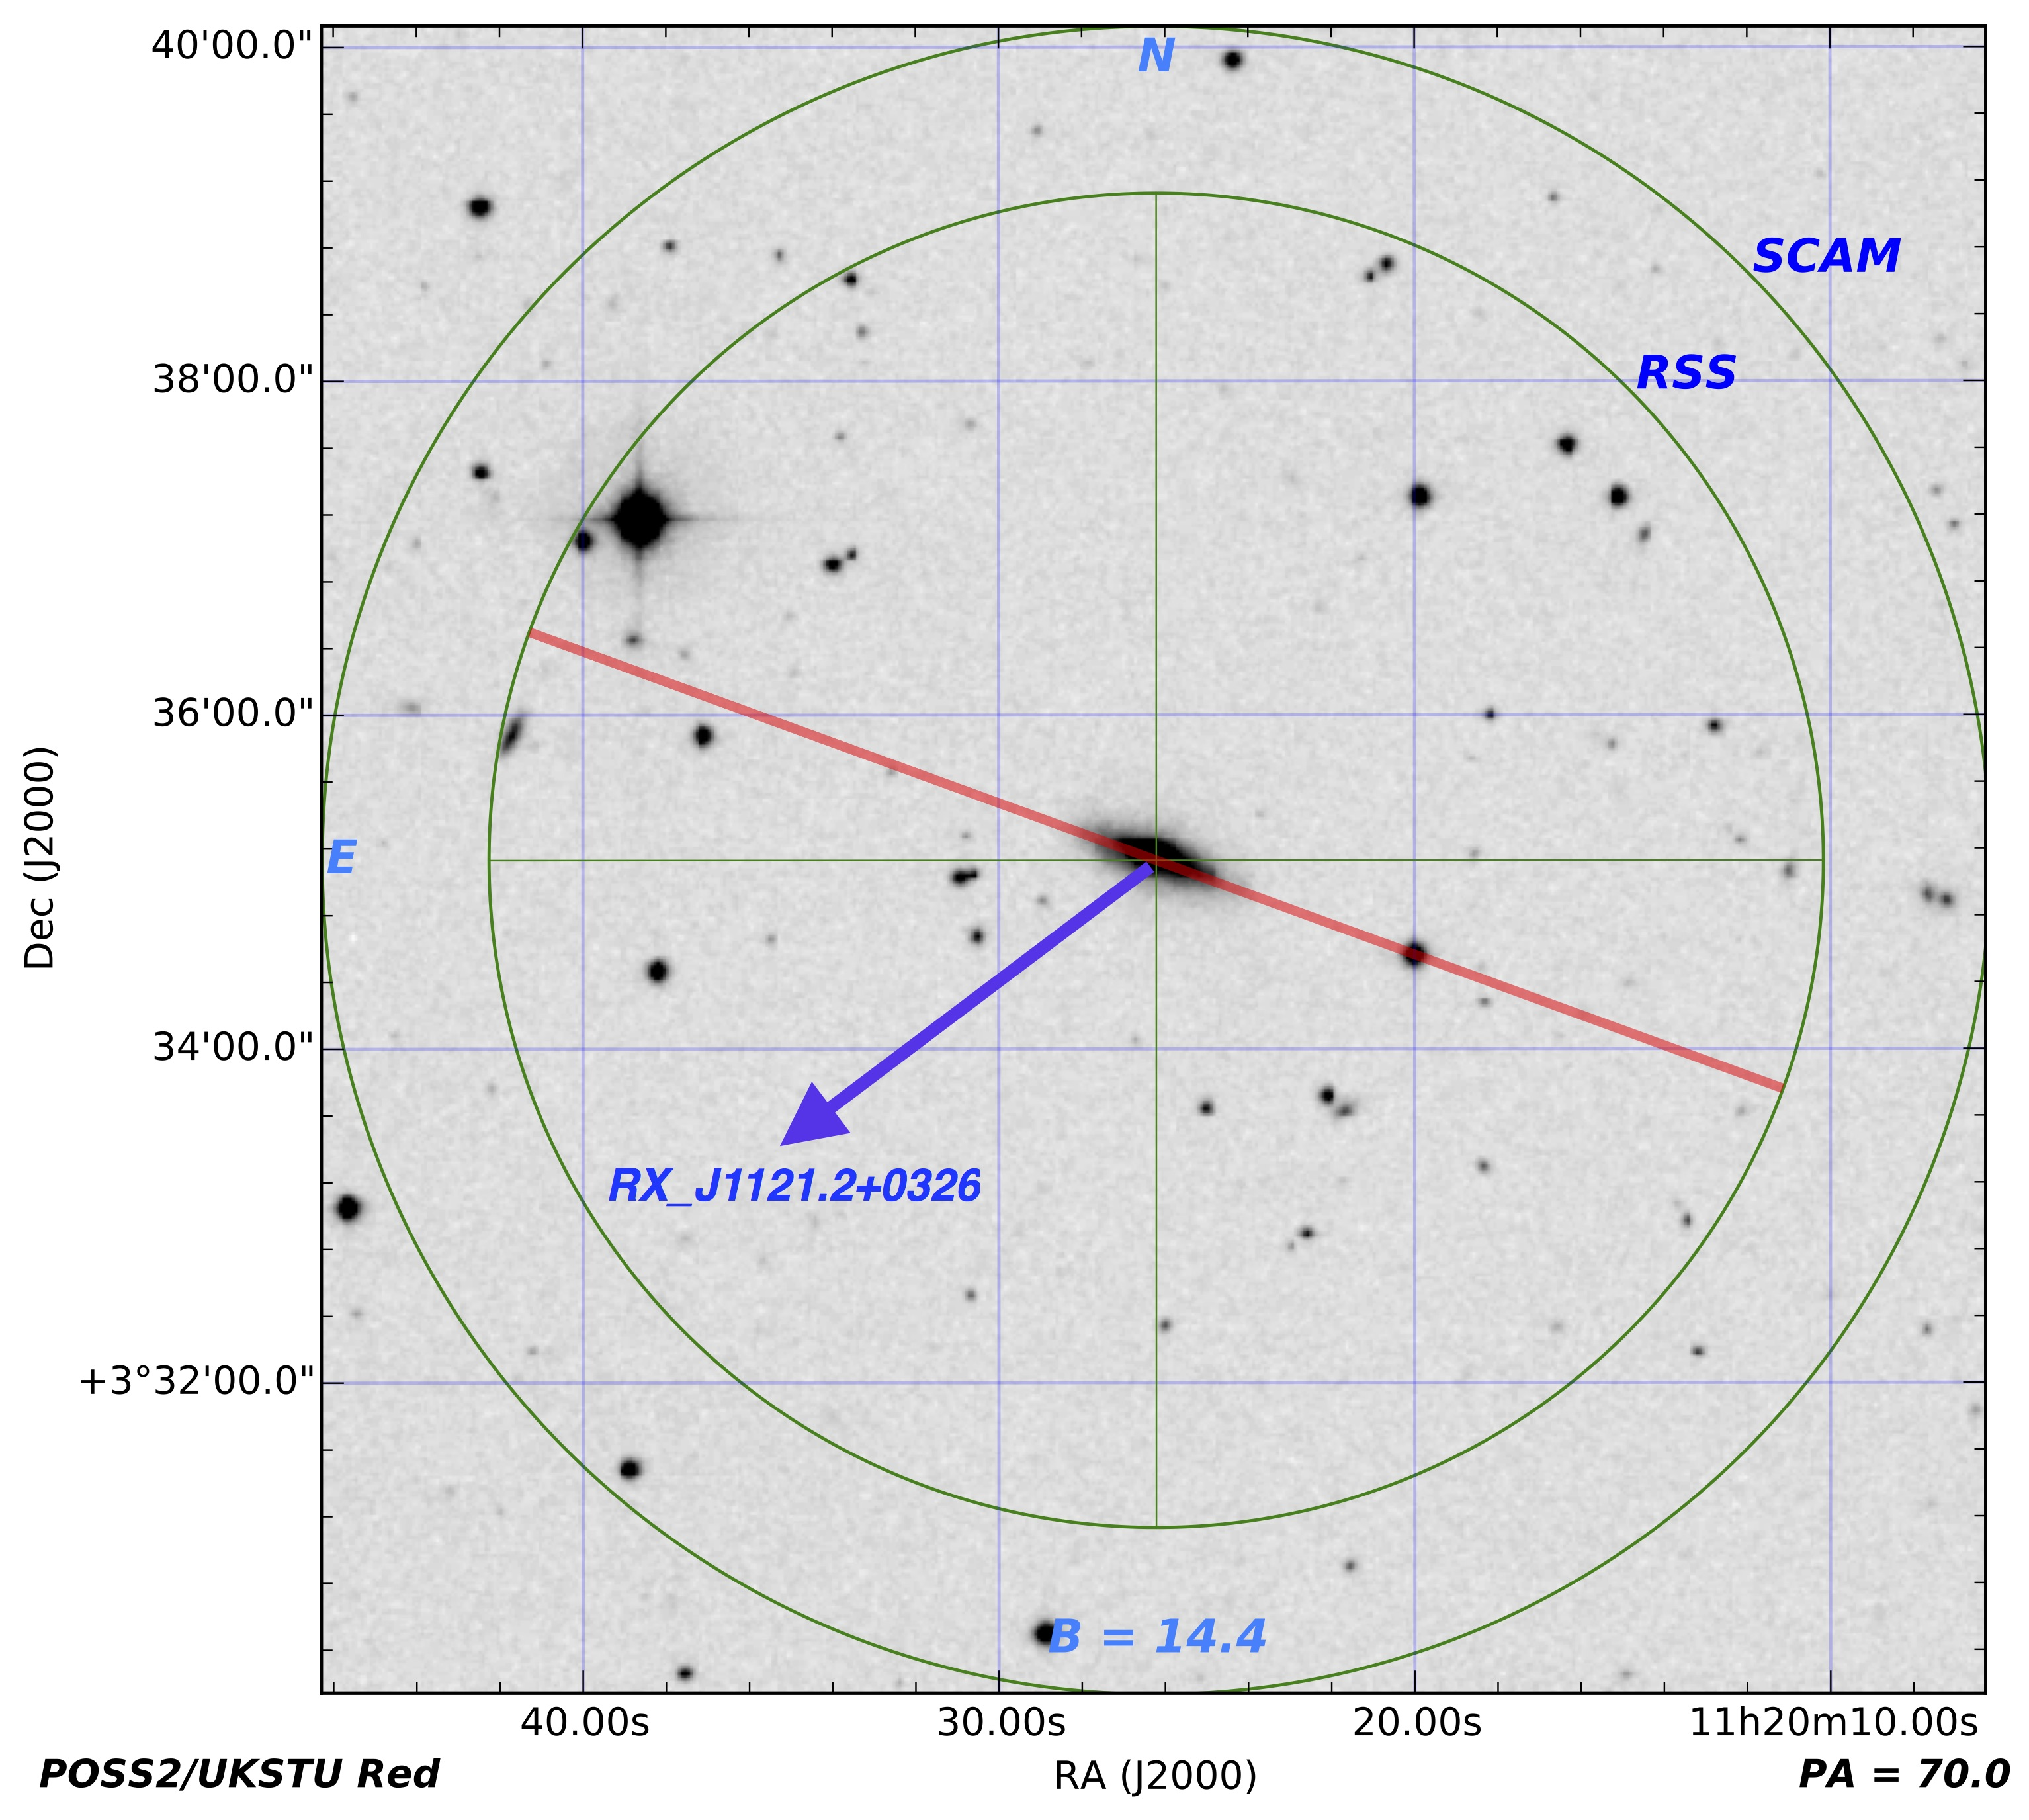
Evidence for a Rotational Component in the CGM of Nearby Galaxies
David French & Bart Wakker (2018, in prep)
Observed rotation curve
NFW fit
Model result – projected velocities
NGC3633
Slit location
Toward QSO RX_J1121.2+0326
3D halo model mockup from different viewing angles. QSO sightline location in black.

Slide 2
Evidence for a Rotational Component in the CGM of Nearby Galaxies
David French & Bart Wakker (2018, in prep)
Observed rotation curve
NFW fit
Model result – projected velocities
NGC3633
Slit location
Toward QSO RX_J1121.2+0326
3D halo model mockup from different viewing angles. QSO sightline location in black.

Slide 3
Co-rotation fraction vs cumulative L*
Locations of absorbers w.r.t. galaxies
Co-rotation fraction vs L*
Doppler b-parameters of absorbers

