Slide 1


Slide 2
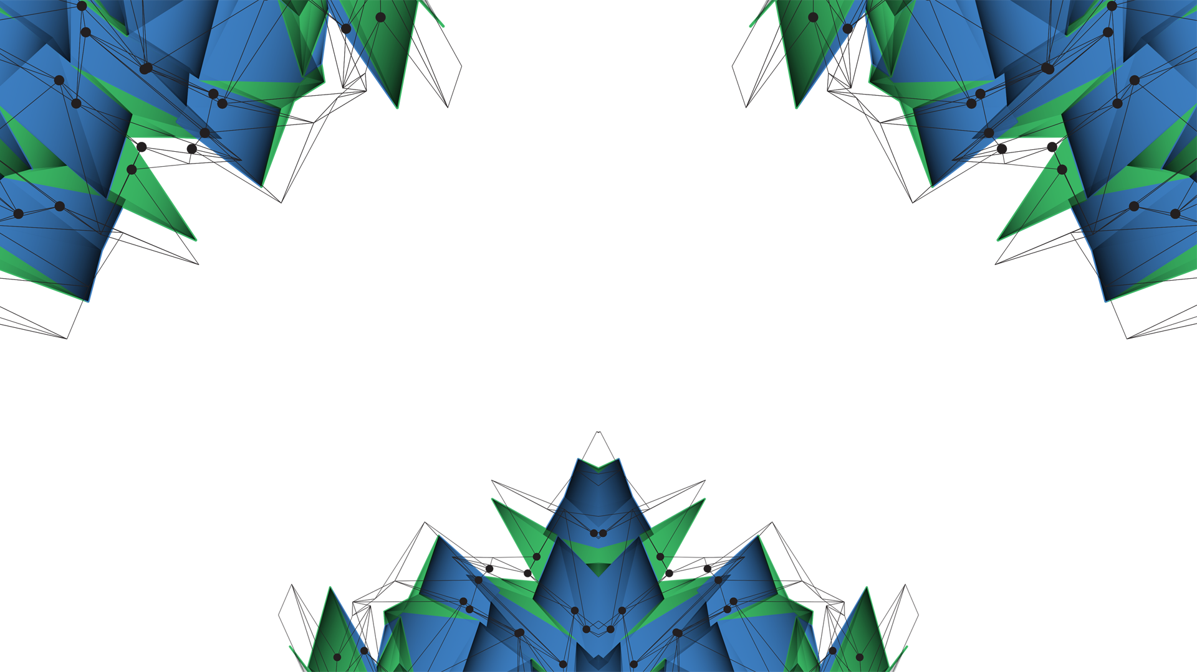
Maximizing Value within the Energy Sector
Proof of concept
Laura Foulquier

Slide 3
Concept
Geomechanics is using parameters to determine if a well is stable or not
Insurance can use the same parameters to rank wells (depending on the well type, drilling events encountered in nearby wells, the formation drilled (rock type, etc …))
Assumption: access to the well-to-be-drilled location

Slide 4
Well Database Format
A well database is built containing already-drilled wells and their:
Name
Location
Their “stability” score
Geospatially indexed (faster queries)
The closest to the well-to-be-drilled, the more weight (inversion distance weighting)
Well Name | Northing | Easting | Projection | Basin | Score

Slide 5
Well Database End of well report information
Available information from End of Well Report
General Information
Well Name
Location (Easting, Northing, Basin)
Drilling summary
Drilling events: losses (minor or major), stuck pipe, pressure kick, blow out, pack off, tight spot, sidetrack
Best practice: Formation integrity test (FIT), reaming , (extended) leak-off test (XLOT)
Notes:
Reaming : cleaning

Slide 6
Well Database Ranking Drilling events
A well stability can be determined by looking at the different events encountered while drilling
To each drilling event is assigned a score
For each well a final score is computed depending on the encountered drilling events and their occurrence
The more negative the final score the less stable the well was
 | Drilling events | Score
Delays Instability | Blowout | - 100
 | Pressure kick | - 20
 | Pack Off | -10
 | Stuck pipe | -10
 | Sidetrack | -50
 | Tight spot | -10
Good Practice | Formation integrity test / FIT | 10
 | Reaming | 10
 | Leak Off Test / LOT | 30

Slide 7
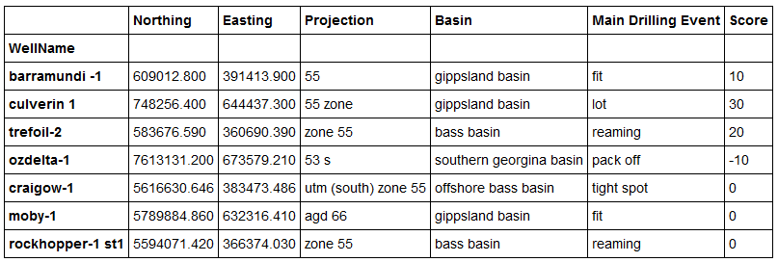
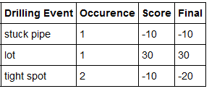
Well Database Examples
A first table is created per well which count the occurrence of each drilling event and compute the final score
The final scores for each drilling event is then summed and saved in the main well database, as well as the drilling event which was encountered most time
Well CRAIGOW-1

Slide 8
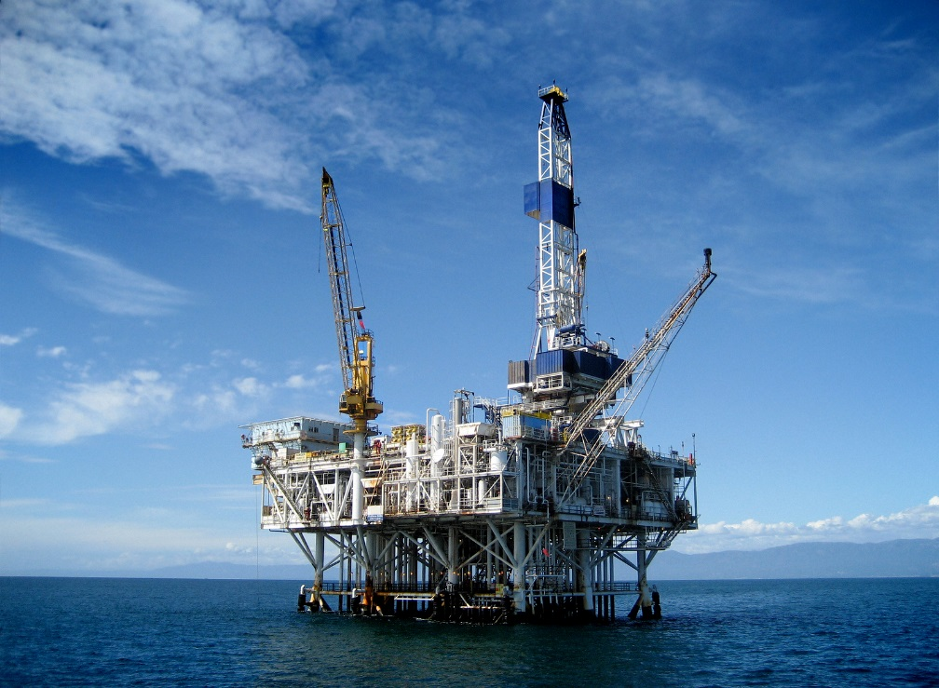

Proof of concept Methodology
Well Spec.
Coordinates
Well Database
Find the closest wells in the area
Premiums estimation
Challenging area to drill ?

Slide 9
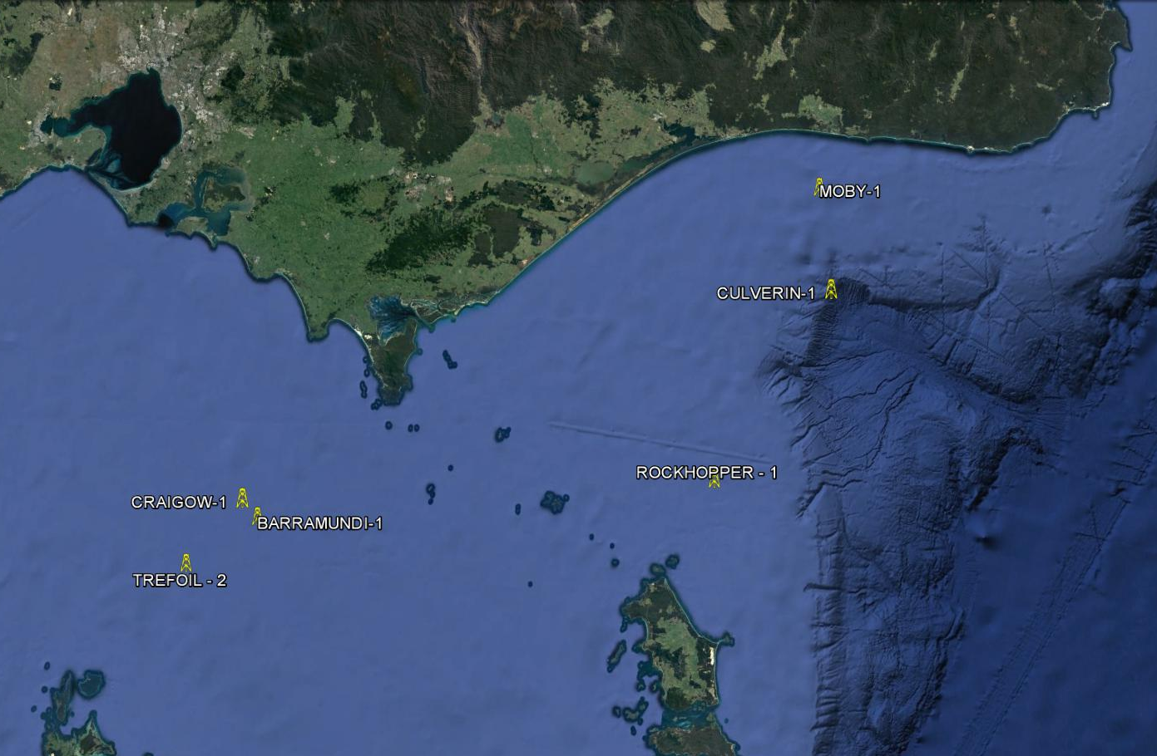
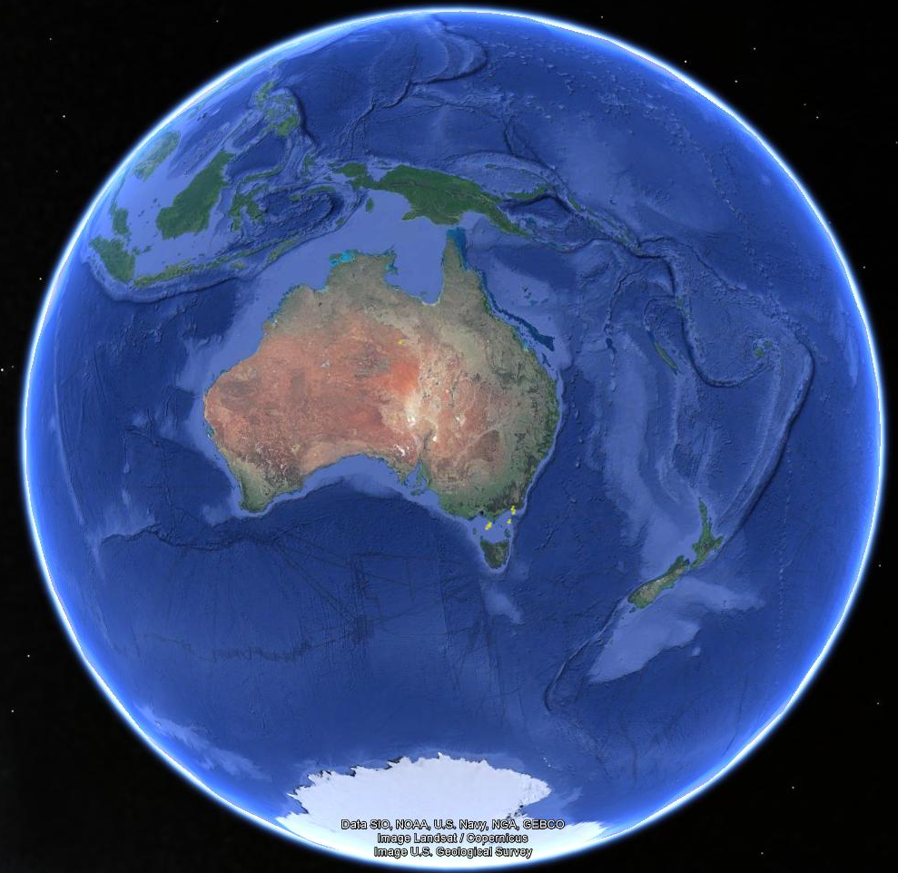
Proof of concept Visualisation

Slide 10
Next Step Focus on Formation
Some formation are more challenging to drill than others due to rock parameters and mechanics (density, cohesion, etc …)
From the asset specification: get the details of the expected drilled formation (type and meters drilled)
Formation Name | Type | Risk | Meters Drilled | Score
 | Sandstone | 10
 | Limestone | 30
 | Shales | 50
 | Salt | 80

Slide 11
Questions ?

