Slide 1
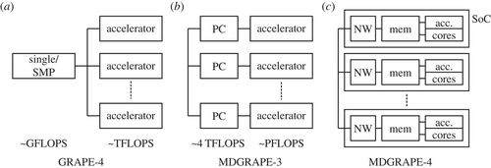
MDGRAPE-4: a special-purpose computer system for molecular dynamics simulations, Volume: 372, Issue: 2021, DOI: (10.1098/rsta.2013.0387)

