Slide 1
"The Pillars of Western Philosophy: An Examination of Epicurus, Socrates, Plato, and Aristotle"

Slide 2
Introduction
The philosophies of Epicurus, Socrates, Plato, and Aristotle have had a profound influence on the development of western philosophical thought, shaping our understanding of key concepts such as ethics, metaphysics, and epistemology. Each of these philosophers offered unique perspectives and insights, which have been studied, debated, and built upon for centuries. Their philosophies have not only shaped academic discourse but have also had a significant impact on various aspects of modern society, including politics, science, and education.

Slide 3
Epicurus
Epicurus (341–270 BCE) was a Greek philosopher who founded the school of philosophy called Epicureanism. His philosophy revolved around the pursuit of pleasure and avoidance of pain, which he believed were the ultimate goals of human life. However, contrary to popular belief, Epicurus didn't advocate for hedonism in the common sense of indulgence in physical pleasures. Rather, he emphasized the enjoyment of simple pleasures, such as friendship, philosophical discussions, and a tranquil life free from fear, particularly fear of the gods and death

Slide 4
Epicurus was greatly influenced by the philosophy of Aristotle and the atomist theory of Democritus. He sought to give a unified system to philosophy, integrating ethics, metaphysics, and epistemology. He established his school, known as "The Garden," in Athens in 306 BCE
His main work, "On Nature," is mostly lost, but excerpts have survived. Other important writings include the "Principal Doctrines" and letters to Herodotus, Menoeceus, and Pythocles. The "Tetrapharmakos," or "The four-part cure," is a poetic doctrine that encapsulates Epicurus' philosophy on happiness: "Don't fear god, Don't worry about death; What is good is easy to get, and What is terrible is easy to endure"

Slide 5
Epicurus is best known for his philosophy of pleasure, which is often misunderstood as advocating for indulgence in physical pleasures. However, his philosophy, known as Epicureanism, promotes the pursuit of mental pleasures over physical ones, advocating for a simple life free from pain and fear
dgsdgsdvsdvsd

Slide 6
Epicurus believed that the ultimate goal of human life is to attain tranquility, which can be achieved by leading a self-sufficient life surrounded by friends. He also argued that death should not be feared as it simply signifies the end of sensation and consciousness.
Epicurus' philosophy was heavily influenced by the atomist theory of Democritus and the philosophy of Aristotle. He believed that the world is made up of atoms moving in a void and that all events can be explained in terms of the interactions of these atoms

Slide 7
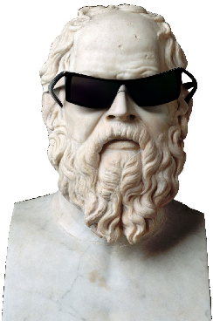
Socrates
Socrates (469–399 BCE) was one of the most influential philosophers of ancient Greece, known for his Socratic method of questioning. He is credited as one of the founders of Western philosophy. Socrates didn't write any philosophical texts himself; our knowledge of his teachings and philosophy comes from the writings of his students, particularly Plato

Slide 8
Socrates' philosophy was centered on the pursuit of virtue and wisdom. He famously claimed to know nothing, emphasizing the importance of recognizing one's own ignorance, a concept now known as Socratic ignorance. He encouraged questioning and critical thinking to understand the underlying principles of life and human nature. Key areas of his philosophical exploration included ethics, justice, and virtue. Socrates believed that "care of the soul," or the cultivation of virtue, was the most important human obligation Socrates was sentenced to death by the Athenian government for impiety and corrupting the youth. He accepted his death sentence and drank hemlock, viewing his death as a release of the soul from the body

Slide 9
Socrates, unlike other philosophers, did not leave any written works. Our knowledge of his philosophy comes from the writings of his students, particularly Plato. He is best known for his Socratic method of questioning, which aimed to expose the ignorance of his interlocutors and stimulate critical thinking Socrates' philosophy centered on the pursuit of virtue and wisdom. He believed that recognizing one's own ignorance is the first step towards wisdom. He argued that the care of the soul, or the cultivation of virtue, is the most important human obligation

Slide 10
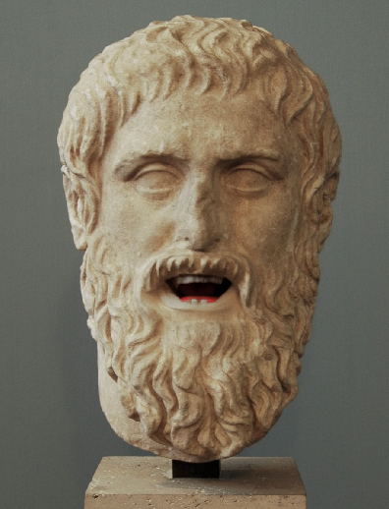
Plato
Plato (428/427–348/347 BCE) was a philosopher, a student of Socrates, and later a teacher to Aristotle. He founded the Academy, an academic program that many consider to be the first Western university

Slide 11
Plato's philosophy is mainly conveyed through his dialogues, which showcase his metaphysical theory of forms. He believed that the physical world is a reflection of more perfect, ideal forms or ideas that exist in a higher realm of reality. This is often referred to as the theory of forms His most famous work is the "Republic," where he details a wise society governed by a philosopher-king. Plato believed that philosophers, by virtue of their understanding of the forms, are best equipped to govern society. He also stressed the importance of education, particularly in science and mathematics Plato's philosophical explorations covered a broad spectrum of areas, including ethics, cosmology, metaphysics, and politics. He made significant contributions to society and his work laid the foundation for Western philosophy

Slide 12

Aristotle
Aristotle (384–322 BCE) was a Greek philosopher and scientist, and a student of Plato. He is considered one of the greatest thinkers in politics, psychology, and ethics. Aristotle made pioneering contributions to all fields of philosophy and science, and he is credited with the invention of formal logic. He also identified various scientific disciplines and explored their interrelationships

Slide 13
Aristotle founded his own school in Athens, known as the Lyceum, where he spent most of his life studying, teaching, and writing. He wrote as many as 200 treatises covering various areas of philosophy and science. However, only 31 of these works are still in circulation today In his work "Metaphysics," Aristotle clarified the distinction between matter and form, where matter was the physical substance of things, and form was the unique nature of a thing that gave it its identity Aristotle also made significant contributions to the study of nature. In his work "Physics," he provided a comprehensive study of the natural world, including a discussion of the First Cause, or God Even though some of his theories were proven incorrect in the light of modern science, Aristotle's work remains a significant starting point for arguments in various fields, including logic, aesthetics, political theory, and ethics

Slide 14
Conclusion
The philosophies of Epicurus, Socrates, Plato, and Aristotle continue to have a significant impact on modern thought. They have shaped our understanding of fundamental aspects of life and the world around us, influencing fields as diverse as politics, science, and education. Their teachings continue to be relevant today, providing a rich source of wisdom and insight for those seeking to understand the nature of reality, the pursuit of knowledge, and the path to a fulfilling life. Their lasting influence is a testament to the depth and enduring value of their philosophical contributions

Slide 15
Source:
ChatGPT

