Slide 1
Using machine learning model and statistics model to forecast different targets of Covid-19
Te-Kai Chen
Chen Chen

Slide 2
Introduction & Problem Definition
Introduction
Covid-19 has been one of the important issue in the world
Forecasting targets of the Covid-19
Problem Definition
Forecasting four targets related to Covid-19
Using 4 Machine learning model and 3 Statistical model
Performing non real-time forecasting and real-time forecasting
Notes:
We have a lot of approaches
Covid-19 has been one of the in the world since it happened
we would use 4 Machine learning model and 3 Statistical model to find out which model can perform better on differnet targets

Slide 3
Proposed Approaches
Machine Learning Model
Recurrent Neural Network (RNN)
Long Short Term Memory (LSTM)
Gated Recurrent Unit (GRU)
Echo State Network (ESN)
Statistical Model
ARIMA
Holt–Winters Additive Model

Slide 4
Dataset Description
Forecasting Targets
Cases & Deaths
US Data
State_Level_Data
Conty_Level_Data
Reproduction Number (Rt)
State_Level_Data
Inpatient bed usage by covid (Hp)
State_Level_Data

Slide 5
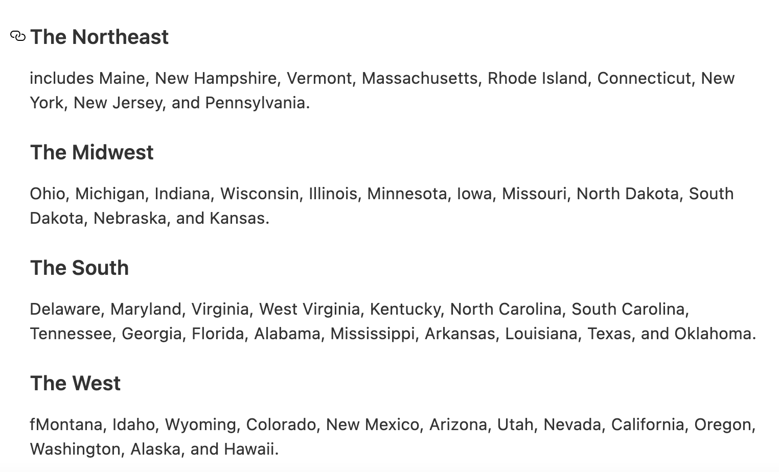
Data Set (Region)
Region:
North-East
Mid-West
South
West

Slide 6
Dataset Description
We use the data from 2020/03/01 to 2020/12/31 as our dataset
Training dataset: The first 90 days : 2020/03/01 to 2020/05/30
Testing dataset:The rest of the data: 2020/05/30 to 2020/12/31
Notes:
Since it’s impossible to wait for a long time to forecasting, we only use 90 days as our training set.

Slide 7
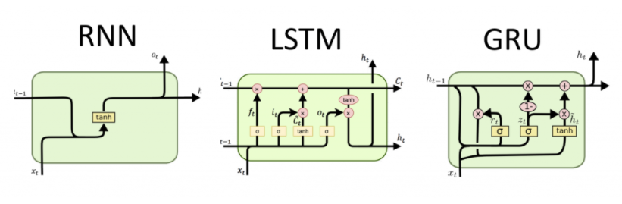
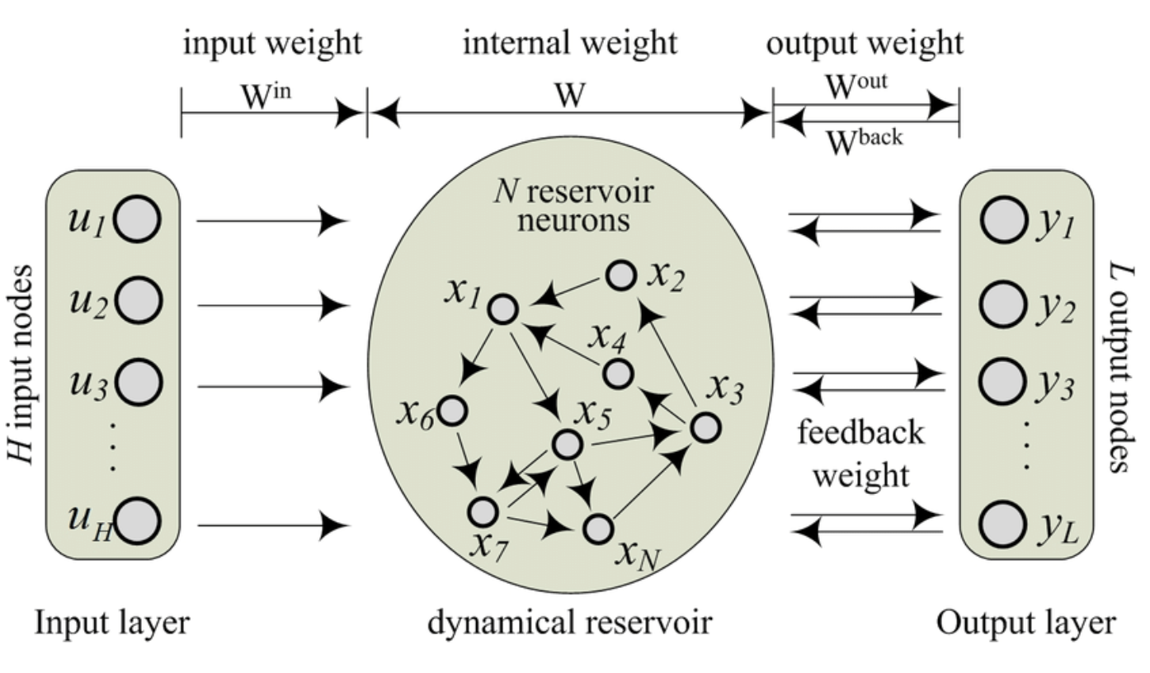
Maching Learning-based approaches
Recurrent Neural Network (RNN)
Long Short-Term Memory
Gated Recurrent Network
Echo State Network (ESN)
Notes:
RNN is a model will consider the current information and the previous inputs.

Slide 8
ARIMA
AKA: Auto-Regressive Integrated Moving Average
It originally developed for economics applications. Their statistical properties, the implementation of the well-known Box–Jenkins methodology during model training process.
Ability to implement various exponential smoothing models have all contributed to their popularity and widespread adoption
ARIMA models assume a linear correlation between the time-series values and attempt to exploit these linear dependencies in observations, in order to extract local patterns

Slide 9
HWASS
AKA: Holt–Winters Additive Model; Exponential Smoothing with Additive Trend and Additive Seasonality
The Holt–Winters additive model is an extension of Holt’s exponential smoothing, a time series forecasting method for univariate information.
It is a simple yet powerful and widely used forecasting fucntion which it can cope with trend and seasonal variation
Exponential smoothing is the procedure of continuously revising a prediction after taking into account the more recent observations.

Slide 10
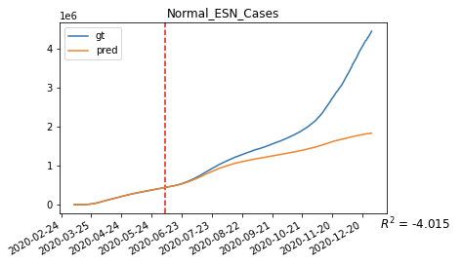
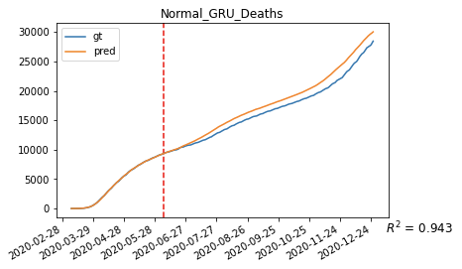
Evaluation of Non-Real-time Forecasting

Slide 11
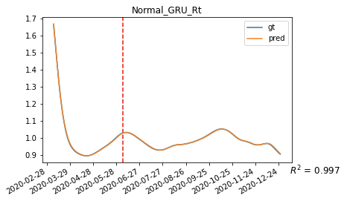
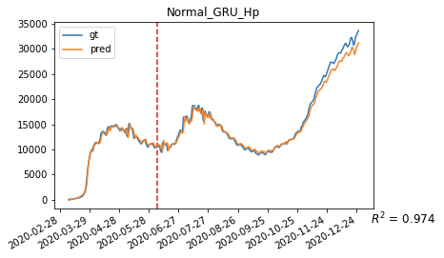
Evaluation of Non-Real-time Forecasting
Notes:
We found that GRU performs better than otherson the average of four targetst!

Slide 12
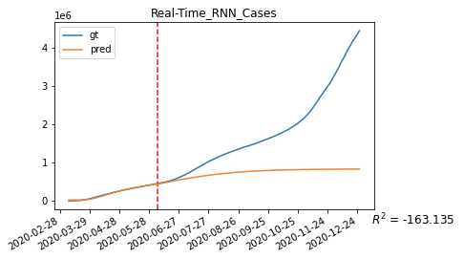
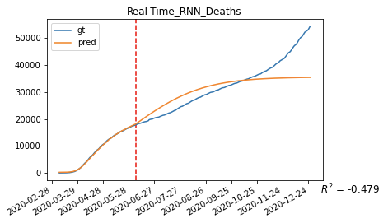
Evaluation of Non-Real-time Forecasting

Slide 13
Evaluation of Real-time Forecasting

Slide 14
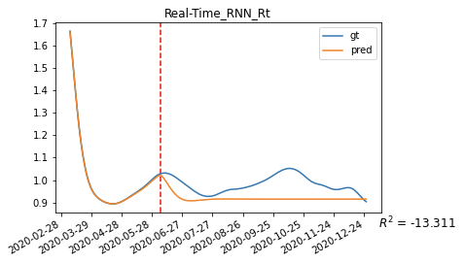
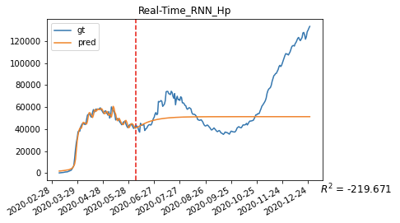
Evaluation of Real-time Forecasting

Slide 15
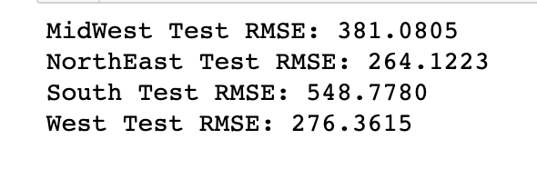
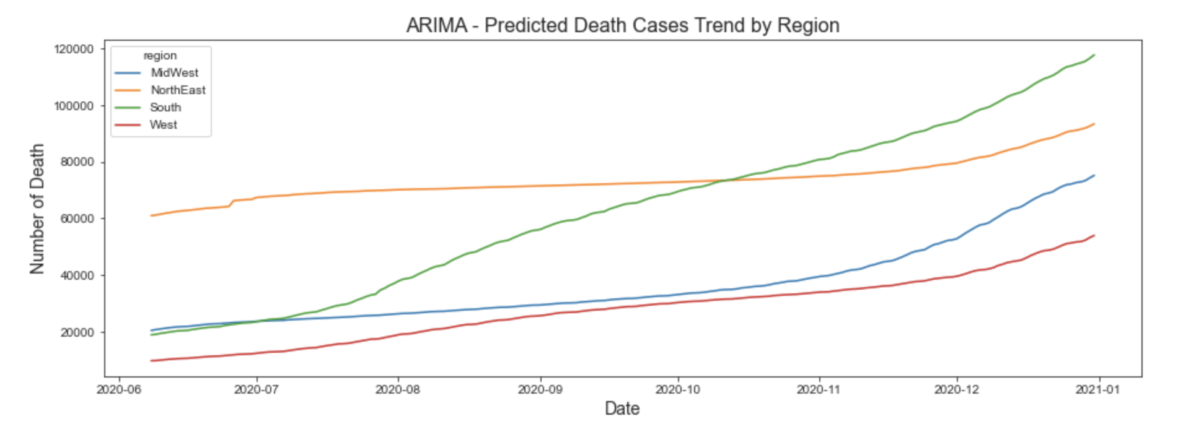
Experiment
results
(ARIMA)
RMSE:

Slide 16
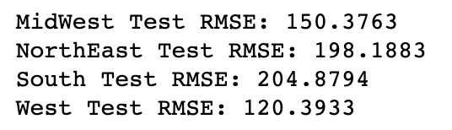
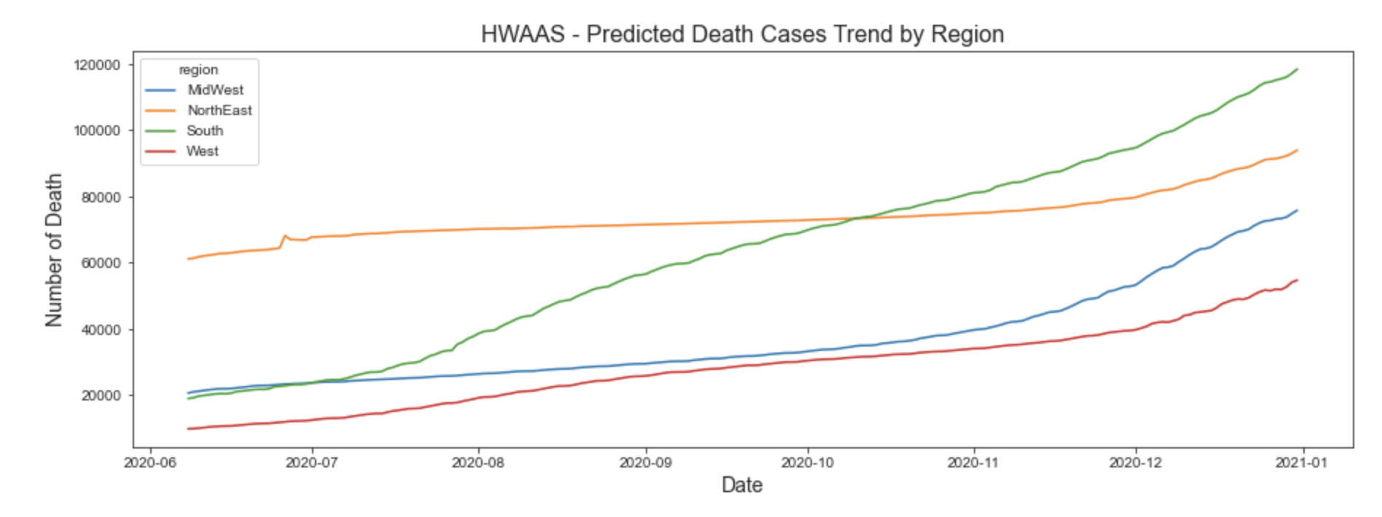
Experimentresults
(HWASS)
RMSE:

Slide 17
Experiment and results
(Statiscal Model)
Top 5 counties:
Cook
Harris
Los Angeles
Maricopa
San Diego
Counties Deaths:
us-counties dataset (NYT)
and
co-est2020.csv (Population 2020)

Slide 18
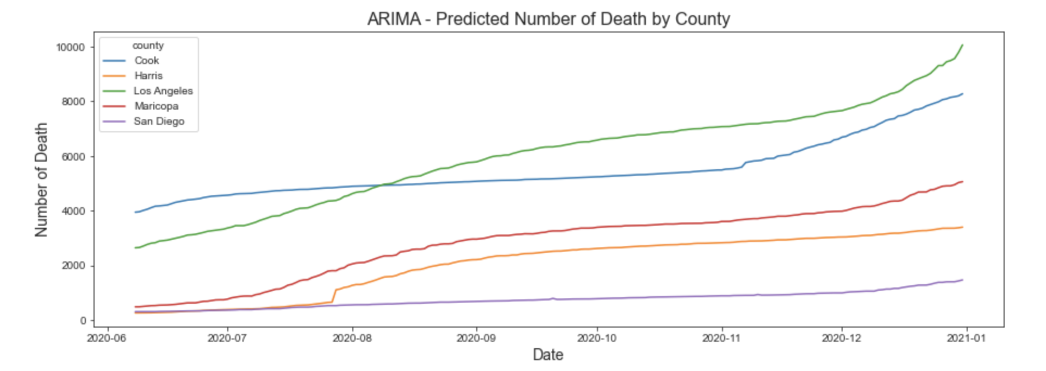
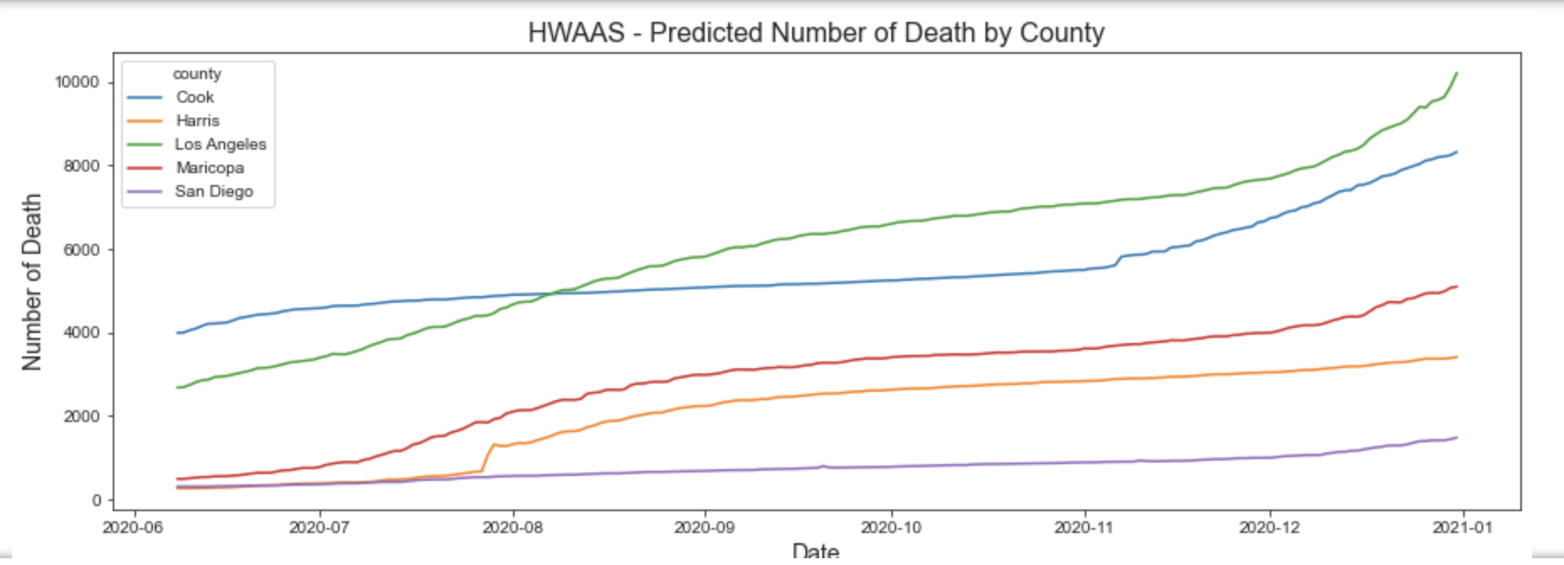
ARIMA
HWASS
ARIMA HWASS
Cook Test RMSE: 32.3131 17.8971
Harris Test RMSE: 36.8339 34.0306
Los Angeles Test RMSE: 53.0878 27.591
Maricopa Test RMSE: 31.9196 19.9 877
San Diego Test RMSE: 11.2858 8.859

Slide 19
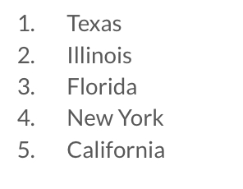
Experiment
results
(Statiscal Model)
Inpatient Beds Used during Covid-19.
data set is coming from “COVID-19_Reported_Patient_Impact_and_Hospital_Capacity_by_State”
We choose the top five states with the highest record of inpatient beds used.

Slide 20
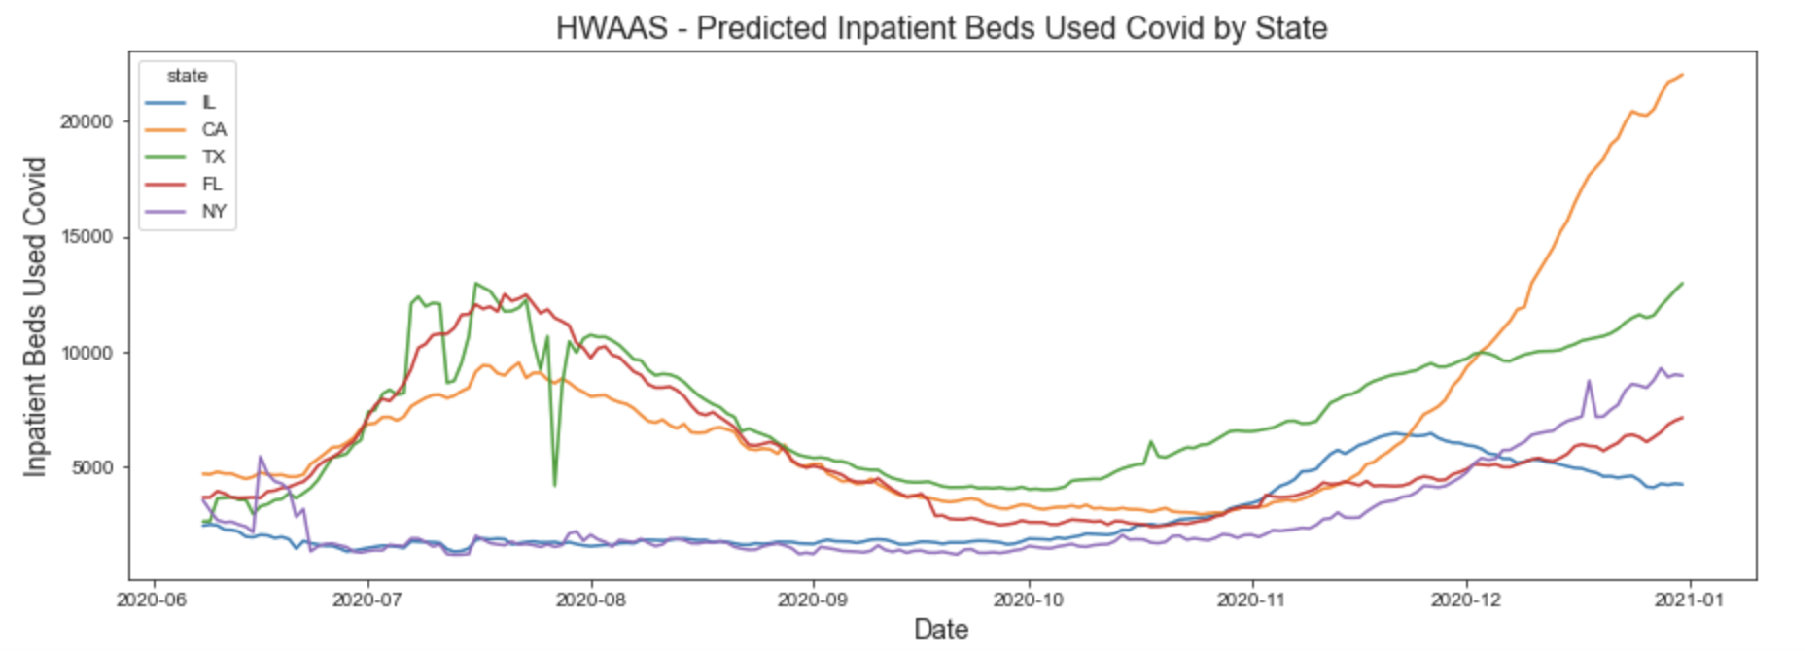
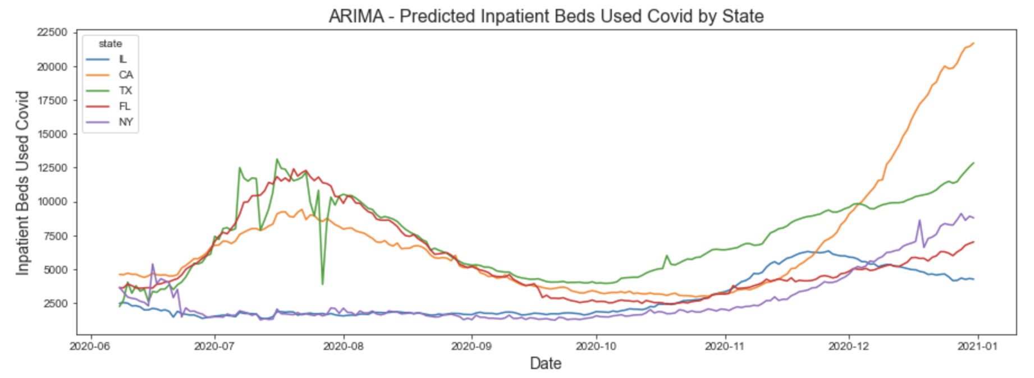
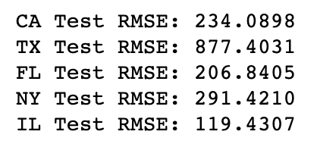
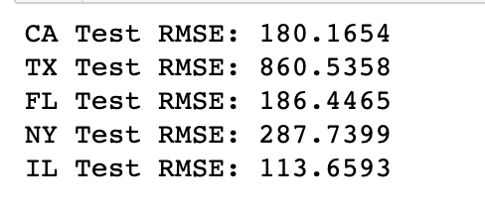
ARIMA
HWASS
Inpatient Beds Used
ARIMA RMSE HWASS

Slide 21
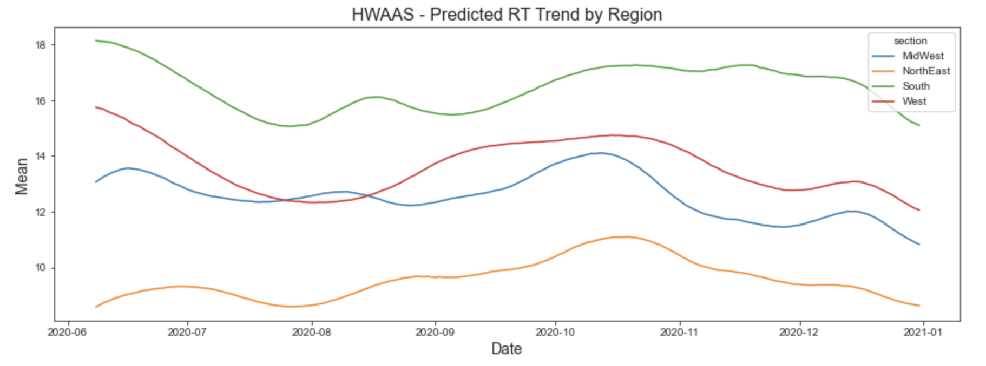
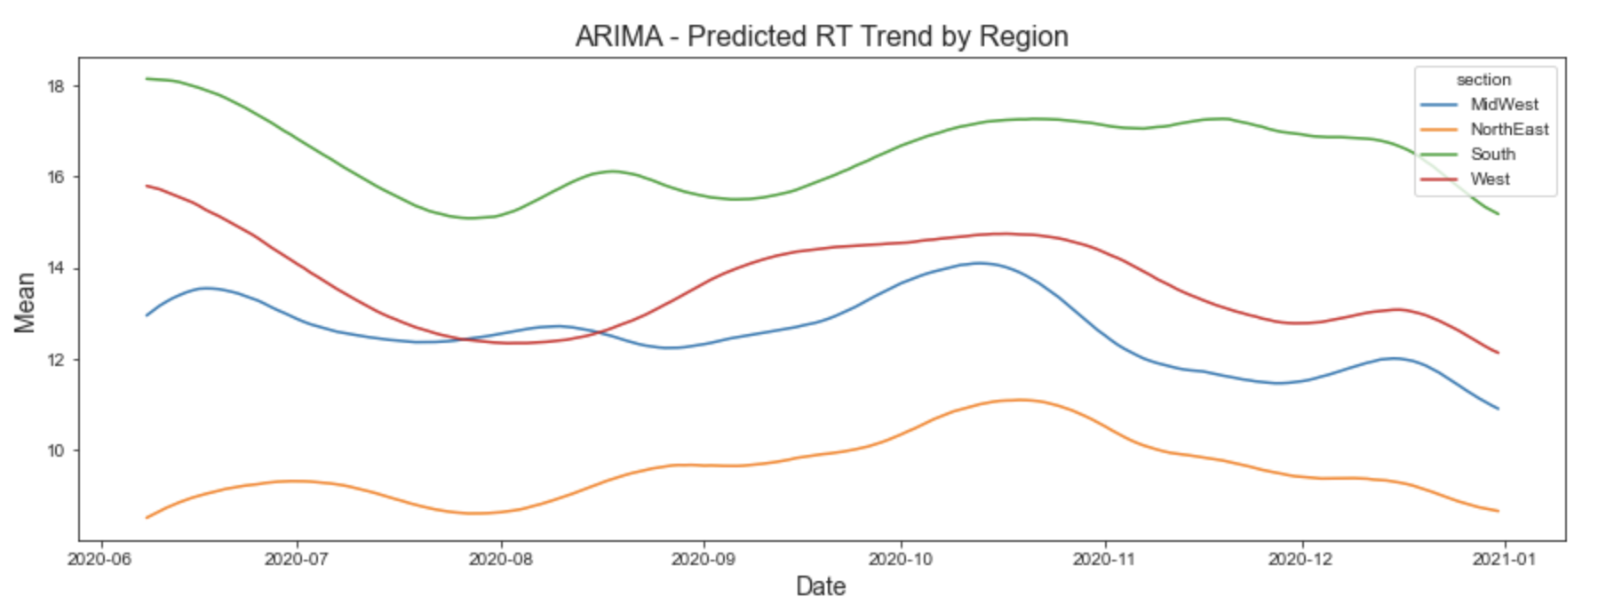
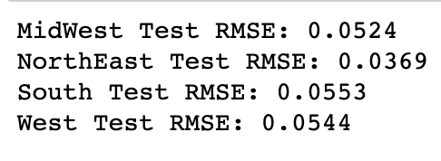
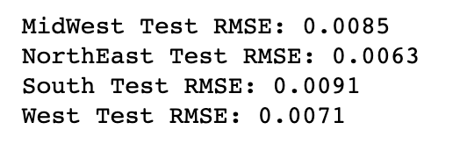
ARIMA
HWASS
For reproduction number (RT)
ARIMA HWASS

Slide 22
Comparison of ARIMA & HWASS
For comparison, each time series model was trained, evaluated and tested using time series representing of the death cases with regarding to the total population of the regions, reproduction number, counties, inpatient bed used.
Using the root mean square error (RMSE) to assess the performance of each time series model, this work compares the different approaches
RMSE : HWASS > ARIMA
GRAPH: Similar trend compare to the whole US data
Performance results of each model for each target are presented in previous slides, indicating that, in terms of RMSE, HWASS would be better than ARIMA regarding to our targets.

Slide 23
Conclusion
In this study, we apply machine learning model and time series methods to develop and estimate the cases (four different targets) with respect to the data sets, looking for specific time range on Covid-19 period.
By using the Covid-19 dataset constructed by NY Times. It helps us to evaluate the performance of the forecasting model more easily. Moreover, it compares with the characteristic and accurancy by different models.
Also, we compare the advantages and the disadvantages(e.g. performance) of each model and figure out which model can be the best to describe Covid-19.

Slide 24
What we learn/Challenges
Real Time forecasting is robust and more dimensional than Non-Real time forecasting.
However, real time forecasting is harder than Non-Real time forecasting, since the factors and important parts needed to be considere, and we find it is difficult to use that bias to forecast the later, revised data.

Slide 25


