Slide 1
Lowland WA lakes food webs
Touch base with Julian
5/18/2021

Slide 2
Data overview
27 different lakes
9 have >1 sampling event (Pine = 6, Wilderness = 3)
Excluding Pine 2013, there are 40 unique lake_year events.

Slide 3
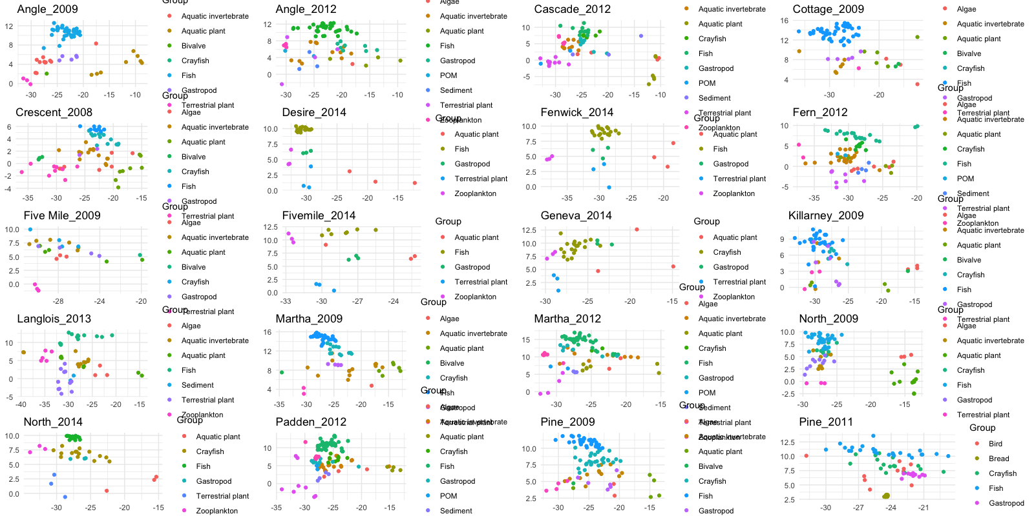

Slide 4
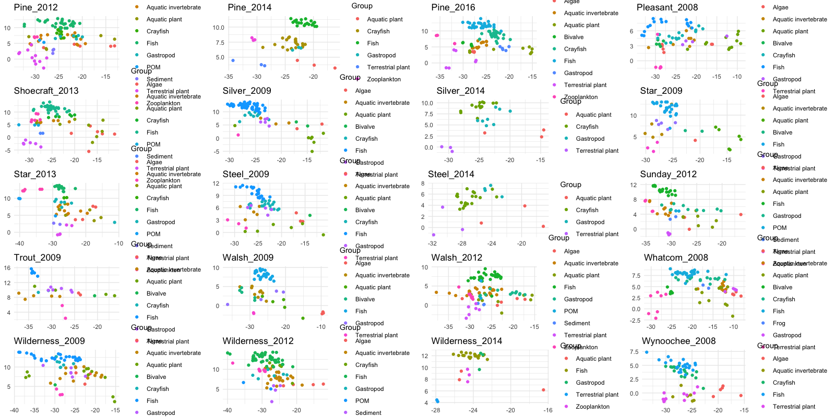

Slide 5
Pumpkinseed (Lepomis gibbosus) was the most commonly captured species
Lepomis gibbosus | 24
Micropterus salmoides | 22
Perca flavescens | 22
Oncorhynchus mykiss | 18
Cottidae | 14
Ambloplites rupestris | 5
Ameiurus nebulosus | 5
Micropterus salmoides juv | 3
Oncorhynchus clarkii | 3
Oncorhynchus nerka | 3
Pomoxis nigromaculatus | 2
Ptychocheilus oregonensis | 2
Lepomis cyanellus | 1
Lepomis macrochirus | 1
Micropterus dolomieu | 1
Micropterus salmoides adu | 1

Slide 6
Can we do a mixing model to ID pumpkinseed invertebrate diet? Short answer is not cleanly.
Constraints
Alternatives
Pumpkinseed eat a wide variety of things, C & N mixing models can only estimate from 3 sources.
Not clear on a universal (ie, works for all 40 lakes) clumping of prey into three meaningful categories/pools.
We can test trends of pumpkin seed relative to resources
We can examine littoral vs pelagic
We can try three source mixing models for a species if willing to lose a lot of information. For example, top three prey items for pumpkinseed, then go from there?

Slide 7
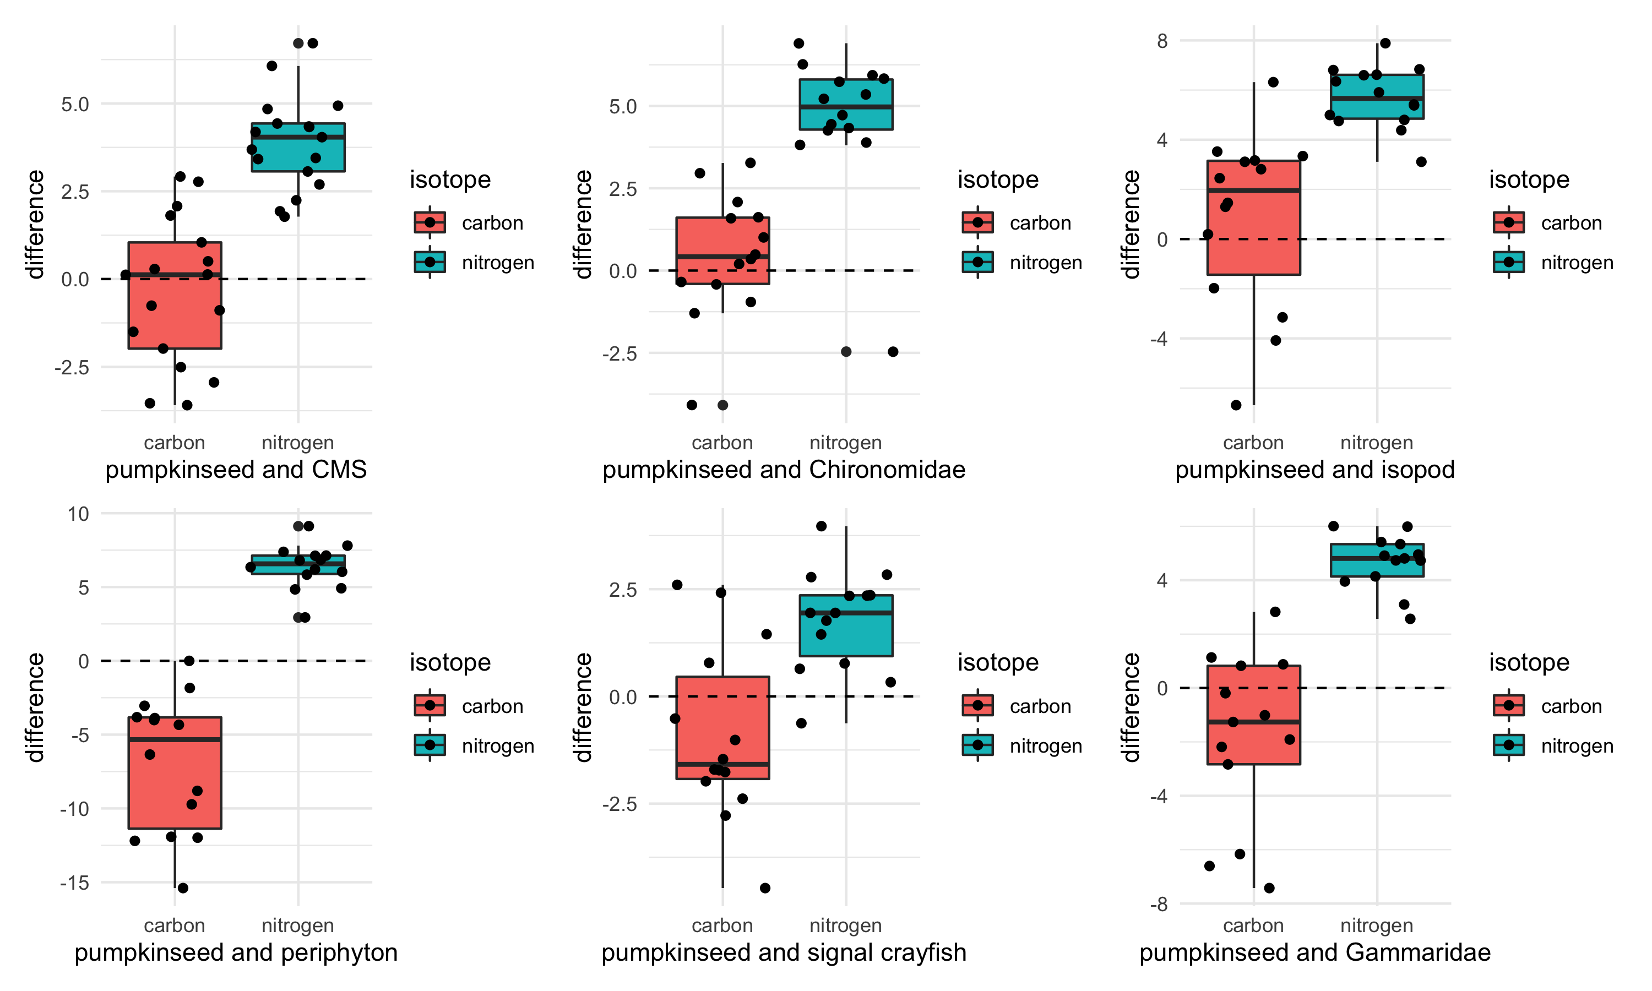
Notes:
Pumpkin seed d13C – comparison organism d13C = values plotted
Each dot is a lake, so we can see how distributed the lakes are
If the value is positive, the pumpkinseed is enriched relative to that prey item (pumpkinseed higher d13C value)
If the value is negative, the pumpkinseed is depleted relative to that prey item (pumpkinseed has a lower d13C value)

Slide 8
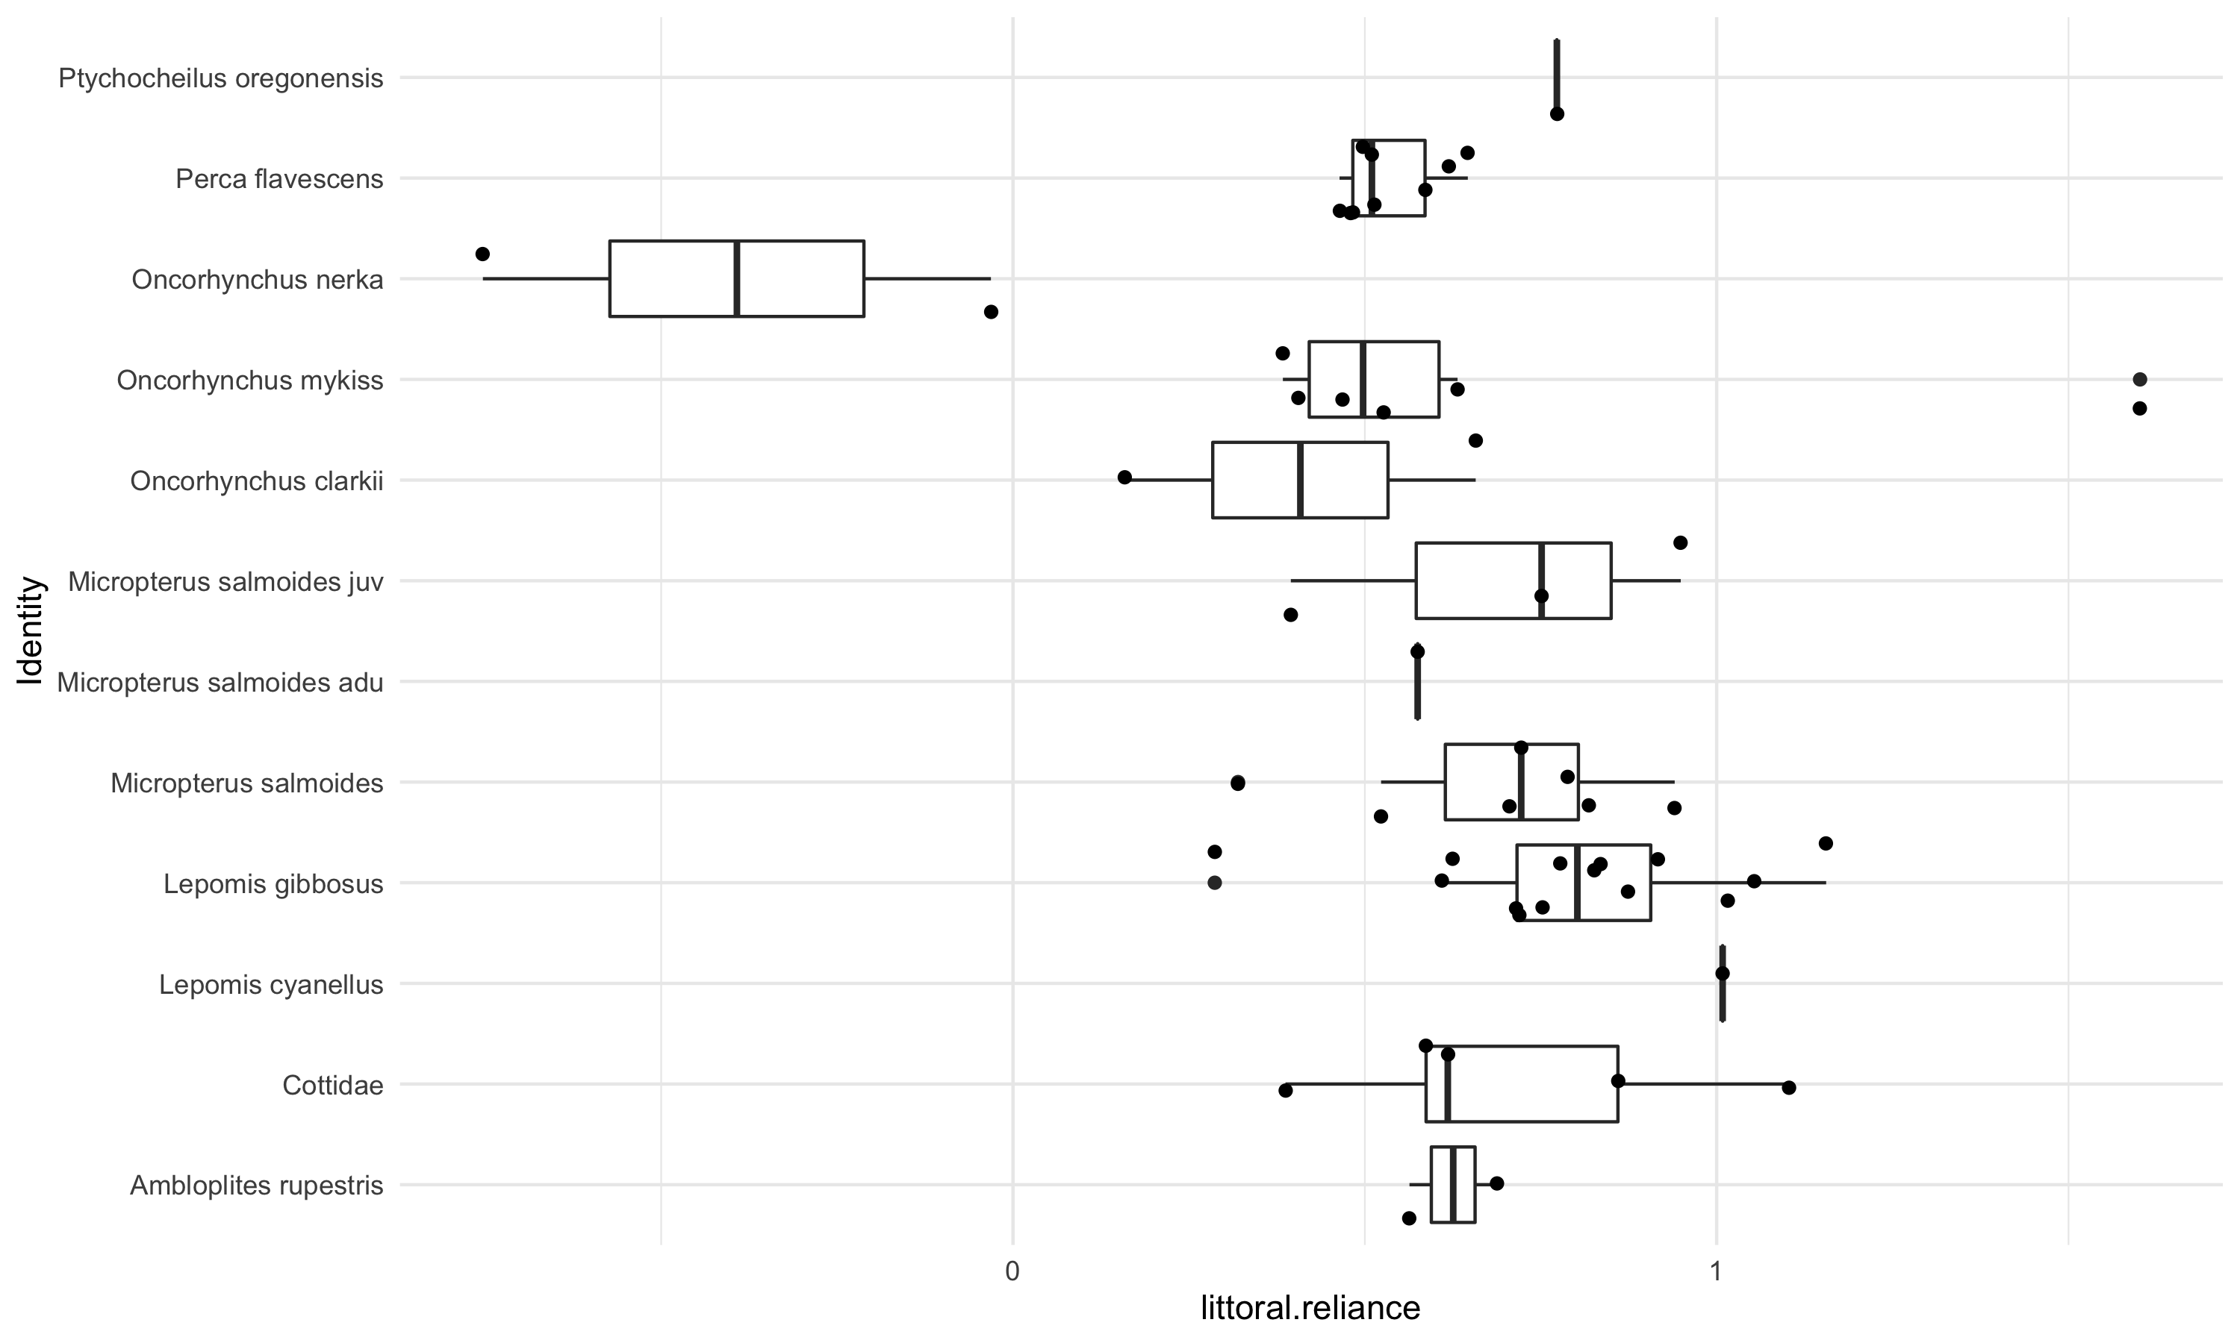
pelagic-littoral reliance
Notes:
This is a basic box plot of the results from lake by lake, littoral vs pelagic reliance for each fish species. This is 17 lake_year sampling events that had both snails and zooplankton. These are the results from a two source mixing models, for all lakes, then the results per species summarized as a box plot.
Details about the mixing models:
The results were not corrected for over or under-estimated fish or endmembers, hence the <0 and >1 values.
“Snails” includes all snails captured from a lake, so if there was more than one type of snail (or zoop) then I took the mean. Alternatively, I could always choose the most enriched and depleted endmembers if more than one value is available.

Slide 9
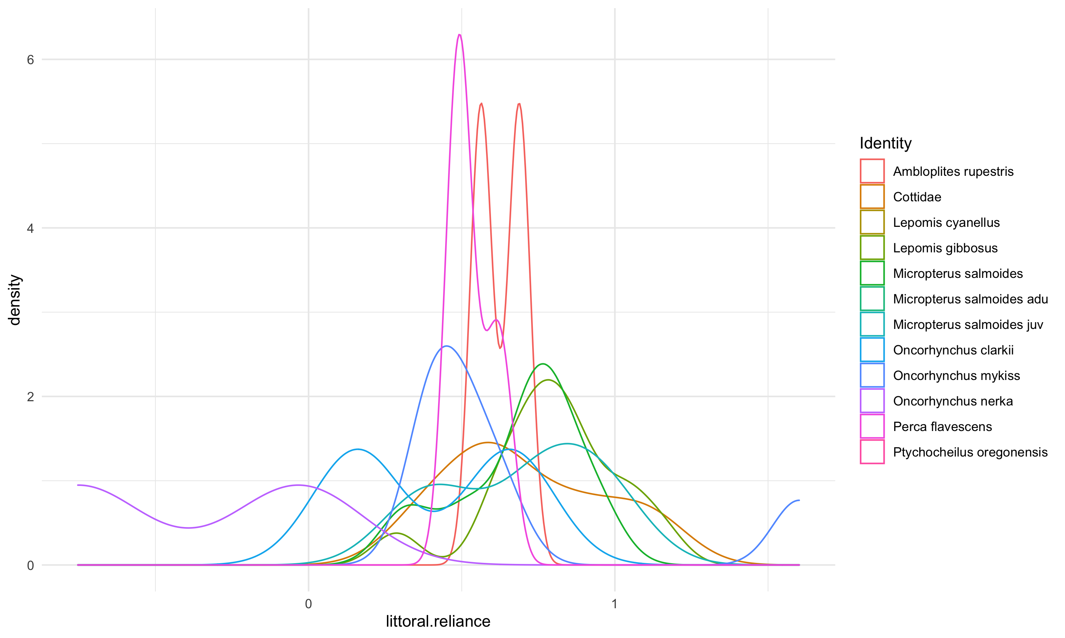
Looking at simple – pelagic vs littoral reliance
Notes:
Density plot to complement the boxplot. Similar info, just an alternative way to look at the littoral-pelagic mixing model results it that lets compare species.

Slide 10
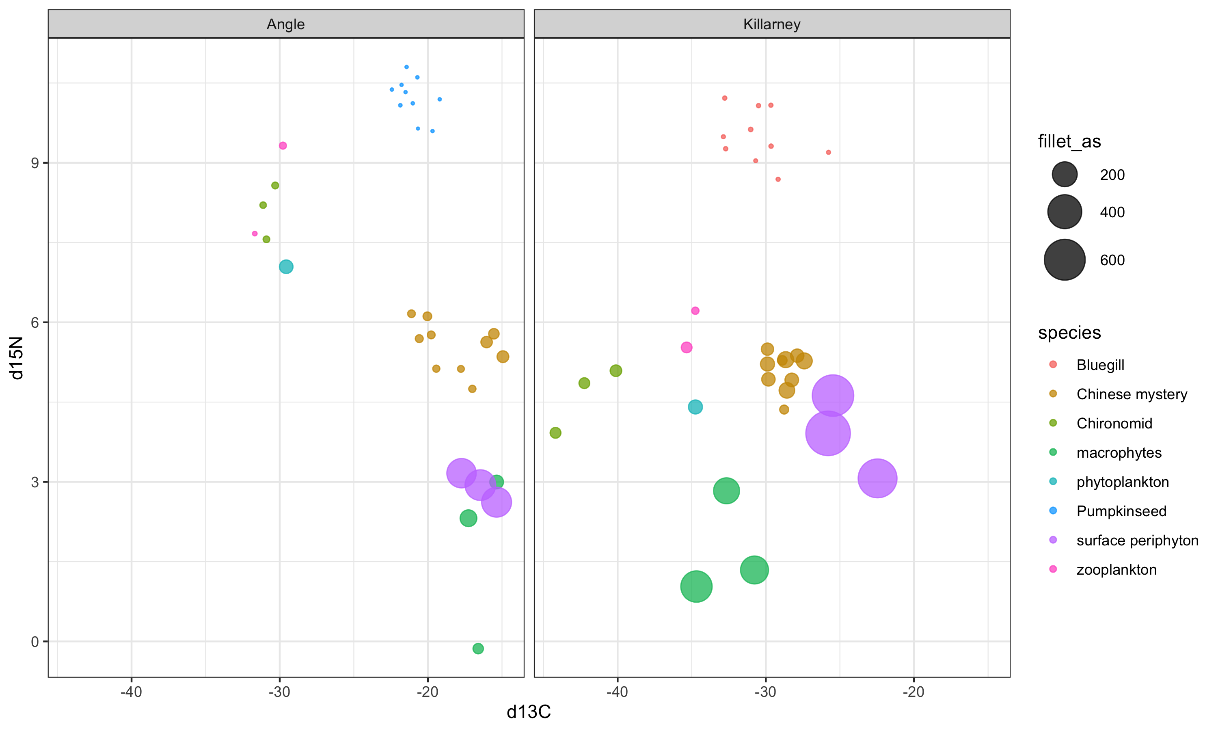
Combined total As µg/g & stable isotopes
Notes:
A quick comparison of all available samples for which we have both C & N isotope data and As data, just looking in one place. I think this is the most informative, and I am curious how

