Slide 1
Lowland WA lakes food webs
Touch base with Julian
5/18/2021

Slide 2
Data overview
27 different lakes
9 have >1 sampling event (Pine = 6, Wilderness = 3)
Excluding Pine 2013, there are 40 unique lake_year events.

Slide 3
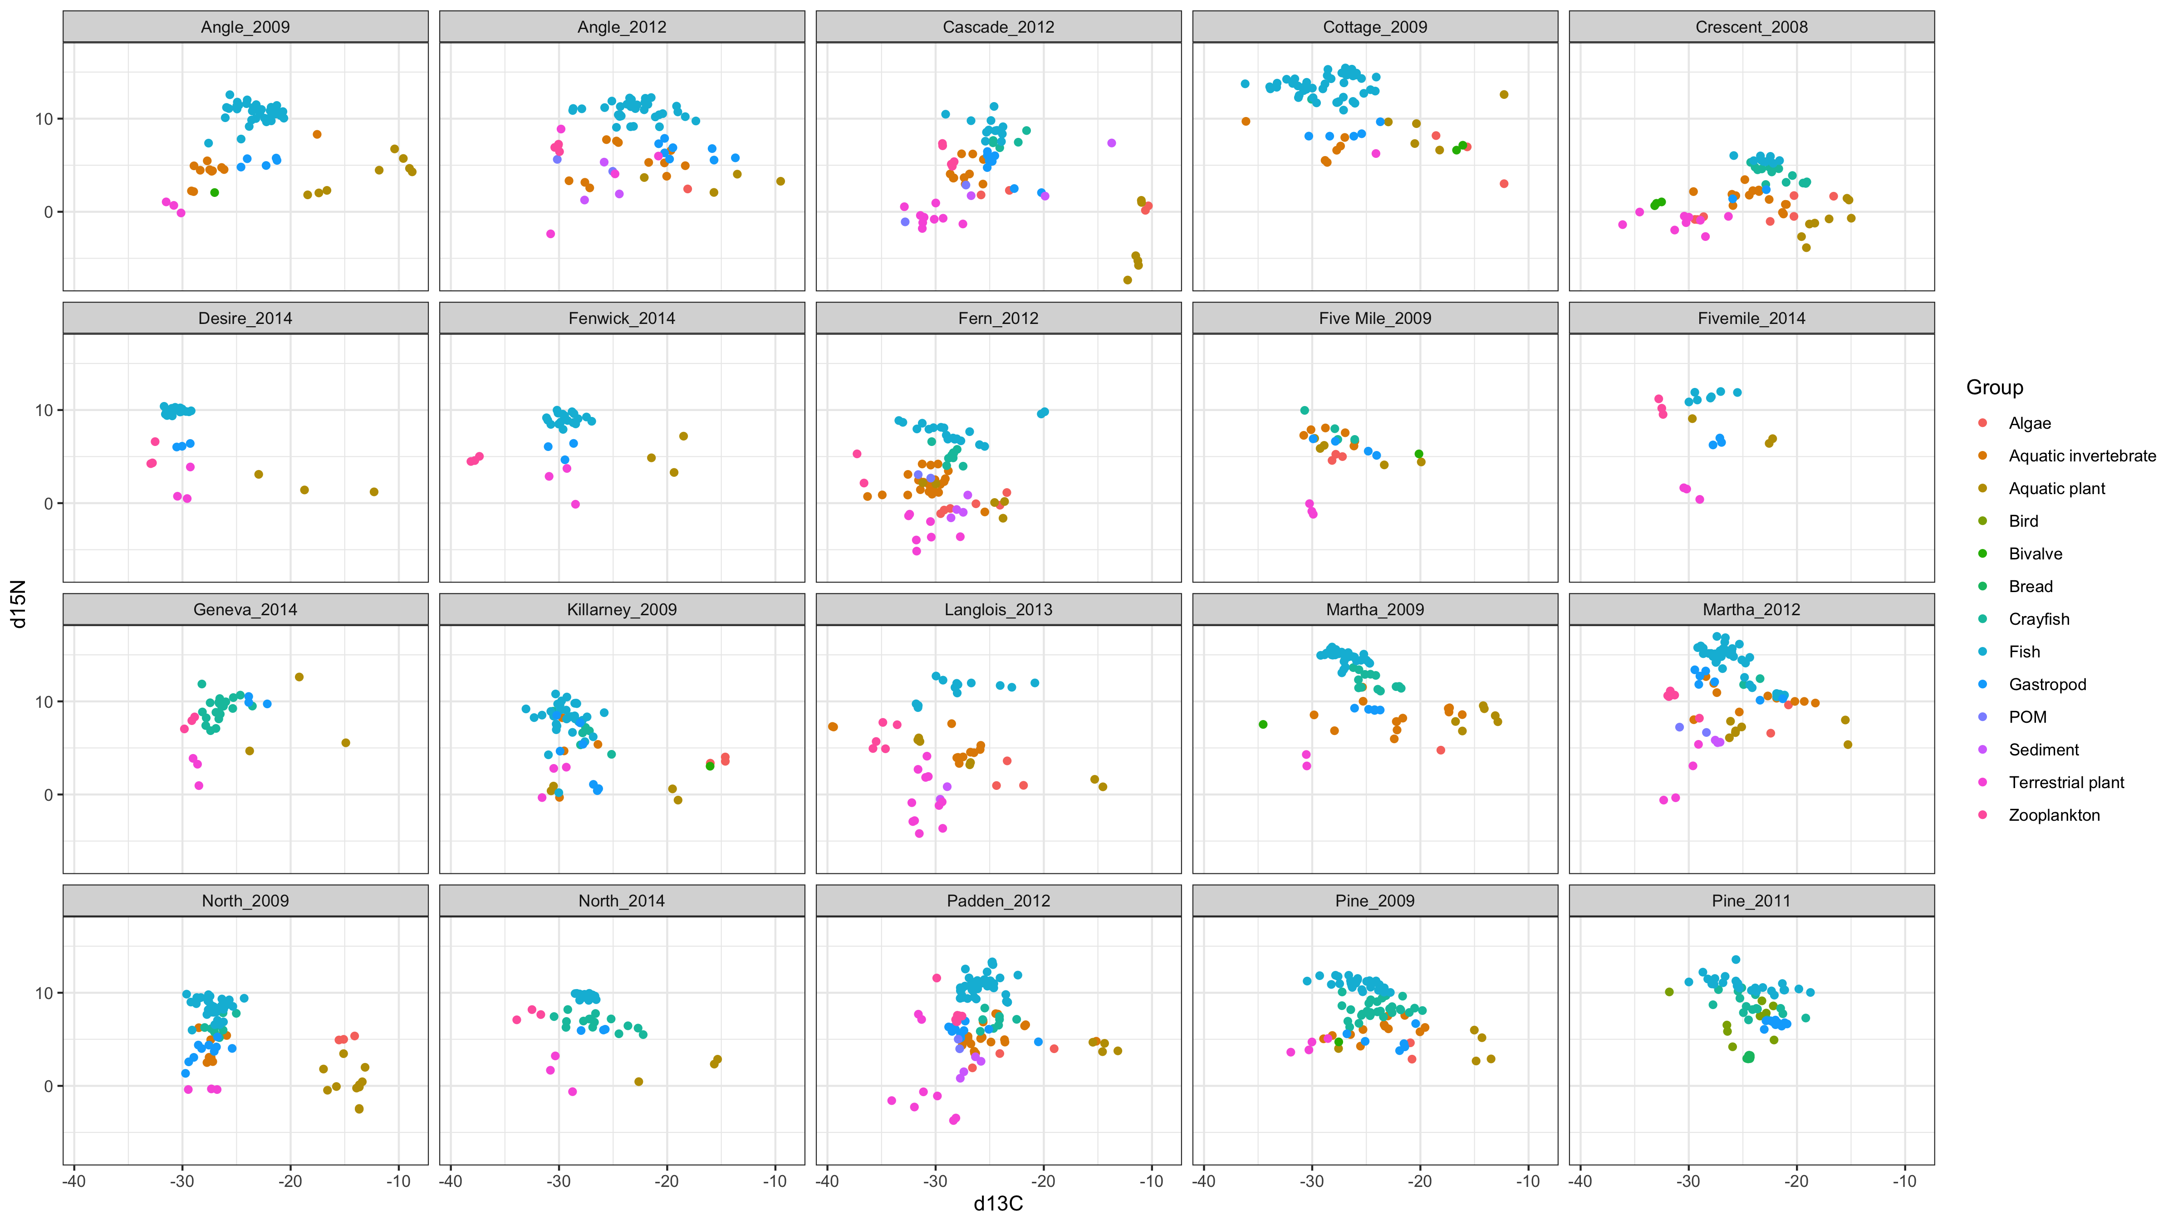
Notes:
Quick and dirty. All lake_year C & N samples plotted, just to get a sense of the big picture. Twenty sets, next slide has 20 more.

Slide 4
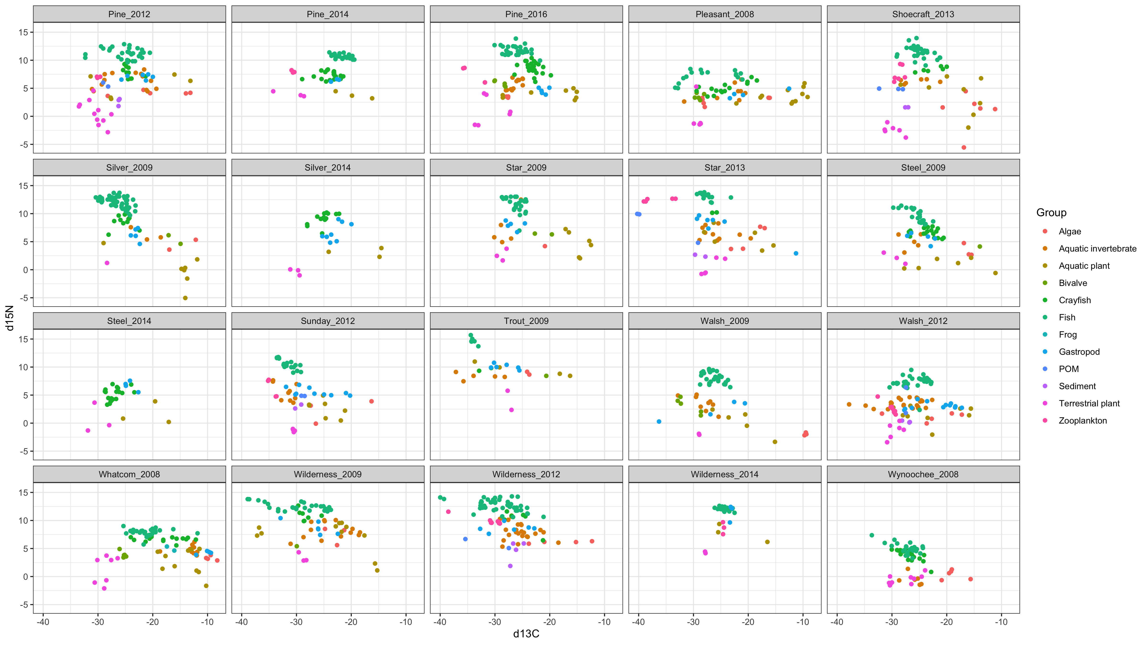

Slide 5
Pumpkinseed (Lepomis gibbosus) was the most commonly captured species
Lepomis gibbosus | 24
Micropterus salmoides | 22
Perca flavescens | 22
Oncorhynchus mykiss | 18
Cottidae | 14
Ambloplites rupestris | 5
Ameiurus nebulosus | 5
Micropterus salmoides juv | 3
Oncorhynchus clarkii | 3
Oncorhynchus nerka | 3
Pomoxis nigromaculatus | 2
Ptychocheilus oregonensis | 2
Lepomis cyanellus | 1
Lepomis macrochirus | 1
Micropterus dolomieu | 1
Micropterus salmoides adu | 1

Slide 6
Can we do a mixing model to ID pumpkinseed invertebrate diet? Short answer, not cleanly.
Constraints
Alternatives
Pumpkinseed consume a wide variety of prey. C & N mixing models can only estimate from 3 sources.
Not clear on a universal (i.e., works for all 40 lakes) clumping of prey into three meaningful categories/pools.
We can test trends of pumpkin seed relative to particular resources.
We can examine littoral vs pelagic reliance.
We can try three source mixing models for a species if we are willing to lose information and the items are adequately spread apart. For example, top three prey items for pumpkinseed, then go from there?

Slide 7
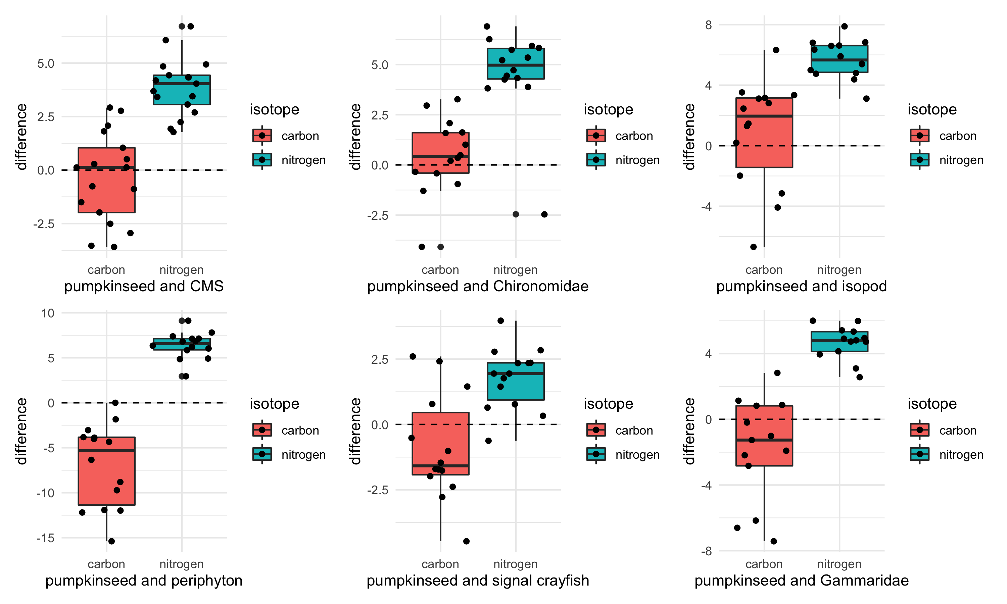
Notes:
Pumpkin seed d13C – comparison organism d13C = values plotted
Each dot is a lake, so we can see how distributed the lakes are, behind the box plot. Quite a bit of variability that could be explored.
If the value is positive, the pumpkinseed is enriched relative to that prey item (pumpkinseed higher d13C value)
If the value is negative, the pumpkinseed is depleted relative to that prey item (pumpkinseed has a lower d13C value)

Slide 8
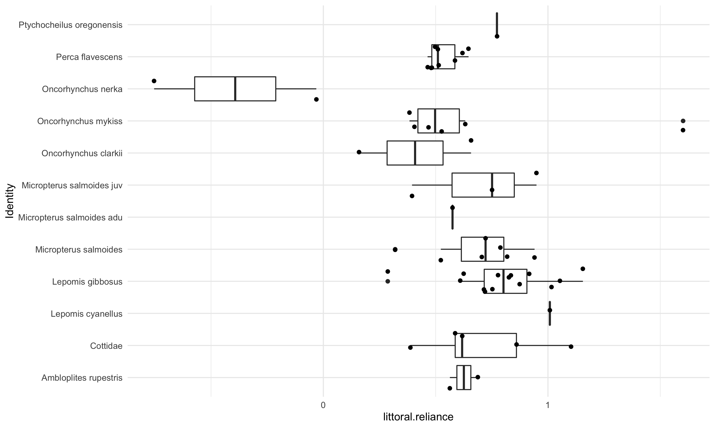
pelagic-littoral reliance
Notes:
This is a basic box plot of the results from lake by lake, littoral vs pelagic stable isotope mixing models, summarized by fish species. This is 17 of the lake_year sampling events; only the lakes that had both snails and zooplankton.
Details about the mixing models:
The results were not corrected for over or under-estimated fish or endmembers, hence the <0 and >1 values.
“Snails” includes all snails captured from a lake, so if there was more than one type of snail (or zoop) then I took the mean. Alternatively, I could always choose the most enriched and depleted endmembers if more than one value is available.

Slide 9
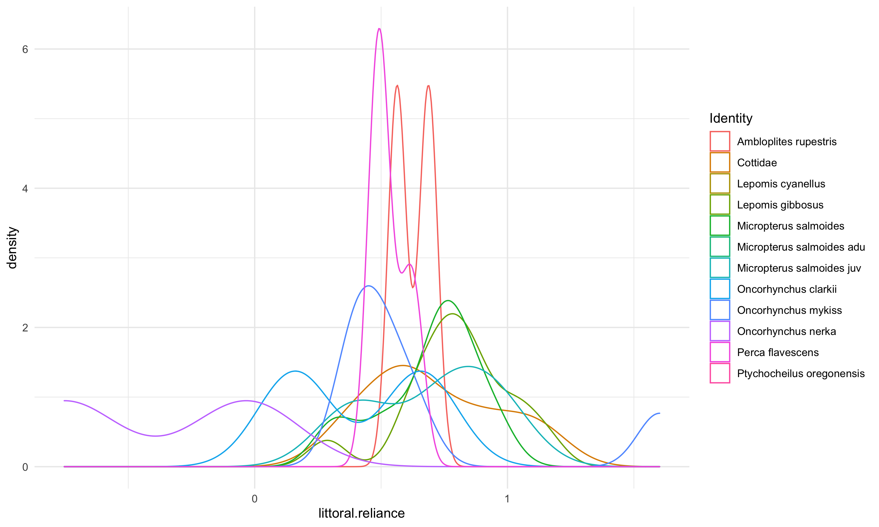
Looking at simple – pelagic vs littoral reliance
Notes:
Density plot to complement the boxplot. Similar info, just an alternative way to look at the littoral-pelagic mixing model results it that lets compare species.

Slide 10
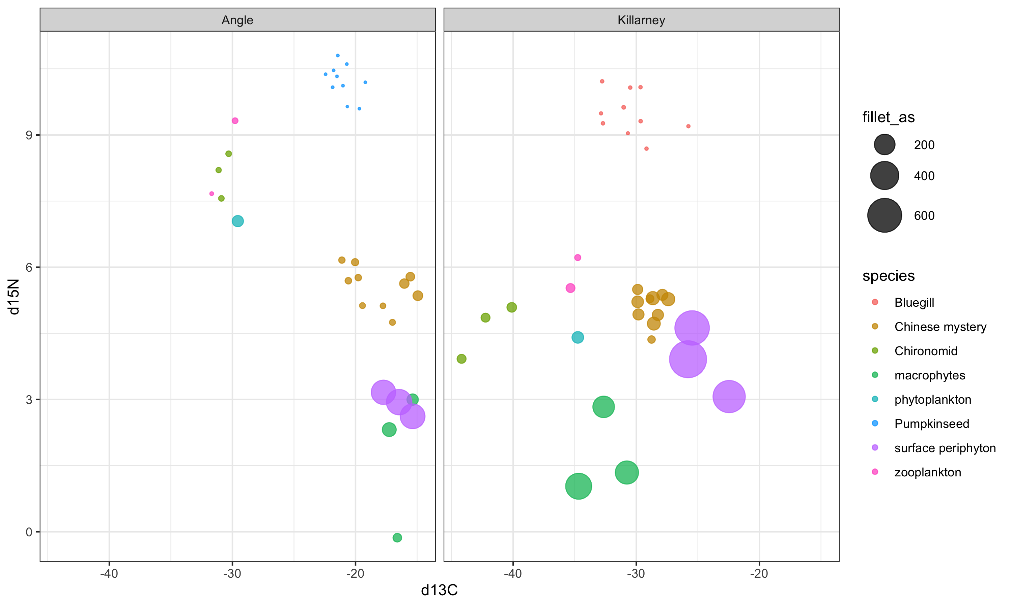
Combined total As µg/g & stable isotopes
Notes:
A quick comparison of all available samples for which we have both C & N isotope data and As data, from the sheet that Erin shared. Circle size reflects the arsenic concentration in ug/g

Slide 11
Extra

Slide 12
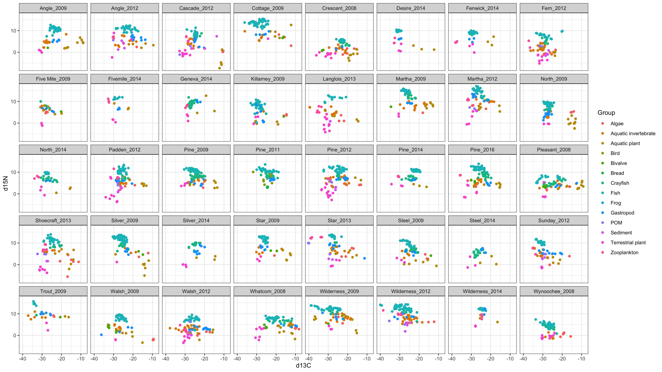
Notes:
All lakes, only useful if on large screen.

