Slide 1
Lowland WA lakes food webs
Touch base with Julian
5/13/2021

Slide 2
Data set overview
27 different lakes
9 have > 1 sampling event (Pine = 6, Wilderness = 3)
Excluding Pine 2013, there are 40 unique lake_year events.

Slide 3
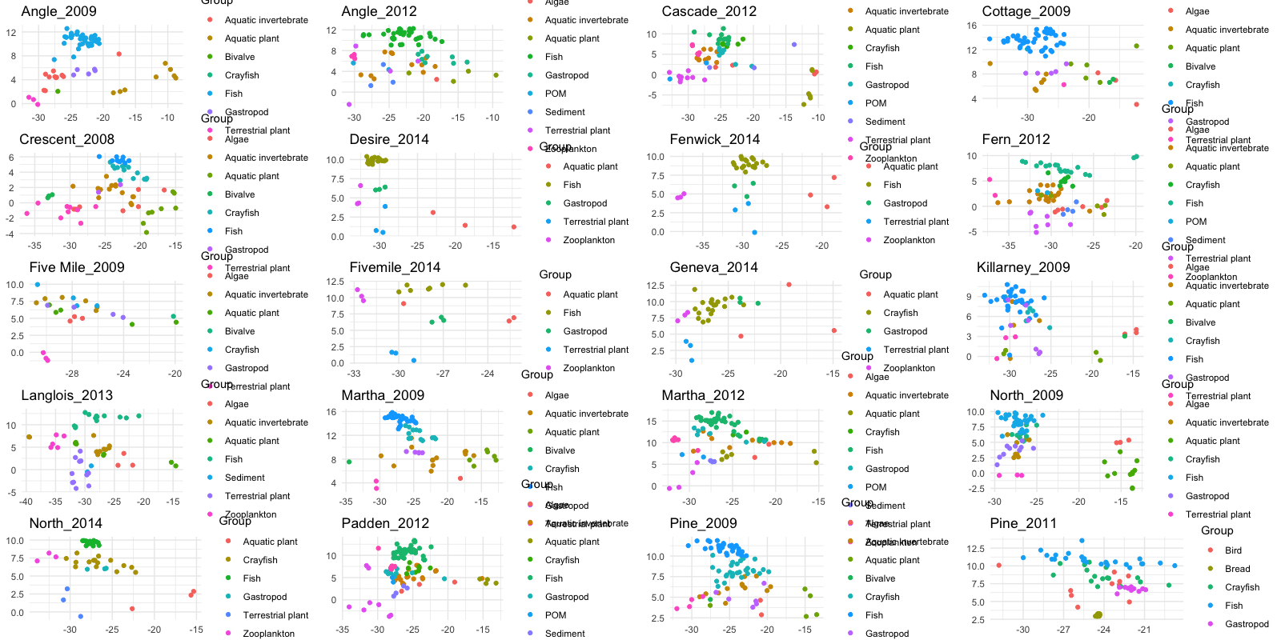

Slide 4
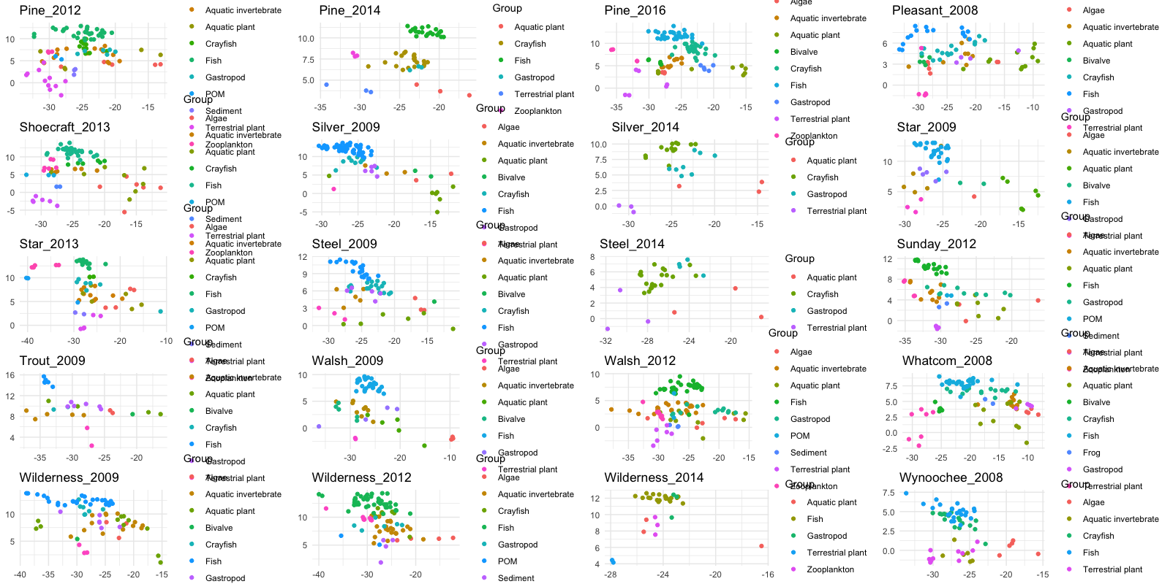

Slide 5
Pumpkinseed (Lepomis gibbosus) was the most commonly captured species
Lepomis gibbosus | 24
Micropterus salmoides | 22
Perca flavescens | 22
Oncorhynchus mykiss | 18
Cottidae | 14
Ambloplites rupestris | 5
Ameiurus nebulosus | 5
Micropterus salmoides juv | 3
Oncorhynchus clarkii | 3
Oncorhynchus nerka | 3
Pomoxis nigromaculatus | 2
Ptychocheilus oregonensis | 2
Lepomis cyanellus | 1
Lepomis macrochirus | 1
Micropterus dolomieu | 1
Micropterus salmoides adu | 1

Slide 6
Can I do a mixing model to ID pumpkin seed invertebrate diet? Short answer is not cleanly.
But I can test trends of pumpkin seed relative to resources
I can examine littoral vs pelagic
I can do three source mixing models for this species and compare.

Slide 7
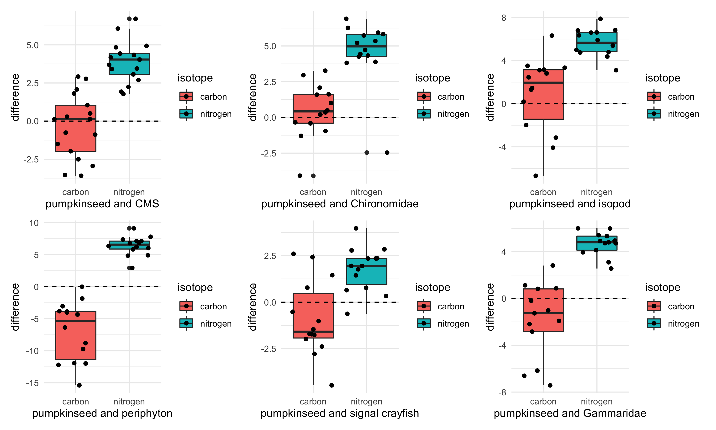
Notes:
Pumpkin seed d13C – comparison organism d13C.
If the value is positive, the pumpkinseed is enriched relative to that prey item (pumpkinseed higher d13C value)
If the value is negative, the pumpkinseed is depleted relative to that prey item (pumpkinseed has a lower d13C value)

Slide 8
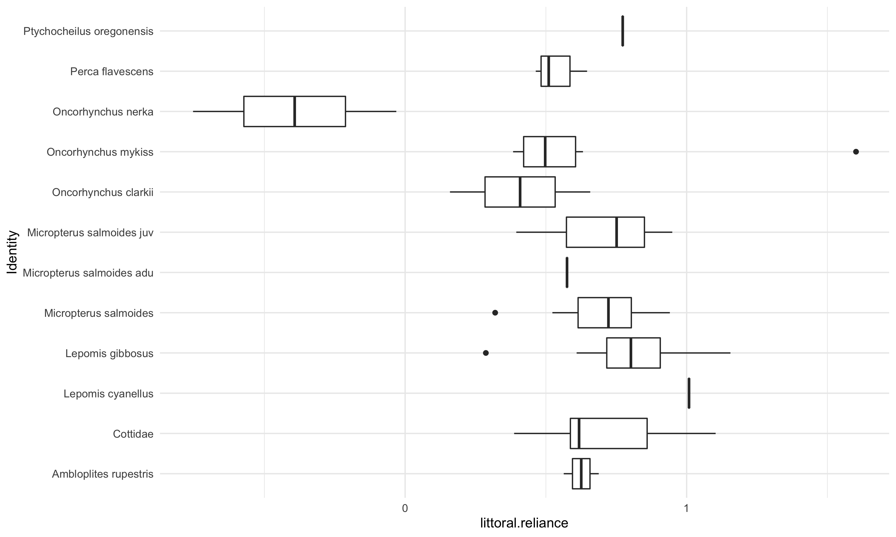
Pelagic vs littoral reliance

Slide 9
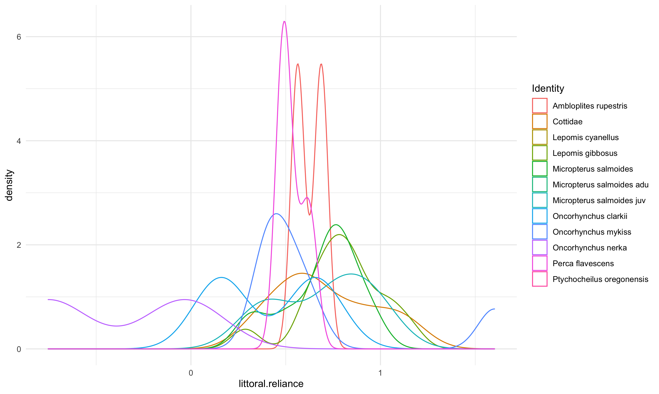
Looking at simple – pelagic vs littoral reliance
Notes:
Density plot to complements the boxplot, just to see how different species compare.

