Slide 2
Problem:
Triangulation

Slide 3
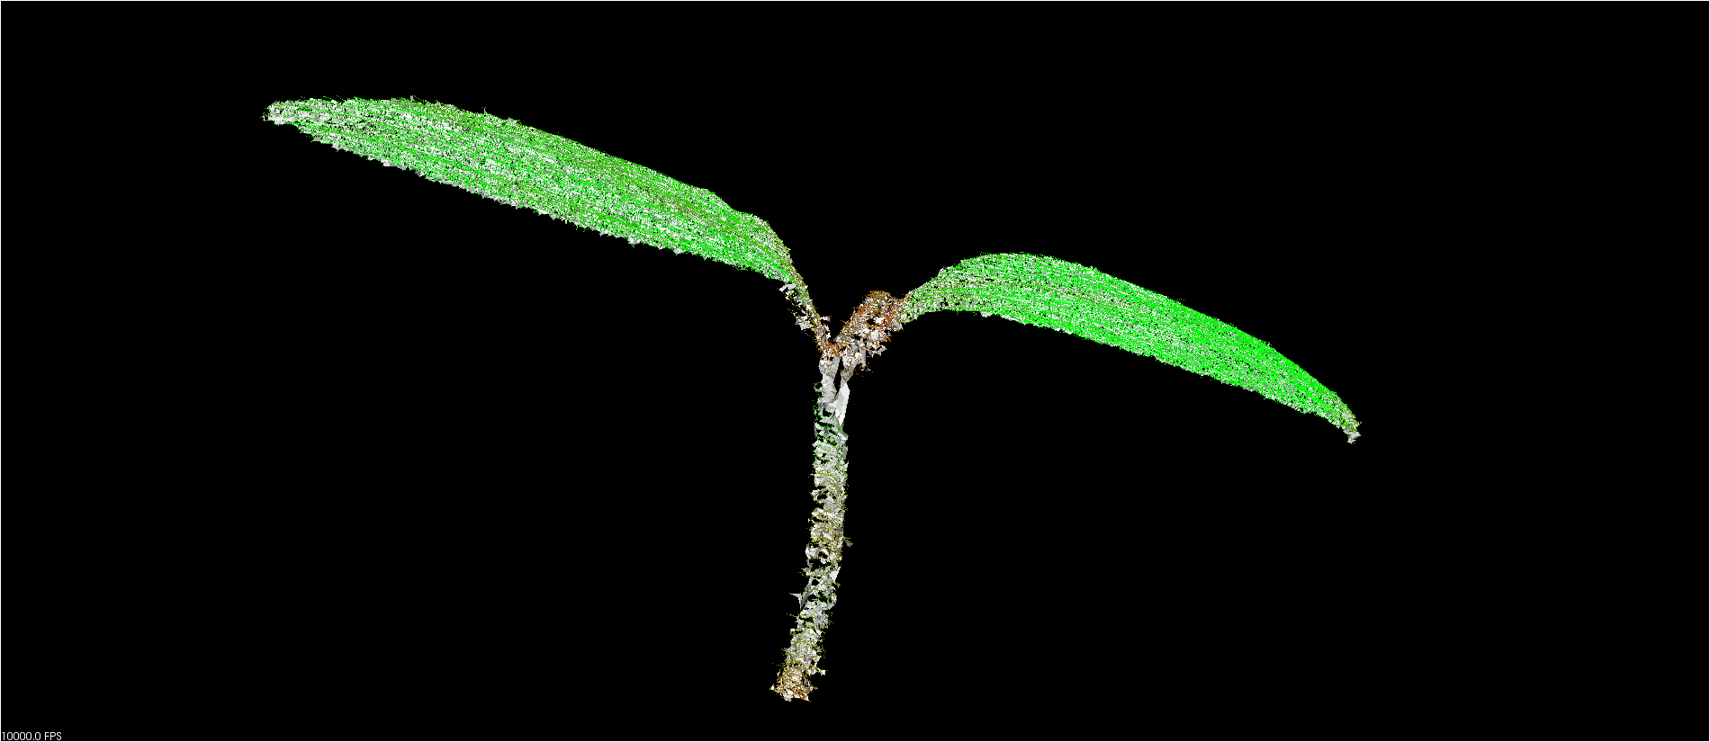
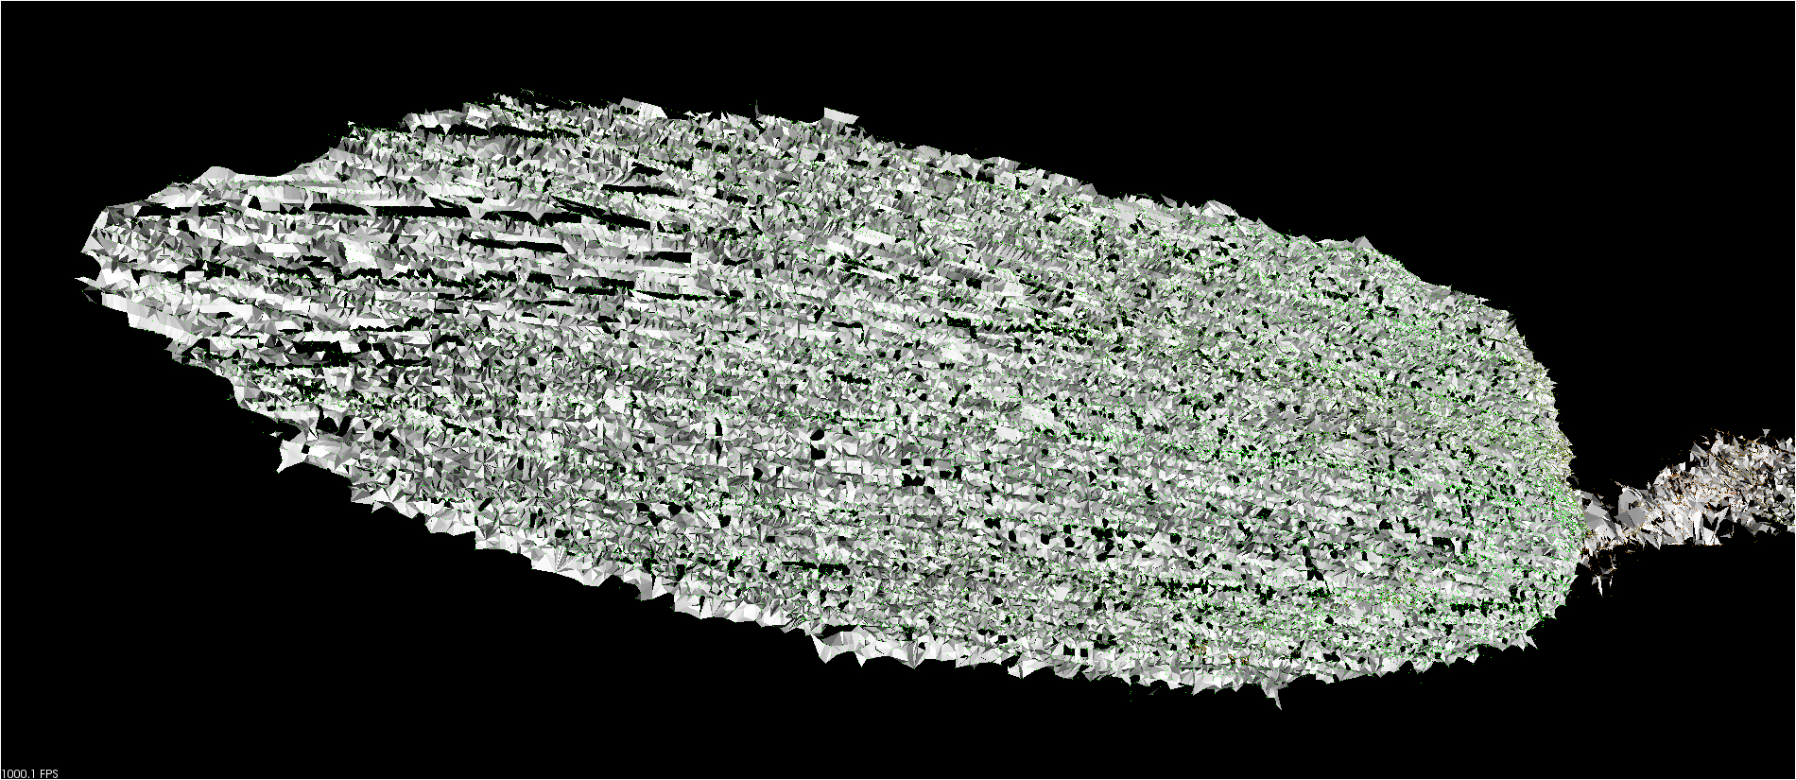
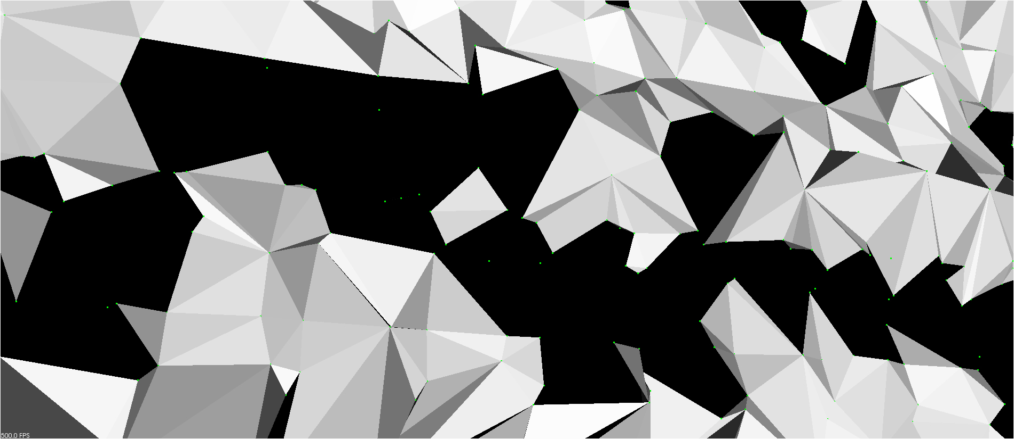

Problem: Triangulation

Slide 4
Problem: Triangulation
Reason for triangulation:
get a 1 ring neighborhood of each point

