Slide 2
Problem:
Triangulation

Slide 3
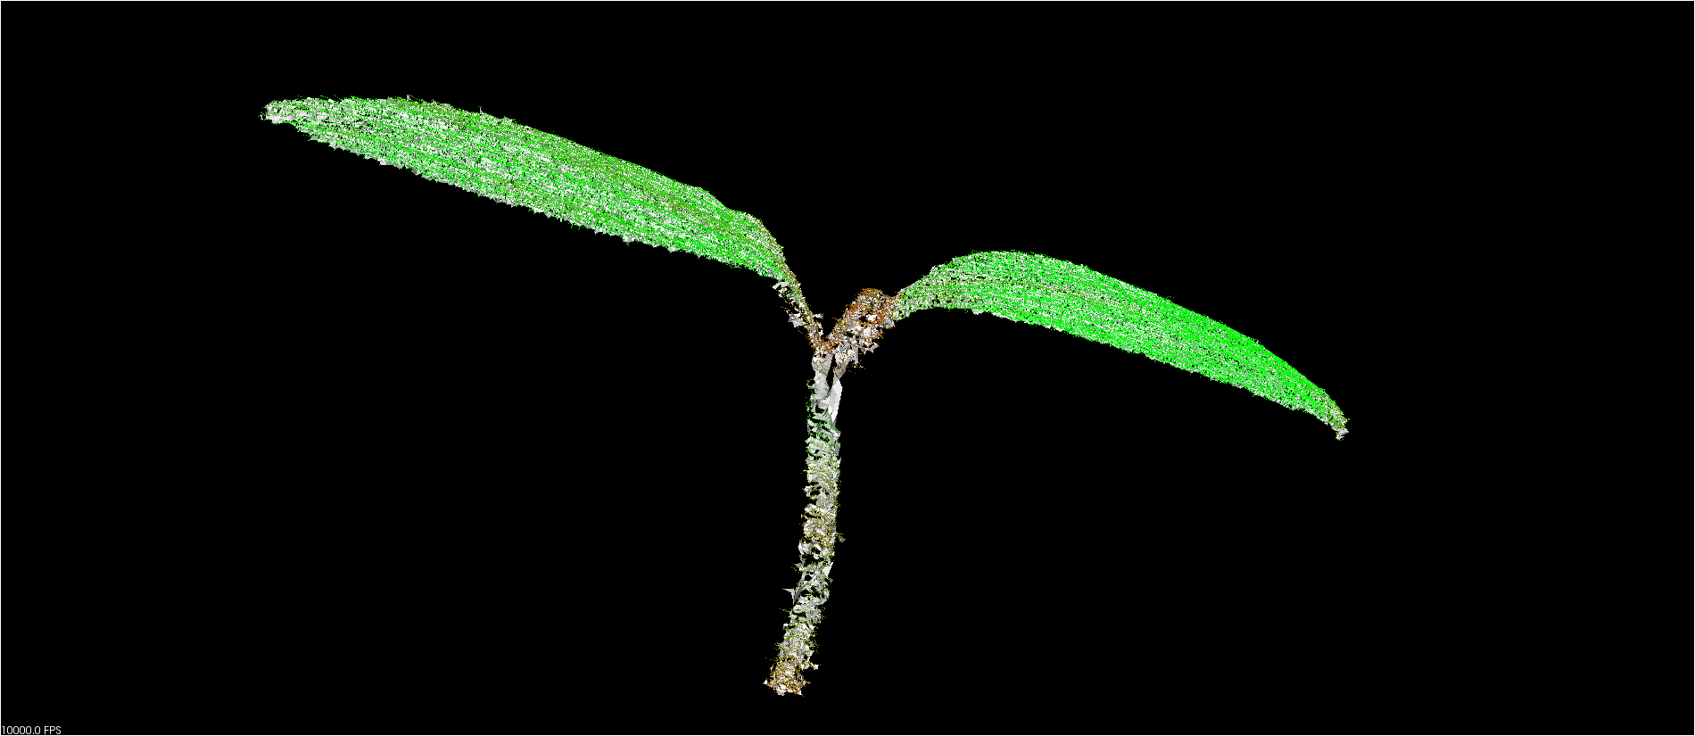
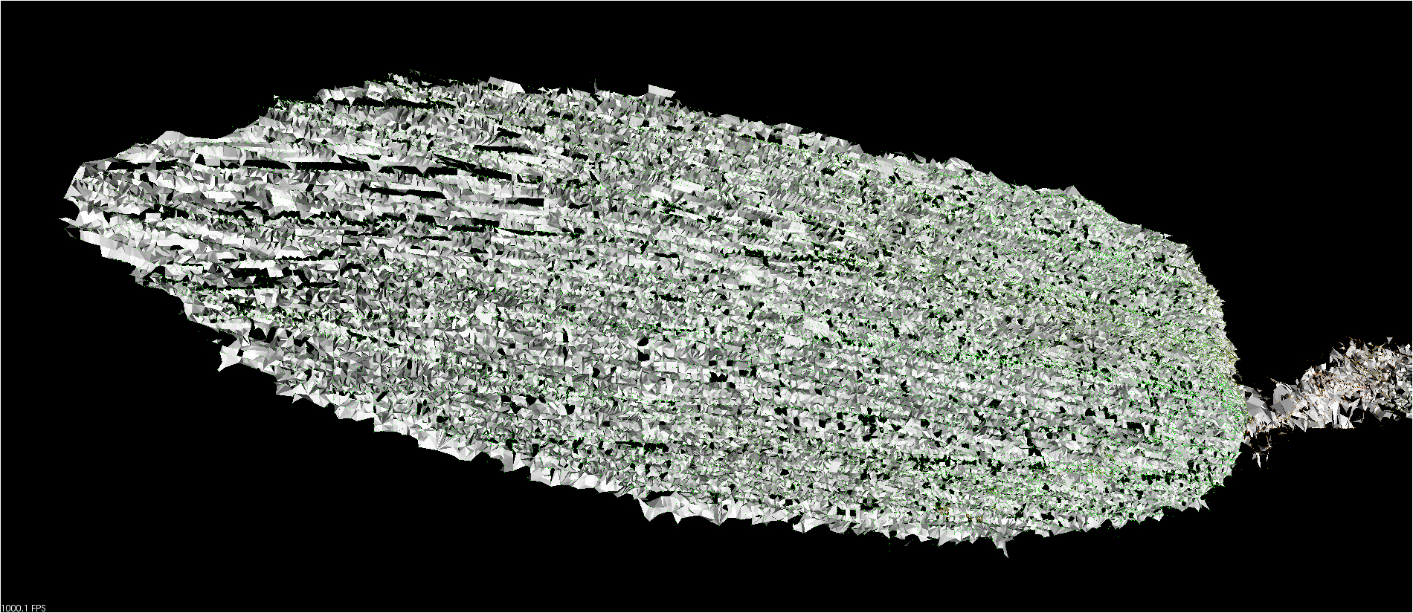
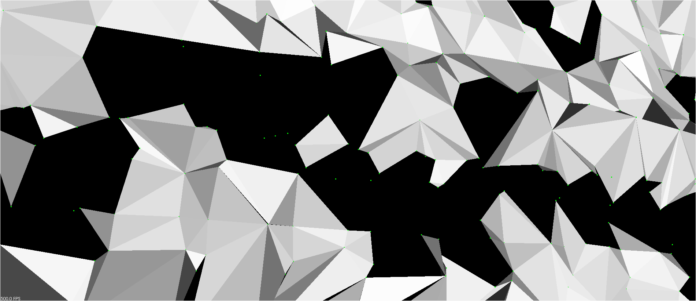
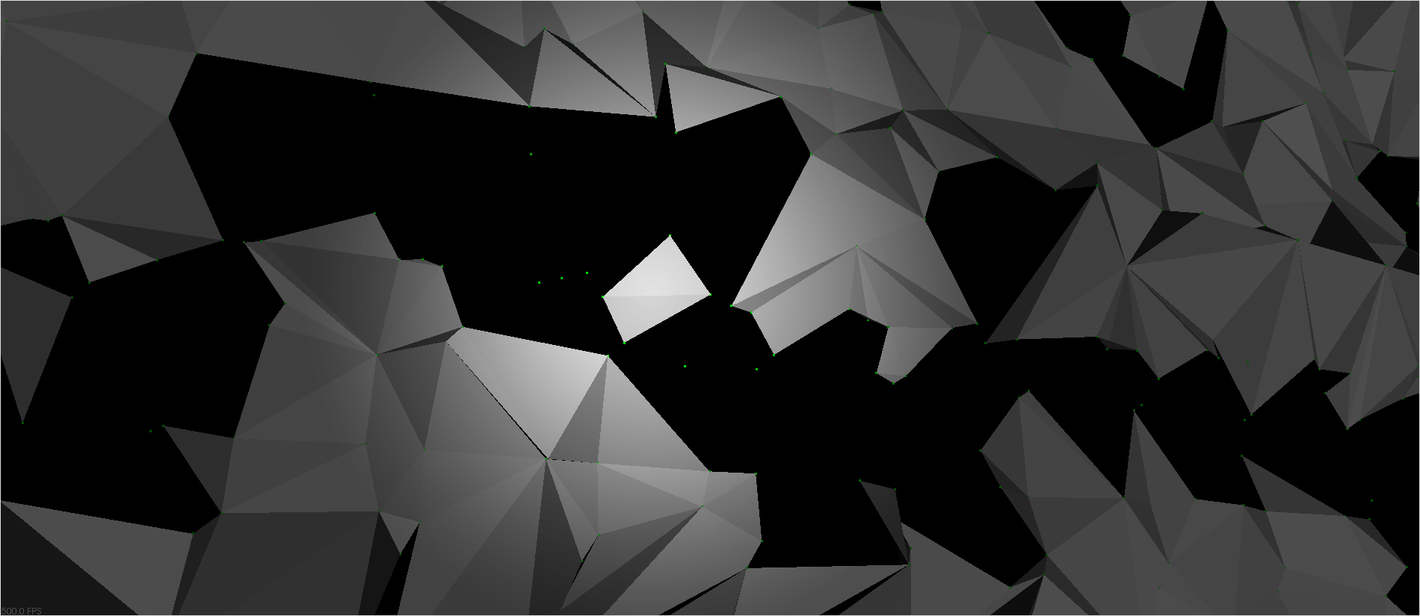
Problem: Triangulation

Slide 4
Problem: Triangulation
Reason for triangulation:
get a 1 ring neighborhood of each point

Slide 5
Problem: Strange Behaviour
PCL/VTK vs CGAL
PCL 1.6.0 CGAL 4.5 setPointCloudRenderingProperties() does not find Pointclouds anymore

