Slide 1
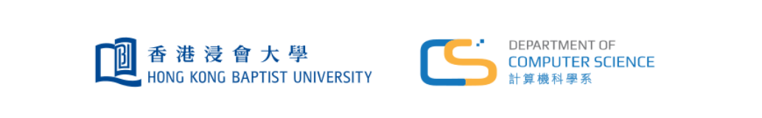

Cloud-Deployed Telegram Chatbot
^{Wenjun YU,Zhan ZHAO, Guofan YU}

Slide 2


Outline
▶ 1. Project Overview
▶ 2. System Architecture
▶ 3. Technical Implementation
3.1 HKBU GenAI API Integration
3.2 Redis Cloud Logging
3.3 Docker Compose Multi-Service
3.4 Auto-Compact Optimization
3.5 Cron + Heartbeat Scheduling
▶ 4. Cloud Deployment & CI/CD
▶ 5. Cost Analysis & Conclusion

Slide 3
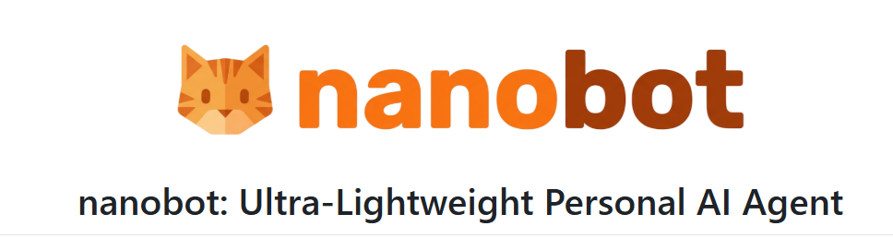
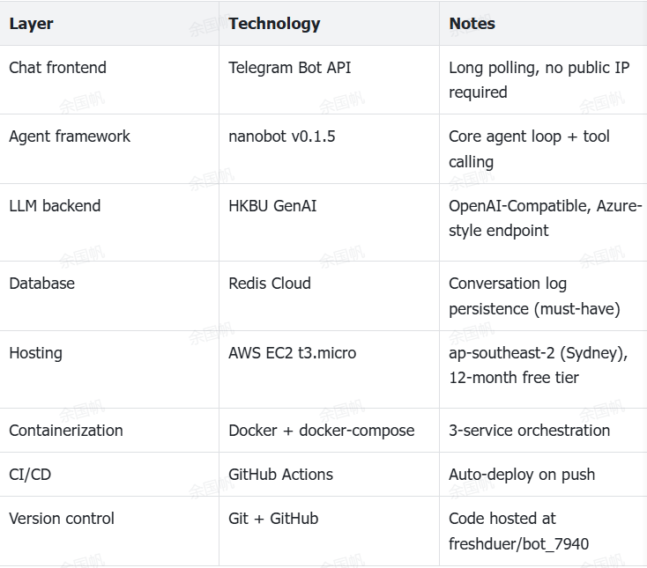
Project Overview
Telegram Chatbot
This project is a cloud-deployed Telegram chatbot built on the open-source nanobot framework (v0.1.5). The bot
accepts natural-language input from users via Telegram and responds by calling a Large Language Model (LLM) backend.
Core functional features:
Natural language chat via Telegram Bot API
LLM-powered responses via HKBU GenAI
Conversation logging
Streaming output
Multi-service Docker Compose
Auto-deployment
Memory & session management
Autonomous scheduling

Slide 4
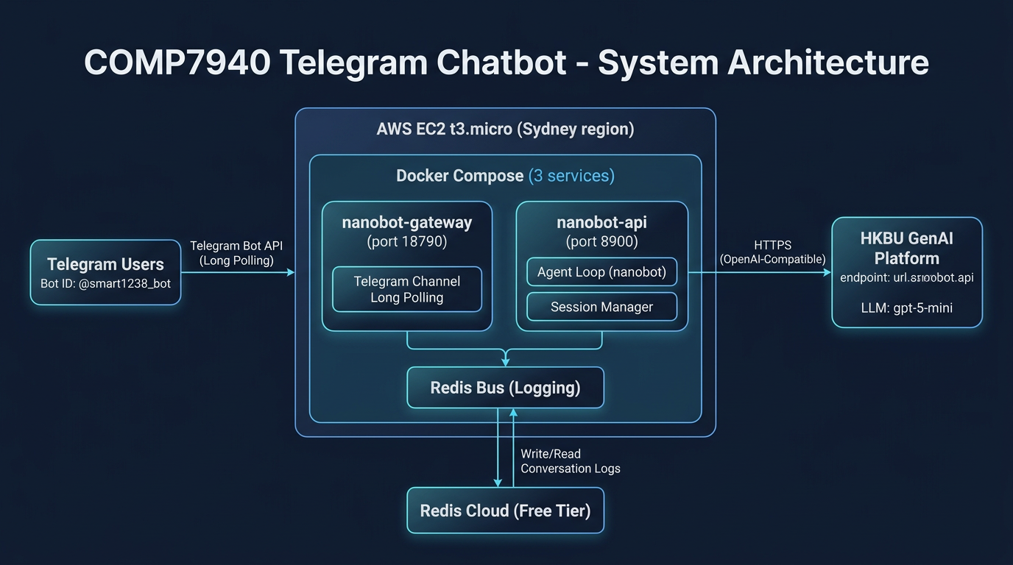
System Architecture
Telegram Chatbot
System workflow
1. User sends message in Telegram
2. Gateway receives via long polling
3. Agent builds prompt from session history
4. LLM call → HKBU GenAI API
5. Streaming response edited in real time
6. Redis writes user + assistant turns
7. Final message delivered to user
Memory:Redis
User Interface:telegram
Deployment:docker
Framework:nanobot
LLM Backend:HKBU API Platform

Slide 5
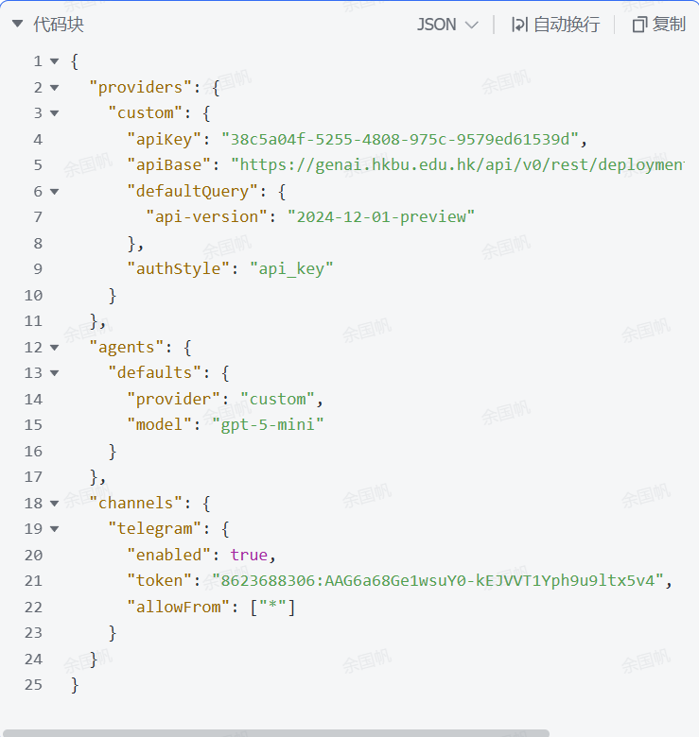
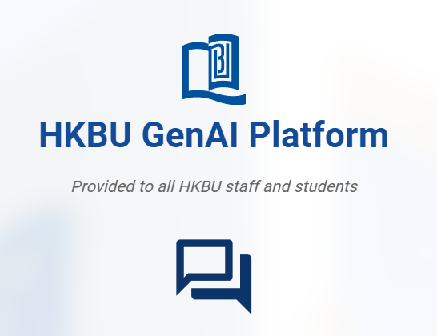
Technical Implementation
HKBU GenAI API Integration
✓ Added defaultQuery & authStyle fields to nanobot ProviderConfig schema
✓ Enables Azure-style endpoints with api-key authentication
✓ Supports required api-version query parameter
✓ Source: nanobot/config/schema.py, providers/openai_compat_provider.py

Slide 6
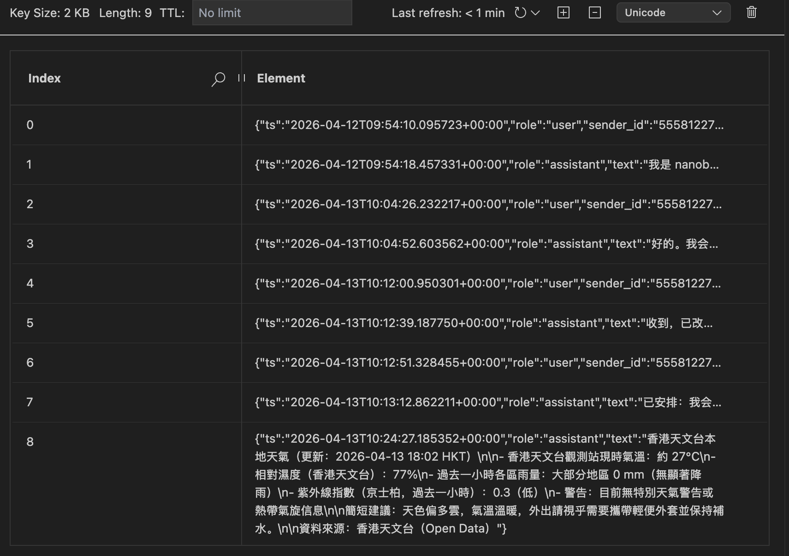
Technical Implementation
Redis Cloud Conversation Logging
• Every user/assistant turn persisted to Redis Cloud
• Log entry structure: timestamp, role, sender_id, text
• Key format: nanobot:conv:{session_key}:{epoch}
• Supports historical conversation replay
• Enables debugging and audit trail
• SSL/TLS encrypted connection

Slide 7
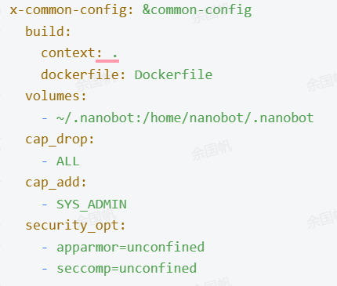
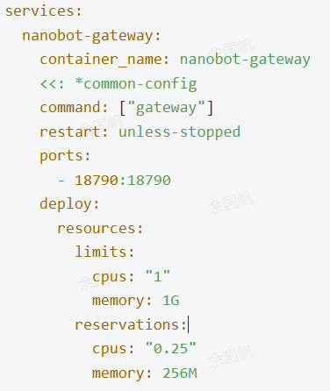
Technical Implementation
Docker Compose Multi-Service
nanobot-gateway Port 18790
nanobot-api Port 8900
nanobot-cli CLI profile
Security Hardening
• cap_drop: ALL (drop all capabilities)
• SYS_ADMIN only (for bubblewrap)
• Non-root user execution
• Resource limits: CPU & Memory
• Restart policies configured

Slide 8
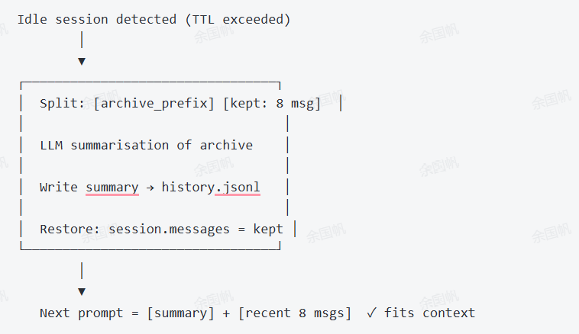
Technical Implementation
Auto-Compact Session Optimization
• Idle session detection (configurable TTL)
• Splits history: archive prefix + recent 8 messages
• LLM summarization of archived messages
• Persists summary to history.jsonl
• Reduces live prompt size by ~75%
• TTL set to 15 minutes of inactivity

Slide 9
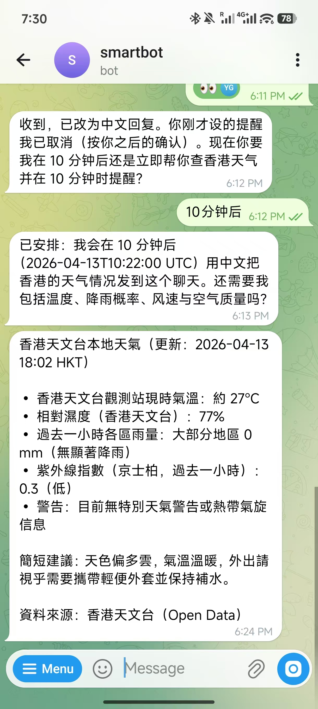
Technical Implementation
Cron + Heartbeat Scheduling-scheduled task
Together, Cron + Heartbeat enable: daily digest summaries, proactive reminders, periodic data collection, and other autonomous behaviours that go beyond a simple reactive chatbot.
HeartbeatService
LLM-driven decision loop:
Phase 1: Read HEARTBEAT.md
Ask LLM: Any tasks?
Phase 2: Execute if needed
CronService
3 scheduling modes:
• at (one-shot)
• every (interval)
• cron (standard expr)

Slide 10
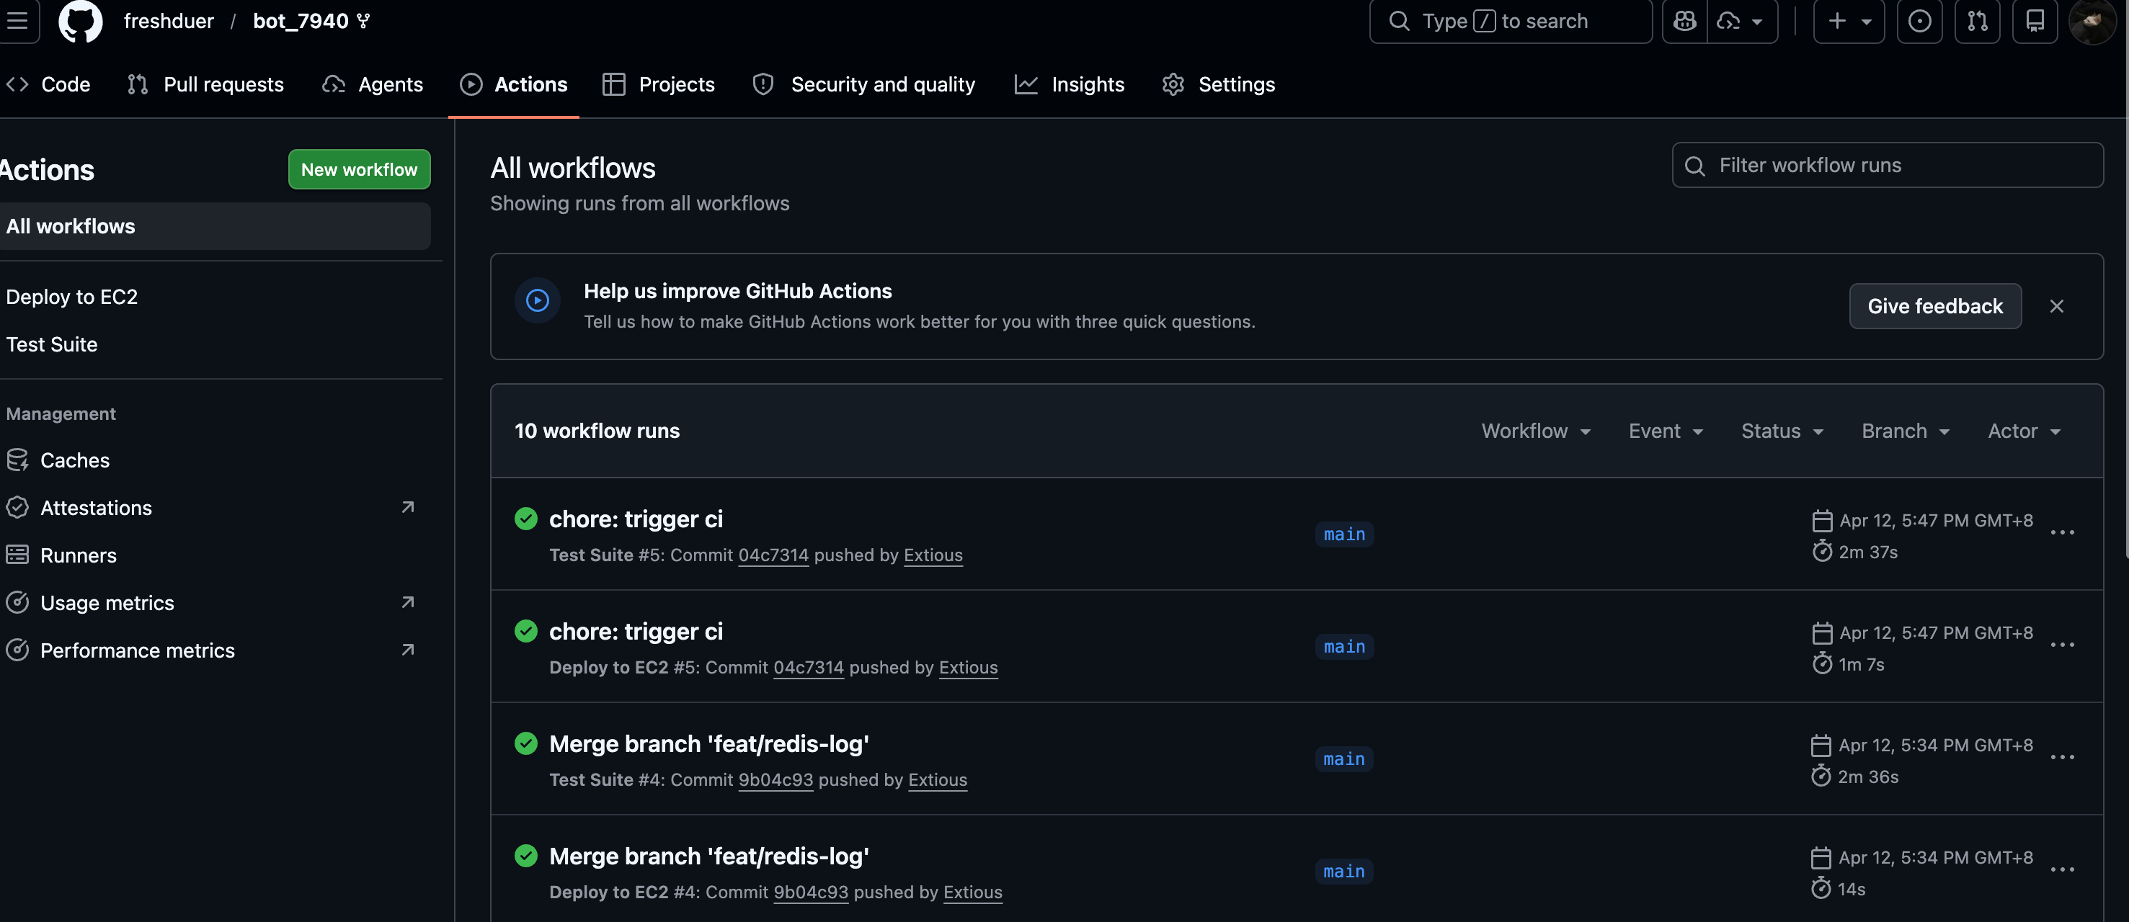
Cloud Deployment & CI/CD
GitHub Actions CI/CD Pipeline
✓ Automated testing on multiple Python versions (3.11, 3.12, 3.13)
✓ One-command deployment after git push
✓ No manual intervention required
1. Push to main
GitHub webhook triggered
2. CI Tests
pytest, ruff lint
3. Build Docker
docker build
4. SSH Deploy
EC2 instance
5. Restart
docker-compose up

Slide 11
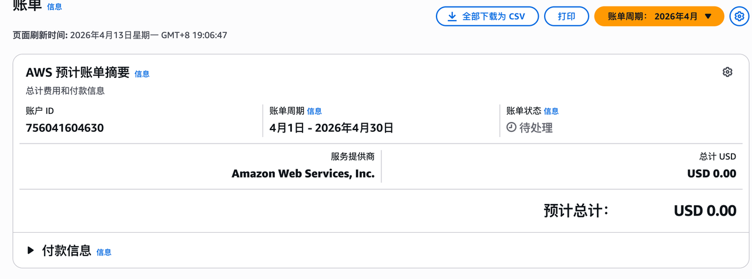
Cost Analysis & Conclusion
Conclusion
7 Mandatory Requirements
✅ Telegram Chatbot (@smart1238_bot)
✅ Redis Cloud Database Logging
✅ AWS EC2 Cloud Hosting
✅ HKBU GenAI LLM Integration
✅ Git Version Control
✅ Docker Containerization
✅ Monitoring & Cost Management ($0.00)
References
Nice-to-Have Features
✅ CI/CD Automation
✅ Multi-container Orchestration
✅ Security Hardening
✅ Auto-Compact Optimization
✅ Cron + Heartbeat Scheduling
nanobot framework: https://github.com/HKUDS/nanobot
nanobot documentation: https://nanobot.wiki/
HKBU GenAI Platform: https://genai.hkbu.edu.hk/
AWS EC2 Documentation: https://docs.aws.amazon.com/ec2/
Docker Documentation: https://docs.docker.com/
Redis Cloud: https://redis.io/cloud/
python-telegram-bot: https://docs.python-telegram-bot.org/

Slide 12
Thanks
Thank you

