Slide 1
openEHR Modelling
Foundations
Dr Paul Miller paulagmiller@gmail.com
Notes:
Hi good morning welcome
I am …
We have 45 minutes to talk you through foundations of openEHR modelling
Which is not a lot of time!

Slide 2
Intro to openEHR modelling
What is openEHR?
  Specifications
  Parts of EHR Specs to read first!
Multilevel modelling
  Reference Model
    The EHR
  Archetypes
  Templates
Reference Model Classes
  Composition
  Section
  Entries
    Observation
    Evaluation
    Instruction
    Action
    Admin Entry
  Cluster
  Element
Notes:
We are going to cover all this in that time.
It is hard to pitch this at the right level, some people may be very experienced and others potentially absolute beginners
So we will cover come basic concepts
But it fairly rapidly gets complicated
Also you may know better than me!

Slide 3

openEHR is:
  A technology for e-health, consisting of:
    Open specifications
    Clinical models
    Software
  Which can be used to:
    Create standards
    Build information &
    Interoperability solutions
openEHR is NOT:
  A Software package
  An app
  A Database
  A Messaging technology
  A Terminology
  A Platform
  A User interface
https://medium.com/@paulagmiller/where-can-i-download-openehr-exe-d697fc2e6e3e
Notes:
So a quick ‘what is openEHR’ in 2 slides. Maybe you are new to all this, and just here to find out!
The link below is promoting my blog post from 2024 where I try and summarise what openEHR is.
The sandy coloured box kind of tries to capture what it is, the pink box what is not.
Confusingly, it is not an instance of an EHR – not something you can download and double click on to install.
It is not free, as in beer, not really as it will cost you resources to implement it – but the blueprints are free as in beer, or as close as they can be.
Interop is not its primary purpose, at least not in the sense of messaging and exchange. Interop in the sense that different applications can make use of the same data, and thus the same semantics, is supported – just by all the apps using the same models and data stores.
openEHR is a platform component, not a complete digital platform. It sits alongside other services to create your platform ecosystem.
Neither does it dictate UIs, it really says very little about the application layer and the user interfaces.

Slide 4

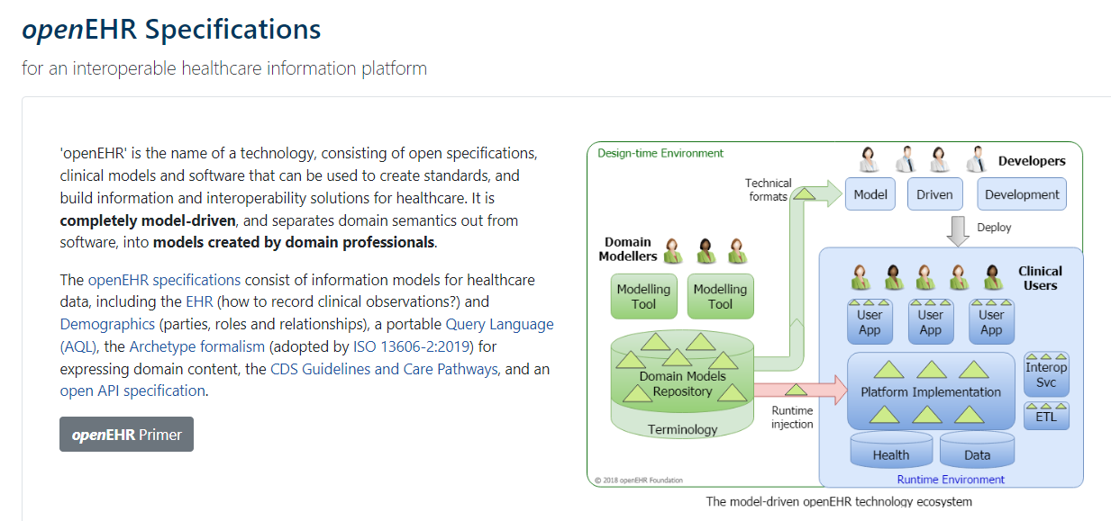

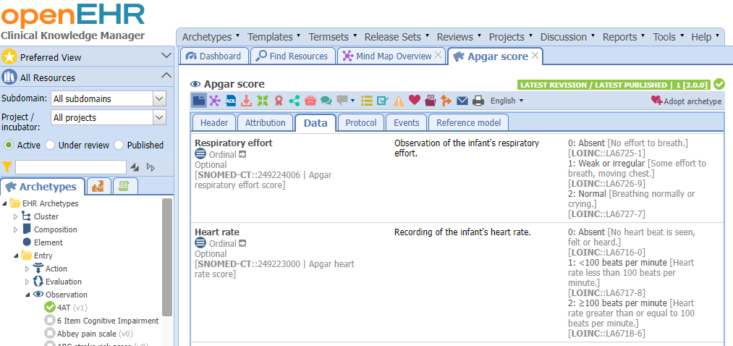
Specifications
Community
Models
Notes:
You can think of openEHR as being these 3 things. Specifications for building clinical data repos and modelling, the global community, which includes everyone in this room, and the actual models themselves which are significant global asset
I know the definition above said openEHR is Specs, Models and software. I would suggest that really it is Specs, Models and the Community.
The ability of the internet to support the commons of domain experts has allowed openEHR (and other entities like Linux, HL7, and even SNOMED) to revolutionise the foundations of EHRs. People no longer need to work inside black boxes, they can work together.
OK, so that’s the very quick ‘what is opneEHR’ Y’all are here to learn about modelling, so lets kick that off now

Slide 5
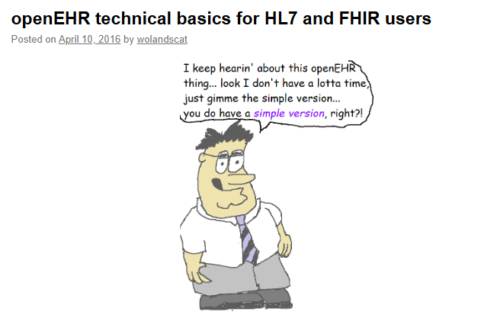
openEHR technical basics for HL7 and FHIR users - Woland's CatWoland's Cat
Notes:
And for this section I am using some images from Tomas Beale’s now 10 year old blog post on openEHR for FHIR folk. It’s a great post, with this weird guy pictures.
It’s worth reading the post itself for a more detailed gorunidng in the multilevel modelling approach of openEHR
That means talking about the 3 layers of the openEHR architecture
The Reference Model
Archetypes
And
Templates

Slide 6
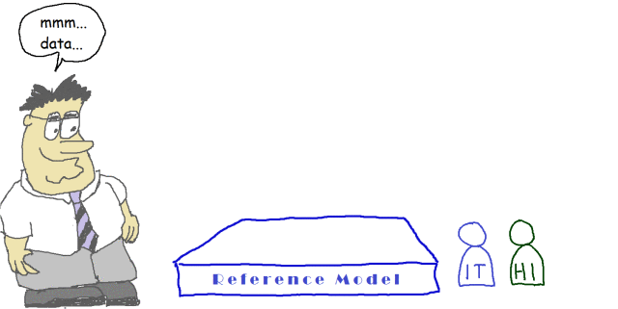
https://wolandscat.net/2016/04/10/openehr-technical-basics-for-hl7-and-fhir-users/
Notes:
The foundational layer is the Reference Model, or ‘RM’.
The RM sets the basic operating parameters and purposes of openEHR, by defining things like Data Types and the types of record entries that are allowed.
It constrains to an extent what you can build on top of it, and also sets openEHR up as definition for health care.
This sets out some basic stuff, like which data types are allowed – things like Quantities, Text values, True/False. It is built around a model of care provision that describes the types of things that need to be in an (‘entries’ EHR) like Observations, evaluations, and instructions. It says that there “shall be data and that data will be for health care.” If it was for say, building construction, then the RM data types and entries would be different.
So the RM just constrains the rest of the specification by providing a foundation for everything else.
The wee people represent who is going to be interested in this layer. IT folk and Health Informaticians.

Slide 7
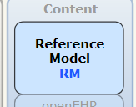
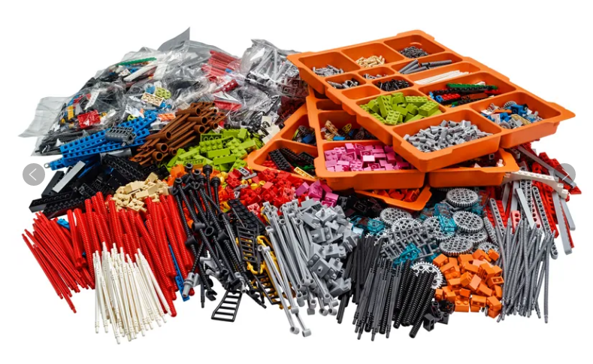
Notes:
You cannot explain openEHR modelling without using at least one Lego™ reference.
I like it for explaining the RM.
The RM is like all the blocks and shapes and connectors you get from Lego. These all allow you to build stuff on top, but you cannot build stuff that is not made out of Lego.
Every lego item has to conform to certain criteria, and so it is with the openEHR RM – it defines the building blocks.

Slide 8
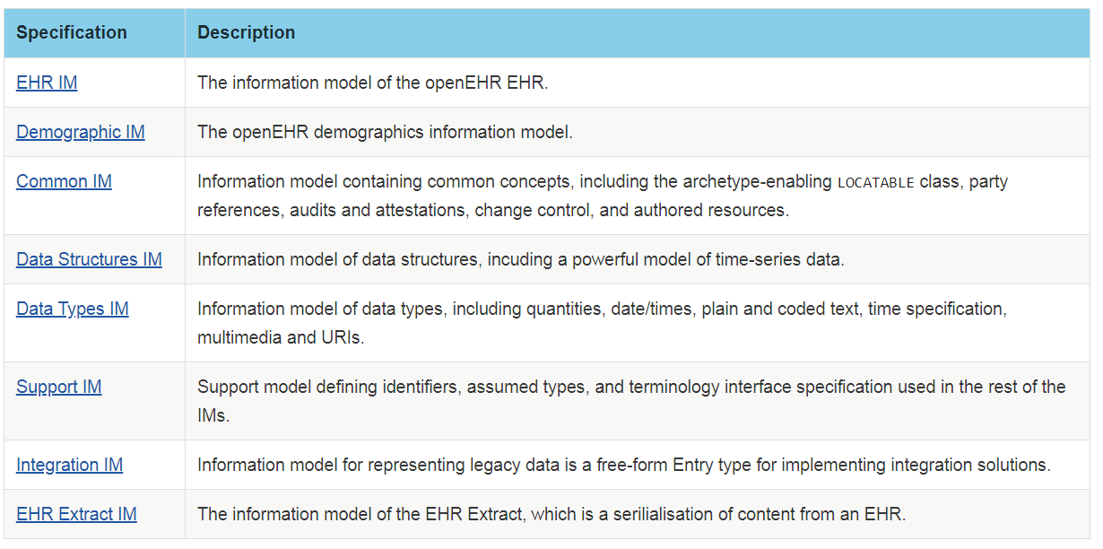
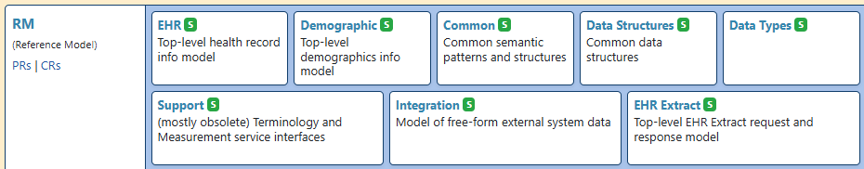
Notes:
And these are the things it defines.
Data types, data structures, common concepts and the EHR model itself
Mostly we are interested in the EHR Model.
In fact, the RM specification is split into many parts. We will mostly be talking about the EHR IM with a bit of Common and Data types.
We will not be using the Demographic model, in general, as the typical practice in platform deployments is to use a separate EMPI, and that does the demographics. In NDP we are not using openEHR for demographics.

Slide 9
Common things all records have
  Data types
    Text
    Codes
    Count
    Date/Time
    Etc.
  A subject
    Usually the patient
  A composer
    The person that wrote the record
  Participants
    People involved in the encounter
  Locations
    Where the encounter took place
  Start and End Dates
    For the encounter or careflow step
Notes:
The RM gives you stuff for free. It recognises that every record stored needs some common stuff, like the subject of care, the person (or machine) that wrote it, who was involved in the encounter and so on; and auditing so that versions of content are tracked and managed, and can be found [Locatable class]
This means, when it comes to modelling, that you do not need to model all that stuff every time.
FHIR has no RM, so resources have to repeat common patterns explicitly, such as subject or practitioner, and it has no persistence specification. It is really for exchange, so of course it takes a different approach to openEHR.
FHIR cannot mandate, for example, Locatable paths or Composer elements because it is about taking data from other systems which may not have those elements.
Not all the RM attributes are exposed in the modelling tooling – most are meant for dev, but as CIs you may need to specify to dev that you want certain elements populated, and what with

Slide 10
Reference Model: EHR
3.0-4.2.4.3 The EHR Information Model & EHR Package
  About 15 minutes
5.0-5.3 Composition Package
  About 10 minutes
8.0-8.1.1 Entry Package
  About 5 minutes
8.2-8.2.5.8 Entry and its Subtypes
  About 30 minutes
Notes:
The RM EHR specification is probably the most useful one for modelling.
It was not until I found this and reread it that I really started to grasp what was going on.
Reading the RM though is bit like climbing Ben Nevis in the dark with only a headtorch. It’s a lot of effort, your frequently take wrong turns, but in the end you generally get there.
Don’t fall off though!
Read these sections first, but understand it is quite dense and heavy going.

Slide 11
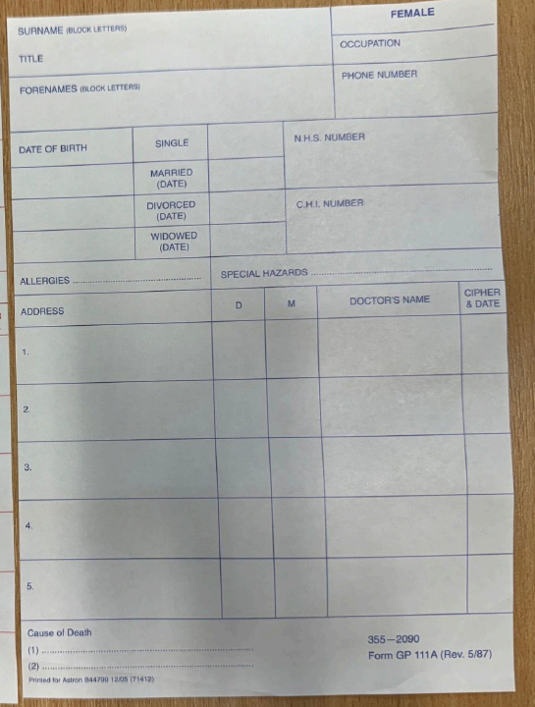
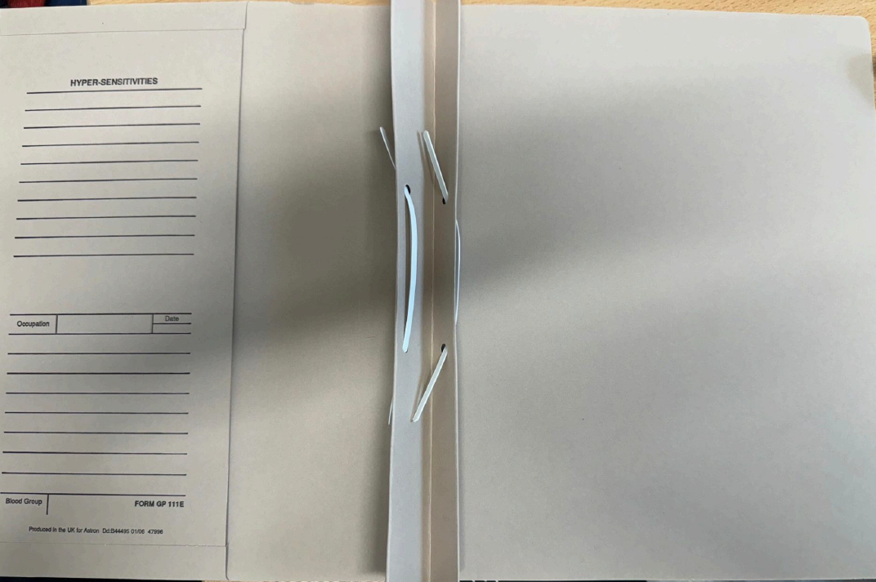

Notes:
Off the back of the RM EHR section, I think it is helpful to understand what the EHR is in openEHR terms
Many of you will be familiar with how records are handled currently, or in the past, on paper charts.
You have a person, now a patient or client as they have contacted the H&SC systems.
In General practice we would create a manila, A4 folder for them, with their IDs on the front cover, along with some other records data, and then inside we would add content.

Slide 12
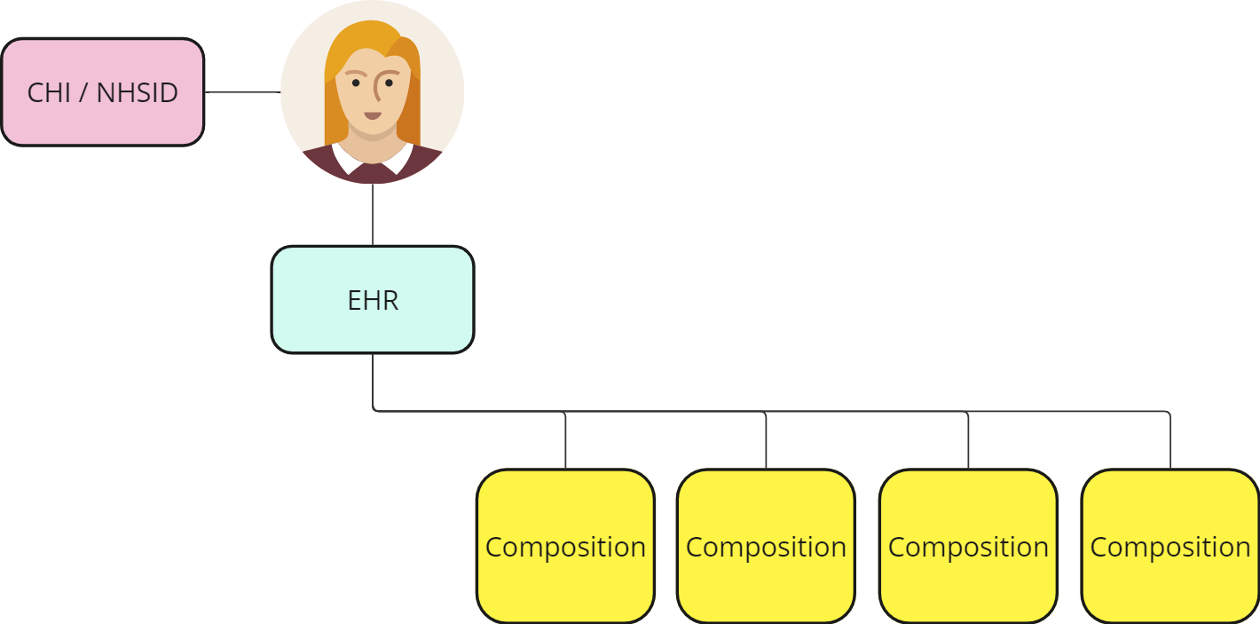
Notes:
In openEHR this is very similar
We have a patient who has a National Health System ID (in Scotland these are called ‘CHI’), and every patient has an openEHR ‘EHR’ with its own unique ID.
One patient, one EHR. That EHR is the same as the manilla A4 folder. It is linked via their NHS ID to their NHS identity. This can happen in different ways depending on your level of comfort with privacy and security.
The EHR is then filled in with content pages or ‘compositions’ which are the records of H&C events, encounters and other data.
The ‘Composition’ is an important concept so I will talk about it more later.

Slide 13
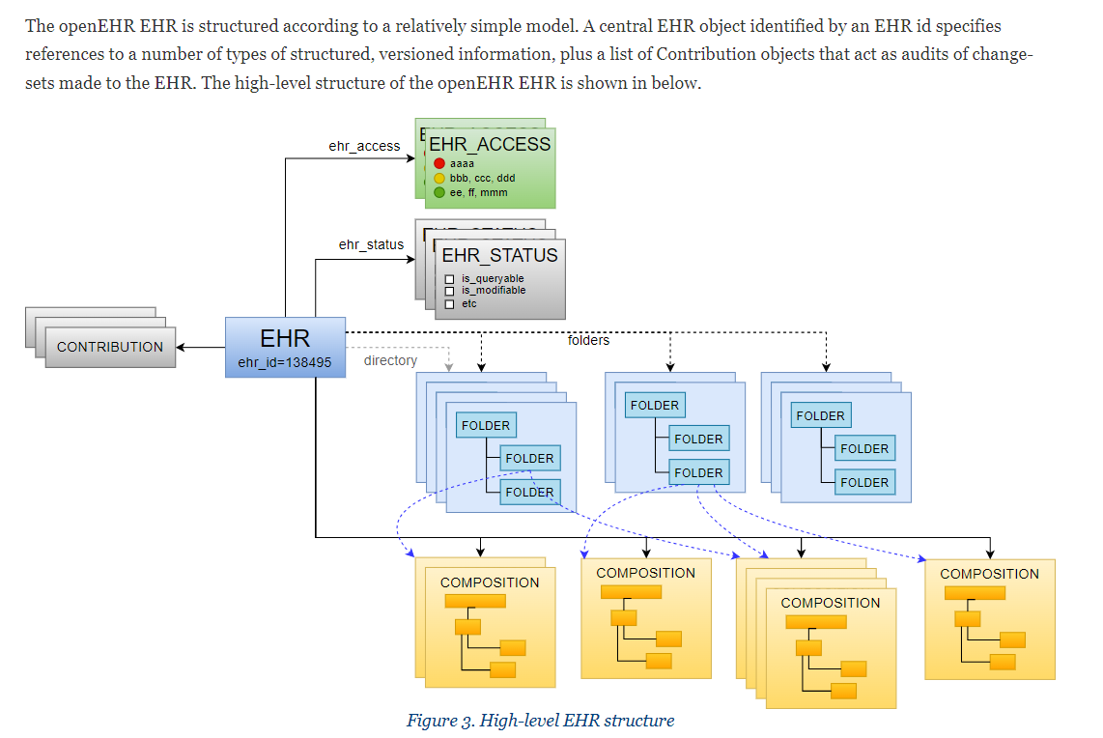
Notes:
I have included this slide as I wanted to just start to hint towards a bit more of the RM EHR structure as it will hopefully help your thinking and not confuse you further.
In openEHR every patient will have an EHR. This will have a unique ID and is the top level container for all the data about them.
The content can be stored in folders to organise it.
Records are stored as ‘compositions’ a term you will hear more about. A composition can be thought of like the form or piece of paper where all the data from the encounter is recorded.
The EHR has a couple of other attributes Access and Status – that can control user access or turn on and off the active state of the EHR.
So main learning point: every patient has an EHR with a unique ID that contains all their records.
From our perspective right now we are really only interested in the EHR concept itself as a container in openEHR for all a person’s records, and the idea that records are stored or committed as compositions.
This diagram shows that the EHR itself has attributes, like whether it is active or not, and that the EHR can be organised into folders and directories to make it easier to search across.

Slide 14
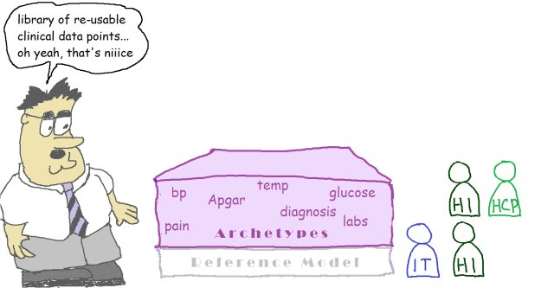
Notes:
Ok so next up is everyone’s favourite: Archetypes
These are data definitions of real-world clinical concepts. They need to be built with input from domain experts and IT people.

Slide 15
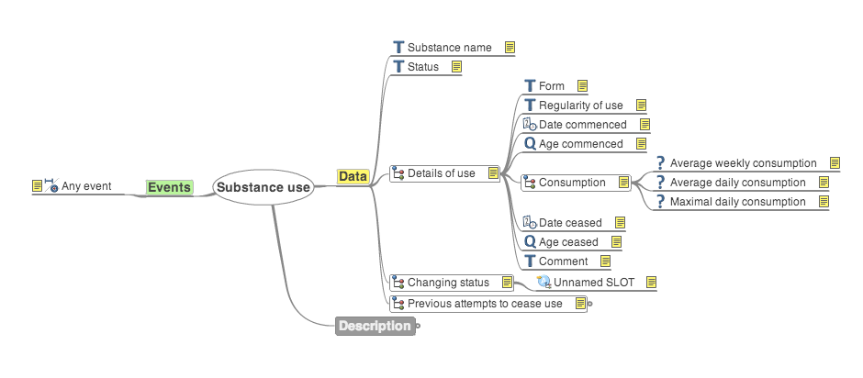
openEHR: Archetypes
Models of discrete clinical concepts
  Blood pressure
  Body weight
  Medication
  Family history
  Housing status
‘Maximal dataset’
  All the data points for every use case, from every perspective
Notes:
Such as BP etc
In openEHR we try and get all the possible things we might need to say or store about a concept included in the Archetype.
That is a human process of requirements gathering, and can only be done with the contributions of domain experts.
We need all the things because in our actual use cases we want to be able to choose which bits of the archetype to use.

Slide 16
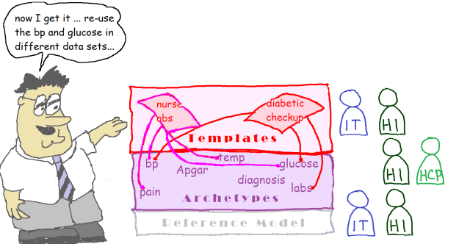
Notes:
IN templates
Templates are essentially data definitions for specific uses. They make use of parts from one or more archetypes to build the content.
Because the data elements come from archetypes they are fully defined already and consistent across different templates.
IOW systolic BP value in different templates will be identifiable as a systolic BP value independent of the templates (“Find me all systolic BP readings”) or identifiable from the template (“Find me all systolic BP values from Diabetic Reviews”).
Once fixed in an archetype the options to change values in a template are limited. Labels can change (e.g.”systolic BP” could be changes to “Systolic”) and occurrence can change only if it does not conflict with the archetype (i.e. Archetype Occurrence is 1..1 mandatory, in the template you cannot make it 0..1 i.e. optional).

Slide 17
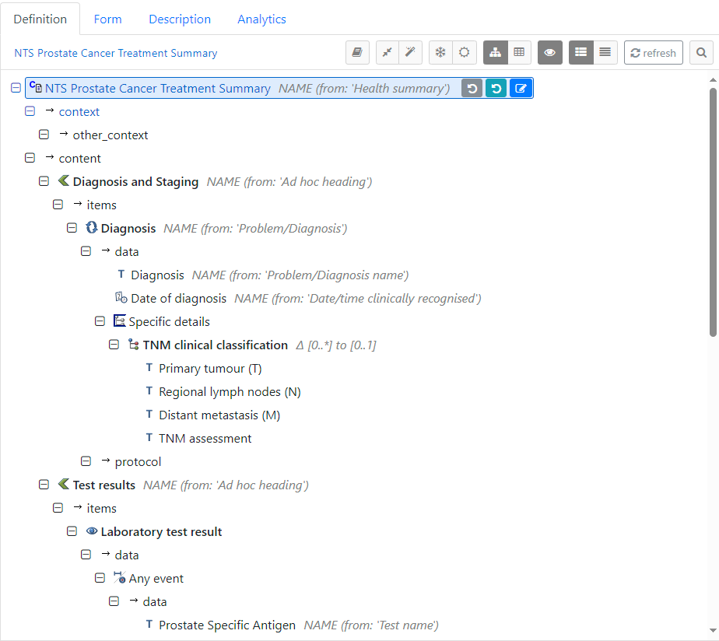
openEHR: Templates
Use cases
Elements from one or more archetypes
  Asthma review
  GP encounter
  NEWS2 Score
  Frailty assessment
Generate technical artefacts
Data stored in the EHR as an instance of a composition
Notes:
A template in openEHR is a data definition for a specific use case.
They can be very contextual, right down to the requirements of a single person or clinic.
But more likely, they tend to cover higher-level care events like specific disorders or tasks.
They use parts of one or more archetypes. In this way, because elements in a Template must come from previously defined archetypes, they always carry their semantics, their meaning. It is embedded in the archetype, and carries into the template.
Templates then add additional context.

Slide 18
Archetype Vs Template
Archetype
Template
Defines the data model for a concept
Archetype building blocks:
  Compositions
  Sections
  Reference Model Entry types
  Clusters
  Elements
Maximal data set
Data model for a use case
Elements from one or more archetypes
Notes:
s
Archetypes are the key building block – fully modelled clinical and care concepts with all their possible attributes, data types, occurrence and so on.
Templates “do all the work”, by being use case data definitions. They will use one or more elements from one or more archetypes.
Today we will really be focussing on templates, making use of existing archetypes, rather than creating new archetypes from scratch.
Our template will make use of archetypes available on the International Clinical Knowledge Manager.
Archetypes are used to model the template, the template itself forming the data definition contained in a composition.
We are going to focus on buitling a template today.
Arc

Slide 19
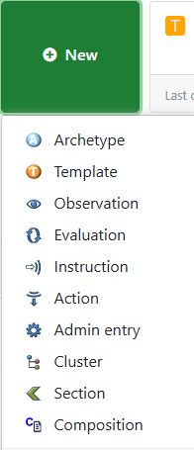
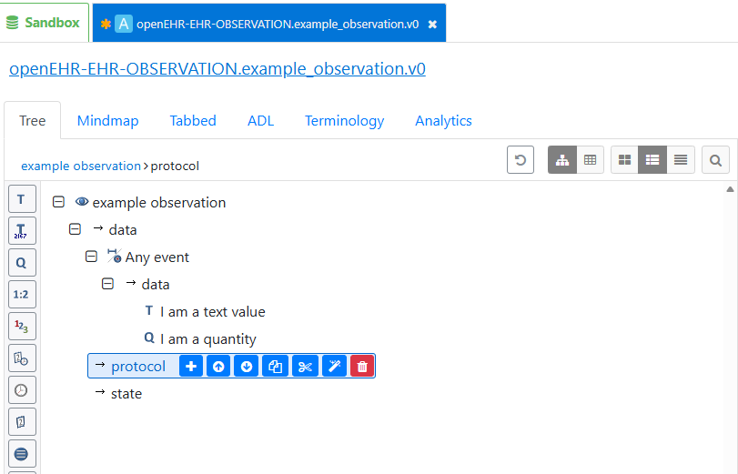
Notes:
Building archetypes is really a different and quite specialised skill.
You can do it in AD, here is the interface,
But most of the time as clinical modellers you wil be using existing archetypes on CKM to create templates
And we are limited in time today, so Templates it is!

Slide 20
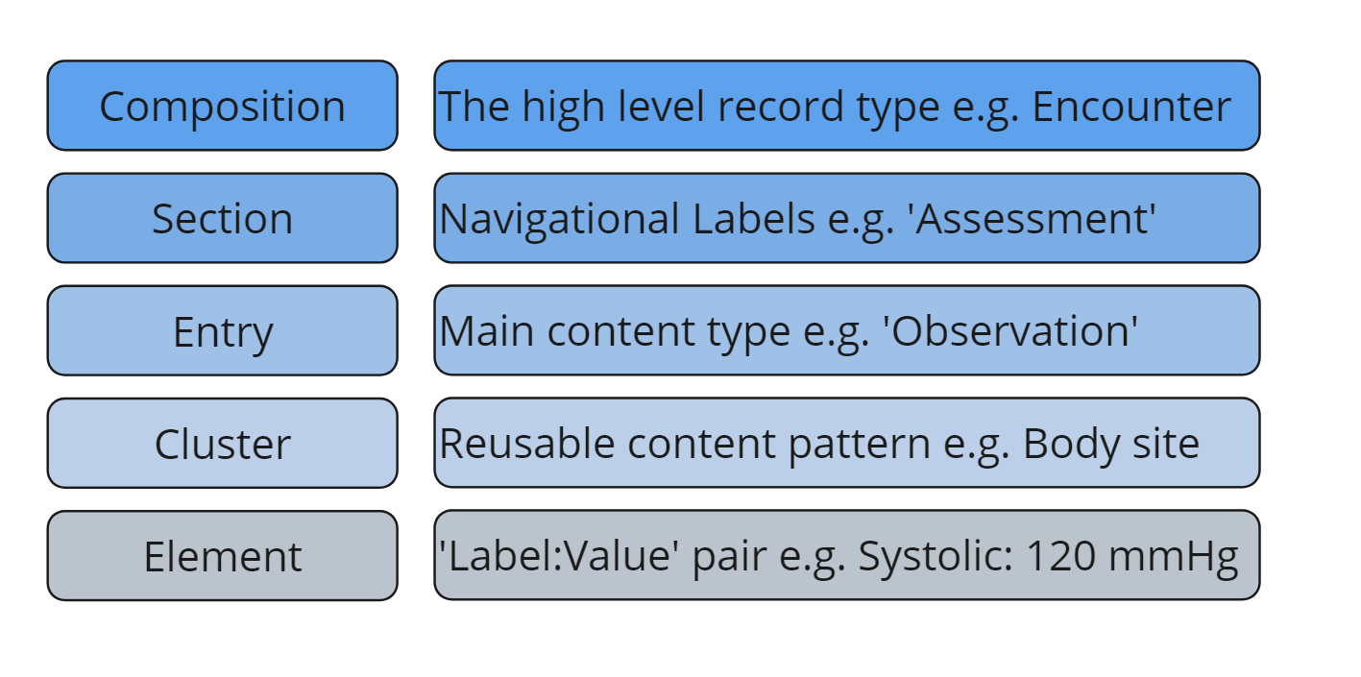
Notes:
This slide shows the openEHR components (building blocks) used to build templates.
Every template is modelled as the data definition for a Composition.
The composition is the high-level record type
We can divide that into sections, to make it easier to read.
The data that will be added is modelled as ‘entry types’ of which there are 5 (Observation, Evaluation, Instruction, Action, Admin)
Where things are used a lot, they can be modelled as clusters, which are re-usable data patterns.
And lastly there are the elements themselves.
The hierarchy view in CKM navigation is sorted alphabetically, which is a little unhelpful, so I have sore of resorted it here.
But All archetypes are classified as being of a specific type. This lets us know what type of concept the archetype represents, based on this flow of care we have 5 Entry Type archetypes:
Observation
Evaluation
Instruction
Action
And
Admin Entry

Slide 21
‘Composition’
Composition Class
Composition Instance
  The container for the record of that type
  The record that we commit to the patient’s EHR – like a filled-in form being filed into the notes
Notes:
‘Composition’ is a term that, somewhat irritatingly, is used in openEHR to refer to 2 things.
First is the Class, or model, which forms the base container for our template or data definition.
Secondly, the term is used to refer to an instance of a composition containing data that is stored in the patient’s EHR.

Slide 22
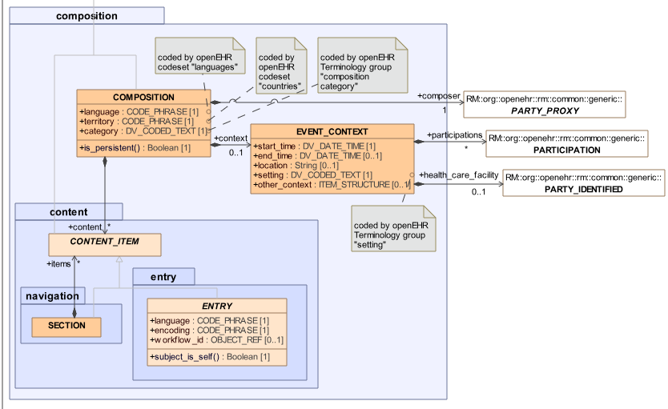
‘COMPOSITION’ Class
‘Context’
  Composer
  Location
  Participants
  Times
‘Content’
  Sections
  Entries
Notes:
This is the Class model. Sorry if you are not familiar. It is not too complex though.
First we have the main class of ‘Composition’ it includes some attributes like Language, for example.
Every Composition can have context attributes, like where and when it happened and who took part - the ‘participations’ off to the right.
Because the RM gives you all of that you do not need to model it every time you create a new template – you get all that for free just by working using the openEHR approach.
Then every composition has Content.
Content can be divvied up into sections for navigation/human readable purposes.
And Content items are all types of ‘Entry’.

Slide 23
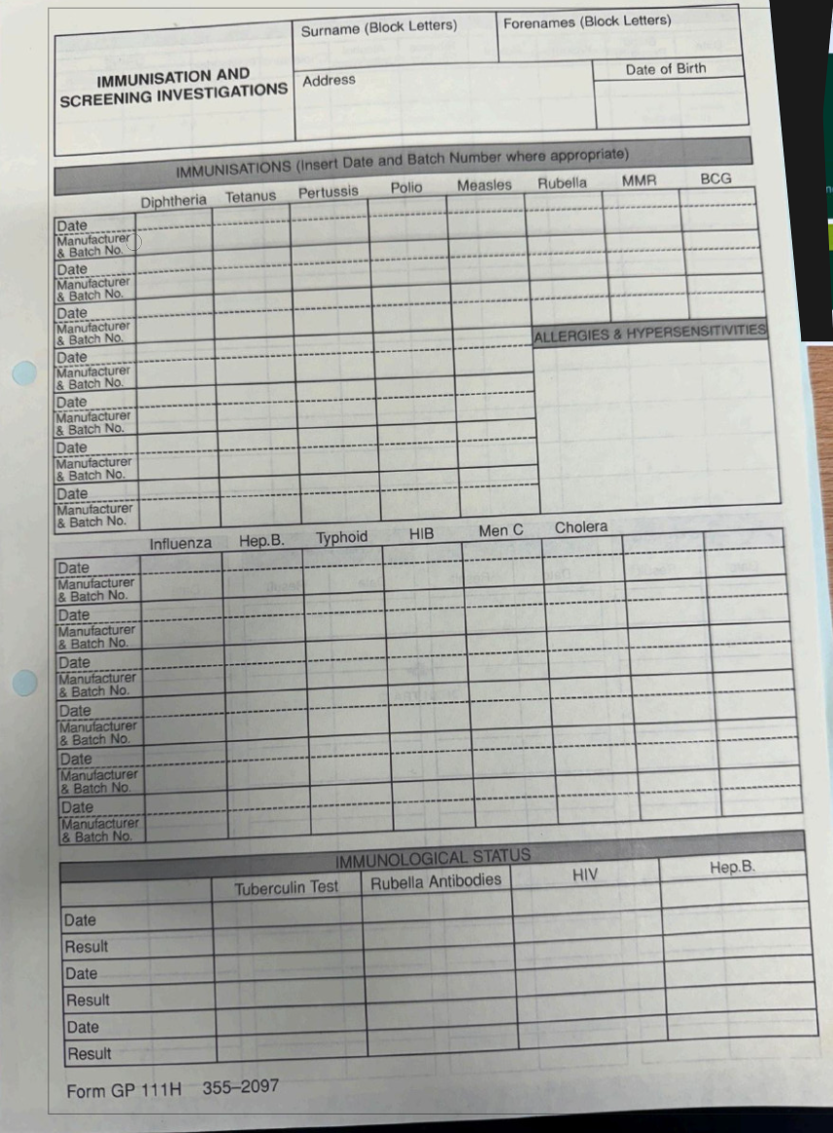
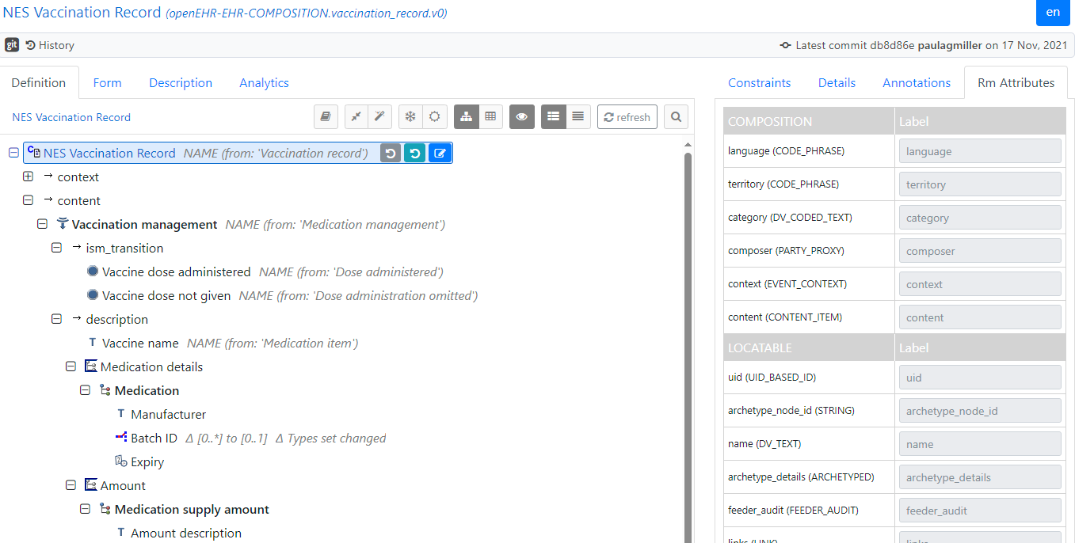
Composition ID
Template Content
Notes:
Here is another example. I am sure this form used to be yellow!
The Composition class sort of maps to the paper record artefact of a colour-coded, headed piece of A4 paper that was used in GP A4 records for different information types.
Here the grey sheet was used to record significant medical history. We had pink sheets for clinical encounter records, yellow for vaccinations and so on.
In effect this is the Composition class – it is a way of keeping all records of a particular type together, like encounters, reports and, in this case, the Problem list.
Here is the CKM problem list composition archetype.
On the grey sheet the lines under the header with two columns are, in effect, the template – with only two elements, ‘Date’ and ‘Diagnosis or Problem’ (though that label is inferred from the use case here).
The composition is a container for a record type, into which you add your template that defines the data elements you want to record.
The Composition ID is equivalent to the header on this A4 form. It says, ‘this form is to be used to record immunisations (and screening) investigations.
The table on the main page has no values entered yet, it is analogous to the template that defines which data elements should be recorded here.
Fill it in with some data in black biro, then staple into the patient record and you have committed an instance of a composition to the paper record! Do the same with an application, a user interface and a “Create Composition” API call (EHR API | EHRbase Docs) to the CDR and you have done the same thing to an EHR.

Slide 24
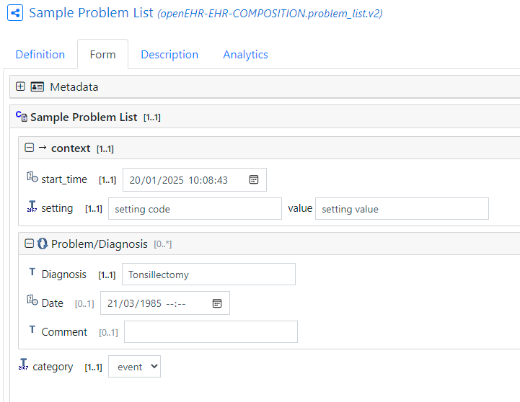
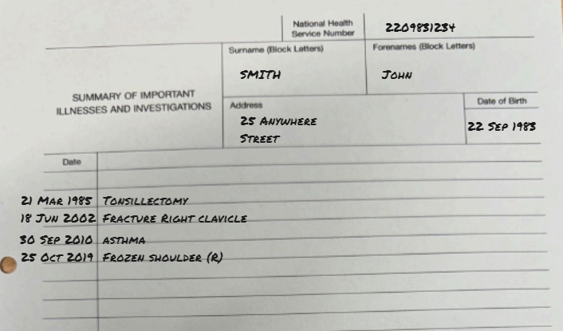
‘COMPOSITION’ Instance
Notes:
For example on our Problem List grey sheet, if you fill all that in, and then put it inside the A4 record you have effectively created an instance of that composition and committed it into the record.
In openEHR, the equivalent is someone using an application to populate the data fields in your template then saving (committing) the record to the EHR as an instance of a composition.

Slide 25
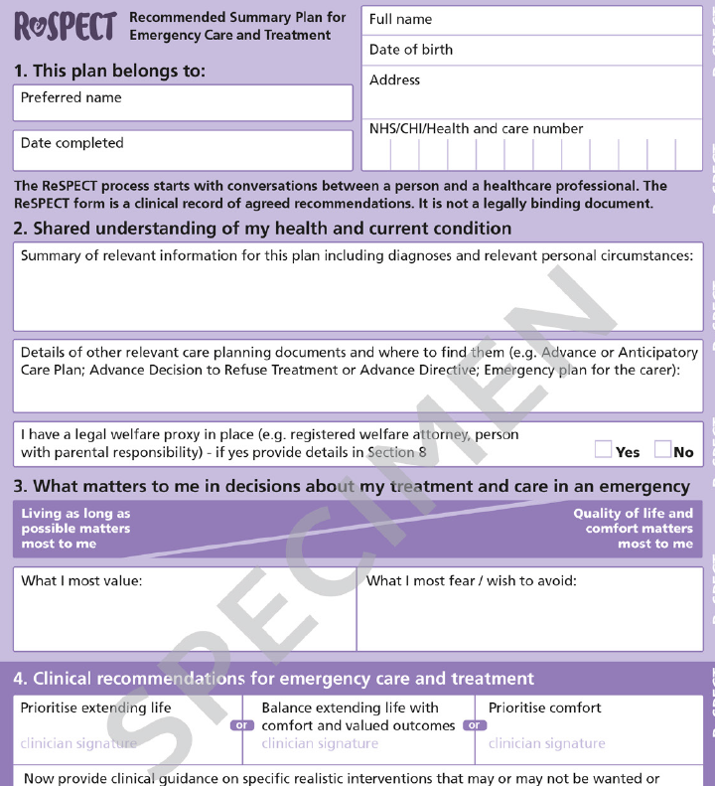
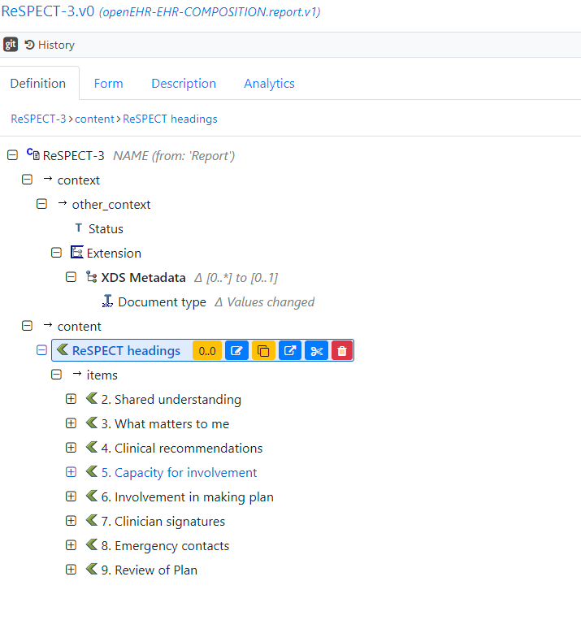
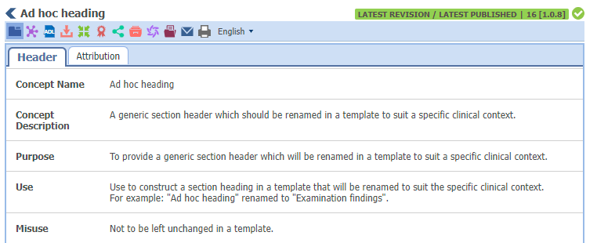
‘SECTION’
Notes:
OK, that was quite heavy going.
Some simpler bits and bobs now.
For templating openEHR provides for ‘Sections’ which are simply navigational headers. For example, for ReSPECT they break down into these.
Commonly, we use the ‘Adhoc heading’ section archetype and just change the label name in archetype designer to whatever we want.
They can do more complex things than this, which is why they are archetyped, but we are not going there today!

Slide 26
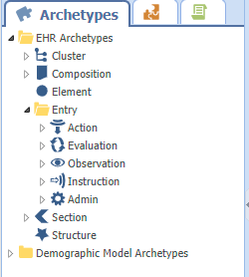
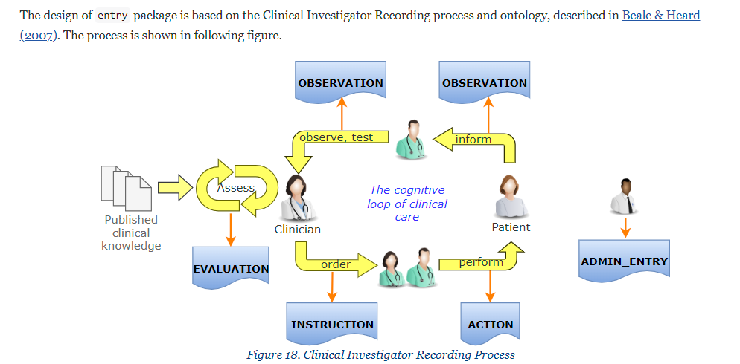
Entry Types
Notes:
Next are Entries – the main data content of the composition.
Entry types reflect this model of care in the diagram.
If you managed to read through some of the EHR RM Specification you may recognise these things.
openEHR Archetypes are built around a model of recording care based on this process. You can see in this process ‘Observation’, ‘Action’, ‘Instruction’ and ‘Evaluation’ as well as ‘Admin Entry’.
The types of records entries in openEHR are defined by this baseline clinical workflow. This is defined in the RM EHR spec.
It represent a common cycle of care.
A clinician assesses a patient and makes an evaluation, such as a differential diagnosis.
They make a plan (instruction) such as order some bloods or other tests.
These are done (Action)
And result in some results (Observations)
Which come back to the clinician to be assessed (evaluated)
.
These concepts make the core ‘entry types’ in openEHR.

Slide 27
Entry Types
Observation
  “What was observed?”
  Facts/Statements
  Includes ‘State’ (of the patient)
  Hb 8.1 g/dl
Evaluation
  “What do we think it means?”
  Opinion/Subjective
  Diagnosis
Instruction
  “What should happen?”
  Directs actions to be done in the future
  Medication order
Action
  “What was done?”
  Tracks the state of activities
  Procedure
Admin entry
  “What administrative information supports the care process?”
  Interpreter needed
Notes:
This is of more relevance to archetype authoring, but still important
Entry types are all for different things, and they all have slightly different core RM attributes to reflect these different high-level concepts.
Observations are things that are measured or stated, The Blood Pressure is 120/70. The patient states they have a family history of heart disease.
Evaluations on the other hand are assessments and opinions.
Instructions describe activities to be performed, like ordering a medication or tests.
Actions follow the state of instruction activities through a standard ‘state machine’ from planned to completed and all the other states like cancelled or postponed.
Admin entries contain no protocol (how it was done) or state (how the patient was) data and are just simple content archetypes for admin purposes.

Slide 28
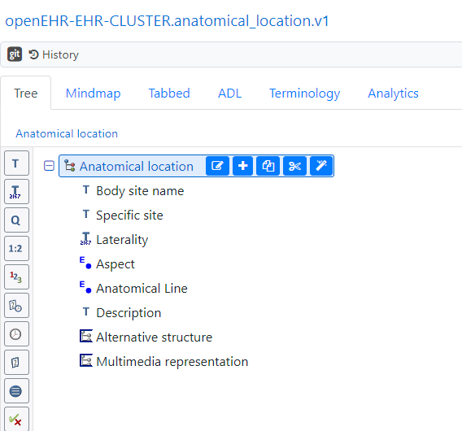
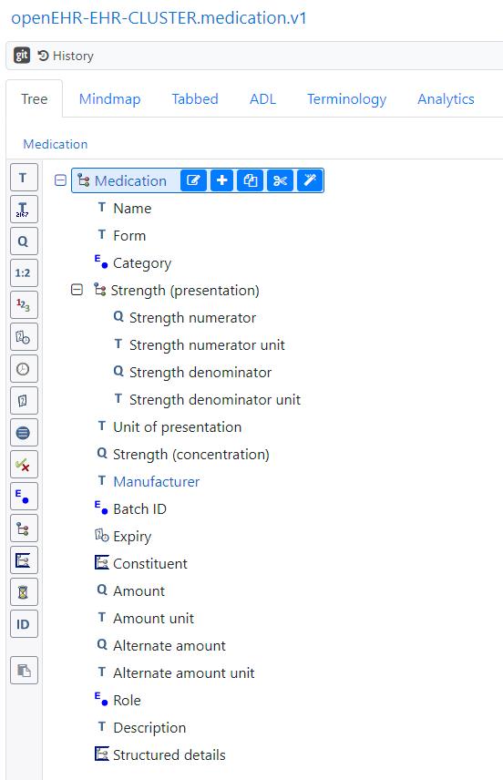
‘CLUSTER’
Notes:
Clusters are used inside Entries when you need a repeatable, re-usable pattern.
For example, body site is something that is used again and again in procedures, or injuries, or conditions, or symptoms
So rather than model that new every time, we create a cluster and we can slot this in as needed.
They get added to ‘cluster slots’ in archetypes. Cluster slots are just containers for clusters, and can be constrained to expect specific clusters or left open to accept anything.

Slide 29
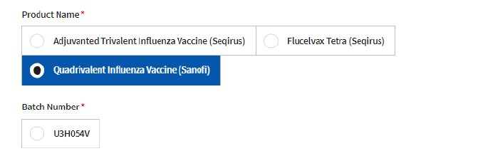
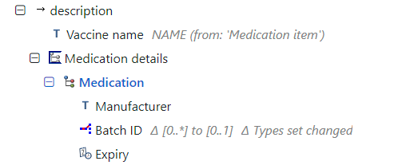
‘CLUSTER’
Notes:
Here, for example is where the Medication Details cluster would be used to map to the Product Batch ID in Vaccine Management Tool.

Slide 30
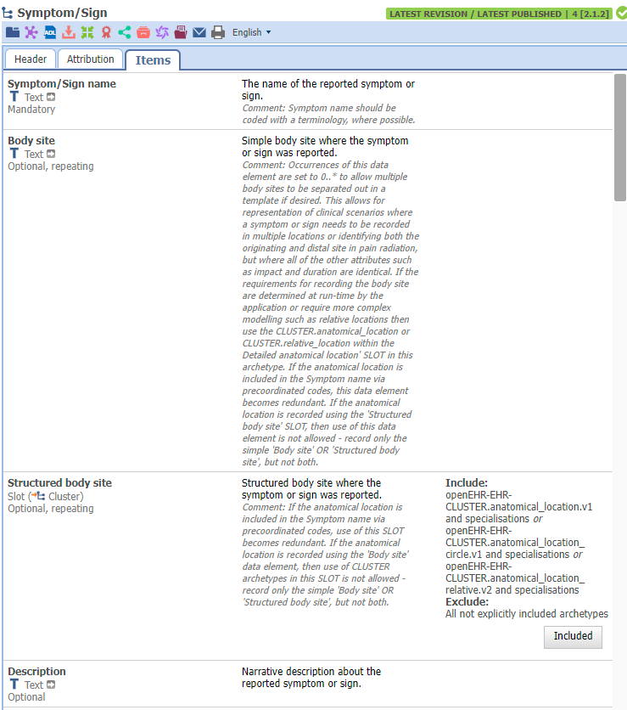
‘ELEMENT’
Label/Description : Value
Data type
  Text
  Coded
  Quantity
  Etc
Occurrence
  Mandatory / Optional
  One or Many
Notes:
Lastly we have Elements, which are just the label/value pair where the value is added via an application or a user using an application.
They are further defined by data types, and also by occurrence and maybe units of measure or allowed values.

Slide 31
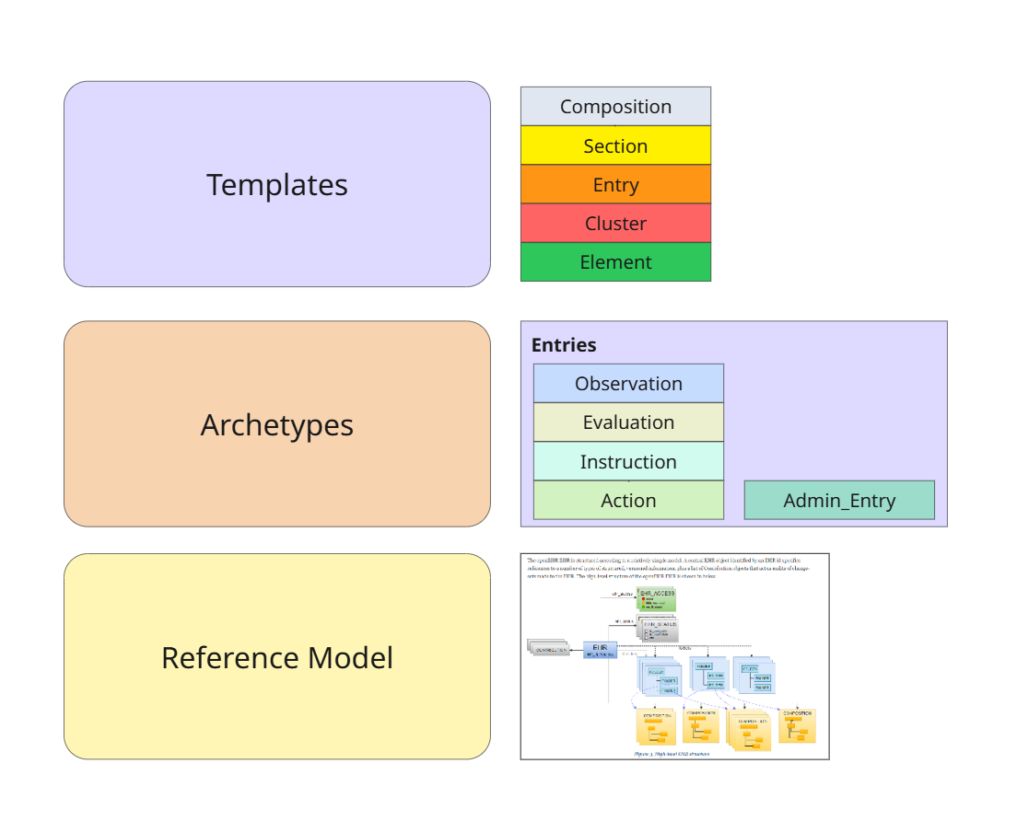

Slide 33
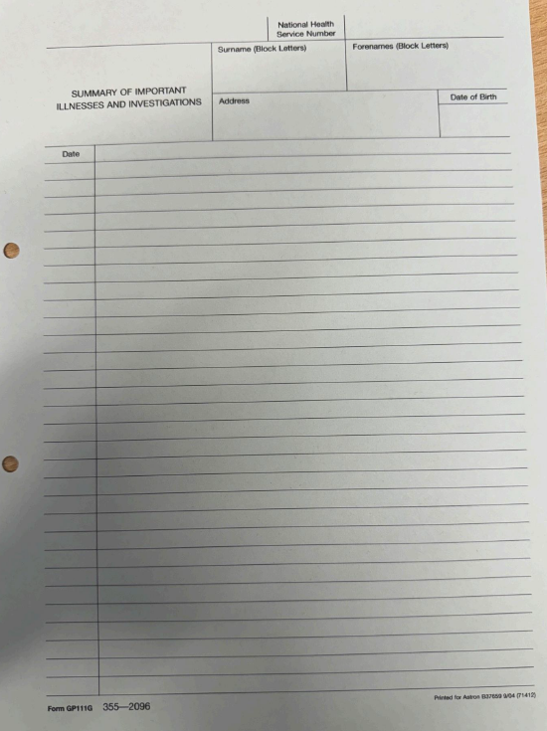
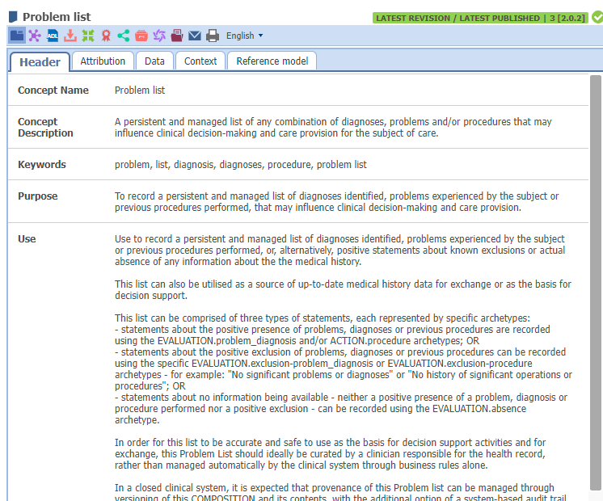
‘COMPOSITION’ Class
Notes:
The Composition class sort of maps to the paper record artefact of a colour-coded, headed piece of A4 paper that was used in GP A4 records for different information types.
Here the grey sheet was used to record significant medical history. We had pink sheets for clinical encounter records, yellow for vaccinations and so on.
In effect this is the Composition class – it is a way of keeping all records of a particular type together, like encounters, reports and, in this case, the Problem list.
Here is the CKM problem list composition archetype.
On the grey sheet the lines under the header with two columns are, in effect, the template – with only two elements, ‘Date’ and ‘Diagnosis or Problem’ (though that label is inferred from the use case here).
The composition is a container for a record type, into which you add your template that defines the data elements you want to record.

