Slide 1
BHOOMI · BhuVerify
SIH 2026
Intelligent Land Record Digitization & Validation System
Problem Statement ID SIH26018 · Theme: Smart Automation · Category: Software
Converts scanned registers, handwritten pages, PDFs and cadastral maps into structured, validated, GIS-linked digital records — with government reviewers holding final authority.
LEGACY
RECORD
BHOOMI
INTELLIGENCE
VERIFIED
DIGITAL RECORD
Scanned / Handwritten / PDF / Image
AI OCR · Validation · GIS · Audit
Structured · Searchable · Auditable
Team Shadow Slayers · Ministry of Rural Development · Repository: github.com/fresherscomputersc-hash/BHOOMI

Slide 2
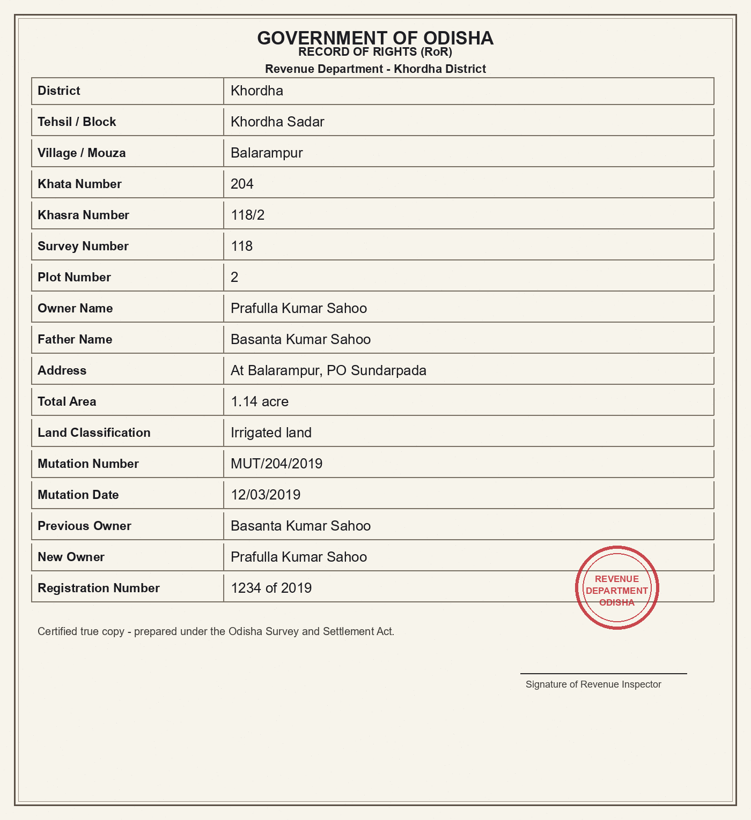
PROPOSED SOLUTION · IDEA TITLE
SIH 2026 · SIH26018 · Smart Automation
What BHOOMI does · How it transforms legacy land records · Key innovations
BHOOMI END-TO-END PIPELINE
SCANNED REGISTER
MULTILINGUAL OCR
Odisha 39-A, UP Khatauni, MP Khasra, Bihar Khatiyan
DOCUMENT
UPLOAD
English · Hindi · Odia · Script-routed second pass (39-A → Oriya)
PDF / Image / Scan
HANDWRITTEN PAGE
CV PREPROCESS
Deskew · Denoise · CLAHE
FIELD CONFIDENCE
Hindi · Odia · English mixed-script pages
OCR / HTR
Per-word confidence · Fusion formula · Auto-review routing < 70%
Tesseract 5.5 · eng+hin+ori
PDF / IMAGE
FIELD EXTRACTION
Multi-page documents, stamps, maps
17 fields · 5 doc profiles
GIS VERIFICATION
CONFIDENCE FUSION
Cadastral polygon matching · Area reconciliation · Discrepancy BR-9
0.45·OCR + 0.30·Pat + 0.15·Prox + 0.10·Cons
CADASTRAL MAP
VALIDATION ENGINE
GeoJSON parcel polygons, survey sheets
BR-1…BR-10 · GIS · Cross-DB
HUMAN-IN-THE-LOOP
HUMAN REVIEW
Government reviewer holds final authority · HTTP 409 blocks approval with open findings
Approve / Reject / Escalate
AUDIT TRAIL
SHA-256 chain · Immutable
NOT AN OCR WRAPPER — the complete value chain: Document → Intelligence → Validation → GIS → Human Review → Auditable Record
Real document: Odisha RoR · Clean scan

Slide 3
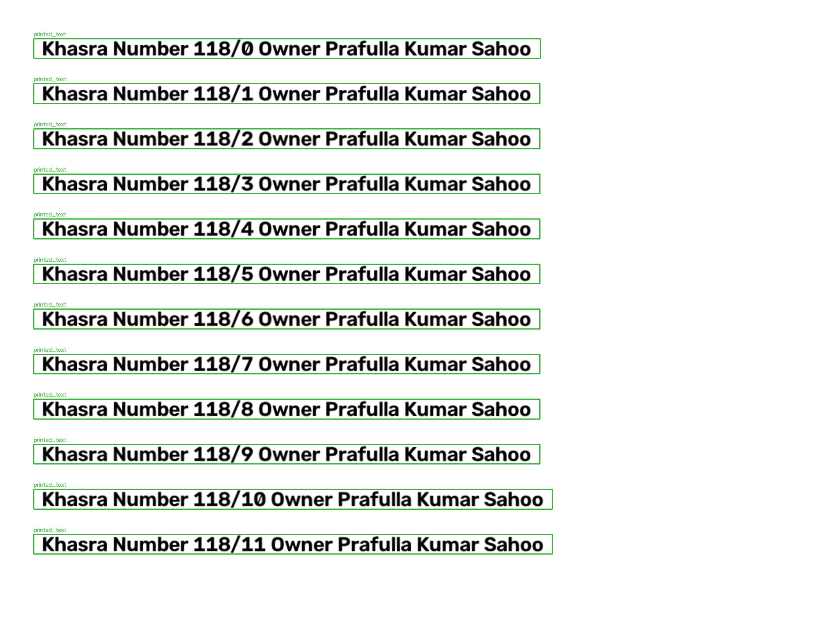
TECHNICAL APPROACH · ARCHITECTURE & PIPELINE
SIH 2026 · SIH26018 · Smart Automation
Native architecture diagram · AI pipeline · Real screenshots · Technology stack
BHOOMI SYSTEM ARCHITECTURE
SOURCES
USER ROLES & DATA
RoR · PATA · PDF · Image · Map
INGESTION
OPERATOR
Upload · Queue view
SQLITE /
POSTGRES
Upload · Hashing · Dedup · Quality
DOCUMENT
INTELLIGENCE
REVIEWER
Correct · Approve · Block
14 Tables
Audit Chain
Record Store
GIS Layer
CV Preprocess · OCR/HTR · Layout · Extraction
SUPERVISOR
Dashboard · Assign · Export
VALIDATION
BR-1…BR-10 · Confidence · Cross-DB · GIS
AUDITOR
Audit trail · Reports
REVIEW
Government Official · Approve / Reject
OUTPUT
Verified Record · Audit Chain · MIS
AI DOCUMENT PROCESSING PIPELINE
DOCUMENT
PREPROCESS
LAYOUT
OCR / HTR
EXTRACTION
CONFIDENCE
VALIDATION
VERIFIED
SECURITY
RBAC · Argon2
Scanned page / PDF
OpenCV: deskew, denoise
Region detection
Tesseract 5.5 · eng+hin+ori
17 canonical fields
Per-field scoring
BR rules + GIS
Auditable record
CLEAN SCAN — Real Odisha RoR
ANNOTATED — OCR detection results
FastAPI · SQLAlchemy
OpenCV · Tesseract 5.5
Shapely · rapidfuzz
spaCy · HF XLM-R (pilot)
Argon2 · RBAC
Vanilla JS · Inline SVG

Slide 4
FEASIBILITY & VIABILITY · EVIDENCE & RISK
SIH 2026 · SIH26018 · Smart Automation
Measured results · Real documents · Tested rules · Security · Human-in-the-loop
MEASURED EVIDENCE · PROTOTYPE
165 TESTS
HUMAN-IN-THE-LOOP WORKFLOW
SECURITY · AUDIT · RISK
Local / 168 on EC2 · All green
AI EXTRACTION
RECORD 01
RECORD 02
RECORD 03
District: Khordha · Khasra: 118/2
Field confidence calculated
SHA-256
Prev Hash
Tamper Detected?
26 DOCUMENTS
Area: 1.14 acre · Owner: Prafulla Kumar Sahoo
CONFIDENCE CHECK
6 demo + 5 stress + 5 Hindi + 5 English + 5 real Bhulekh RoRs
Low < 70% → Mandatory review
Every AI decision and every human correction writes one append-only row. Each row stores SHA-256 of previous row — tampering breaks the chain, detectable via verify_chain() (FR-12).
REVIEWER QUEUE
Government officer assigned
79–84% OCR
VERIFY / CORRECT
RISK: INVENTED DATA
Real Odisha scans · Multi-script pages
Evidence shown; corrections captured
Anti-hallucination contracts per doc type (e.g., plot 417 is NOT a khasra; khatiyan 18 is NOT a khata). AI never writes back without reviewer approval.
APPROVE / REJECT
15/15 BYTE-ID
Server refuses (HTTP 409) if critical open
Deterministic reruns · No drift (Groq-off core)
RISK: GARBLAGED OCR
REAL DOCUMENT · Odisha RoR (Clean)
AUDIT LOG
Script-routed second pass + confidence bands. Any result < 70% is routed to mandatory human review. Zero crashes on adversarial set (36.8% accuracy, 100% routed to review).
Old + new value · Hash added
< 1 s/RECORD
Validation latency · 15–127 s/doc (2 vCPU)

Slide 5
IMPACT & BENEFITS · BEFORE → AFTER · SCALE
SIH 2026 · SIH26018 · Smart Automation
Revenue officers · Auditors · Governance · Scalability path · Real impact metrics
BEFORE → AFTER · THE TRANSFORMATION
IMPACT DIMENSIONS · SCALABILITY
LEGACY PROCESS
BHOOMI PROCESS
REVENUE OFFICERS
AUDITORS & SUPERVISORS
Paper registers / handwritten pages
AI OCR / HTR extraction
★
Reviewer queue · One-click corrections captured as training data · Approve/reject/escalate with full evidence.
◆
Tamper-evident hash-chained trail · MIS dashboard (accuracy, pendency, errors, state-wise) · CSV export.
Manual reading & entry
17 structured canonical fields
No structured fields
Field-level confidence scoring
No cross-database check
Automated validation (BR-1…BR-10)
No GIS verification
GIS cadastral verification
ADMINISTRATION
GOVERNANCE
No audit trail
Government reviewer approval
●
Digitization % tracked live · Review completion rates · Discrepancies flagged, never silently resolved.
■
Reliable digital records from legacy pages · Multilingual access · Transparent, data-driven land administration.
Inconsistent formats across states
Immutable SHA-256 audit chain
High error rate · Slow review
Searchable · Exportable · Auditable
SCALABILITY PATH · PROTOTYPE → PRODUCTION
PHASE 1
PHASE 2
PHASE 3
PHASE 4
Prototype · 26 docs · SQLite
District Pilot · Live adapters
Government Integration · PostGIS
Multi-district · Multi-state

Slide 6
RESEARCH · REFERENCES · ROADMAP
SIH 2026 · SIH26018 · Smart Automation
Verified sources · Adapter contracts · Production swap path · Next phases
REFERENCES & SOURCES
GOVERNMENT ADAPTER LAYER
PRODUCTION SWAP · ROADMAP
SIH PROBLEM STATEMENT
DATABASE
SQLite → PostgreSQL + PostGIS
SIH26018 · Ministry of Rural Development · Smart Automation Theme
QUEUE
In-process → Redis / Celery
CODE & REPO
BHOOMI ADAPTER LAYER
github.com/fresherscomputersc-hash/BHOOMI · FastAPI · SQLAlchemy · Vanilla JS
Live-ready contracts · Mock data now
HTR ENGINE
Tesseract → TrOCR / IndicHTR
DOCUMENT INTELLIGENCE
BHULEKH / RoR
MOCK · LIVE CONTRACT READY
OpenCV · Tesseract 5.5 · spaCy NER · Hugging Face XLM-R · TrOCR (trialed)
Ownership verification
LAYOUT
OpenCV heuristics → YOLO / Detectron2
GIS & CADASTRAL
BHU NAKSHA
MOCK · LIVE CONTRACT READY
AUTH
Seeded + Argon2 → Department SSO + MFA
Shapely · Sample GeoJSON layer · BhuNaksha integration (adapter-ready)
Cadastral map reference
IGR
MOCK · LIVE CONTRACT READY
GIS SERVING
Sample GeoJSON → GeoServer
GOVERNMENT SYSTEMS
Registration / deed
Bhulekh / RoR · BhuNaksha · IGR · LGD · DILRMP / LRMS — mock adapters, live-ready contracts
LRMS / DILRMP
MOCK · LIVE CONTRACT READY
Downstream status
ROADMAP
SECURITY & AUDIT
SHA-256 chain · Argon2 hashing · RBAC · Audit trail with re-verify
LGD MASTER
MOCK · LIVE CONTRACT READY
1
2
3
4
Village / tehsil check
PHASE 1
PHASE 2
PHASE 3
PHASE 4
Prototype · 26 docs
District Pilot · Live adapters
Govt Integration · PostGIS
Multi-state Scale
BhuVerify is decision support — it does not adjudicate disputes, change ownership, or write back to government systems without formal approval. Every claim backed by repository evidence (tests, code, demo data, measured metrics).

