Slide 1
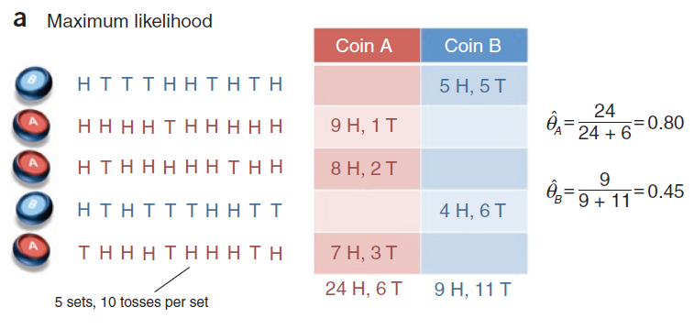
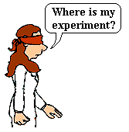

Coin Tossing

Slide 2

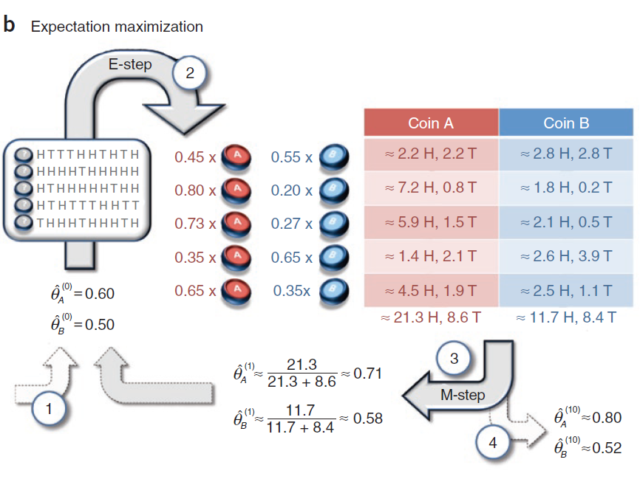



Coin Tossing
Z={A, B}
?
$$We want : θ→Z$$
$$We need : P\left(Z | D,θ\right)$$
Q1: What makes it challenging?
Q2: Can we go from $Z$ to $θ$?
Q3: Can we go from $θ$ to $Z$?

Slide 3
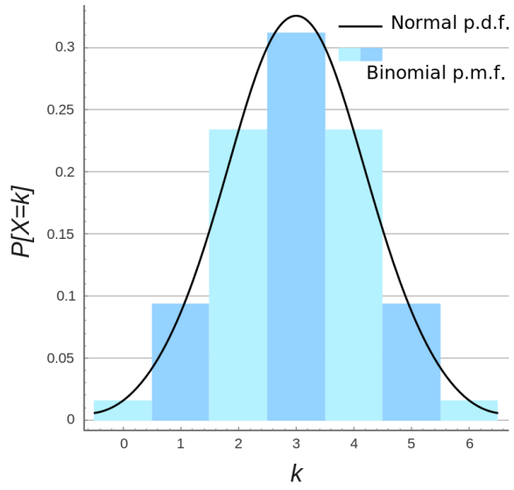
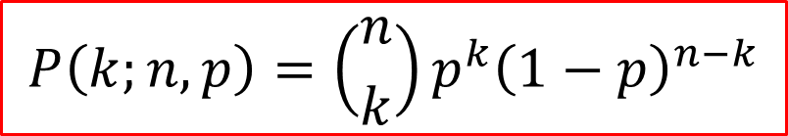
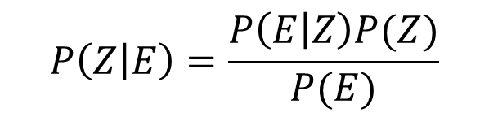
Bayes’ Theorem
Likelihood of Z given evidence E
Prior probability of Z
$$P\left(Z | E\right)=\frac{P\left(E | Z\right)P(Z)}{P(E)}$$
Posterior probability of Z given evidence E
Probability of evidence E
$$P\left(k;n,p\right)=\left({n \atop k}\right)p^{k}{\left(1−p\right)}^{n−k}$$

Slide 4





$$θ_{A}=0.6 θ_{B}=0.5 D=\{9H,1T\}$$
$$P\left(′A′ | D\right)=\frac{P\left(D|^{′}A^{′}\right)P(′A^{′})}{P(D)}$$
$$=\frac{C_{10}^{9}×{0.6}^{9}×0.4×0.5}{P\left(D|^{′}A^{′}\right)P(′A′)+P\left(D|^{′}B^{′}\right)P(′B^{′})}$$
$$≈0.80$$

Slide 5
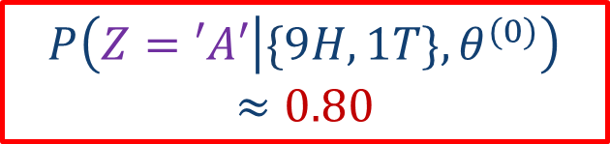
$$P\left(Z=′A′ | \{9H,1T\},θ^{(0)}\right)≈0.80$$
Z={A, B}

