Slide 1
Breast Cancer Prediction from Digitized image of a Fine Needle Aspirate (FNA) of a Breast Mass Using Deep Neural Network (TensorFlow 2.0)
Springboard Data Science Capstone Project II
Frew Berhe
(MPH/Epidemiology, Data Science Career Track student, May 28 cohort)

Slide 2
Introduction
Breast cancer one of the most common causes of death in women.
Accurate diagnosis of breast cancer is of prime importance.
Fine Needle Aspirate (FNA) of breast tumor
Pathologists require expertise and skill for analysis of FNA sample.
Hence, development of algorithms which rely on digitized image analysis, is of great interest.

Slide 3
Objective
To predict breast cancer as benign or malignant using data set from the digitized image of FNA sample.
We propose to use data and build a DNN model using TensorFlow 2.0
Doctors and pathologists in different Hospitals can use such model

Slide 4
Breast Cancer Wisconsin Diagnostic Data Set
The data set was acquired from the Kaggle Competition
Digitized image of FNA of a breast mass
Originally, 569 observations and 33 columns
This data contains information on nuclear morphometry
10 real valued features : Area_mean, perimeter_mean
10 Mean of three Worst values: Area_worst, perimeter_worst
10 Standard Error (se): Area_se, perimeter_se
Finally, after dropping and cleaning
565 observations and 31 columns.
4 outliers: 2 from each classes removed

Slide 5
Pre-PROCESSING
We have a 63% to 37% benign vs malignant
Thus, we don’t need to balance our dataset.
No categorical feature
Scaling
No need to shuffle our data.

Slide 6
Pre-PROCESSING …cont’d
Split scaled data to
80% training set = 452 observations
10% validation set= 56 observations
10% test set = 57 observations
Saved it in “*.npz” format : TensorFlow friendly format.

Slide 7
modeling
Type : Deep Neural Network
Binary classification: 1 for Malignant, 0 for Benign
Tools: TensorFlow 2.0

Slide 8
Define Model
Input size: 30 …. default
Used 3 hidden layers
Activation function for the hidden layers : “ReLU”
Hidden layer size (nodes) : 40 nodes
Activation function for the output layer layer: “sigmoid”

Slide 9
Compile Model
Optimizer : “adam”
Loss : “binary_crossentropy”
Metrics : AUC, and Accuracy

Slide 10
Fit Model
Epoch size : 200
Batch size : 64
Early stopping : patience=2

Slide 11
Training and Validation Results
Training Data Validation Data
Loss 0.0203 0.0510
AUC 0.9998 1.0000
Accuracy 0.9956 0.9821

Slide 12
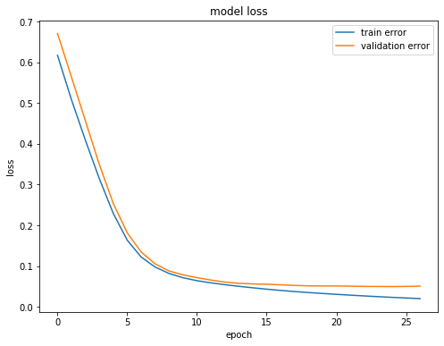
Training and Validation Results

Slide 13
Test data Result
Test Data
AUC 0.9967
Accuracy 0.9825
Loss 0.0979

Slide 14
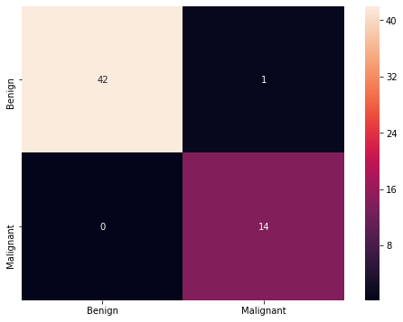
Test data Result …cont’d

Slide 15
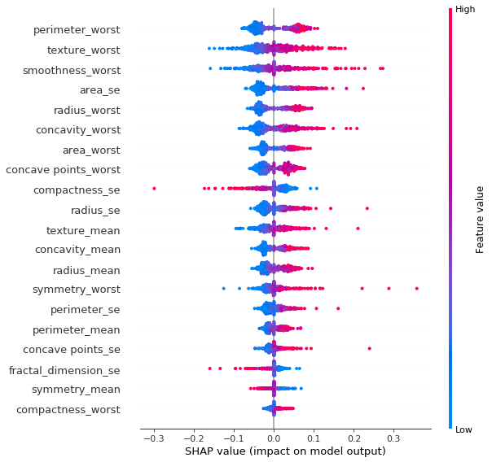
Feature Importance Using SHAP Values
Red points on right side : High values of a feature leads to malignant prediction
Blue points on the right side: Low values of a feature leads to malignant prediction

Slide 16
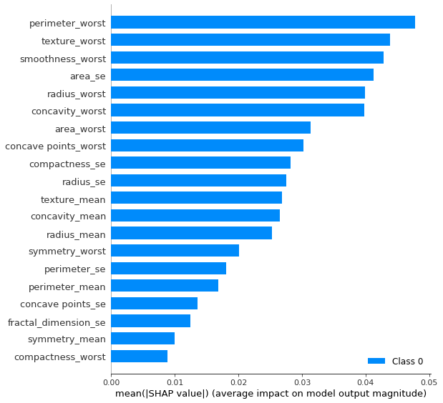
Standard Bar Plot of SHAP values for each feature

Slide 17
Recommendations
In order to make predictions on new data:
Filter out some features,
Select the 20 important features
Scale the data
Feed the data to the TensorFlow model

Slide 18
Recommendations …cont’d
As a result, one can achieve about 98% accuracy
Doctors and pathologists in different Hospitals can apply this outstanding model
To make early clinical decisions with greater confidence.
The Health care industry in general

Slide 19
Assumptions and Limitations
Model prediction dependent on the accuracy of morphologic measurement of the nuclei.
Small sample size: 569 is relatively small

Slide 20
Conclusions
We used Wisconsin breast cancer diagnostic data
we got an outstanding model with AUC score of 0.9967, & accuracy of 0.9825.
'perimeter_worst', 'texture_worst', 'smoothness_worst' top 3 important features
The model can be improved by overcoming the limitations
This can be utilized by the healthcare industry for the early and accurate diagnosis.

Slide 21
Acknowledgement
My deepest gratitude to my mentor Mr. Rahul Sagrolikar (Lead Data Scientist)
Springboard Data Science

Slide 22

Data Science for Accurate and Early Diagnosis
THANK YOU!!!

