Slide 1
Predicting the Occurrence of West Nile Virus (WNV) in Chicago
Springboard Data Science Capstone Project I
Frew Berhe
(MPH/Epidemiology, Data Science Career Track student, May 28 cohort)

Slide 2
Introduction
West Nile Virus (WNV) caused by virus & spread through infected mosquitoes
Chicago has had trouble controlling the spread of WNV
Traps were set up to capture mosquito’s and checked for WNV
Knowing which traps are more likely to have WNV present is important

Slide 3
Objective
Our goal is to generate a model that predicts where and where in Chicago WNV occurs.
The Chicago Department of Public Health (CDPH) can use the model:
To get information on when and where the city will spray airborne pesticides.

Slide 4
WNV Dataset
The data set was acquired from the Kaggle Competition
This data contains information on
1. Main data(location, testing) : 12 columns, & 10506 rows
2. Weather data: 16 columns & 2944 rows
Finally after dropping some columns and merging by date
24 columns and 10506 rows

Slide 5
Pre-PROCESSING
107 rows with values below 5th percentile or above 95th percentile were removed
Target variable is WNV presence in Mosquito: Yes or No
No (9955), and Yes (551): Imbalanced data
Filtering by target variable
Only 3 Mosquito species had at least one positive test for WNV
865 rows filtered out
Created 14 Lag variables(1 up to 14 days lag) for each of the 16 weather variables.
A total of 224 lag variables

Slide 6
Pre-processing … cont’d
Under sampling with a ratio of 1 to 4
Pandas get dummies for the categorical variable ‘Species’
Split the data into train (70%) and test (30%)
After doing IV analysis, correlation, and VIF
8 features and 1928 rows for the training data
8 features and 827 rows for the

Slide 7
modeling
Type : Supervised Learning
Binary classification: 1 for WNV present, 0 for WNV not present
Highly imbalanced data: 5.24% data tagged with class 1
Tools: Python’s scikit learn

Slide 8
Modeling…cont’d
Classification algorithms used
Logistic Regression
KNN
SVM
Random Forest
Extremely Randomized Tree
Ada-Boost
Gaussian NB
Gradient Boosting

Slide 9
Best Algorithm
We applied 8 classification algorithms
Gradient Boosting Classifier is the finest one:
Lowest Log Loss (0.37),
Best accuracy score (0.84),
Second-best ROC AUC score (0.71)

Slide 10
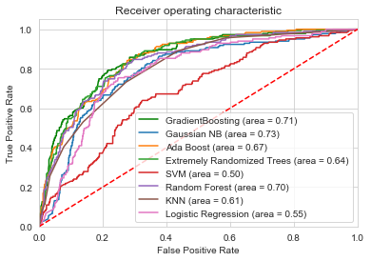
Model comparison by ROC AUC Curve

Slide 11
Recommendations
In order to make predictions on new data:
Filter out some features,
Engineering on weather variables (“Heat(lag_14)”, & “ResultDir (lag_14)”)
Pandas get dummies method on categorical feature (‘Species’)
Feed the eight features to the Gradient Boosting Model

Slide 12
Recommendations …cont’d
Important Features sorted in descending order
Number of mosquitoes caught in trap (“NumMosquitos”)
Resultant wind speed (“ResultSpeed”)
Resultant wind direction (14 after) (“ResultDir(lag_14)”)
Departure from normal temperature (“Depart”)
Day of week (“Day_of_week”)
CULEX RESTUANS species of mosquito (“Species_CULEX RESTUANS”)
CULEX PIPIENS species of mosquito (“Species_CULEX PIPIENS”)
Heat (“Heat(lag_14)”)

Slide 13
Recommendations …cont’d
The City of Chicago and the Chicago Department of Public Health (CDPH)
Can apply this model and
Identify when and where the city will spray airborne pesticides
Control adult mosquito populations,
Reduce morbidity and mortality due to the disease.

Slide 14
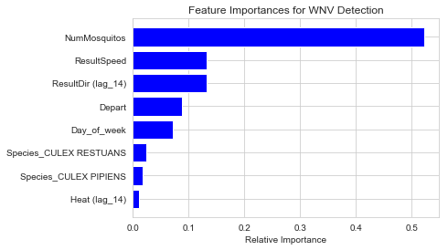

Slide 15
Assumptions and Limitations
We assume that all features are independent, though there might be some time-correlations
Model prediction dependent on weather prediction
We couldn’t use the Spray dataset

Slide 16
Conclusions
Both datasets contributed to the predictive power of the model.
Out of 8 models, the Gradient Boosting provided the best results.
Out of 250 features, we used only eight features
The model can be improved by overcoming the limitations

Slide 17
Acknowledgement
My deepest gratitude to my mentor Mr. Rahul Sagrolikar (Lead Data Scientist)
Springboard Data Science

Slide 18
THANK YOU!!!

