Slide 1
DATASAFARI
Stay connected anywhere in the world
Mobile App Presentation

Slide 2
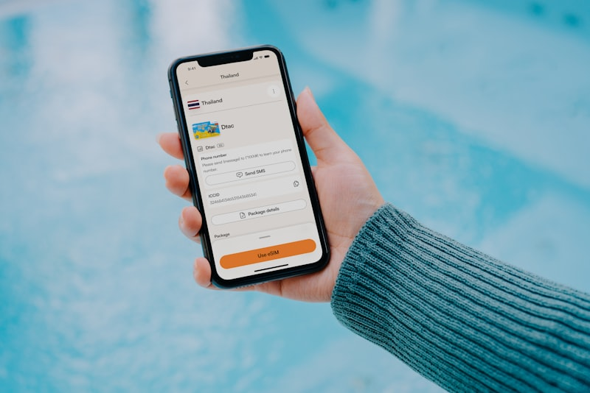
Manage everything from your phone
Browse plans across 200+ destinations
Activate eSIM in under 2 minutes
Track data usage in real time
Top up instantly, mid-trip
24/7 live support via in-app chat

Slide 3


Simple 3-step setup
Choose -> Install -> Connect. No physical SIM, no store visit, no hassle.
Choose your plan
Scan the QR code
Connect instantly

Slide 4
Why travellers choose DataSafari
85%
200+
3 min
24/7
Average savings vs roaming
Countries & regions
Average activation
Live customer support
Available in: USA, UK, Japan, UAE, Singapore, Brazil, Canada, India, Mexico, South Korea, Italy, Spain, Thailand, Greece, Turkey, Portugal, Netherlands, Philippines, Malaysia, Kenya, Nigeria, Indonesia, Argentina, Chile, South Africa, Australia, France, Germany

Slide 5
Ready to travel connected?
Download DataSafari from the App Store or Google Play
datasafari.world

