Slide 1

Final Project:
To Print or Not to Print?
Benjamin Freund

Slide 2

Print vs. Digital
Will the rise of digital media alter the long-standing industry of print media, slowly driving it into oblivion?
Notes:
Image Source: https://shyamsblogs.wordpress.com/2016/05/25/print-media-vs-electronic-media/

Slide 3
Research Questions
How has the number of Pulitzer Prize winners affected newspaper circulation?
  Quality vs. Quantity
How have revenues from advertising and circulation changed over time?
  Allocation of resources

Slide 4
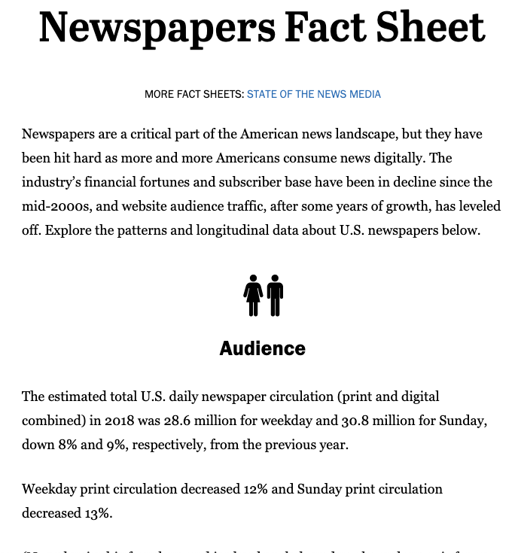
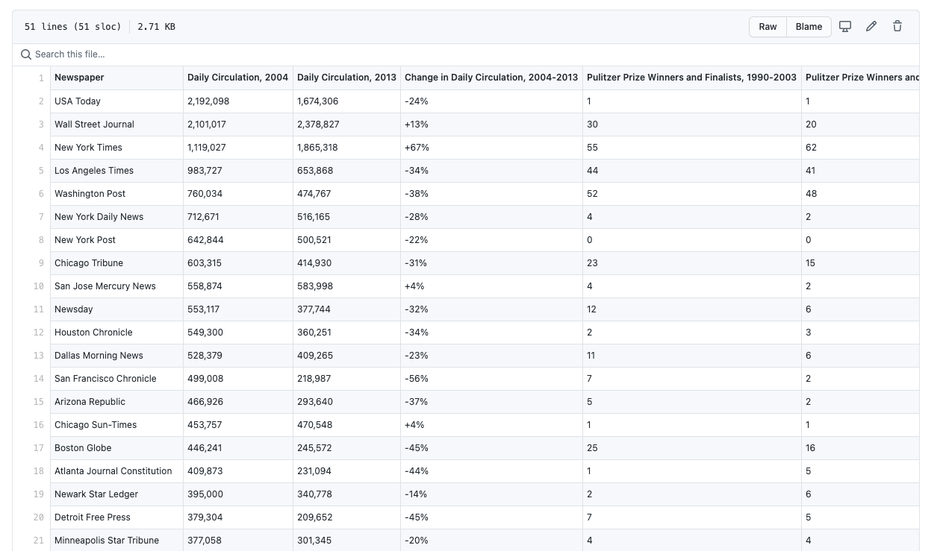
Data Sources
On the left is a fact sheet from the Pew Research Center about various newspaper trends.
On the right is a dataset from FiveThirtyEight’s GitHub repository.

Slide 5
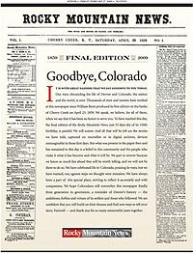

Data Anomalies
Both newspapers circulated in 2004, but not in 2013
  Rocky Mountain News – stopped in 2009
  New Orleans Times-Picayune – was circulating daily in 2013, but not always in newspaper format
Notes:
Image Sources:
Rocky Mountain News - https://en.wikipedia.org/wiki/Rocky_Mountain_News
New Orleans Times-Picayune - https://www.nola.com/news/business/article_c1a7c109-d8b3-53ea-96d5-1d55338c3089.html

Slide 6
Missing Data
Both datasets from the Pew Research Center have missing data
Total Circulation dataset – weekday and Sunday circulation for 2010
Revenue dataset – circulation revenue for 1990
When this happened, I inserted the mean value for the given variable

Slide 7

Use of Scientific Notation
Values in the datasets are often too large for Python to properly display. Therefore, scientific notation is employed to simplify the presentation of the data.

Slide 8
EDA Takeaways
FiveThirtyEight dataset
  Both average daily circulation and average number of Pulitzer prize winners and finalists decreased
  Wall Street Journal, USA Today, and New York Times had highest daily circulation, while New York Times, Washington Post, and Los Angeles Times had most Pulitzer prize winners and finalists
Pew Research Center’s datasets
  Average weekday circulation is greater than average Sunday circulation
  Advertising revenue is greater than circulation revenue

Slide 9
RQ1 - Correlation Matrix
Pulitzer Prize Winners and Finalists, 1990-2003 and Daily Circulation, 2004 → 0.446074
Pulitzer Prize Winners and Finalists, 2004-2014 and Daily Circulation, 2013 → 0.532106
Total Pulitzer Prize Winners and Finalists, 1990-2014 and Total Circulation 2004 and 2013 → 0.497523

Slide 10
RQ1 – Regression Results
Pulitzer Prize Winners and Finalists, 1990-2003 and Daily Circulation, 2004
  R-Squared = 0.199
Pulitzer Prize Winners and Finalists, 2004-2014 and Daily Circulation, 2013
  R-Squared = 0.283
Total Pulitzer Prize Winners and Finalists, 1990-2014 and Total Circulation 2004 and 2013
  R-Squared = 0.248

Slide 11

Answering RQ1
According to all three models I ran on the FiveThirtyEight dataset, I can not predict newspaper circulation by looking at the number of Pulitzer Prize winners. Therefore, I would say that Pulitzer Prizes have little to no effect on newspaper circulation.
Notes:
Image Source: https://www.diyphotography.net/2019-pulitzer-prize-winners-announced-for-breaking-news-and-feature-photography/

Slide 12
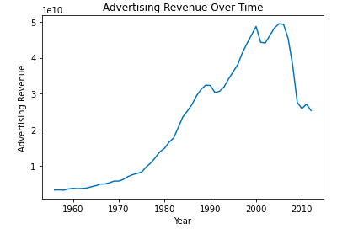
RQ2 – Advertising Revenue Over Time
Increasing since before 1960
Started to plummet around mid-2000s
Theory: Companies who were previously advertising with newspapers started finding other new digital ways to advertise.

Slide 13
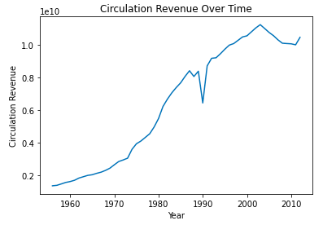
RQ2 – Circulation Revenue Over Time
Steadily increasing since before 1960
Slight dip around 1990

Slide 14
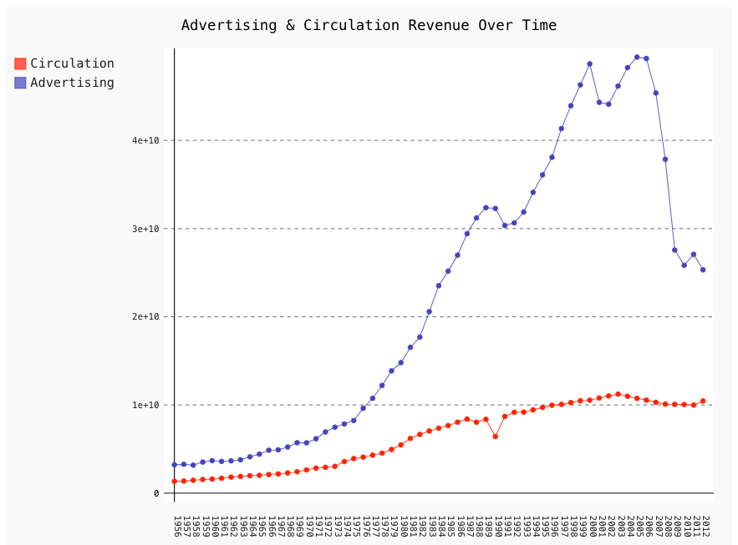
RQ2 – Advertising and Circulation Revenue Over Time
Advertising revenue is much more profitable, generating more revenue
Circulation revenue is much more consistent, steadily increasing over time

Slide 15

Answering RQ2
If a newspaper company is looking for a large source of revenue, focusing on advertising revenue seems to be the way to go. However, if they are looking for a consistent source of steadily growing revenue, circulation seems to be the revenue channel to focus on. Either way, neither revenue stream can prove the rise or fall of print media.
Notes:
Image Source: https://support.appsflyer.com/hc/en-us/articles/360001546009-Revenue-attribution-overview

Slide 16
Conclusion
Neither Pulitzer prizes nor revenue streams could help determine whether print media is dying
Limitations:
  Years not matching
  Scope
  More
Ideal is for electronic and print media to balance each other

