Slide 1
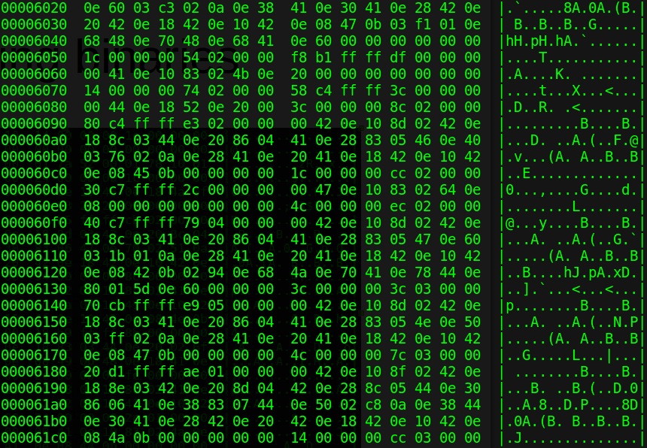
Hacking binaries
reverse engineering binaries
cracking applications

Slide 2
Binary
Code that is compiled to run with a particular processor
Binary contains machine code
Machine code is the language of the processor
Windows executable .exe, Linux ELF
Written in some language (C, C++)
Compiled to machine language → binary file
Java is compiled into byte code for the JVM
binary = native code = machine code = executable

Slide 3
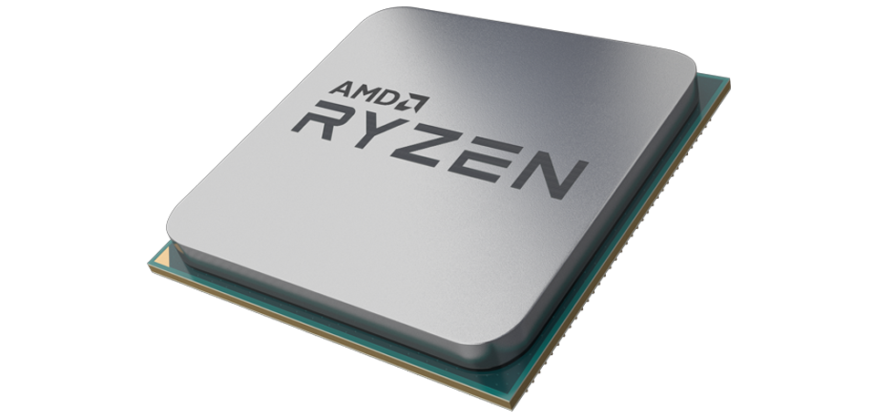
High level code
(Java)
High level code
(C)
compiler
Byte code
compiler
JVM
Machine code
(binary)
Machine code
(binary)

Slide 4
Hacking a binary
Change the binary in such a way that it behaves differently
E.g.
  Modifying an application so it won’t send your personal data to the company
  Removing protections from malware so it can be analysed
  Modifying an application to make it ‘registered’ (crack)

Slide 5
Understand the binary
We only have the binary with unreadable machine code
Make it more human readable
Decompile:
  high level code machine code
  high level code machine code (difficult)
  Large applications really difficult or impossible.
Disassemble:
  No lost information but difficult to understand
  We get disassembly code (instructions), x86
  ASM is the language of the CPU

Slide 6
Now some low level stuff...

Slide 7
CPU
Executes CPU instructions, machine code
Registers = super fast memory inside the CPU
  Used to store variables; ~200x faster than RAM
  64bits
  rax, rdi, ecx, dil
FLAGS register used to hold state
  Some instruction modifies register and next instruction uses state of register
  Used with conditional jumps, JA, JNE, Jxx
  ZF; 0 or 1
  CF; 0 or 1

Slide 8
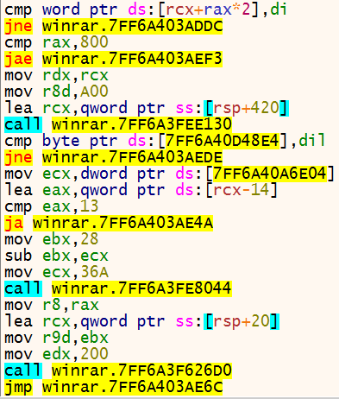
ASM CPU instructions
mov A, B = copy B to A
cmp A, B = compare A to B (substract B from A)
jmp [Address] = continue execution from [Address]
ja [Address] = Jump Above. Conditional. Only jump if certain flags are set. Many Jxx, jne, je, jle,…
ZF = Zero Flag. Will be set when the result of a cmp is zero. Just a bit that can be set in the processor
call = call function and return value in rax

Slide 9
if/else in ASM
if (a == 1) {
    printf()
} else {
atoi()
}
0x01 cmp ecx, 1 (ZF set)
0x02 je 0x27
0x03 call atoi
…
0x27 call printf

Slide 10
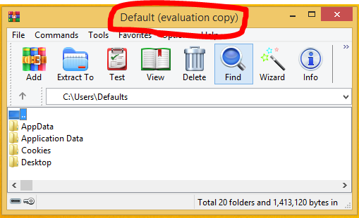
Example application
Change it’s behaviour so that it’s registered
Runs in some state
  State: not registered (“evaluation”)
  We want: registered
How do we get to the registered state?
How did the high level code look like?

Slide 11
Registration logic
How would the application check if it’s registered?
At some point, there must be function checking if the program is registered (check)
  Could be many checks
  We don’t know how it looks like
Find that registration-check function (routine)

Slide 12
Find the registration routine
Can be anywhere in the many lines of assembly
Hypothesis:
  if ( !isRegistered() ) {
    …
    printString(“evaluation”);
  } else {
    ...
    printString(“string_we_dont_know”)
  }

Slide 13
Flow that leads to “evaluation”
Print “evaluation” in the title bar
code path
If ( !isRegistered() )
Else { }
code path
Print something else in the title bar
Find where “evaluation copy” is used

Slide 14
Attack plan
Search for the “evaluation copy” string in the binary
Trace back to find the registration routine
Modify registration routine so it takes the ‘else’

Slide 15
x64dbg
Disassembler: human readable machine code (ASM)
Debugger:
  Pause execution of code
  Read contents of registers and other CPU information

Slide 16
demo

Slide 17
Protecting
Obfuscate
Pack
VM
Online verfication

