Slide 1
MULTICYCLE PROCESSOR

Slide 2
Muticycle Processor
A single-cycle processor is simple to implement. However, it has multiple disadvantages, such as the cycle time being limited by the longest instruction, which is the load word (lw) instruction.
The multicycle processor solves these problems, providing higher clock speed, different instructions which use different numbers of steps (thus simpler instructions complete faster), and utilization of only one adder, which is reused for different purposes throughout the entire cycle.

Slide 3
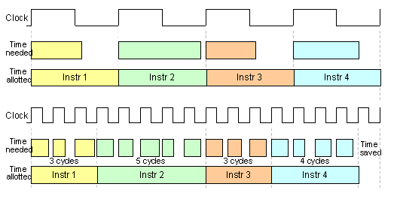
Multicycle vs. Single Cycle

Slide 4
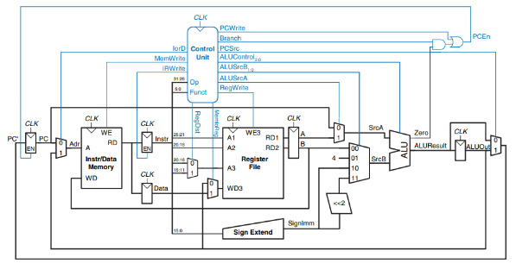
Complete Multicycle MIPS Processor

Slide 5
ALU

Slide 6
ALU
The Arithmetic logic unit is a combinational circuit that performs arithmetic and bitwise operations on integer binary numbers. It is mainly composed of two input operands, a function selector, output result and flag bits. In this multicycle processor design, zero flag is used and passed to the control unit.

Slide 7
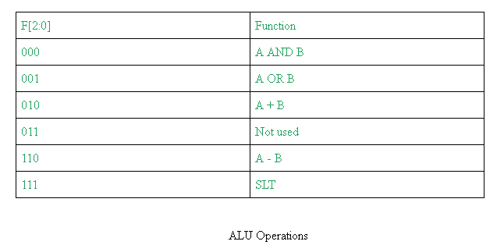

Slide 8
Code for ALU
always @ ( * )
case (F[2:0])
3'b000: Y <= A & B; // AND
3'b001: Y <= A | B; // OR
3'b010: Y <= A + B; // ADD
//3'b011: Y <= 0; // not used
3'b110: Y <= A - B; // SUB
3'b111: Y <= A < B ? 1:0; //SLT
default: Y <= 0; //default to 0, should not happen
endcase
assign Zero = (Y == 32'b0);
endmodule
module alu( input [31:0] A, B,
input [2:0] F,
output reg [31:0] Y,
output Zero);

Slide 9
Testbench for ALU
#8 A = 2; B = 3;
#8 A = 5; B = 7;
#8 A = 13; B = 10;
#8 A = 25; B = 25;
#8 A = 35; B = 56;
#8 A = 75; B = 100;
#8 A = 200; B = 155;
#8 A = 360; B = 400;
#8 A = 1023; B = 780;
#8 A = 1570; B = 2047;
end
always
begin
#1 F = F + 1;
end
endmodule
module alu_t();
reg [31:0] A, B;
reg [2:0] F;
wire Zero;
wire [31:0] Y;
alu uut (A, B, F, Y, Zero);
initial begin
A = 0;
B = 0;
F = 0;

Slide 10
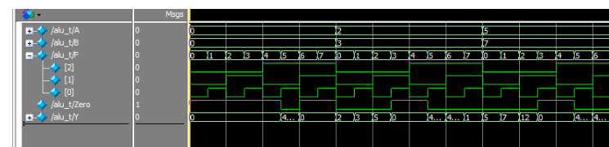
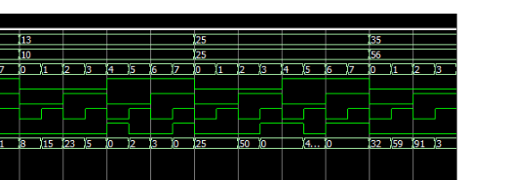
Waveform of the ALU

Slide 11
MEMORY

Slide 12
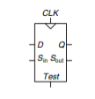
What is a Memory?
Memory refers to a device that is used to store information for immediate use in a computer or related computer hardware device. A single cell memory element is just a single scannable flip flop.
Scannable Flipflop

Slide 13
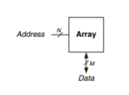
Cont. Memory
A memory unit can be made by creating an array of flipflops that can be read and written. The following figure shows the basic symbol for the memory.

Slide 14
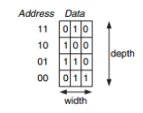
Generic Memory Symbol
Memory Array Function
The memory size can be determined by multiplying its width and depth in this case, the memory unit above can store 12bits of data.

Slide 15
Memory Organization
The memory can read and write data. Each block of memory has its own address that is used to locate the data. The memory is composed of inputs: clock, for timing, write enable latch, address bits for locating data, write data, the data needed to be stored. The output is only read data that outputs data based on the current address bit input.
In multicycle processor, the memory is shared. Both instruction and data share the same memory block. A single memory block is a machine code that is derived from the assembly code of the program. To interpret machine language, one must decipher the fields of each 32-bit instruction word. Different instructions use different formats, but all formats start with a 6-bit opcode field. Thus, the best place to begin is to look at the opcode. If it is 0, the instruction is R-type; otherwise it is I-type or J-type.

Slide 16
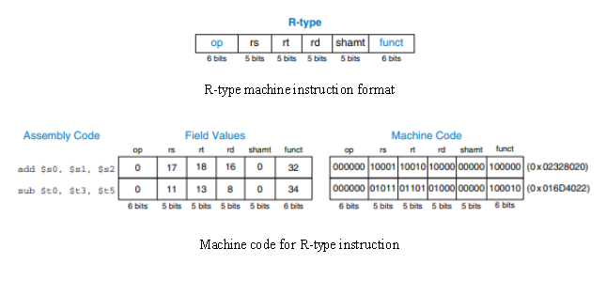

Slide 17
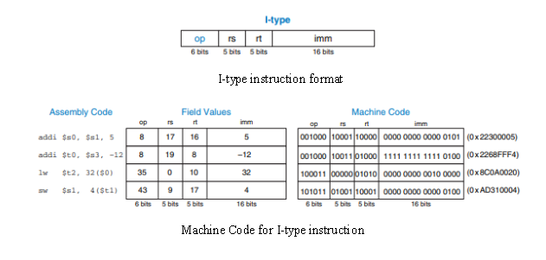

Slide 18
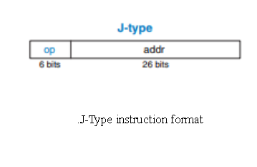

Slide 19
Code for Memory
module mem(input clk, we,
input [31:0] a, wd,
output [31:0] rd);
reg [31:0] RAM[63:0];
initial begin
RAM[0] <= 32'h20020005;
RAM[1] <= 32'h2003000c;
RAM[2] <= 32'h2067fff7;
RAM[3] <= 32'h00e22025;
RAM[4] <= 32'h00642824;
RAM[5] <= 32'h00a42820;
RAM[6] <= 32'h10a7000a;
RAM[7] <= 32'h0064202a;
RAM[8] <= 32'h10800001;
RAM[9] <= 32'h20050000;
RAM[10] <= 32'h00e2202a;
RAM[11] <= 32'h00853820;
RAM[12] <= 32'h00e23822;
RAM[13] <= 32'hac670044;
RAM[14] <= 32'h8c020050;
RAM[15] <= 32'h08000011;
RAM[16] <= 32'h20020001;
RAM[17] <= 32'hac020054;
end
assign rd = RAM[a[31:2]]; // word aligned
always @(posedge clk)
if (we)
RAM[a[31:2]] <= wd;
endmodule

Slide 20
Testbench for Memory
initial begin
a <= 10; //read memory from address 10
#10;
a <= 25; //read memory from address 25
#10;
a <= 25;
we <= 1;
wd <= 32'habcd1234; //write abcd1234 to address 25
#10;
we <= 0;
a <= 5; //read memory from address 5
#10;
a <= 25; //read memory from address 25
#10;
$stop;
end
endmodule
module mem_tb;
reg clk, we;
reg [31:0] a, wd;
wire [31:0] rd;
mem uut(clk, we, a, wd, rd);
always begin
clk <= 1; #5; clk <= 0; #5;
end
initial begin
we <= 0;
wd <= 0;
end

Slide 21
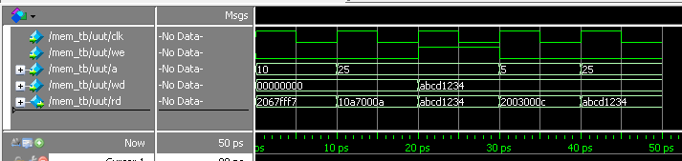
Waveform of Memory

Slide 22
REGISTER

Slide 23
Register:
A register is a quick-access storage location for a processor
Usually comprises of a small amount of storage, and each of these storage parts may be either read-only or write-only
Registers are able to store light data for an amount of time, and can serve as an interface which allows the CPU to communicate with the I/O and memory components

Slide 24
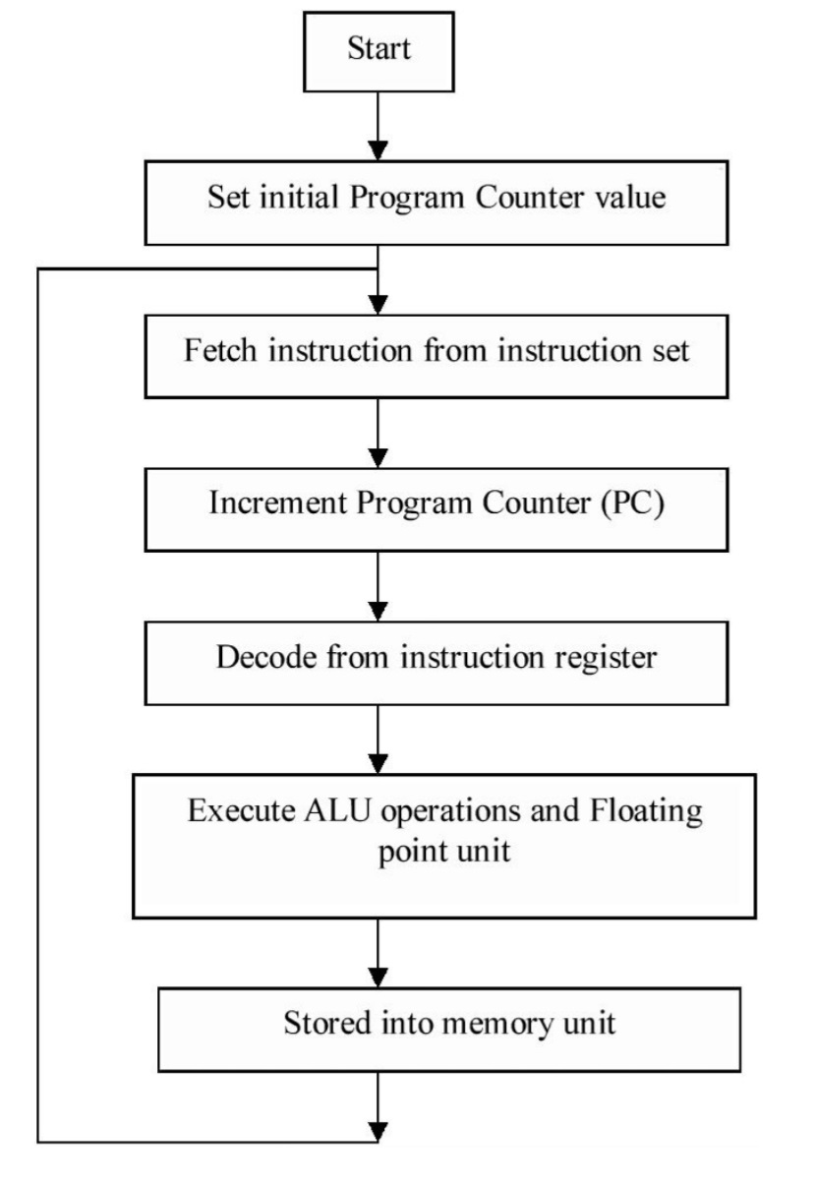
To demonstrate the flow of processes of a register, a flowchart is illustrated below:

Slide 25
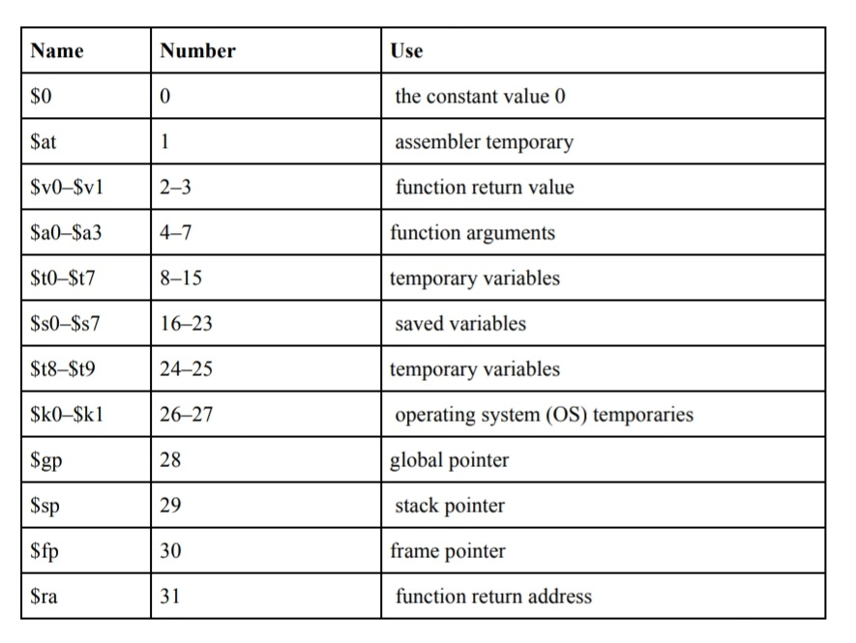
The Register Set
The MIPS architecture defines 32 registers. Each register has a name and a number ranging from 0 to 31. The following table lists the name, number, and use for each register. $0 always contains the value 0 because this constant is frequently used in computer programs.

Slide 26
Code for Register :
module regfile (input clk,
input we3,
input [4:0] ra1, ra2, ra3,
input [31:0] wd3,
output [31:0] rd1, rd2);
reg [31:0] rf [31:0];
always @ (posedge clk)
if (we3)
rf[wa3] <= wd3;
assign rd1 = (ra1 != 0) ? rf[ra1]:0;
assign rd2 = (ra2 != 0) ? rf[ra2]:0;
endmodule
Notes:
Ra1, ra2, ra3 (3 ported register files
Read two ports cominationally
Write third port on the rising edge of the clock
Register 0 hardwred to 0

Slide 27
Testbench for Register:
`timescale 1 ns / 1 ns
module register_file_tst();
reg clk, we3;
reg [4:0] a1, a2,a3;
reg [31:0] wd3;
wire [31:0] rd1, rd2;
register_file UUT (clk, we3,a1,a2, a3,wd3, rd1, rd2);
initial begin
wd3 =32'b0;
a1 = 5'b0;
a2 = 5'b0;
a3 = 5'b0;

Slide 28
we3 = 1'b0;
clk = 1'b0;
#100
we3=1'b1;
#20
wd3=32'habcd_efab;
a1=5'h0;
a2=5'h0;
a3=5'h1;
#20
wd3=32'h0123_4567;
a1=5'h1;
a2=5'h0;
a3=5'h2;
#20
wd3=32'hcccc_cccc;
a1=5'h2;
a2=5'h1;
a3=5'h3;
#20
wd3=32'h3333_4567;
a1=5'h2;
a2=5'h3;
a3=5'h1;
end
always begin
#10;
clk =~clk;
end
endmodule

Slide 29
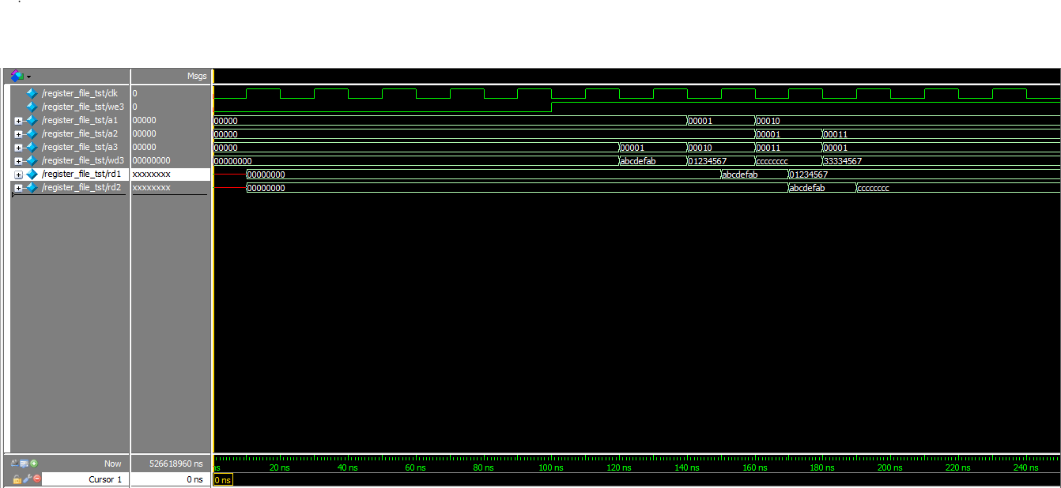
Waveform of the Register:

Slide 30
CONTROL UNIT

Slide 31
Control Unit
The control unit is the part of the computer’s central processing unit (CPU), which directs the operation of the processor. It was included as part of the von Neumann architecture by John von Neumann.
It is the responsibility of the control unit to tell the computer’s memory, arithmetic/logic unit (ALU), and input/output (I/O) devices how to respond to the instructions that have been sent to the processor. It fetches internal instructions of the programs from the main memory to the processor instruction register, and based on this register contents, the control unit generates a control signal that supervises the execution of these instructions.

Slide 32
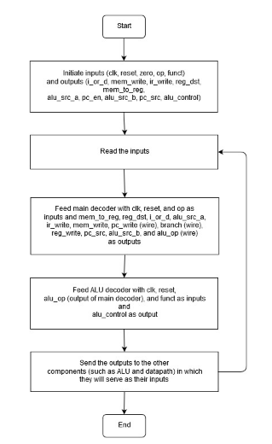

Slide 33
Cont. Control Unit
The controller will have two major modules, the main decoder and the ALU decoder. The controller will read inputs from the top level in which it will provide control signals as outputs which are processed by the main decoder and the ALU decoder. The main decoder uses opcodes as input while the ALU decoder uses functions as input. The alu_op output port of the main decoder will be used as an input port by the ALU decoder. A more detailed operation on how the controller works will be discussed in the state diagram.

Slide 34
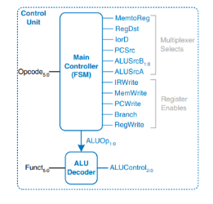
Control Unit Internal Structure

Slide 35
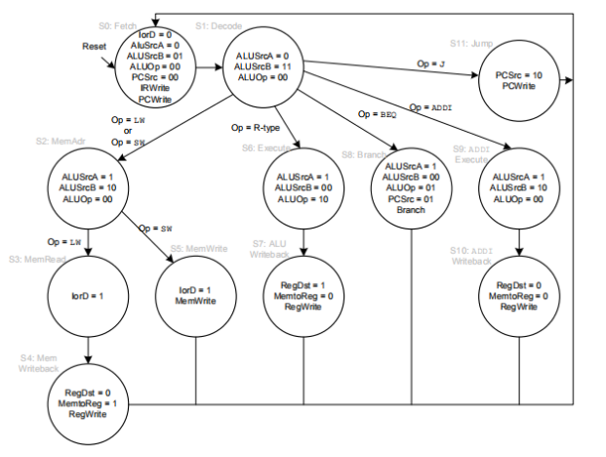
Control Unit State Diagram

Slide 36
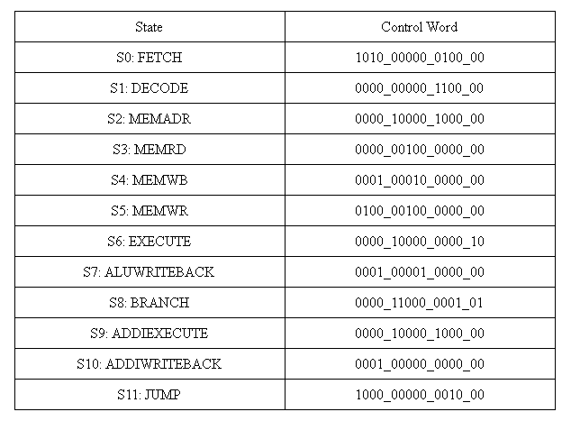
Control Unit State Table

Slide 37
Code for the Control Unit
// The main controller produces multiplexer select and register enable
// signals for the datapath. The select signals are MemtoReg, RegDst,
// IorD, PCSrc, ALUSrcB, and ALUSrcA. The enable signals are IRWrite,
// MemWrite, PCWrite, Branch, and RegWrite.
module controller(input clk, reset,
input [5:0] op, funct,
input zero,
output pcen, memwrite, irwrite, regwrite,
output alusrca, iord, memtoreg, regdst,
output [1:0] alusrcb, output [1:0] pcsrc,
output [2:0] alucontrol);
wire [1:0] aluop;
wire branch, pcwrite;

Slide 38
// Main Decoder and ALU Decoder subunits.
maindec md(clk, reset, op,
pcwrite, memwrite, irwrite, regwrite,
alusrca, branch, iord, memtoreg, regdst,
alusrcb, pcsrc, aluop);
aludec
ad(funct, aluop, alucontrol);
assign pcen = pcwrite | (branch & zero);
endmodule

Slide 39
Main Decoder
// The controller receives the current instruction from the datapath
// and tell the datapath how to execute that instruction.
module maindec(input clk, reset,
input [5:0] op,
output pcwrite, memwrite, irwrite, regwrite,
output alusrca, branch, iord, memtoreg, regdst,
output [1:0] alusrcb,
output [1:0] pcsrc,
output [1:0] aluop);

Slide 40
// FSM States
parameter FETCH = 5'b00000; // State 0
parameter DECODE = 5'b00001; // State 1
parameter MEMADR = 5'b00010; // State 2
parameter MEMRD = 5'b00011; // State 3
parameter MEMWB = 5'b00100; // State 4
parameter MEMWR = 5'b00101; // State 5
parameter EXECUTE = 5'b00110; // State 6
parameter ALUWRITEBACK = 5'b00111; // State 7
parameter BRANCH = 5'b01000; // State 8
parameter ADDIEXECUTE = 5'b01001; // State 9
parameter ADDIWRITEBACK = 5'b01010; // state a
parameter JUMP = 5'b01011; // State b

Slide 41
// MIPS Instruction Opcodes
parameter LW = 6'b100011; // load word lw
parameter SW = 6'b101011; // store word sw
parameter RTYPE = 6'b000000; // R-type
parameter BEQ = 6'b000100; // branch if equal beq
parameter ADDI = 6'b001000; // add immidiate addi
parameter J = 6'b000010; // jump j
reg [4:0] state, nextstate;
reg [16:0] controls;
state register
always @(posedge clk or posedge reset)
if(reset) state <= FETCH;
else state <= nextstate;

Slide 42
// next state logic
always @( * )
case(state)
FETCH: nextstate <= DECODE;
DECODE: case(op)
LW: nextstate <= MEMADR;
SW: nextstate <= MEMADR;
RTYPE: nextstate <= EXECUTE;
BEQ: nextstate <= BRANCH;
ADDI: nextstate <= ADDIEXECUTE;
J: nextstate <= JUMP;
default: nextstate <= FETCH;
endcase
MEMADR: case(op)
LW: nextstate <= MEMRD;
SW: nextstate <= MEMWR;
default: nextstate <= FETCH;
endcase
MEMRD: nextstate <= MEMWB;
MEMWB: nextstate <= FETCH;
MEMWR: nextstate <= FETCH;
EXECUTE: nextstate <= ALUWRITEBACK;
ALUWRITEBACK: nextstate <= FETCH;
BRANCH: nextstate <= FETCH;
ADDIEXECUTE: nextstate <= ADDIWRITEBACK;
ADDIWRITEBACK: nextstate <= FETCH;
JUMP: nextstate <= FETCH;
default: nextstate <= FETCH;
endcase

Slide 43
// output logic
assign {pcwrite, memwrite, irwrite, regwrite, alusrca, branch, iord, memtoreg, regdst, alusrcb, pcsrc, aluop} = controls;
always @( * )
case(state)
FETCH: controls <= 19'b1010_00000_0100_00;
DECODE: controls <= 19'b0000_00000_1100_00;
MEMADR: controls <= 19'b0000_10000_1000_00;
MEMRD: controls <= 19'b0000_00100_0000_00;
MEMWB: controls <= 19'b0001_00010_0000_00;
MEMWR: controls <= 19'b0100_00100_0000_00;

Slide 44
EXECUTE: controls <= 19'b0000_10000_0000_10;
ALUWRITEBACK: controls <= 19'b0001_00001_0000_00;
BRANCH: controls <= 19'b0000_11000_0001_01;
ADDIEXECUTE: controls <= 19'b0000_10000_1000_00;
ADDIWRITEBACK: controls <= 19'b0001_00000_0000_00;
JUMP: controls <= 19'b1000_00000_0010_00;
default: controls <= 19'b0000_xxxxx_xxxx_xx; // should never happen
endcase
endmodule

Slide 45
ALU Decoder
module aludec(input [5:0] funct,
input [1:0] aluop,
output reg [2:0] alucontrol);
always @( * )
case(aluop)
3'b000: alucontrol <= 3'b010; // add
3'b001: alucontrol <= 3'b010; // sub
// RTYPE instruction use the 6-bit funct field of instruction to specify ALU operation
3'b010: case(funct)
6'b100000: alucontrol <= 3'b010; // ADD
6'b100010: alucontrol <= 3'b110; // SUB
6'b100100: alucontrol <= 3'b000; // AND
6'b100101: alucontrol <= 3'b001; // OR
6'b101010: alucontrol <= 3'b111; // SLT
default: alucontrol <= 3'bxxx; // ???
endcase
default: alucontrol <= 3'bxxx; // ???
endcase
endmodule

Slide 46
Testbench for Control Unit
module controllert();
reg clk, reset, zero;
reg [5:0] op, funct;
wire iord, memwrite, irwrite, regdst, memtoreg, regwrite, alusrca, pcen;
wire [1:0] alusrcb, pcsrc;
wire [2:0] alucontrol;
reg [31:0] instr;
always @ ( * ) begin
op <= instr [31:26];
funct <= instr [5:0];
end
controller uut(clk, reset, op, funct, zero, pcen, memwrite, irwrite, regwrite, alusrca, iord, memtoreg, regdst, alusrcb, pcsrc, alucontrol);
always #1 clk = ~clk;

Slide 47
initial
begin
clk = 0;
reset = 1;
zero = 0;
#2 reset = 1; instr = 0;
#2 reset = 0; instr = 32'h20020005; //addi
#2 reset = 0; instr = 32'h20020005; //addi
#2 reset = 0; instr = 32'h20020005; //addi
#2 reset = 0; instr = 32'h20020005; //addi
#2 reset = 0; instr = 32'h2003000c; //addi
#2 reset = 0; instr = 32'h2003000c; //addi
#2 reset = 0; instr = 32'h2003000c; //addi
#2 reset = 0; instr = 32'h00e22025; //or
#2 reset = 0; instr = 32'h00e22025; //or
#2 reset = 0; instr = 32'h00e22025; //or
#2 reset = 0; instr = 32'h00e22025; //or
#2 reset = 0; instr = 32'h00642824; //and
#2 reset = 0; instr = 32'h00642824; //and
#2 reset = 0; instr = 32'h00642824; //and
#2 reset = 0; instr = 32'h00642824; //and

Slide 48
#2 reset = 0; instr = 32'h00a42820; //add
#2 reset = 0; instr = 32'h00a42820; //add
#2 reset = 0; instr = 32'h00a42820; //add
#2 reset = 0; instr = 32'h00a42820; //add
#2 reset = 0; instr = 32'h00853820; //add
#2 reset = 0; instr = 32'h00853820; //add
#2 reset = 0; instr = 32'h00853820; //add
#2 reset = 0; instr = 32'h00853820; //add
#2 reset = 0; instr = 32'h00e23822; //sub
#2 reset = 0; instr = 32'h00e23822; //sub
#2 reset = 0; instr = 32'h00e23822; //sub
#2 reset = 0; instr = 32'h00e23822; //sub
#2 reset = 0; instr = 32'hac670044; //sw
#2 reset = 0; instr = 32'hac670044; //sw
#2 reset = 0; instr = 32'hac670044; //sw
#2 reset = 0; instr = 32'hac670044; //sw
#2 reset = 0; instr = 32'h8c020050; //lw
#2 reset = 0; instr = 32'h8c020050; //lw
#2 reset = 0; instr = 32'h8c020050; //lw
#2 reset = 0; instr = 32'h8c020050; //lw
#2 reset = 0; instr = 32'h8c020050; //lw
#2 $stop;
end

Slide 49
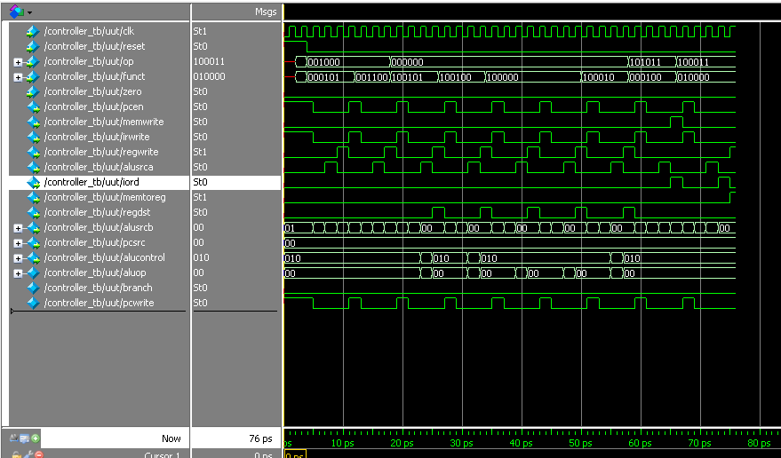
Waveform of the Control Unit

Slide 50
DATAPATH

Slide 51
Multicycle Datapath
The design for the datapath of a MIPS processor is similar to that of the single-cycle processor, only it involves using a combined memory for both data and instructions, since by doing this it is easier to read in one cycle and is more practical. Reading or writing the data takes place in a separate cycle.

Slide 52
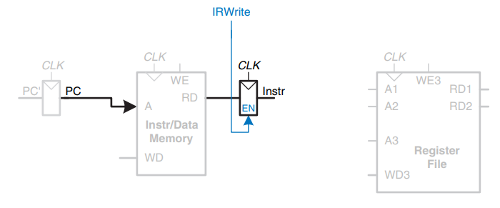
Step 1: Fetch instruction from memory

Slide 53
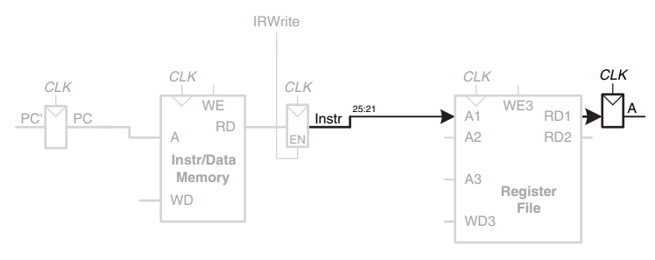
Step 2a: Read source operand from register file

Slide 54
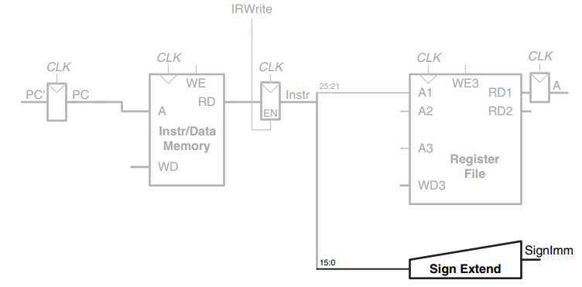
Step2b: Sign-extend the immediate

Slide 55
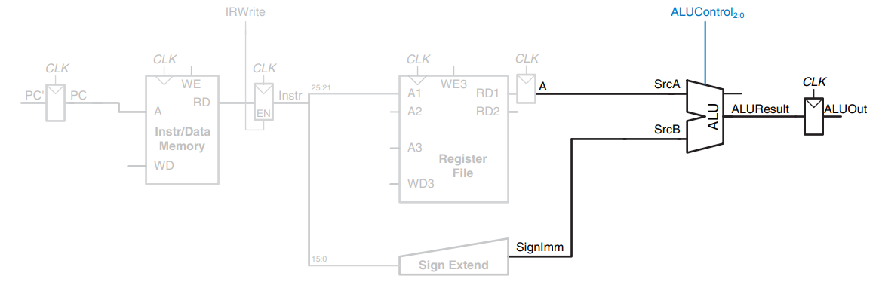
Step 3: Add base address to offset

Slide 56
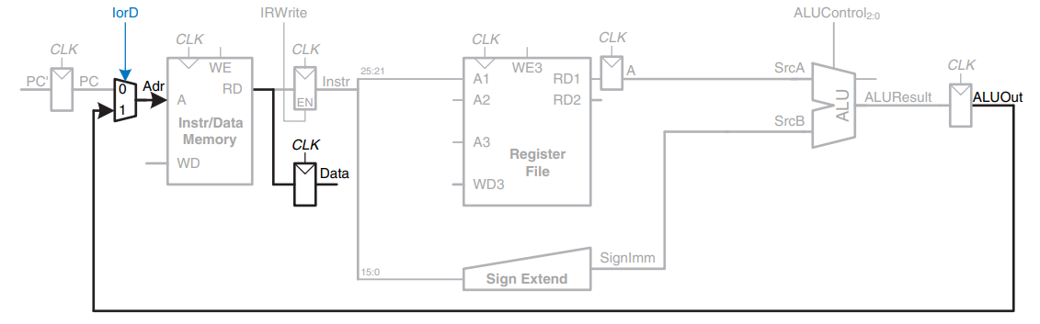
Step 4: Load data from memory

Slide 57
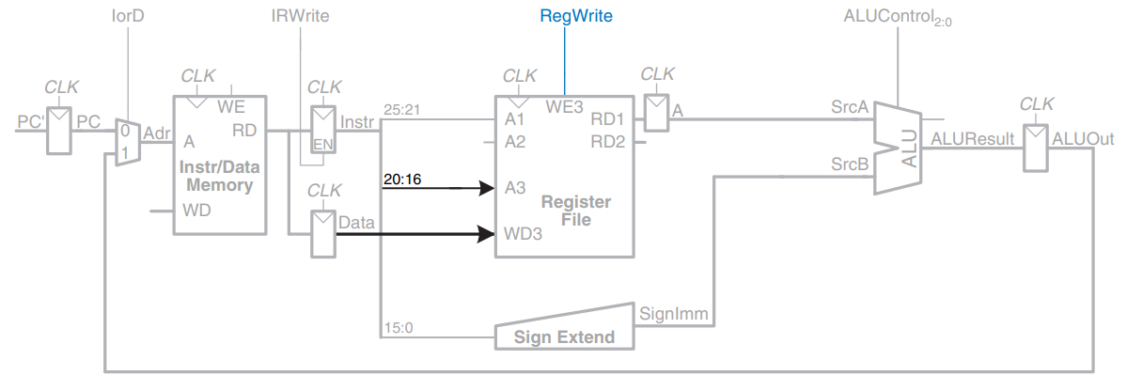
Step 5: Write data back to register file

Slide 58
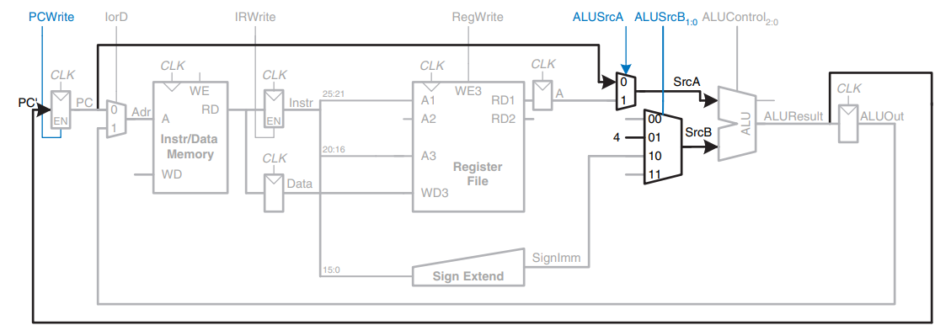
Step 6: Increment PC by 4

Slide 59
Enhanced datapath for sw instruction
This completes the datapath for the lw instruction. Next, let us extend the datapath to also handle the sw instruction. Like the lw instruction, the sw instruction reads a base address from port 1 of the register file and sign-extends the immediate. The ALU adds the base address to the immediate to find the memory address. All of these functions are already supported by existing hardware in the datapath.

Slide 60
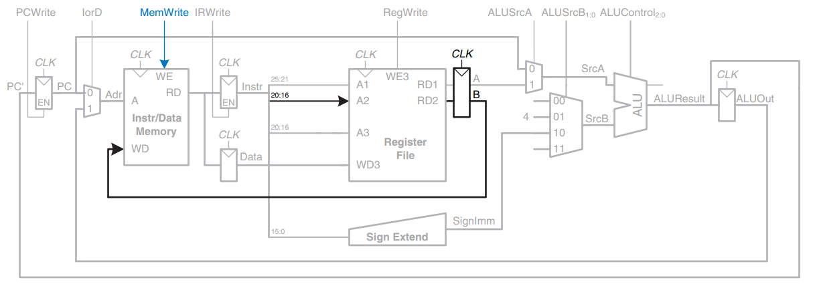
Enhanced datapath for sw instruction

Slide 61
Enhanced datapath for R-type instructions
For R-type instructions, the instruction is again fetched, and the two source registers are read from the register file. ALUSrcB1:0, the control input of the SrcB multiplexer, is used to choose register B as the second source register for the ALU.

Slide 62
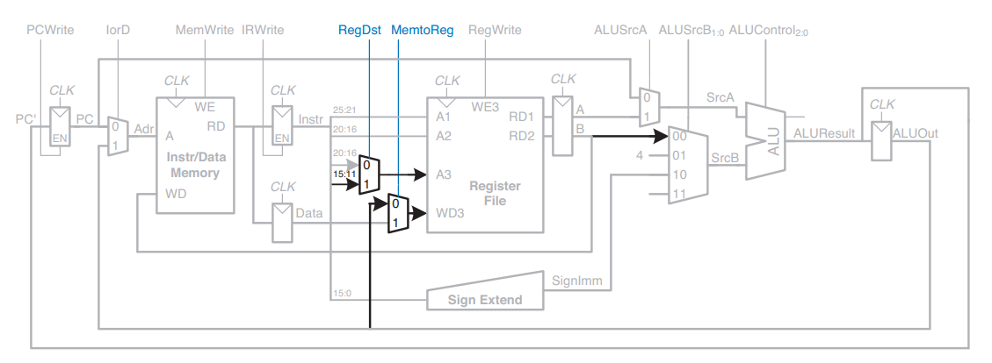
Enhanced datapath for R-type instructions

Slide 63
Enhanced datapath for beq instruction
For the beq instruction, the instruction is fetched again, and the two source registers are read from the register file. To determine whether the registers are equal, the ALU subtracts the registers and, upon a zero result, sets the Zero flag. Meanwhile, the datapath must compute the next value of the PC if the branch is taken: PC′ = PC + 4 + SignImm × 4.

Slide 64
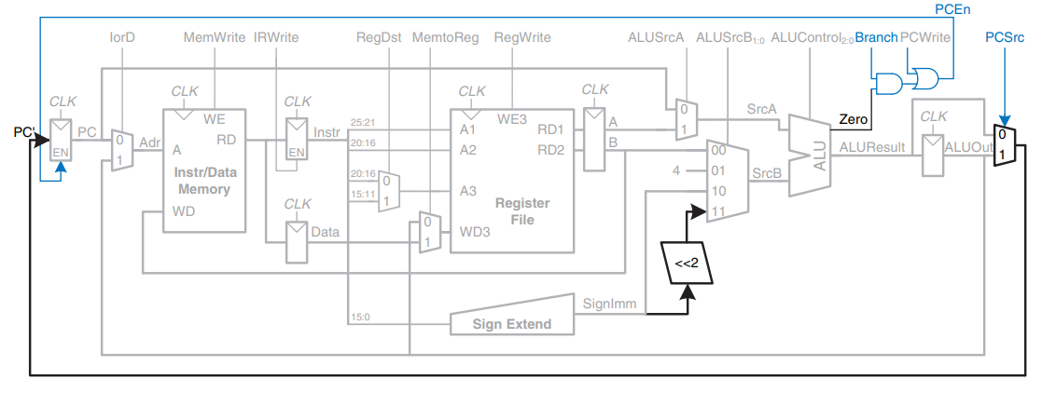
Enhanced datapath for beq instruction

Slide 65
Generic Building Blocks
This section contains generic building blocks that may be useful in any MIPS microarchitecture, including a left shift unit, sign-extension unit, resettable flip-flop, and multiplexer.

Slide 66
Left Shift Unit (Multiply by 4)
Left shifters move bits and multiply by powers of 2. As the name implies, a left shifter shifts a binary number left by a specified number of positions.
Ex: 11001 LSR 2 = 00110; 11001 LSL 2 = 00100
Shifts the number to the left (LSL) and fills empty spots with 0’s.

Slide 67
Code for Left Shift Unit
module sl2(input [31:0] a, output [31:0] y);
assign y = {a[29:0], 2'b00}; // shift left by 2
endmodule

Slide 68
Testbench for Left Shift Unit
`timescale 1ps/1ps
module s12_tb;
reg[31:0] a;
wire[31:0] y;
initial begin
a = 32'hffffffff;
#1 a = 32'habcd1234;
#1 $stop;
end
sl2 uut(a, y);
endmodule

Slide 69

Waveform For Left Shift Unit

Slide 70
Sign Extension
Sign extension is the operation, in computer arithmetic, of increasing the number of bits of a binary number while preserving the number's sign (positive/negative) and value. This is done by appending digits to the most significant side of the number, following a procedure dependent on the particular signed number representation used. For example, if six bits are used to represent the number "00 1010" (decimal positive 10) and the sign extend operation increases the word length to 16 bits, then the new representation is simply "0000 0000 0000 1010". Thus, both the value and the fact that the value was positive are maintained. If ten bits are used to represent the value "11 1111 0001" (decimal negative 15) using two's complement, and this is sign extended to 16 bits, the new representation is "1111 1111 1111 0001". Thus, by padding the left side with ones, the negative sign and the value of the original number are maintained.

Slide 71
Code for Sign Extension
module signext(input [15:0] a, output [31:0] y);
assign y = {{16{a[15]}}, a};
endmodule

Slide 72
Testbench For Sign Extension
`timescale 1ps/1ps
module signext_tb;
reg[15:0] a;
wire[31:0] y;
initial begin
a = 32'hfff3;
#1 a = 32'h004f;
#1 $stop;
end
signext uut(a, y);
endmodule

Slide 73



Waveform for Sign Extension

Slide 74
Multiplexer
Multiplexers are among the most commonly used combinational circuits. They choose an output from among several possible inputs based on the value of a select signal. A multiplexer is sometimes affectionately called a mux.

Slide 75
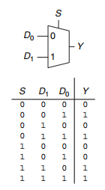
2:1 multiplexer symbol and truth table

Slide 76
Wider Multiplexers
A 4:1 multiplexer has four data inputs and one output. Two select signals are needed to choose among the four data inputs. The 4:1 multiplexer can be built using sum-of-products logic, tristates, or multiple 2:1 multiplexers.

Slide 77
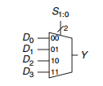
4:1 Multiplexer

Slide 78
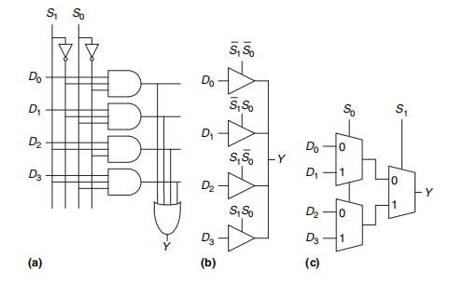
4:1 multiplexer implementations
(a) two-level logic, (b) tristates, (c) hierarchical

Slide 79
Code for Multiplexer 2:1
module mux2 #(parameter WIDTH = 8)
(input [WIDTH-1:0] d0, d1,
input s,
output [WIDTH-1:0] y);
assign y = s ? d1 : d0;
endmodule

Slide 80
Testbench for 2:1 Multiplexer
`timescale 1ps/1ps
module mux2_tb;
parameter WIDTH = 32;
reg [WIDTH-1:0] d0, d1;
reg s;
wire [WIDTH-1:0] y;
initial begin
d0 = 32'h1234abcd;
d1 = 32'habcd1234;
s = 0;
#2 $stop;
end
always #1 s = s + 1;
mux2 #(WIDTH) uut(d0, d1, s, y);
endmodule

Slide 81
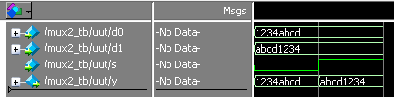
Waveform for 2:1 Multiplexer

Slide 82
Code for Multiplexer 3:1
module mux3 #(parameter WIDTH = 8)
(input [WIDTH-1:0] d0, d1, d2,
input [1:0] s,
output [WIDTH-1:0] y);
assign #1 y = s[1] ? d2 : (s[0] ? d1 : d0);
endmodule

Slide 83
Testbench for 3:1 Multiplexer
`timescale 1ps/1ps
module mux3_tb;
parameter WIDTH = 32;
reg [WIDTH-1:0] d0, d1, d2;
reg [1:0]s;
wire [WIDTH-1:0] y;
initial begin
d0 = 32'h1234abcd;
d1 = 32'habcd1234;
d2 = 32'h11112222;
s = 0;
#4 $stop;
end
always #1 s = s + 1;
mux3 #(WIDTH) uut(d0, d1, d2, s, y);
endmodule

Slide 84
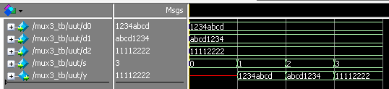
Waveform for 3:1 Multiplexer

Slide 85
Code for Multiplexer 4:1
module mux4 #(parameter WIDTH = 8)
(input [WIDTH-1:0] d0, d1, d2, d3,
input [1:0] s,
output reg [WIDTH-1:0] y);
always @( * )
case(s)
2'b00: y <= d0;
2'b01: y <= d1;
2'b10: y <= d2;
2'b11: y <= d3;
endcase
endmodule

Slide 86
Testbench for 4:1 Multiplexer
`timescale 1ps/1ps
module mux4_tb;
parameter WIDTH = 32;
reg [WIDTH-1:0] d0, d1, d2, d3;
reg [2:0] s;
wire [WIDTH-1:0] y;
initial begin
d0 = 32'h1234abcd;
d1 = 32'habcd1234;
d2 = 32'h11112222;
d3 = 32'h0;
s = 0;
#4 $stop;
end
always #1 s = s + 1;
mux4 #(WIDTH) uut(d0, d1, d2, d3, s, y);
endmodule

Slide 87
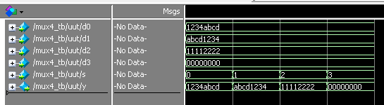
Waveform for 4:1 Multiplexer

Slide 88
Flipflop
A resettable flip-flop adds another input called RESET. When RESET is FALSE, the resettable flip-flop behaves like an ordinary D flip-flop. When RESET is TRUE, the resettable flip-flop ignores D and resets the output to 0. Resettable flip-flops are useful when we want to force a known state (i.e., 0) into all the flip-flops in a system when we first turn it on. Such flip-flops may be synchronously or asynchronously resettable. Synchronously resettable flip-flops reset themselves only on the rising edge of CLK. Asynchronously resettable flip-flops reset themselves as soon as RESET becomes TRUE, independent of CLK.

Slide 89

Symbol for the resettable flip-flop

Slide 90
Resettable Flip Flop with Enable
This type of flop register is similar to the simple flop register but requires enable input to be high to work.

Slide 91
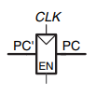
Symbol for resettable flip-flop with enable

Slide 92
Code for Resettable Flipflop
module flopr #(parameter WIDTH = 8)
(input clk, reset,
input [WIDTH-1:0] d,
output reg [WIDTH-1:0] q);
always @(posedge clk, posedge reset)
if (reset) q <= 0;
else q <= d;
endmodule

Slide 93
Testbench for Resettable Flipflop
`timescale 1ps/1ps
module flopr_tb;
parameter WIDTH = 32;
reg clk, reset;
reg [WIDTH-1:0] d;
wire [WIDTH-1:0] q;
always begin
clk <= 1; #1; clk <= 0; #1;
end
initial begin
d = 32'hABCD1234;
reset = 0;
#2;
d = 32'h200500C;
#2;
reset = 1;
#2;
reset = 0;
#2 $stop;
end
flopr #(WIDTH) uut(clk, reset, d, q);
endmodule

Slide 94
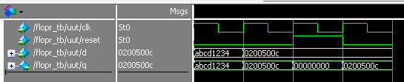
Waveform for Resettable Flipflop

Slide 95
Code for Resettable Flipflop with Enable
module flopenr #(parameter WIDTH = 8)
(input clk, reset,
input en,
input [WIDTH-1:0] d,
output reg [WIDTH-1:0] q);
always @(posedge clk, posedge reset)
if (reset) q <= 0;
else if (en) q <= d;
endmodule

Slide 96
Testbench for Resettable Flipflop with Enable
`timescale 1ps/1ps
module floprenr_tb;
parameter WIDTH = 32;
reg clk, reset, en;
reg [WIDTH-1:0] d;
wire [WIDTH-1:0] q;
always begin
clk <= 1; #1; clk <= 0; #1;
end
initial begin
d = 32'hABCD1234;
reset = 0;
en = 1;
#2;
d = 32'h200500C;
#2;
reset = 1;
#2;
reset = 0;
en = 0;
#2 $stop;
end
flopenr #(WIDTH) uut(clk, reset, en, d, q);
endmodule

Slide 97
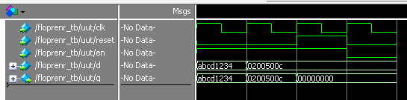
Waveform for Resettable Flipflop with Enable

Slide 98
Completed Datapath for Multicycle Processor

Slide 99
Code for Datapath
module datapath(input clk, reset,
input pcen, irwrite, regwrite,
input alusrca, iord, memtoreg, regdst,
input [1:0] alusrcb,
input [1:0] pcsrc,
input [2:0] alucontrol,
output [5:0] op, funct,
output zero,
output [31:0] adr, writedata,
input [31:0] readdata);
// Internal signals of the datapath module
wire [4:0] writereg;
wire [31:0] pcnext, pc;
wire [31:0] instr, data, srca, srcb;
wire [31:0] a;
wire [31:0] aluresult, aluout;
wire [31:0] signimm; // the sign-extended immediate
wire [31:0] signimmsh; // the sign-extended immediate shifted left by 2
wire [31:0] wd3, rd1, rd2;

Slide 100
// op and funct fields to controller
assign op = instr[31:26];
assign funct = instr[5:0];
// datapath
flopenr #(32) pcreg(clk, reset, pcen, pcnext, pc);
mux2 #(32) adrmux(pc, aluout, iord, adr);
flopenr #(32) instrreg(clk, reset, irwrite, readdata, instr);
flopr #(32) datareg(clk, reset, readdata, data);
mux2 #(5) regdstmux(instr[20:16], instr[15:11], regdst, writereg);
mux2 #(32) wdmux(aluout, data, memtoreg, wd3);
regfile rf(clk, regwrite, instr[25:21], instr[20:16],
writereg, wd3, rd1, rd2);
signext se(instr[15:0], signimm);
sl2 immsh(signimm, signimmsh);

Slide 101
flopr #(32) areg(clk, reset, rd1, a);
flopr #(32) breg(clk, reset, rd2, writedata);
mux2 #(32) srcamux(pc, a, alusrca, srca);
mux4 #(32) srcbmux(writedata, 32'b100, signimm, signimmsh,
alusrcb, srcb);
alu alu(srca, srcb, alucontrol, aluresult, zero);
flopr #(32) alureg(clk, reset, aluresult, aluout);
mux3 #(32) pcmux(aluresult, aluout,
{pc[31:28], instr[25:0], 2'b00}, pcsrc, pcnext);
endmodule

Slide 102
Interfacing the Components

Slide 103
Multicycle MIPS processor
// Multicycle MIPS processor
module mips(input clk, reset,
output [31:0] adr, writedata,
output memwrite,
input [31:0] readdata);
wire zero, pcen, irwrite, regwrite,
alusrca, iord, memtoreg, regdst;
wire [1:0] alusrcb;
wire [1:0] pcsrc;
wire [2:0] alucontrol;
wire [5:0] op, funct;

Slide 104
// The control unit receives the current instruction from the datapath and tells the
// datapath how to execute that instruction.
controller c(clk, reset, op, funct, zero,
pcen, memwrite, irwrite, regwrite,
alusrca, iord, memtoreg, regdst,
alusrcb, pcsrc, alucontrol);
// The datapath operates on words of data. It
// contains structures such as memories, registers, ALUs, and multiplexers.
// MIPS is a 32-bit architecture, so we will use a 32-bit datapath.
datapath dp(clk, reset,
pcen, irwrite, regwrite,
alusrca, iord, memtoreg, regdst,
alusrcb, pcsrc, alucontrol,
op, funct, zero,
adr, writedata, readdata);
endmodule

Slide 105
Connection of Processor and the Memory
module topmulti(input clk, reset,
output [31:0] writedata, adr,
output memwrite);
wire [31:0] readdata;
// instantiate processor and memory
mips mips(clk, reset, adr, writedata, memwrite, readdata);
mem mem(clk, memwrite, adr, writedata, readdata);
endmodule

Slide 107
Testing and Evaluation

Slide 108
TESTING & EVALUATION
The following tests were made first on each component to see if each one works, and then they were all tested as a top-level multi-cycle processor in order to verify that the entire program works correctly as expected.

Slide 109
Top Level
To test the correctness of the entire multicycle processor, the following assembly code is used.

Slide 110
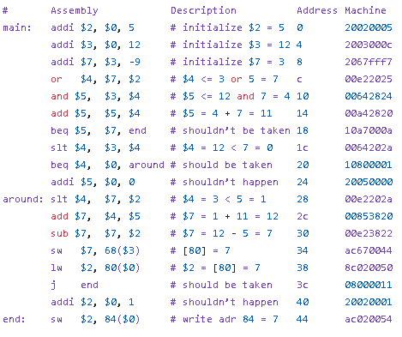
MIPS Assembly Code

Slide 111
MIPS Assembly Code
All instructions add, sub, and, or, slt, addi, lw, sw, beq, j are used in the program. If successful, it should write the value 7 to address 84D (44H)
Recall that memory is initialized with the equivalent machine code to run the program. The machine code holds both instruction and data and are decoded by the control unit and the register file.

Slide 112
Testbench code for Multicycle Processor
module testbench();
reg clk;
reg reset;
wire [31:0] writedata, dataadr;
wire memwrite;
// keep track of execution status
reg [31:0] cycle;
// instantiate device to be tested
topmulti dut(clk, reset, writedata, dataadr, memwrite);
// initialize test
initial
begin
reset <= 1; # 12; reset <= 0;
cycle <= 1;
end

Slide 113
// generate clock to sequence tests
always
begin
clk <= 1; # 5; clk <= 0; # 5;
cycle <= cycle + 1;
end
// check results
// If successful, it should write the value 7 to address 84
always@(negedge clk)
begin
if (memwrite) begin
if (dataadr === 84 & writedata == 7) begin
$display("Simulation succeeded");
$stop;
end else if (dataadr !== 80) begin
$display("Simulation failed");
$stop;
end
end
end
endmodule

Slide 114
Actual Waveform of ALU using MIPS Assembly Code:
The program starts at cycle 2 after reset. The ALU arithmetic operation usually runs at ADDIEXEC and EXEC state. The cycle location of the ALU will be shown in the instruction trace. The ALU also used to increment the program counter by 4 at the FETCH state and then go to DECODE state which is iterative before and after instruction the result of the ALU is ignored at this state.

Slide 115
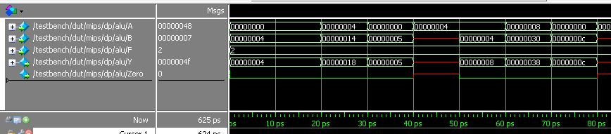
initialized $2 = 5 at 30ps, initialized $3 = 12 at 70ps.

Slide 116
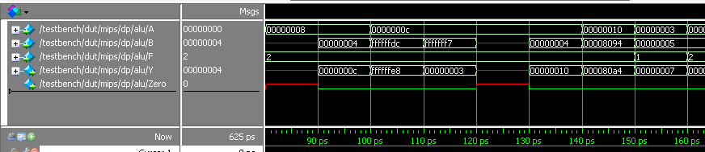
initialized $7 = $3 - 9 = 12 - 9 = 3 at 110ps. $4 <= 3 or 5 = 7 at 150ps.

Slide 117
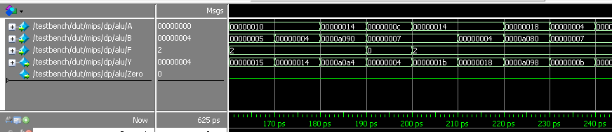
$5 <= 12 and 7 = 4 at 190ps, $5 = 4 + 7 = 11 at 230ps

Slide 118
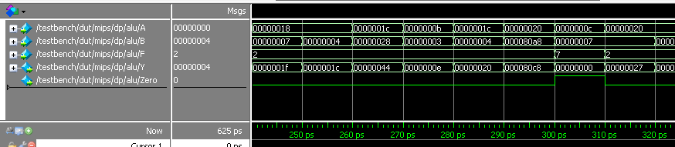
$4 = 12 < 7 = 0, zero = 1 at 300ps

Slide 119
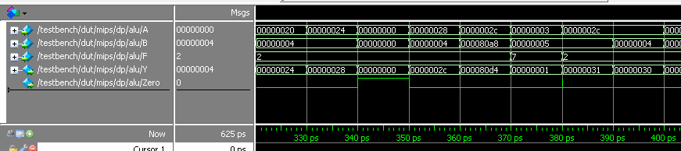
$4 = 3 < 5 = 1 at 370ps

Slide 120
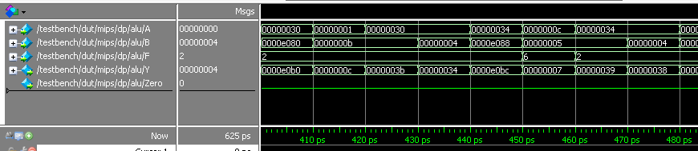
$7 = 1 + 11 = 12 at 410ps, $7 = 12 - 5 = 7 at 450ps

Slide 121
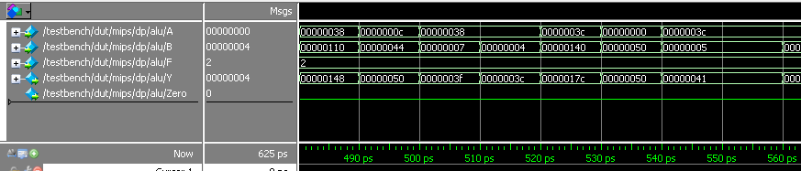
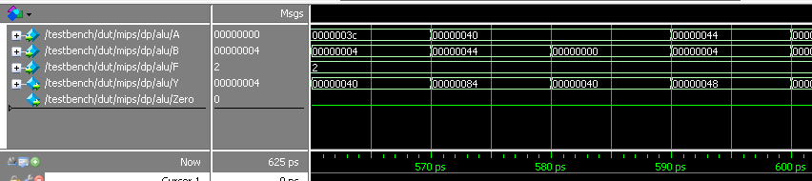
The ALU is not used for after 450ps so we don’t need the output from here.

Slide 122
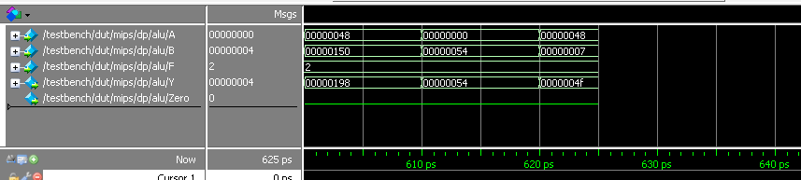

Slide 123
Actual Waveform of Memory using MIPS Assembly Code:
This part is just reading instruction and data from the memory at the given address until at 480ps where I-type instruction (sw, lw) is used.

Slide 124
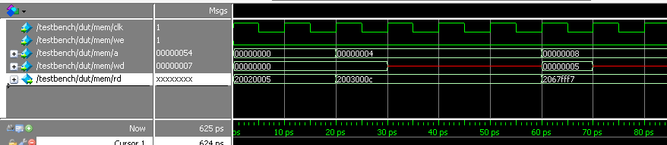


Slide 125



Slide 126



Slide 127

At 500ps the actual writing of data happens at MEMWRITE state where 7 is stored at address [50h] or [80d] at 540ps the data at [80d] is read and the 7 value is returned.

Slide 128


At last the value 7 is stored at address [54h] or [84d] at 620ps

Slide 129
Actual Waveform of Control Unit using MIPS Assembly Code:
The control unit outputs correctly based on the state diagram.

Slide 130


Slide 131


Slide 132


Slide 133


Slide 134


Slide 135


Slide 136

Actual Waveform of Register File using MIPS Assembly Code:
The data is stored at the WRITEBACK state of the processor.

Slide 137

$2 = 5 at 40ps

Slide 138

$3 = 12 at 80ps

Slide 139

$7 = 3 at 120ps

Slide 140

$4 = 7 at 160ps

Slide 141

$5 = 4 at 200ps

Slide 142

$5 = 11 at 240ps

Slide 143

$4 = 0 at 310ps

Slide 144


Slide 145

$4 = 1 at 380ps

Slide 146

$7 = 12 at 420ps

Slide 147

$7 = 7 at 460ps

Slide 148


Slide 149

$2 = 7 at 550ps

Slide 150


Register is not used in the following part

Slide 151
Actual Waveform of Datapath using MIPS Assembly Code:
The datapath elements is just the same as the ALU, memory and control unit except the program counter that handles the program flow and the signimm and signimmsh which sign extend the data.

Slide 152


Slide 153


Slide 154


Slide 155


Slide 156


Slide 157


Slide 158


Slide 159


Slide 160


Slide 161


Slide 162


Slide 163


Slide 164


Slide 165


Slide 166


Slide 167

At this point, the data input is red indicating that the next memory address contains no instruction or data which is the end of the program.

Slide 168
Actual Instruction Trace Waveform
The following waveform contains the instruction trace of the multicycle processor, the cycle, reset, program counter, instruction, state, the ALU inputs and result, zero flag and the FSM control word.

Slide 169


Slide 170


Slide 171


Slide 172


Slide 173


Slide 174


Slide 184
At this point, the data input is red indicating that the next memory address contains no instruction or data which is the end of the program.

Slide 185
Instruction Trace
The instruction trace contains the total cycle took for the program, the cycle count of each instruction. The ALU, FSM State and the control word. ALUResult values that are used for decoding is marked as X because it is not needed.

Slide 186

Completed Instruction Trace Table

Slide 187


Slide 188


Slide 189


Slide 190


Slide 191
Conclusion

Slide 192
Conclusion
The test program took 62 cycles / 620ps to finish and the desired output is achieved. However some anomalies are found in the ALU.
The other components performs correctly as expected and no major issues are found in the processor.

Slide 193
The zero flag outputs x value instead of zero because the scrB contains no data at the start. Where in the expected instruction trace zero = 0 at this point. This event does not cause any major faults.

Slide 194
And at 380ps, data glitch are found. The possible cause is the A and F changes value at the same time where in practical it is not when A = 3, B = 5 and F = SLT (7), and A < B results in Y = 1 and then at a split picosecond the A changes value to 2C where A < B became false and causes Y = 1 and zero = 1 at that moment and then changing the F selector to ADD (2) resulting zero = 0. The propagation delay difference between A and F is the main reason of this.

Slide 195
Recommendation
It is highly recommended that the code be optimized to be as short as possible, i.e. the code must be shortened for readability. It is also recommended that the variables used in the code must be uniformed and that all members assigned to work on the processor are informed clearly of the variables in order to avoid mistakes in declaring or assigning values to nonexistent variables.

Slide 196
ASSESSMENT
The making of the entire multicycle processor in Verilog took approximately a total of 30 hours, including testing, debugging, and evaluation. Some problems encountered during the making of the program in Verilog include: At times, the ‘begin’ and ‘end’ statements may be misused, which can lead to errors similar to in languages like C, when the opening and closing braces (‘{‘ and ‘}’) are missing or misplaced. Naming conventions are also a problem; when another user creates and adds some lines of code to the program, s/he may confuse or mistake the names of the variables, creating bugs in the code. Regs and wires are also often confused, leading to testbench errors. Despite overlooking some of the errors in the program, the project was accomplished with a significant amount of knowledge acquired from the subject.
Overall, project successfully increased students' knowledge of processors, processor design, and Verilog implementation of the design. The students also further learned the importance of planning, teamwork, and effective documentation of results.

