Slide 1
Real images
(3, 64, 64)
D
Real(1)
?
Fake(0)
G
Random
noise
Fake images
(3, 64, 64)

Slide 2
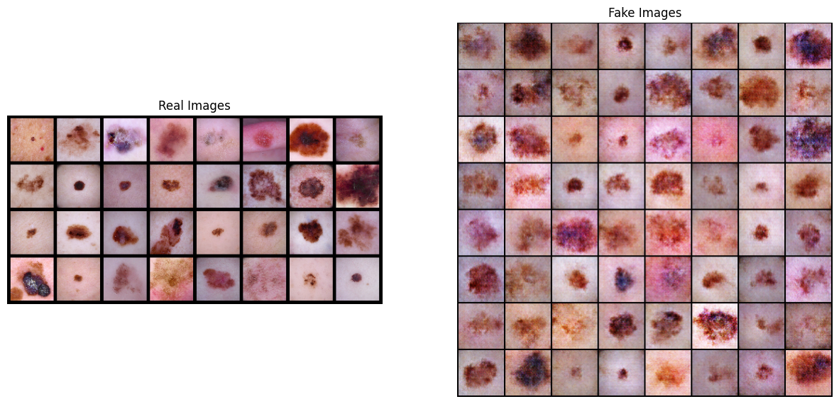
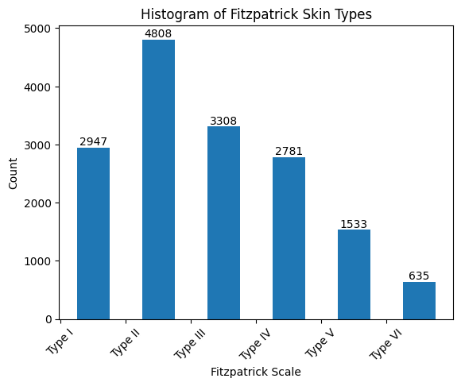
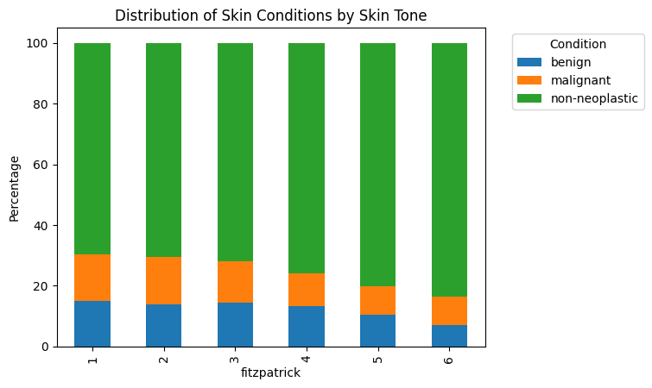
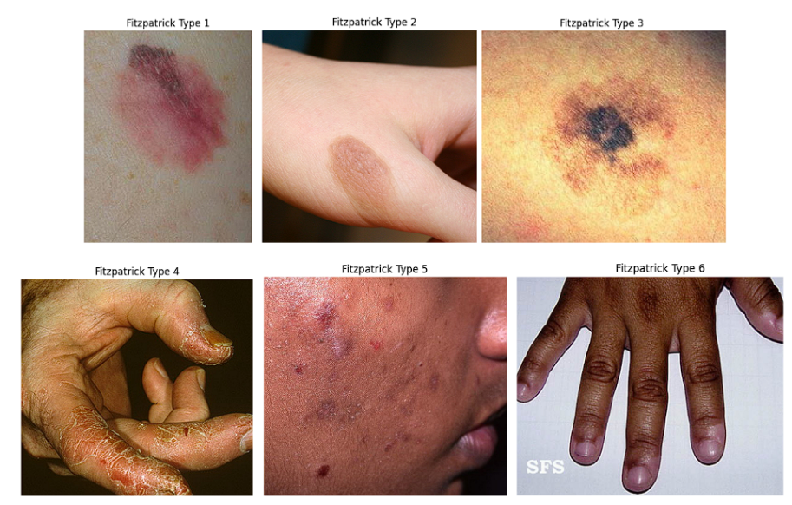
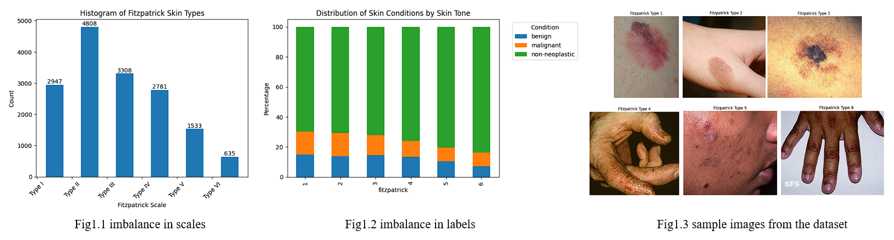
Fig1.1 imbalance in scales
Fig1.2 imbalance in labels
Fig1.3 sample images from the dataset

Slide 3
I
II
III
IV
V
VI
0
1
Fitzpatrick17k
Test
Train
Augmentation
ResNet18
(pretrained)
Prediction

