Slide 1
MACHINE AND ASSEMBLY LANGUAGE
CSC 315/305

Slide 2
Class Meeting: Monday 12 - 2pm prompt
Venue: E304
LECTURERS:
Dr. O.A Sennaikke 08033322378, osennaike@unilag.edu.ng
Dr. F.O Alamu 08034905719, falamu@unilag.edu.ng
Office Hours:
4-6pm, other times by appointment or open door.

Slide 3
Objectives:
At the end of this course, the emphasis is for the student to be able to
assimilate principles associated with Machine and assembly language
write assembly language programs using specific simulators or emulators.
know different microprocessor architecture and structure of the assembly language instruction that can run on each family of Microprocessors.
do Numeric operation and conversion, string processing, disk storage and file processing using the X86 microprocessor

Slide 4
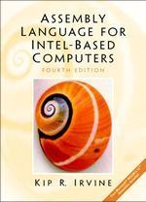
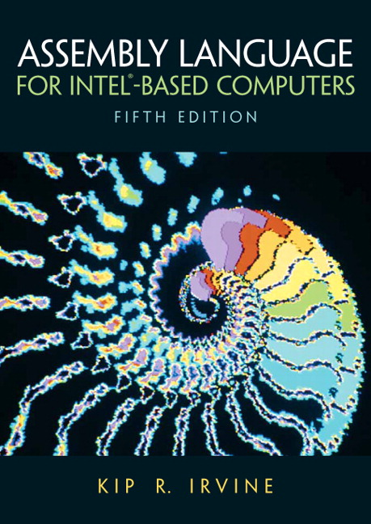
Textbooks:
Assembly Language for x86 Processors, Sixth Edition Kip R. Irvine and other standard text books in machine language and assembly language

Slide 5
Administration of the course:
The students are expected to attend all classes.
An official written document stating why you are absent from any class or test if per chance you are absent from the class.
Hence a notice of such absences should be submitted in writing in advance.
An excused absence requires a written testament of illness or other catastrophe from a physician or other official duly certified by UNILAG and health centre

Slide 6
Grading:
Grading will be based on class work, quizzes, Exams, Special Assignments/Design Projects and the Final Examination according to the following scheme:
Continuous assessment 30%
Examinations 70%
Total 100%

Slide 7
Lecture | Day | Topics | Lecturer | Assignments
1 | Monday | Introduction to basic concepts | Dr. Alamu | Assignment1
2 | Monday | Microprocessor architecture | Dr. Alamu | Assignment 2
3 | Monday | Introduction to Assembly Language | Dr. Alamu | Assignment 3
4 | Monday | Introduction to Assembly Language | Dr. Alamu | Assignment 4
5 | Monday | Instructions Addressing | Dr. Alamu | Assignment 5
6 | Monday | Library procedure | Dr. Alamu | Assignment 6
7 | Monday | TEST ONE/ REVISION | TEST ONE | TEST ONE

Slide 8
OUTLINE FOR TODAY
Introduction To Microprocessors
Evolution Of The Microprocessor
Micro Computer Programming Language
A Hierarchy Of Languages
Assembly And Machine Language
Compiler And Assembler
Translating Languages
Advantages Of High-level Languages
Why Learn Assembly Language?
Assembly Vs. High-level Languages
Software Tools Are Needed For Editing
Data Representation

Slide 9
INTRODUCTION TO MICROPROCESSORS
The basic building blocks of a computer are the central processing unit (CPU), the Input/output (I/O) and the memory
Due to advances in semiconductor technology, it is possible to fabricate the CPU on one or more chips
The result is the microprocessor, which can only be programmed using binary numbers
A bit size of a microprocessor is the number of bits that can be processed simultaneously by the basic arithmetic circuits of the microprocessor

Slide 10
A number of bits taken as a group in this manner is called a word.
For example Intel 4004 is a 4 bit machine and is said to process a 4-bit word or have 4 bit word length
An 8 bit word is referred to as a byte and a 4 bit word is known as a nibble
It is important to note that a processor can perform calculations involving more than its bits size, but it must be performed sequentially
Hence taking more time to complete the operation

Slide 11
Evolution of the microprocessor
Name of microprocessors | Year | bits | Technology | Generation | Advantages
Intel 4004, Intel 8008 | 1971 | 4 bits | P-MOS | First generation | Low cost, slow speed, low output current not compatible with TTL
Motorola 6800, Intel 808, Zilog Z80 | 1973 | 8 bits | N-MOS | Second generation | Faster speed, higher density, compatible with TTL
Intel 8086,Motorola 68000 | 1978 | 16 bit s | H -MOS | Third generation | Speed 4xNMOS, Twice circuit density of NMOS
MC68020 | 1980 | 32 bits | Low-power HMOS | Fourth generation | Assignment?
 | Assignment | 64 bits and 86bit

Slide 12
Micro computer programming language
Programming varies from one microcomputer to another
8-bit microcomputers can be programmed using binary or hexadecimal numbers (machine Language (ML)) and semi-English language statements (assembly language (AL))
16- and 32-bits microcomputers in addition to ML and AL use a more understandable human oriented language called high level language
Regardless of the language used, the program will be converted to machine language

Slide 13
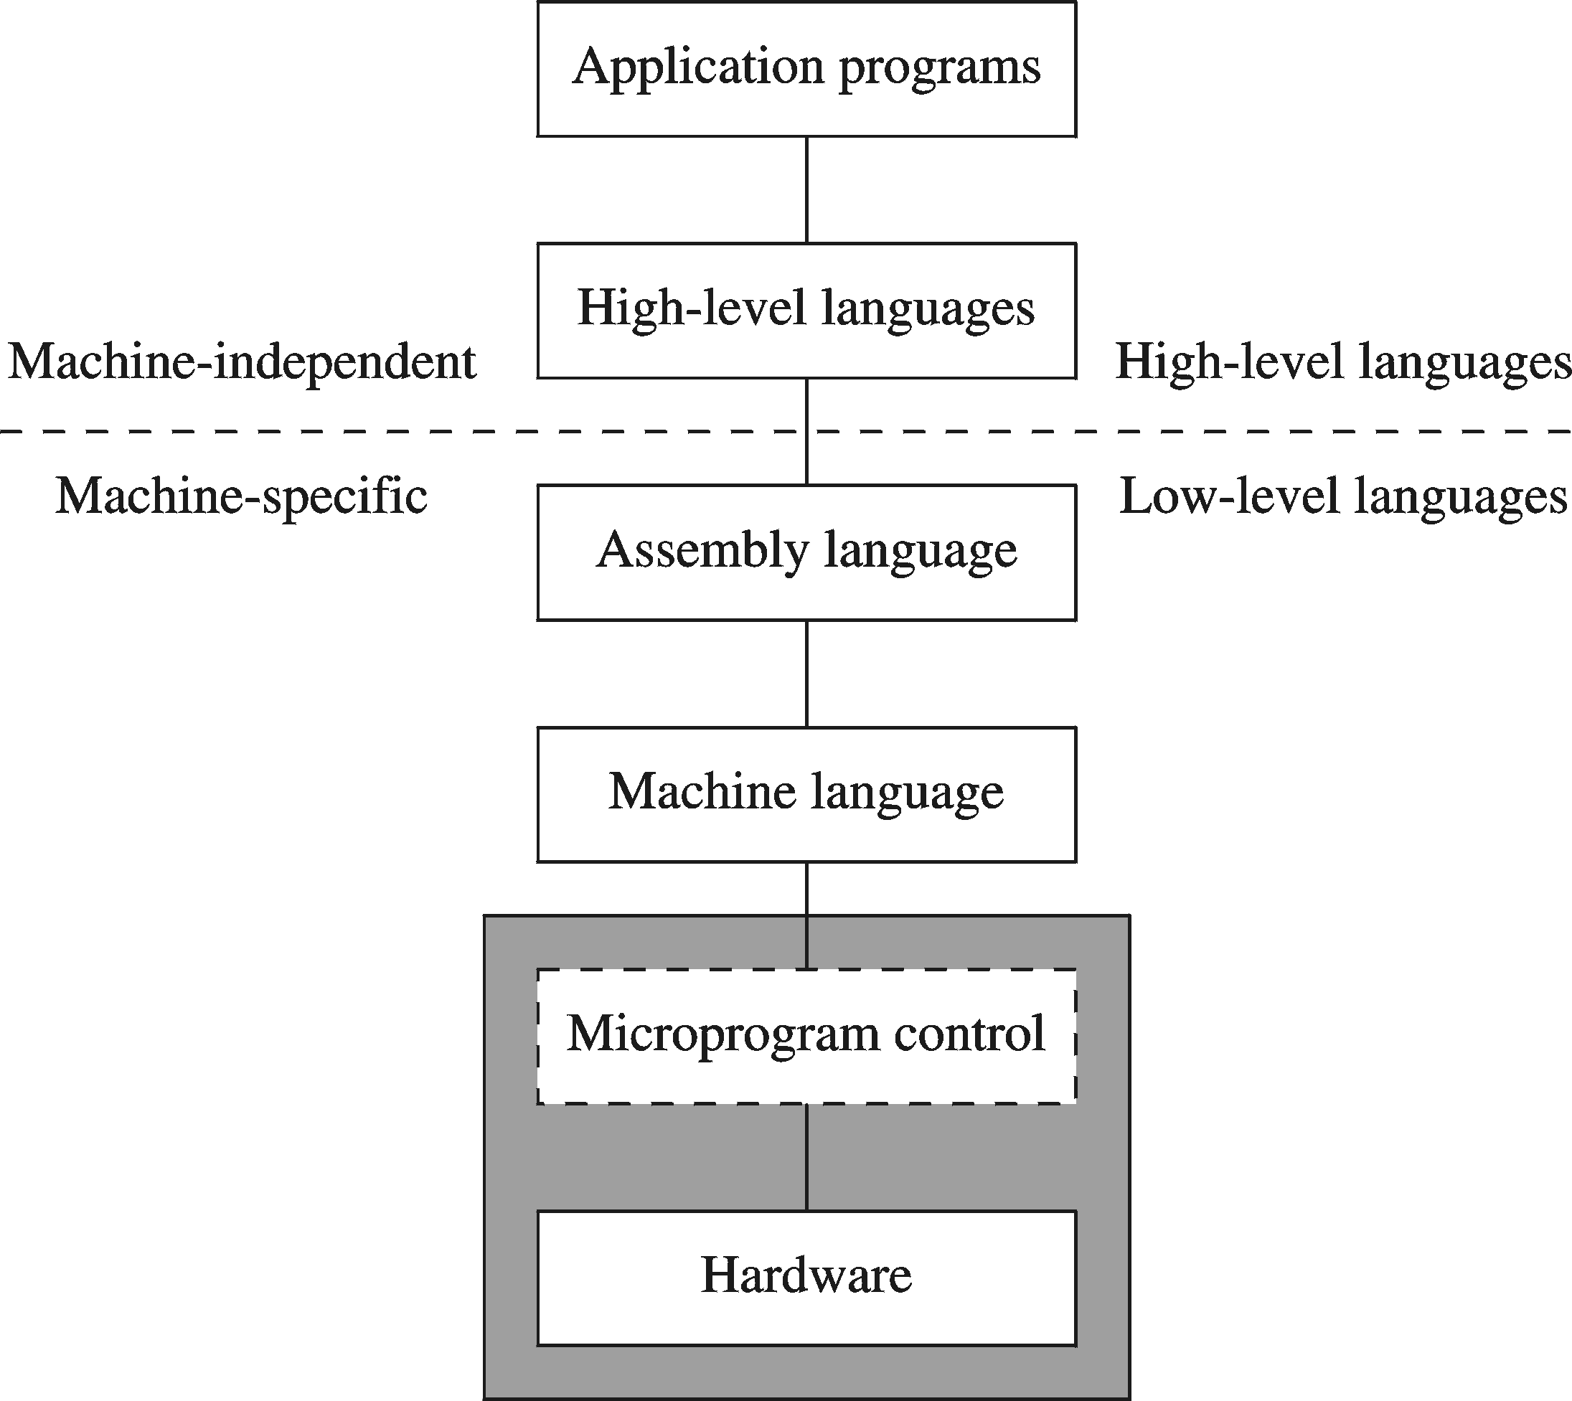
A Hierarchy of Languages

Slide 14
Assembly and Machine Language
Machine language
Native to a processor: executed directly by hardware
Instructions consist of binary code: 1’s and 0’s
Assembly language
Slightly higher-level language
Readability of instructions is better than machine language
One-to-one correspondence with machine language instructions
Assemblers translate assembly to machine code
Compilers translate high-level programs to machine code
Either directly, or
Indirectly via an assembler

Slide 15
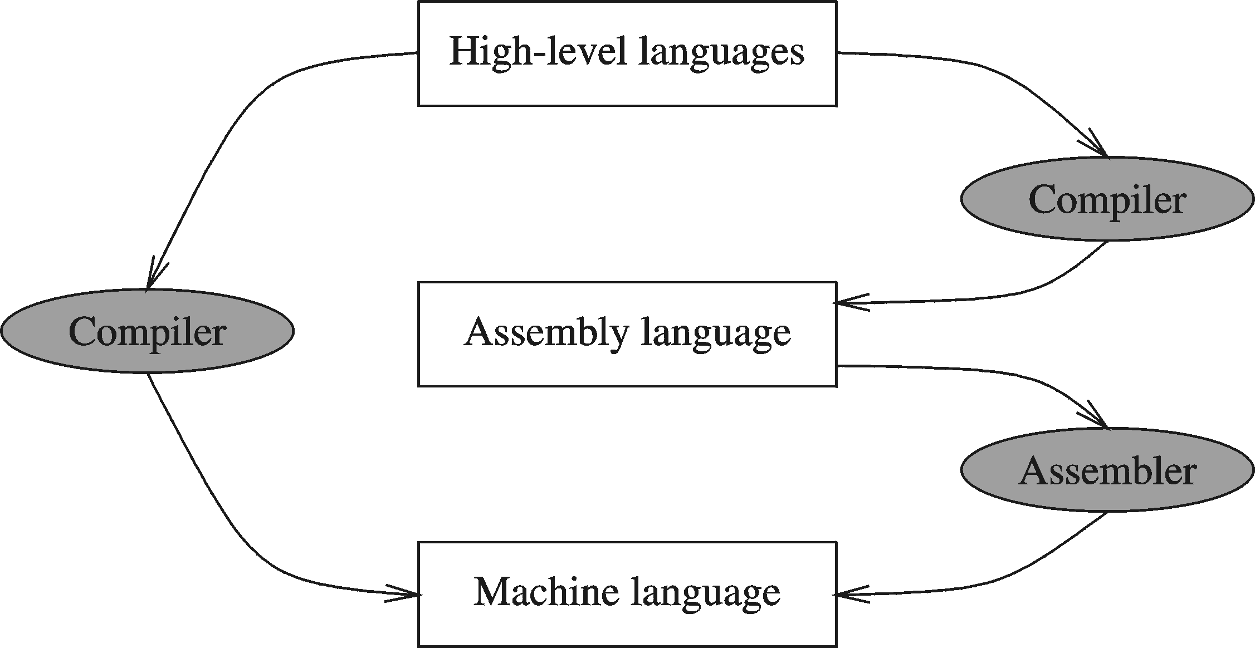
Compiler and Assembler

Slide 16
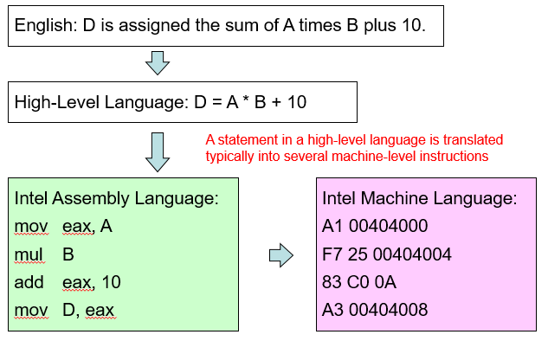
Translating Languages

Slide 17
Advantages of High-Level Languages
Program development is faster
High-level statements: fewer instructions to code
Program maintenance is easier
For the same above reasons
Programs are portable
Contain few machine-dependent details
Can be used with little or no modifications on different machines
Compiler translates to the target machine language
However, Assembly language programs are not portable

Slide 18
Why Learn Assembly Language?
Two main reasons:
Accessibility to system hardware
Space and time efficiency
Accessibility to system hardware
Assembly Language is useful for implementing system software
Also useful for small embedded system applications
Space and Time efficiency
Understanding sources of program inefficiency
Tuning program performance
Writing compact code

Slide 19
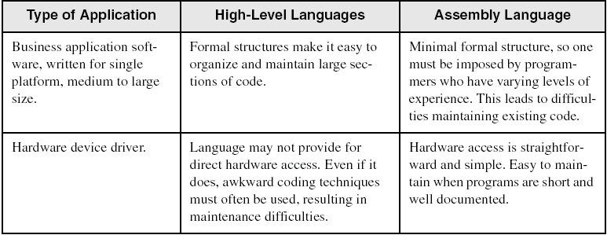
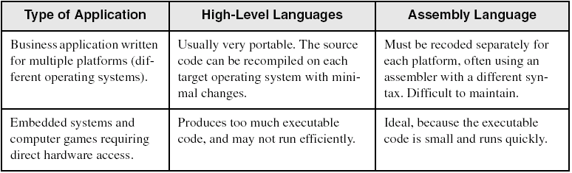
Assembly vs. High-Level Languages
Some representative types of applications:

Slide 20
Assembler
Software tools are needed for editing, assembling, linking, and debugging assembly language programs
An assembler is a program that converts source-code programs written in assembly language into object files in machine language
Popular assemblers have emerged over the years for the Intel family of processors. These include …
TASM (Turbo Assembler from Borland)
NASM (Netwide Assembler for both Windows and Linux), and
GNU assembler distributed by the free software foundation
MASM (Macro Assembler from Microsoft)

Slide 21
Linker and Link Libraries
You need a linker program to produce executable files
It combines your program's object file created by the assembler with other object files and link libraries, and produces a single executable program
We will also use a link library for input and output

Slide 22
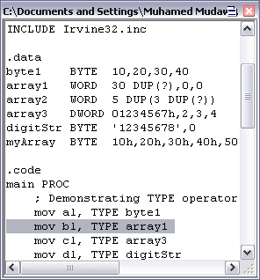
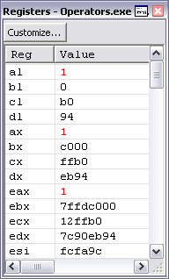
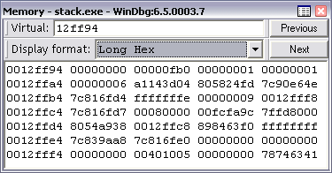
Debugger
Allows you to trace the execution of a program
Allows you to view code, memory, registers, etc.

Slide 23
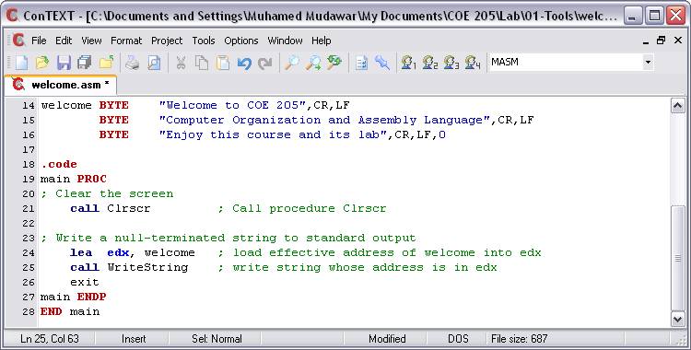
Editor
Allows you to create assembly language source files
Some editors provide syntax highlighting features and can be customized as a programming environment

Slide 24
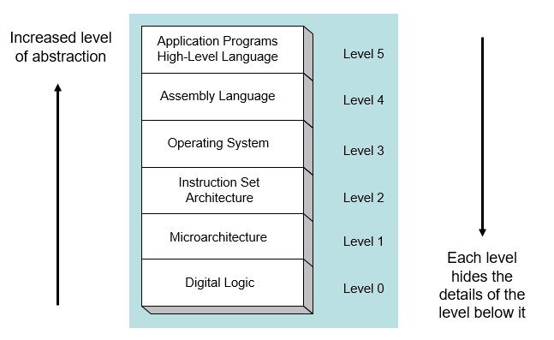
Programmer’s View of a Computer System

Slide 25
Application Programs (Level 5)
Written in high-level programming languages
Such as Java, C++, Pascal, Visual Basic . . .
Programs compile into assembly language level (Level 4)
Assembly Language (Level 4)
Instruction mnemonics are used
Have one-to-one correspondence to machine language
Calls functions written at the operating system level (Level 3)
Programs are translated into machine language (Level 2)
Operating System (Level 3)
Provides services to level 4 and 5 programs
Translated to run at the machine instruction level (Level 2)

Slide 26
Instruction Set Architecture (Level 2)
Specifies how a processor functions
Machine instructions, registers, and memory are exposed
Machine language is executed by Level 1 (microarchitecture)
Microarchitecture (Level 1)
Controls the execution of machine instructions (Level 2)
Implemented by digital logic (Level 0)
Digital Logic (Level 0)
Implements the microarchitecture
Uses digital logic gates
Logic gates are implemented using transistors

Slide 27
Data representation

Slide 28
Binary Numbers
Hexadecimal Numbers
Base Conversions
Integer Storage Sizes
Binary and Hexadecimal Addition
Signed Integers and 2's Complement Notation
Binary and Hexadecimal subtraction
Carry and Overflow
Character Storage

Slide 29
Binary Numbers
Digits are 1 and 0
1 = true
0 = false
MSB – most significant bit
LSB – least significant bit
Bit numbering:

Slide 30
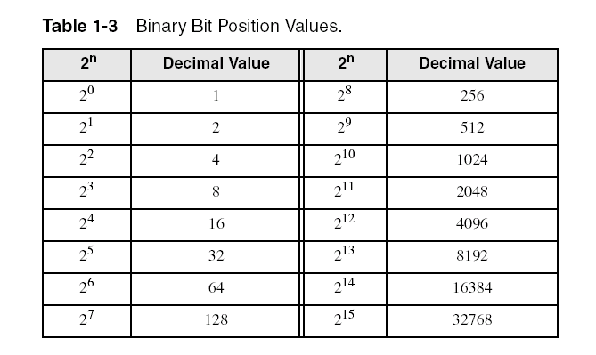
Binary Numbers
Each digit (bit) is either 1 or 0
Each bit represents a power of 2:
Every binary number is a sum of powers of 2

Slide 31
Converting Binary to Decimal
Weighted positional notation shows how to calculate the decimal value of each binary bit:
Decimal = (d_{n-1} × 2^{n-1}) + (d_{n-2} × 2^{n-2}) + ... + (d₁ × 2¹) + (d₀ × 2⁰)
d = binary digit
binary 00001001 = decimal 9:
(1 × 2³) + (1 × 2⁰) = 9

Slide 32
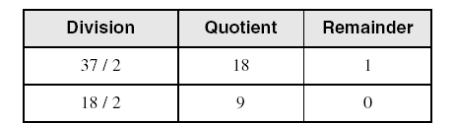
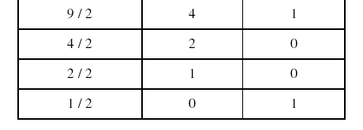
Convert Unsigned Decimal to Binary
Repeatedly divide the decimal integer by 2. Each remainder is a binary digit in the translated value:
least significant bit
most significant bit
stop when quotient is zero
37 = 100101

Slide 33
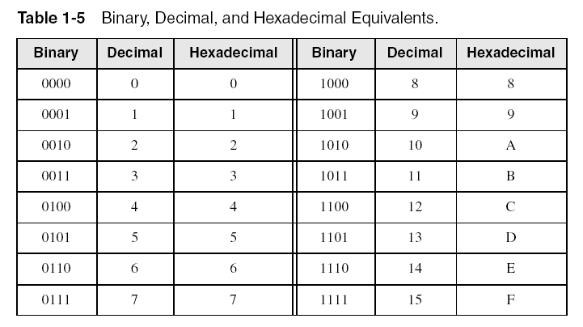
Hexadecimal Integers
Binary values are represented in hexadecimal.

Slide 34

Converting Binary to Hexadecimal
Each hexadecimal digit corresponds to 4 binary bits.
Example: Translate the binary integer 000101101010011110010100 to hexadecimal:

Slide 35
Converting Hexadecimal to Decimal
Multiply each digit by its corresponding power of 16:
Decimal = (d₃ × 16³) + (d₂ × 16²) + (d₁ × 16¹) + (d₀ × 16⁰)
d = hexadecimal digit
Examples:
Hex 1234 = (1 × 16³) + (2 × 16²) + (3 × 16¹) + (4 × 16⁰) =
Decimal 4,660
Hex 3BA4 = (3 × 16³) + (11 * 16²) + (10 × 16¹) + (4 × 16⁰) =
Decimal 15,268

Slide 36
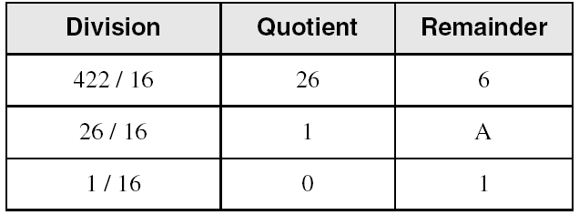
Converting Decimal to Hexadecimal
Repeatedly divide the decimal integer by 16. Each remainder is a hex digit in the translated value:
least significant digit
most significant digit
stop when quotient is zero
Decimal 422 = 1A6 hexadecimal

Slide 37
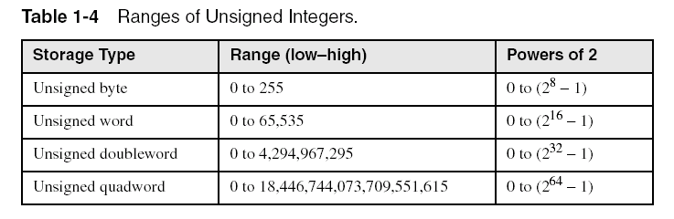
Integer Storage Sizes
Standard sizes:
Class work
What is the largest unsigned integer that may be stored in 20 bits?

Slide 38
Binary Addition
Start with the least significant bit (rightmost bit)
Add each pair of bits
Include the carry in the addition, if present
carry:
1
0
0
0
0
0
1
0
0
(4)
+
0
0
0
0
0
1
1
1
(7)
0
0
0
0
1
0
1
1
(11)
bit position:
7
6
5
4
3
2
1
0

Slide 39
Hexadecimal Addition
Divide the sum of two digits by the number base (16). The quotient becomes the carry value, and the remainder is the sum digit.
1
1
36 28 28 6A
42 45 58 4B
78 6D 80 B5
21 / 16 = 1, remainder 5
Important skill: Programmers frequently add and subtract the addresses of variables and instructions.

Slide 40
Signed Integers
Several ways to represent a signed number
Sign-Magnitude
Biased
1's complement
2's complement
Divide the range of values into 2 equal parts
First part corresponds to the positive numbers (≥ 0)
Second part correspond to the negative numbers (< 0)
Focus will be on the 2's complement representation
Has many advantages over other representations
Used widely in processors to represent signed integers

Slide 41
Two's Complement Representation
Positive numbers
Signed value = Unsigned value
Negative numbers
Signed value = Unsigned value – 2^{n}
n = number of bits
Negative weight for MSB
Another way to obtain the signed value is to assign a negative weight to most-significant bit
= -128 + 32 + 16 + 4 = -76
8-bit Binary value | Unsigned value | Signed value
00000000 | 0 | 0
00000001 | 1 | +1
00000010 | 2 | +2
. . . | . . . | . . .
01111110 | 126 | +126
01111111 | 127 | +127
10000000 | 128 | -128
10000001 | 129 | -127
. . . | . . . | . . .
11111110 | 254 | -2
11111111 | 255 | -1
1
0
1
1
0
1
0
0
-128
64
32
16
8
4
2
1

Slide 42
Forming the Two's Complement
starting value | 00100100 = +36
step1: reverse the bits (1's complement) | 11011011
step 2: add 1 to the value from step 1 | + 1
sum = 2's complement representation | 11011100 = -36
Sum of an integer and its 2's complement must be zero:
00100100 + 11011100 = 00000000 (8-bit sum) ⇒ Ignore Carry
The easiest way to obtain the 2's complement of a binary number is by starting at the LSB, leaving all the 0s unchanged, look for the first occurrence of a 1. Leave this 1 unchanged and complement all the bits after it.

Slide 43
Sign Bit
Highest bit indicates the sign. 1 = negative, 0 = positive
If highest digit of a hexadecimal is > 7, the value is negative
Examples: 8A and C5 are negative bytes
A21F and 9D03 are negative words
B1C42A00 is a negative double-word

Slide 44
Sign Extension
Step 1: Move the number into the lower-significant bits
Step 2: Fill all the remaining higher bits with the sign bit
This will ensure that both magnitude and sign are correct
Examples
Sign-Extend 10110011 to 16 bits
Sign-Extend 01100010 to 16 bits
Infinite 0s can be added to the left of a positive number
Infinite 1s can be added to the left of a negative number
10110011 = -77
11111111 10110011 = -77
01100010 = +98
00000000 01100010 = +98

Slide 45
Two's Complement of a Hexadecimal
To form the two's complement of a hexadecimal
Subtract each hexadecimal digit from 15
Add 1
Examples:
2's complement of 6A3D = 95C2 + 1 = 95C3
2's complement of 92F0 = 6D0F + 1 = 6D10
2's complement of FFFF = 0000 + 1 = 0001
No need to convert hexadecimal to binary

Slide 46
Binary Subtraction
When subtracting A – B, convert B to its 2's complement
Add A to (–B)
0 0 0 0 1 1 0 0 0 0 0 0 1 1 0 0
0 0 0 0 0 0 1 0 1 1 1 1 1 1 1 0 (2's complement)
0 0 0 0 1 0 1 0 0 0 0 0 1 0 1 0 (same result)
Carry is ignored, because
Negative number is sign-extended with 1's
You can imagine infinite 1's to the left of a negative number
Adding the carry to the extended 1's produces extended zeros
–
+
Practice: Subtract 00100101 from 01101001.

Slide 47
Hexadecimal Subtraction
When a borrow is required from the digit to the left, add 16 (decimal) to the current digit's value
Last Carry is ignored
16 + 5 = 21
-1
1
1
C675
A247
242E
C675
5DB9 (2's complement)
242E (same result)
-
+
Practice: The address of var1 is 00400B20. The address of the next variable after var1 is 0040A06C. How many bytes are used by var1?

Slide 48
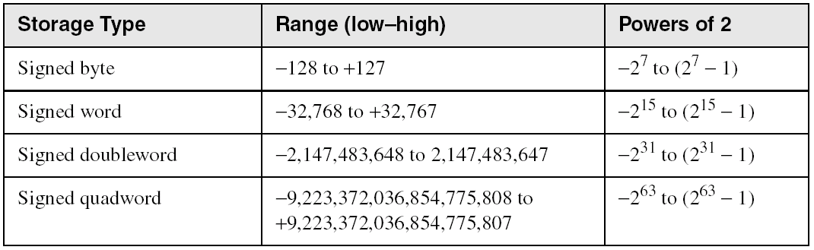
Ranges of Signed Integers
The unsigned range is divided into two signed ranges for positive and negative numbers
Practice: What is the range of signed values that may be stored in 20 bits?

Slide 49
Carry and Overflow
Carry is important when …
Adding or subtracting unsigned integers
Indicates that the unsigned sum is out of range
Either < 0 or >maximum unsigned n-bit value
Overflow is important when …
Adding or subtracting signed integers
Indicates that the signed sum is out of range
Overflow occurs when
Adding two positive numbers and the sum is negative
Adding two negative numbers and the sum is positive
Can happen because of the fixed number of sum bits

Slide 50
Carry and Overflow Examples
We can have carry without overflow and vice-versa
Four cases are possible
1
1
1
1
1
1
0
0
0
0
1
1
1
1
15
0
0
0
0
1
1
1
1
15
+
+
0
0
0
0
1
0
0
0
8
1
1
1
1
1
0
0
0
245 (-8)
0
0
0
1
0
1
1
1
23
0
0
0
0
0
1
1
1
7
Carry = 0 Overflow = 0
Carry = 1 Overflow = 0
1
1
1
1
0
1
0
0
1
1
1
1
79
1
1
0
1
1
0
1
0
218 (-38)
+
+
0
1
0
0
0
0
0
0
64
1
0
0
1
1
1
0
1
157 (-99)
1
0
0
0
1
1
1
1
143
(-113)
0
1
1
1
0
1
1
1
119
Carry = 0 Overflow = 1
Carry = 1 Overflow = 1

Slide 51
Character Storage
Character sets
Standard ASCII: 7-bit character codes (0 – 127)
Extended ASCII: 8-bit character codes (0 – 255)
Unicode: 16-bit character codes (0 – 65,535)
Unicode standard represents a universal character set
Defines codes for characters used in all major languages
Used in Windows-XP: each character is encoded as 16 bits
UTF-8: variable-length encoding used in HTML
Encodes all Unicode characters
Uses 1 byte for ASCII, but multiple bytes for other characters
Null-terminated String
Array of characters followed by a NULL character

Slide 52
Printable ASCII Codes
 | 0 | 1 | 2 | 3 | 4 | 5 | 6 | 7 | 8 | 9 | A | B | C | D | E | F
2 | space | ! | " | # | $ | % | & | ' | ( | ) | * | + | , | - | . | /
3 | 0 | 1 | 2 | 3 | 4 | 5 | 6 | 7 | 8 | 9 | : | ; | < | = | > | ?
4 | @ | A | B | C | D | E | F | G | H | I | J | K | L | M | N | O
5 | P | Q | R | S | T | U | V | W | X | Y | Z | [ | \ | ] | ^ | _
6 | ` | a | b | c | d | e | f | g | h | i | j | k | l | m | n | o
7 | p | q | r | s | t | u | v | w | x | y | z | { | | | } | ~ | DEL
Examples:
ASCII code for space character = 20 (hex) = 32 (decimal)
ASCII code for 'L' = 4C (hex) = 76 (decimal)
ASCII code for 'a' = 61 (hex) = 97 (decimal)

Slide 53
Control Characters
The first 32 characters of ASCII table are used for control
Control character codes = 00 to 1F (hex)
Not shown in previous slide
Examples of Control Characters
Character 0 is the NULL character ⇒ used to terminate a string
Character 9 is the Horizontal Tab (HT) character
Character 0A (hex) = 10 (decimal) is the Line Feed (LF)
Character 0D (hex) = 13 (decimal) is the Carriage Return (CR)
The LF and CR characters are used together
They advance the cursor to the beginning of next line
One control character appears at end of ASCII table
Character 7F (hex) is the Delete (DEL) character

Slide 54
Terminology for Data Representation
Binary Integer
Integer stored in memory in its binary format
Ready to be used in binary calculations
ASCII Digit String
A string of ASCII digits, such as "123"
ASCII binary
String of binary digits: "01010101"
ASCII decimal
String of decimal digits: "6517"
ASCII hexadecimal
String of hexadecimal digits: "9C7B"

Slide 55
Summary
Assembly language helps you learn how software is constructed at the lowest levels
Assembly language has a one-to-one relationship with machine language
An assembler is a program that converts assembly language programs into machine language
A linker combines individual files created by an assembler into a single executable file
A debugger provides a way for a programmer to trace the execution of a program and examine the contents of memory and registers
A computer system can be viewed as consisting of layers. Programs at one layer are translated or interpreted by the next lower-level layer
Binary and Hexadecimal numbers are essential for programmers working at the machine level.

Slide 56
Thank you for listening
Assignment due for submission in the next class, before the commencement of class

