Slide 1
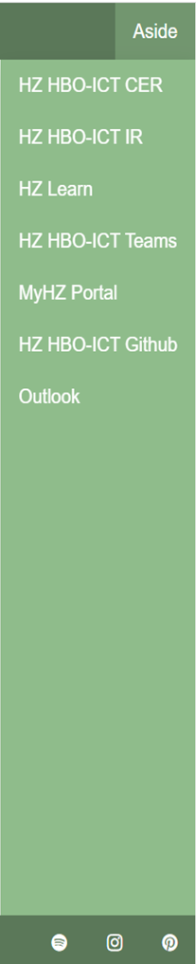
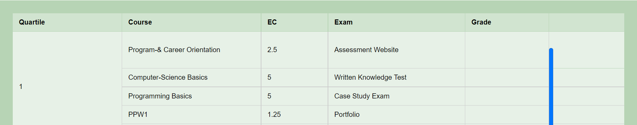
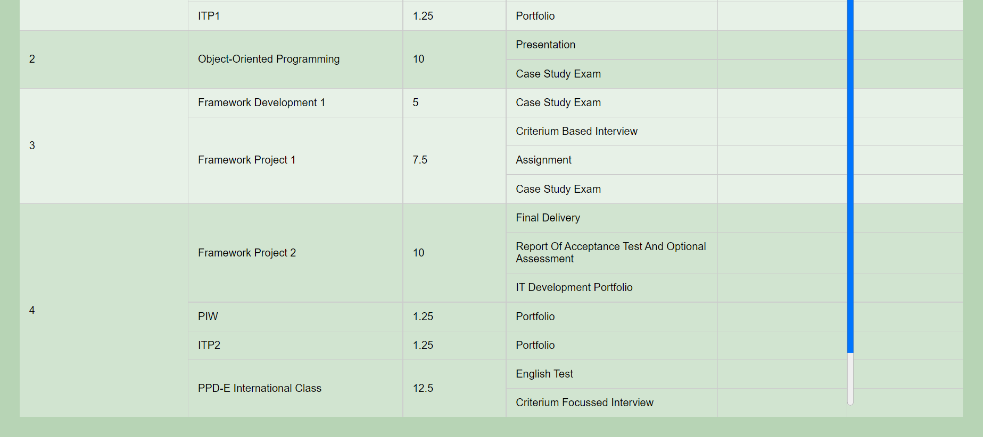
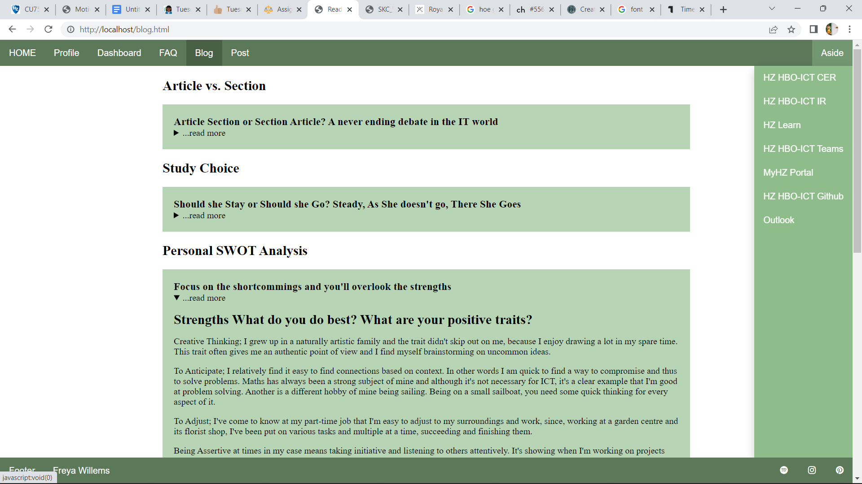
‘I need to start my dream somewhere. And if it isn't at the beginning of the end, it shall be from 0 to 1.’ - me
-Freya vs. Motivation-
I applied to ICT with the main thought being, I need to start somewhere. In the end I want to create something beautiful, inside and out, something timeless.
I gain my happiness from solving problems and achieving progress. Society evolves and methods improve, this means there will always be something new to learn and for me to be happy doing what I love.
With ICT I do not only start the journey towards my dream job, which truth be told is still unclear, I also learn the basics. Learning is a process of trial and error, which starts somewhere and will inevitably end. But until then, I want to keep creating.

