Slide 1

Password Strength Prediction
Group 2
Avinash Raval AU2040031
Zalak Shah AU2040217
Freya Modi AU2040222
Freyal Shah AU2040228

Slide 2
Introduction
Passwords secure online accounts and sensitive information, but weak ones risk user data and privacy.
Reliable and efficient ways are needed to measure password strength and help users create stronger ones.
Comparing existing machine learning models can improve accuracy and analysis.

Slide 3
Problem Statement
The project involves comparing machine learning models to accurately predict password strength based on factors like length and complexity, with the goal of creating stronger passwords to defend against cyber attacks.

Slide 4
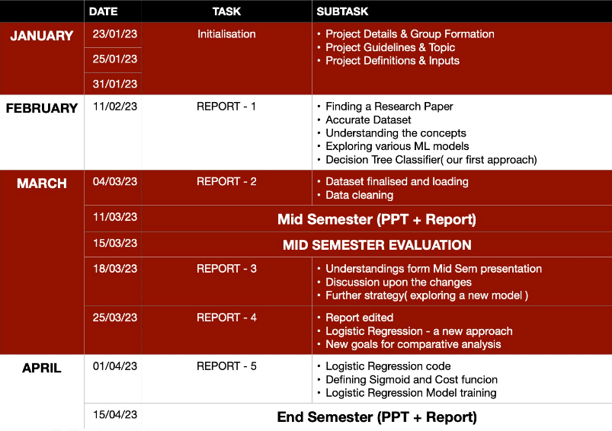
GANNT CHART

Slide 5
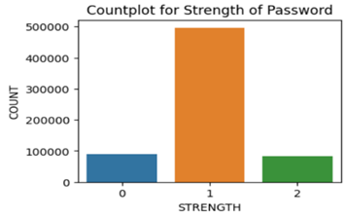
Our Approach
Performing EDA after loading the data.
Extracting features from the data.
Complexity of the password in this model judged by:
The length of the password
Mix of upper and lower case characters
Number of special characters in the password.

Slide 6

Our Approach
Splitting the dataset into test and train data.
Training the model using the logistic regression on the training dataset.
Since there was a single dataset, it was split into two sets namely test and training in the ratio of 20:80 respectively.
Initiating by defining the cost function
Gradient descent is used in order to minimise the cost function and find the optimal parameters at the end of every epoch.

Slide 7

Our Approach
Testing the model using test data and evaluating its performance.
Checking for overfitting.
After training the model, it was tested against the test dataset and its accuracy was measured.
The model was then tested against the training dataset and the train test error was found.

Slide 8
Final Results
The initial model was a Decision Tree Classifier that provided accuracy of 90%. The current model for prediction is Logistic Regression Classifier.
The current results show that our model can predict the strength of a password with an accuracy of 74.30%, meaning that approximately 74.3 percent of total passwords are correctly classified by the model.

Slide 9
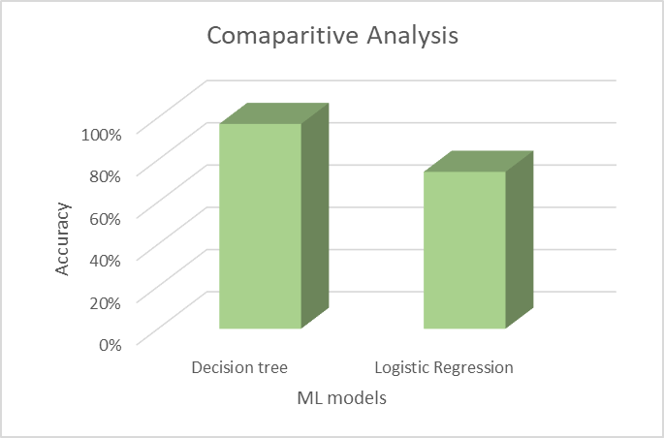
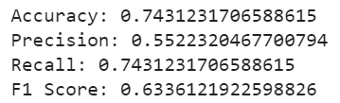
Final Results
Results found by testing with Logistic Regression
Comparision of both the models in terms of accuracy

Slide 10
Conclusions
The difference in accuracy might be due to the reason that the model is underfit in case of Logistic Regression and overfit in case of Decision Tree Classifier.
As a result, we conclude that we should not rely only on one model for password strength detection but should opt for a mixture of models which would have more accuracy complexity to capture complex relationships in the data.

Slide 11
References
[1] Bansal, B. (2019, june 27). password strength classifier dataset.Kaggle.com.https://www.kaggle.com/datasets/bhavikbb/password-strength-classifier-dataset
[2] Building a Password Strength Classifier Model Using Machine Learning. (2022, January 26). Section.io. Retrieved March 11, 2023, from https://www.section.io/engineering-education/building-a-password-strength-classifier-model-using-machine-learning/#adding-features-and-labels
[3] AdityaBagad/Password-Strength-Analysis: Password Strength Analysis using Machine Learning Classification Algorithms. (n.d.). GitHub. Retrieved March 11, 2023, from https://github.com/AdityaBagad/Password-Strength-Analysis
[4] U. Farooq, “Real Time Password Strength Analysis on a Web Application Using Multiple Machine Learning Approaches,” International Journal of Engineering Research & Technology (IJERT), ISSN: 2278- 0181 Vol. 9 Issue 12, December 2020
[5] Sarkar, S., & Nandan, M. (2022). Password Strength Analysis and its Classification by Applying Machine Learning Based Techniques. 10.1109
[6] Password Strength Prediction Using Supervised Machine Learning Techniques. (2009, December 1). IEEE Conference Publication | IEEE Xplore. https://ieeexplore.ieee.org/document/5376606?denied=

Slide 12
Thank you
for listening!

