Slide 1


Jimeng Network
绩盟网络
COMPANY PROFILE 2026
Engineering that lives
inside your business.
Digital and AI engineering for brands — from strategy to systems in production.
Strategy · Engineering · Operations · AI Forward Deployed Engineering
Shanghai Jimeng Network Technology Co., Ltd. | Since 2014

Slide 2

WHO WE ARE
Twelve years of getting things shipped
An engineering-first team that turns ideas into working systems.
Founded in Shanghai in 2014, Jimeng Network is an engineering-first digital and AI services company. Our team brings together internet marketing specialists, brand strategists, senior engineers and designers — and our core engineering team has worked side by side for over a decade.
2014
100+
Founded
Projects delivered
Headquartered in Shanghai
Across web, mobile, platforms & AI
We deliver end-to-end strategy, engineering and operations for brands across beauty, luxury, e-commerce and internet platforms. Today, we also deploy AI directly into our clients' day-to-day operations through Forward Deployed Engineering (FDE).
10M+
1,000+
Scale systems
AI videos / month
Built and operated long-term
Produced at scale for brands
JIMENG NETWORK
01

Slide 3

OUR JOURNEY
On the front line of every technology wave
From the first websites to AI in production — we have shipped through every shift since 2014.
2014
Mobile
Platforms
2026
WEB & BRAND
MOBILE & WECHAT
ENTERPRISE PLATFORMS
AI-NATIVE
Digital brand presence
The mobile ecosystem
Business-critical systems
AI in production
Responsive websites, brand strategy, marketing campaign pages
Official accounts, mini programs, e-commerce apps, community tools
Management systems, C2C marketplace & settlement, multi-account platforms
AIGC content production lines, AI FDE, our own product ThinkNova
JIMENG NETWORK
02

Slide 4




WHAT WE DO
Four core services
From strategy to shipped systems — and now, AI in production.
01
02
03
04
NEW
Strategy &
Planning
Engineering &
Delivery
Operations &
Growth
AI Forward Deployed
Engineering
Business models, marketing campaigns and brand strategy — tailored project plans built on your strengths.
Design, development, testing and maintenance for websites, mini programs, apps and enterprise systems.
Data-driven operation of online platforms and private communities, plus campaign planning and offline events.
Engineers embedded on the front line, deploying LLMs, AIGC and AI agents into your real workflows.
JIMENG NETWORK
03

Slide 5

04
NEW BUSINESS
AI FDE
Forward Deployed Engineering
AI projects rarely fail because the model isn't good enough.
They fail because no one wires it into the real business.
JIMENG NETWORK
04

Slide 6
WHAT IS FDE
Not outsourcing. Not another SaaS seat.
Engineers in the room, accountable for results.
Forward Deployed Engineering was pioneered by leading Silicon Valley AI and data companies. Instead of waiting for requirements from afar, engineers embed with your team on the front line, start from real business problems, and ship AI as production systems that are used, measured and continuously improved.
 | Outsourcing | Off-the-shelf SaaS | Jimeng AI FDE
Starting point | A requirements doc | Standard features | Real problems on the ground
Deliverable | Software built to spec | A generic account | AI running inside your business
Customisation | Medium | Low | Deeply fitted to your process & data
Iteration | Every change re-quoted | Wait for the roadmap | Rapid, on-site iteration
Outcome | Ends at handover | You figure it out | Owns results, then transfers know-how
JIMENG NETWORK
05

Slide 7





HOW WE DELIVER
Four phases from idea to production
A proven delivery method, from on-site discovery to handover.
01
02
03
04
Discover
Prototype
Deploy
Transfer & Run
1–2 wks
2–4 wks
4–8 wks
Ongoing
On-site interviews, process mapping and data audit to find the highest-ROI AI opportunities.
A working prototype on real data, with business owners reviewing every step.
Integration with your systems and permissions, staged rollout, monitoring and evaluation.
Documentation, training and handover — or long-term managed operations by our team.
DELIVERABLES Opportunity assessment · Working prototype · Production system · Evaluation dashboard · Runbook & user guide
* Typical timelines; actual duration depends on scope.
JIMENG NETWORK
06

Slide 8


CAPABILITY STACK
A complete AI engineering stack
From foundation models to the apps your team actually uses.
Applications
AI customer service · Content production · Sales assistants · Analytics agents
Guardrails
Orchestration
Agent workflows · Prompt engineering · Multi-model routing · Evaluation
Role-based access & audit logs
Data security & private deployment
Automated content compliance
Data
RAG knowledge bases · Enterprise data integration · Creative asset management
Integrations
Models
LLMs · Image generation · Video generation · Speech synthesis (multi-vendor)
WeCom · WeChat · Mini programs
OA / CRM / e-commerce back-ends
Object storage & asset libraries
JIMENG NETWORK
07

Slide 9




SOLUTION PLAYBOOKS
AI for four kinds of business
Playbooks distilled from the industries we have served.
E-COMMERCE & RETAIL
BEAUTY
AI Product Content Factory
Smart Creative Hub
Product images, selling-point copy and short videos generated in batches, connected to your catalogue and auto-formatted for every channel.
Centralised asset management, AI rewriting and localisation for every platform, with automated brand-guideline and ad-compliance checks.
LUXURY
PLATFORMS
AI Clienteling Assistant
AI Marketing Video Line
Grounded in product knowledge and service scripts, helping advisors hold warm, on-brand one-to-one conversations.
Scripting, storyboarding, generation and QA industrialised end to end — sustaining output of a thousand videos a month.
JIMENG NETWORK
08

Slide 10




FDE CASE · XIANYU
Xianyu: an AI marketing video line
PRODUCTION PIPELINE
AI-generated marketing videos, delivered at scale.
Brief & Script
Campaign topics turned into scripts
1,000+
AI Storyboard
Shot-by-shot visual plan
AI marketing videos delivered every month
Generation
Video, voice-over and captions
We produce AI marketing videos at scale for Xianyu's marketing campaigns. Our in-house ThinkNova AIGC pipeline runs as a dedicated production line — from campaign brief and script to storyboard, generation, human QA and batch delivery — fully standardised to sustain 1,000+ videos every month.
QA & Review
Human checks for quality & brand fit
Batch Delivery
AIGC Video
Delivery at Scale
Dedicated Line
Ongoing Ops
Platform-ready files, on schedule
JIMENG NETWORK
09

Slide 11
SELECTED CLIENTS
Brands we have served
From global luxury to China's leading internet platforms.
L'ORÉAL
VACHERON
CONSTANTIN
1号店
L'Oréal
Vacheron Constantin
Yihaodian (YHD)
Beauty
Luxury watchmaking
E-commerce
闲鱼
1500
LUXURY CAR CLUB
二次源
Xianyu
1500 Luxury Car Club Union
Erciyuan
Internet platform
Premium community
Consumer fintech tool
Brand names are used solely to describe our service experience. All trademarks belong to their respective owners.
JIMENG NETWORK
10

Slide 12
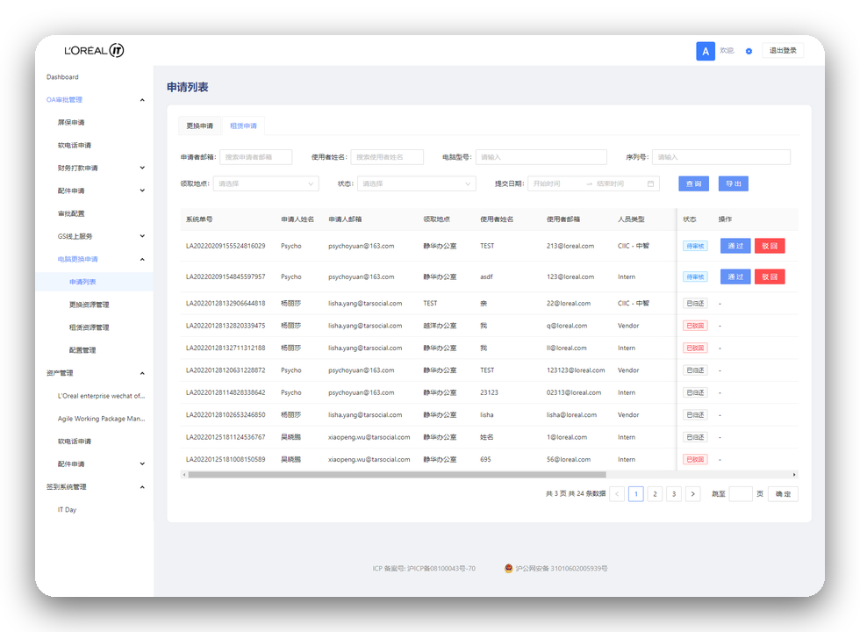
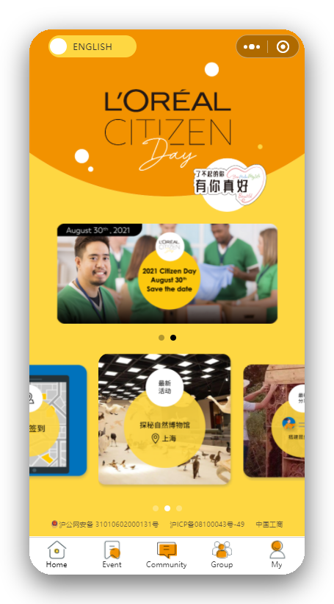
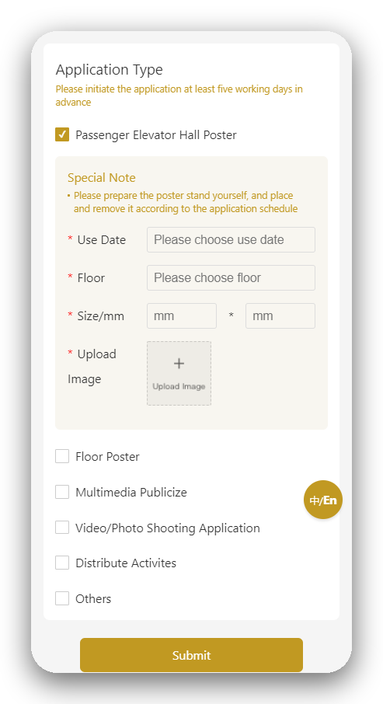

CLIENT CASE · 01
LONG-TERM PARTNERSHIP
L'Oréal China
Marketing digital & IT services
Long-term IT services for L'Oréal's marketing and OA management systems — from project advice to continuous iteration and maintenance, meeting the brand's strict security requirements.
SCOPE OF WORK
Project planning & technical advisory
OA management H5 & creative asset management
Marketing H5 campaigns & mini programs
Multi-account WeChat management platform
JIMENG NETWORK
11

Slide 13
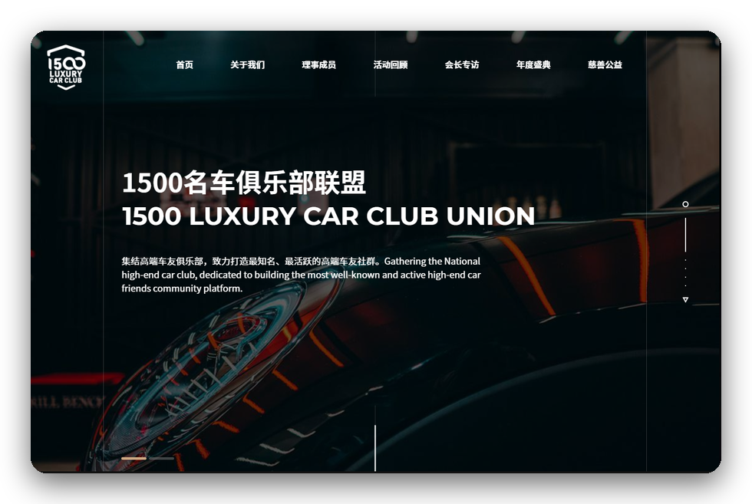
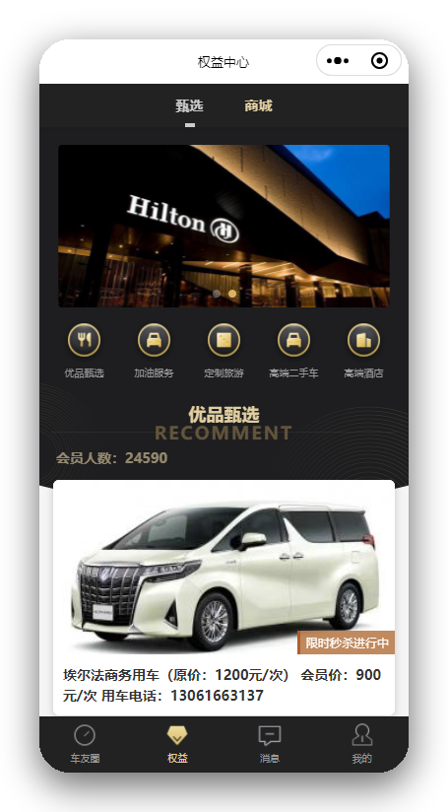
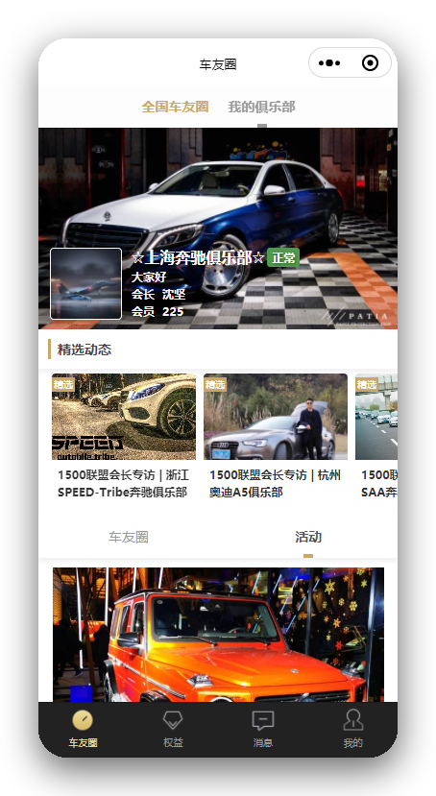
CLIENT CASE · 02
1500 Luxury Car Club Union
Brand, platform & events
A club uniting premium car owners worldwide and bringing together luxury-brand owner clubs across China. We planned and delivered its complete online product suite and supporting marketing.
SCOPE OF WORK
Brand communication strategy
Website & WeChat official account
Community marketing mini program
Exhibition planning & on-site execution
Ongoing operations advisory
JIMENG NETWORK
12

Slide 14
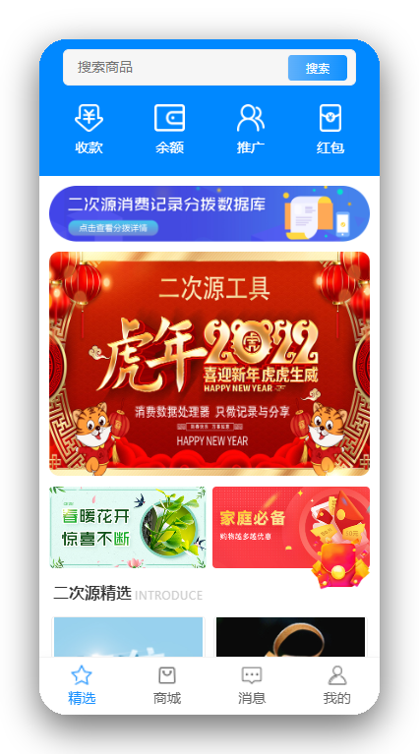
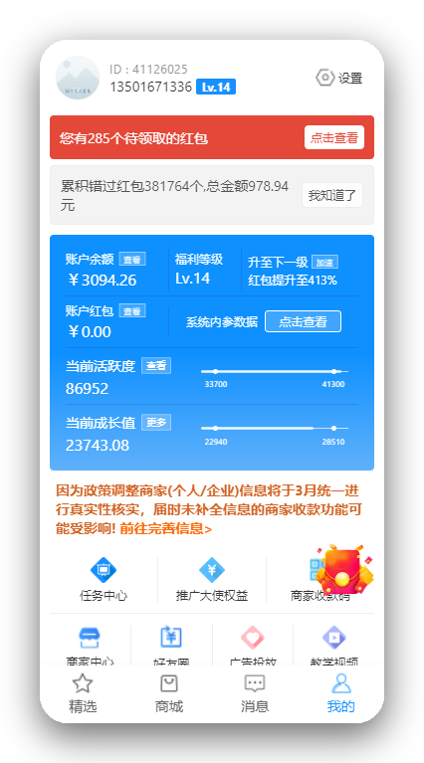
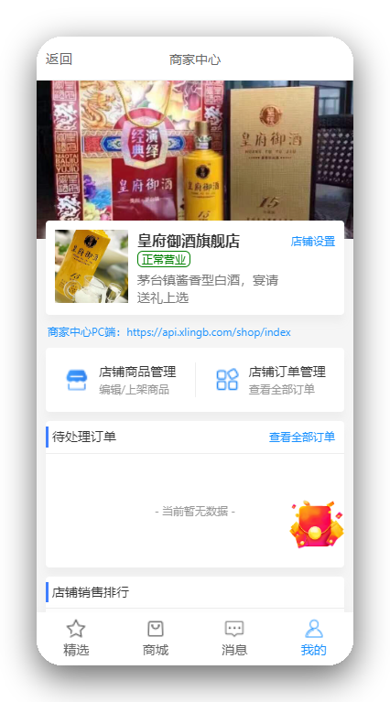
CLIENT CASE · 03
GMV RMB 10M+
Erciyuan
C2C marketplace, settlement & payment tool
An all-in-one platform combining a C2C marketplace, a settlement system and a payment tool, with user transaction volume exceeding RMB 10 million. We partnered closely from planning through engineering, content and campaigns.
SCOPE OF WORK
Project & execution planning
WeChat official account / app development
Short-video content production
Campaign planning & execution
JIMENG NETWORK
13

Slide 15




OUR PRODUCT
ThinkNova
An AI marketing content platform built in-house
Pick a scene
01
New launch, store tour, promotion, price list, festivals
Pick a scene, add a product, upload a photo — and get a ready-to-post 15-second marketing video or poster in about three minutes. ThinkNova is both a SaaS product for small businesses and the engine behind the AIGC production lines we deploy for brands.
Fill in two lines
02
Just the product name and the price or offer
Upload a photo
03
The video faithfully recreates your storefront & products
~3 min
9
2
Generate
04
From input to video
Output languages
Products: video + poster
Script, voice-over, storyboard and captions — all automatic
JIMENG NETWORK
14

Slide 16





WHY JIMENG
Why brands work with us
Six reasons clients keep coming back.
A decade-long core team
End-to-end capability
Brand-grade standards
Our core engineers have worked together for over ten years — quality never slips with turnover.
Strategy, design, engineering, operations and AI — delivered by one team.
Experienced with global beauty and luxury brands and their security & compliance demands.
Proven at scale
AI-native
Long-term partner
Years of building and operating multiple 10M-scale systems.
Our own AIGC pipeline, with proven capacity of a thousand videos a month.
Dedicated one-to-one service, with continuous iteration well after launch.
JIMENG NETWORK
15

Slide 17



ENGAGEMENT MODELS
Three ways to work with us
Choose the model that fits your project.
RECOMMENDED
Project-Based
AI FDE
Managed Operations
Clear scope, milestones and acceptance criteria — ideal for websites, mini programs, apps and enterprise systems.
Engineers embedded in your team, delivering AI production systems through discover, prototype, deploy and transfer.
Content production, platform operations and community management as a monthly service — continuously delivered and improved.
Fixed scope & pricing
On-site or remote embedding
Monthly service package
Milestone acceptance
Phased delivery & sign-off
AI content at scale
Post-launch warranty
Knowledge transfer & training
Data reviews & iteration
JIMENG NETWORK
16

Slide 18
THANK YOU
The digital age changes fast; we never drift with the tide.
We start from delivering value — and do everything we promise.
Shanghai Jimeng Network Technology Co., Ltd.
jimeng.it.com

