Slide 1
Unflummoxing Videos with Gstreamer
Making a Hard Thing Possible

Slide 2
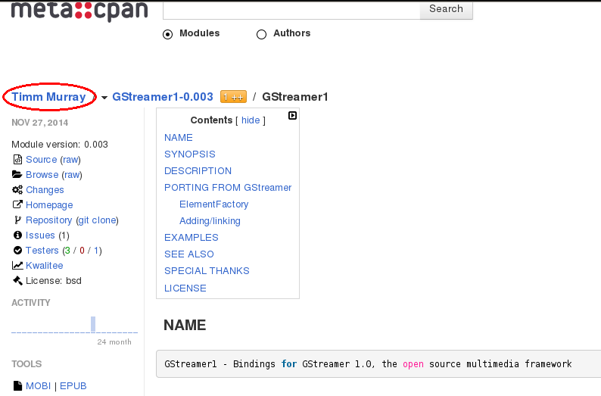
This Means Nothing

Slide 3
Q: “What do I use to play a .mkv?”
A: “I have no idea”

Slide 4
Vocabulary
Codec: encode video or audio, usually compressed
Container: Combine video and audio into one file (also subtitles, maybe other stuff)
A container could contain any of the codecs it supports
Some containers only support one video and one audio codec
Can have a file that's just codec data (like .mp3)

Slide 5
Versions
On CPAN:
  GStreamer – gst 0.10
  GStreamer1 – gst 1.0
The 0.10 API is deprecated

Slide 6
Plugins
Good – Follows best practices, well documented
Bad – Deviates from best practices or missing docs
Ugly – OMG
Packages usually named “gstreamer-plugins-good”, etc.
Just install all of them

Slide 7
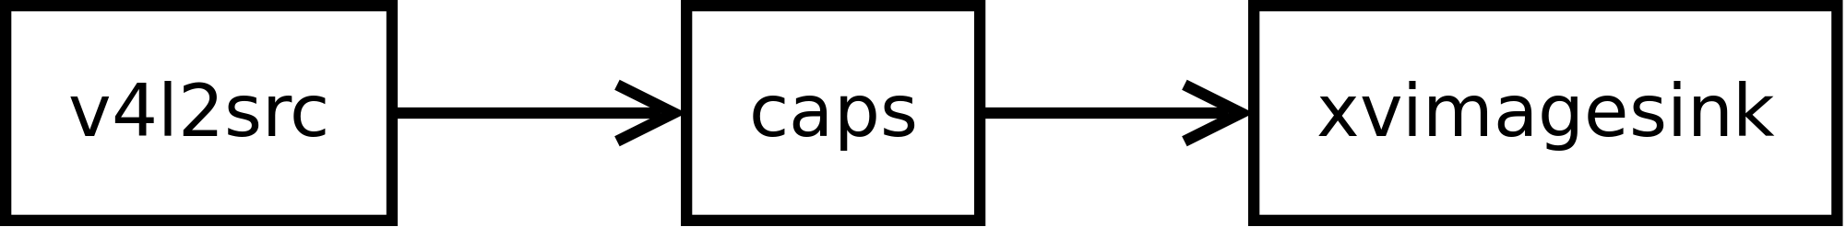
Gstreamer Pipeline

Slide 8
Gstreamer Pipeline
gst-launch-1.0 v4l2src device=/dev/video0 \
! 'video/x-raw,width=640,height=480' \
! xvimagesink

Slide 9
Again, but this time in Perl

Slide 10
use GStreamer1;
use Glib qw( TRUE FALSE );
my $loop = Glib::MainLoop->new( undef, FALSE );
GStreamer1::init([ $0, @ARGV ]);

Slide 11
my $pipeline = GStreamer1::Pipeline
->new( 'pipeline' );
my $v4l2src = GStreamer1::ElementFactory::make(
v4l2src => 'and_who');
my $capsfilter = GStreamer1::ElementFactory::make(
capsfilter => 'are_you' );
my $xvimagesink = GStreamer1::ElementFactory::make(
xvimagesink => 'the_proud_lord_said' );

Slide 12
$v4l2src->set(
device => “/dev/video0”,
);
my $caps = GStreamer1::Caps::Simple->new(
'video/x-raw',
width => 'Glib::Int' => 640,
height => 'Glib::Int' => 480,
);
$capsfilter->set( caps => $caps );

Slide 13
$pipeline->add( $_ ) for
$v4l2src,
$capsfilter,
$xvimagesink;
$v4l2src->link( $capsfilter );
$capsfilter->link( $xvimagesink );

Slide 14
my $bus = $pipeline->get_bus;
$bus->add_signal_watch;
$bus->signal_connect( 'message::error',
\&bus_error_callback, $loop );
$pipeline->set_state( 'playing' );
$loop->run;
$pipeline->set_state( 'null' );

Slide 15
sub bus_error_callback
{
my ($bus, $msg, $loop) = @_;
my $s = $msg->get_structure;
warn $s->get_value('gerror')->message . "\n";
$loop->quit;
return FALSE;
}

Slide 16
Now we'll go try it

Slide 17
What now?

Slide 18
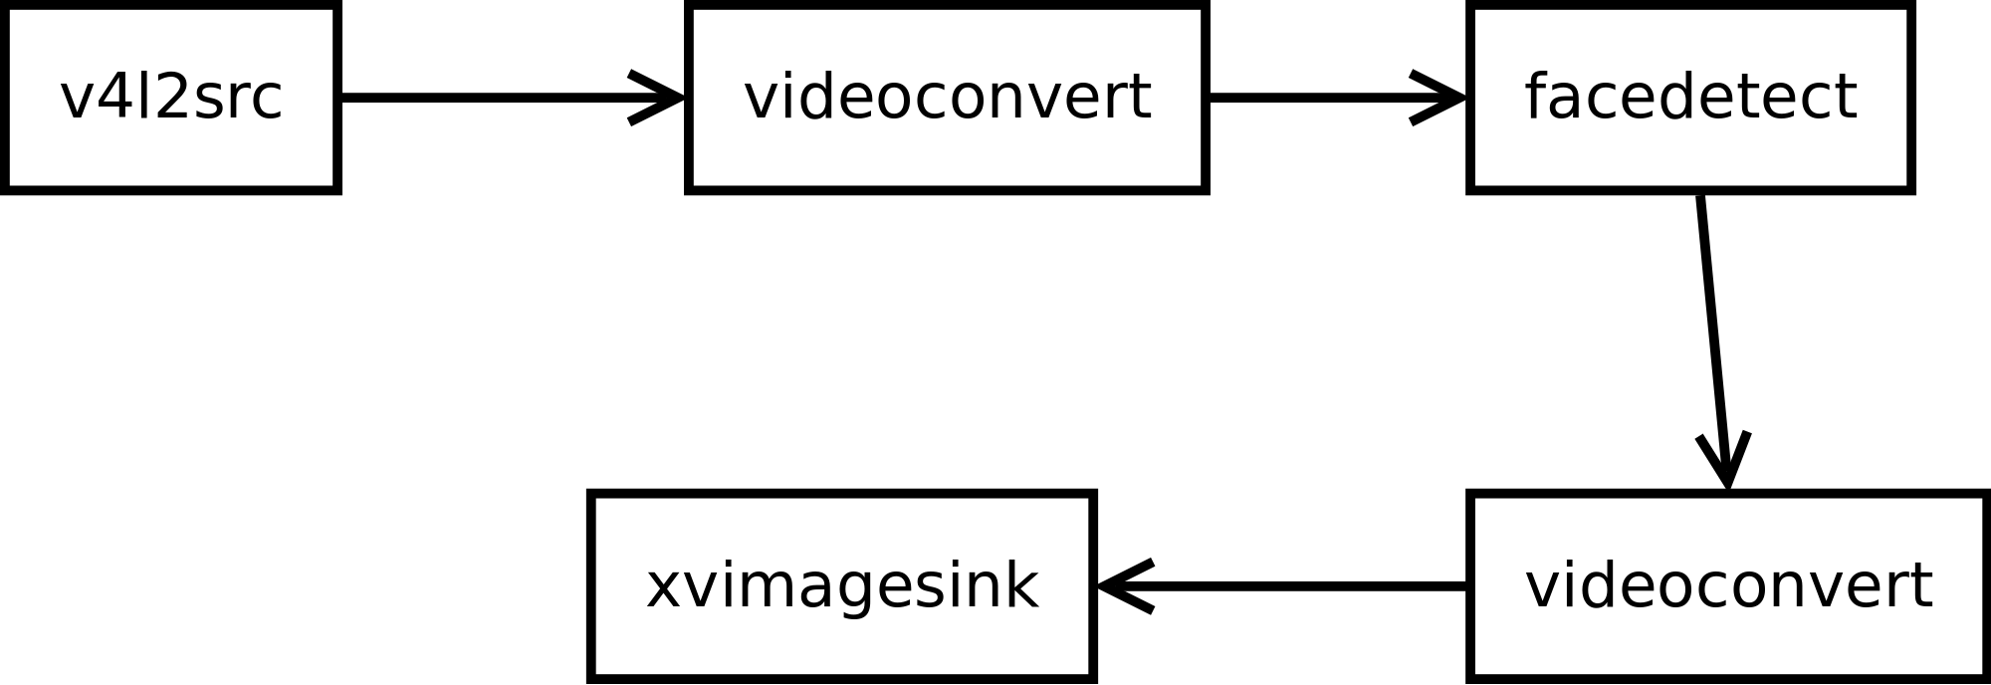
How about detecting faces?

Slide 19
Let's take a look at the code

Slide 20
Facedetect callback is nice
What else works with callbacks?
How about getting the full image data?
(See grab_frames.pl)

