Slide 1
Parsing in Perl
– or “So You Want to Write a Compiler?”

Slide 2
IANACS – I Am Not a Computer Scientist
But sometimes I pretend
Crash course in the Theory of Computation
Lexing
BNF
CPAN Parser Libraries

Slide 3
Compilers: Not Just for “Compiling”
Techniques for building compilers are very powerful
Really about manipulating data between different forms
Once you understand, start seeing use for “compilers” everywhere
Useful even if you never design or implement a language
That's why we start with Theory of Computation

Slide 4
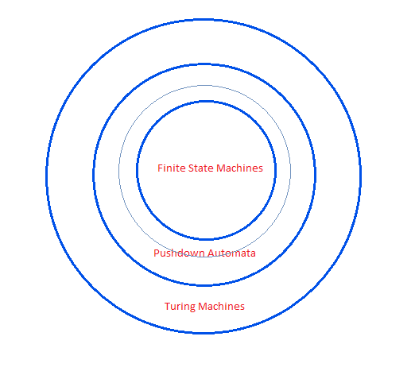
Theory of Computation Bullseye

Slide 5
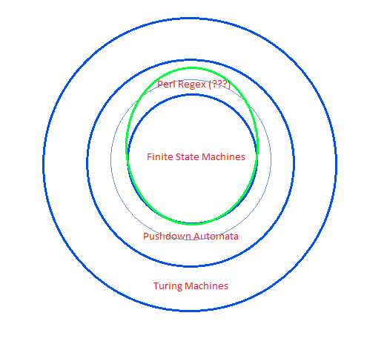
Perl Breaks the Bullseye

Slide 6
This is Impossible (Says the Computer Scientist)
/\A (0+) 1 \1 \z/x
(Match any number of 0s, followed
by a 1, followed by the same number
of 0s—so says the Pumping Lemma)
Possible: /\A 0+ 1 0+ \z/x

Slide 7
Overcoming FSM's Limitations
(CS-Approved Way)
Start with simple form of memory: stack
Can now solve previous impossible problem
Push the 0s on the stack
Hit the 1
Pop the 0s off the stack
Hit end of string
If stack is empty, string is accepted

Slide 8
Less Abstract Problem
Balanced parentheses
Can't be done with FSM
Can be done with Pushdown Machine
Also recursive Perl regexen (stolen from perlfaq6, v5.10 and up):
/(< (?: [^<>]++ | (?1))* >)/xg

Slide 9
Still Need More Power
Turing Machines
Instead of stack, gets random access memory (paper tape)
All programming languages aim to be Turing Complete
(Except that they don't have infinite memory)

Slide 10
But Not Too Much Power
Most programming languages implement their grammar as context-free
Although not Perl (snippet by Randal Schwartz):
whatever / 25 ; # / ; die "this dies!";
(See http://www.jeffreykegler.com/Home/perl-and-undecidability)
That's why PPI was so hard to implement

Slide 11
Done with CS, on to Parsing
Simple calculator language
Syntax based on Lisp
Lisp is really, really easy to parse
Start with EBNF (Extended Backus-Naur Form)
EBNF is a simple way to define a grammar

Slide 12
Examples
(+ 1 2)
(- 5 (* 1 4))
(/ (* 5 20) (+ 5 5 7))

Slide 13
Equivalent Abstract Syntax Trees
[ '+', 1, 2 ]
[ '-', 5, [ '*', 1, 4 ] ]
[ '/', [ '*', 5, 20 ], [ '+', 5, 5, 7 ] ]

Slide 14
EBNF
start = func
func = open_paren op arg {arg} close_paren
arg = integer | func
integer = { digit }
open_paren = "("
close_paren = ")"
digit = "0" | "1" | "2" | "3" | "4" | "5" | "6" | "7" | "8" | "9"
op = "+" | "-" | "*" | "/"

Slide 15
Implementation Details
'run_tests.pl' unit tests Evaluator, Tokenizer, and grammar implementations
Tokenizer takes a string and breaks it up (FSM)
Evaluator takes a data structure and runs it (Turing Machine)
Grammar implementations go in between Tokenizer and Evaluator (Pushdown Machine)

Slide 16
First Step: Lexing/Tokenizing
Lexing usually implemented as FSM
Often just breaking on whitespace
Could also be more complicated, like stripping comments and collapsing whitespace
Can catch some very simple errors, sometimes
Most parsers have a separate lexing step
  But not Parse::RecDescent
    But you can fake it if you want

Slide 17
Lexing Options
By hand
String::Tokenizer
HOP::Lexer
Plenty of others
Tends to be a tedious job any way you do it
I like HOP::Lexer, just because

Slide 18
Go look at lib/Tokenizer.pm

Slide 19
Last Step: Evaluator
Every parser is expected to generate same AST
Evaluator takes that AST and runs it

Slide 20
Go look at lib/Evaluator.pm

Slide 21
Parse By Hand
Procedures
Not a bad option for our little language
Good to know how to do it with only procedures
Parsing libraries will make our lives easier for more complicated languages

Slide 22
Go look at lib/Procedural.pm

Slide 23
Parse::RecDescent
Probably most common Perl parsing library
Damian module
  Which means it's probably too clever for its own good
Good or bad, you'll see this one a lot

Slide 24
Go look at lib/ParseRecDescent.pm

Slide 25
Marpa
New Hotness
Fast
  Most practical grammars in linear time
  All unambiguous grammars in no worse than O(n**2)
  Ambiguous grammars in O(n**3)
  Never backtracks
Nice, clean interface

Slide 26
Go look at lib/Marpa.pm

