Slide 1
Car Telemetry

Slide 2
Autocross?
https://www.youtube.com/watch?feature=player_detailpage&v=8p1iNLbEj-E#t=104

Slide 3
GPS (NMEA)
use GPS::NMEA;
my $gps = GPS::NMEA->new(
Port => '/dev/ttyUSB0',
Baud => 9600,
);
while(1) {
my($ns,$lat,$ew,$lon) = $gps->get_position;
say "($ns,$lat,$ew,$lon)";
}

Slide 4
Accelerometer
use Device::LSM303DLHC;
my $lsm = Device::LSM303DLHC->new(
I2CBusDevicePath => '/dev/i2c-1',
);
my $accel = $lsm->Accelerometer;
$accel->enable;
my ($x, $y, $z, $wut) = $accel->getAccelerationVectorInG;
say “[$x,$y,$z,$wut]”;

Slide 5
Video
my $rpi = Device::WebIO::RaspberryPi->new;
my $vid_in_fh = $rpi->vid_stream( 0, 'video/H264' );

Slide 6

Make a box—Attach::Stuff
my $attach = Attach::Stuff->new({
width => 26,
height => 34,
screw_default_radius => 1.25,
screw_holes => [
[ 3, 3 ],
[ 26 - 3, 3 ],
],
});
my $svg = $attach->draw;
print $svg->xmlify;

Slide 7
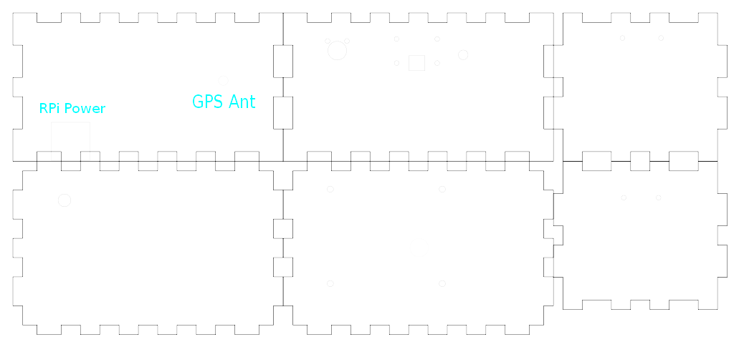
Makercase.com + Attach::Stuff

