Slide 1
Raspberry Pi and Perl

Slide 2
What is this thing?
Small, cheap computer
System-on-a-chip, includes CPU, GPU, RAM
A few options for OS
  We'll focus on Linux
First intended to teach kids to program
  Developers thought modern computers to complicated
Became popular among hardware hackers

Slide 3
Raspberry Pi Hardware (Model B)
ARM-on-a-chip (Broadcom BCM2835)
512 MB RAM
GPU
2x USB Ports
HDMI, RCA video
Ethernet
SD card for OS and storage
USB micro port for power (need ~700mA)
Optional camera

Slide 4
Camera Module
Optional perpherial
Better than your average web cam
5MP Native Resolution (2592x1944)
Video, 1080p30, 720p60, 640x480p60/90
Can access through external program for now
  (Working on direct Perl access)

Slide 5
Raspberry Pi Software
Many types of OS, but Raspbian most popular
  Debian distro
Very easy setup, just copy files to SD card
Perl already installed
HiPi modules interface to hardware

Slide 6
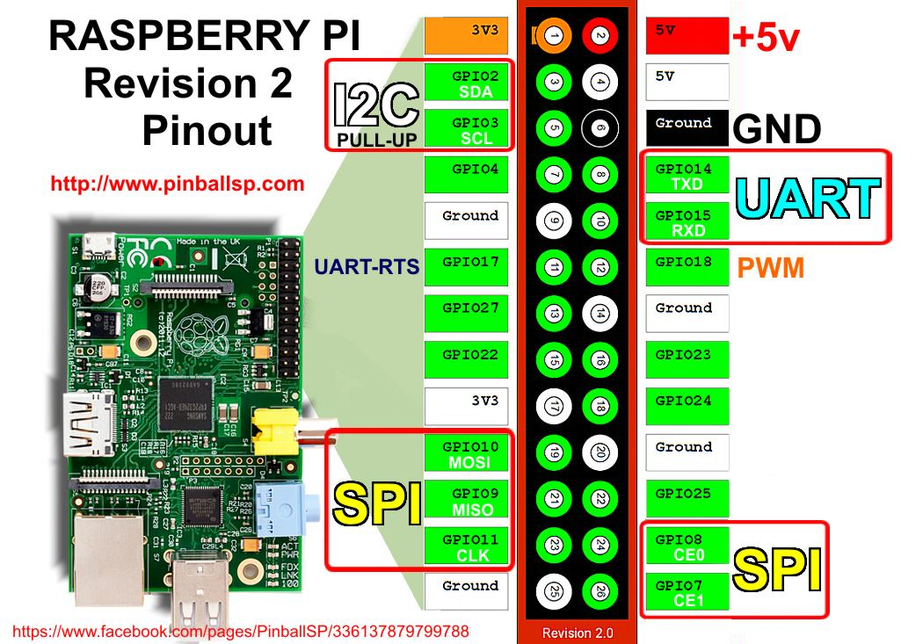
Peripheral Interface

Slide 7
Project Ideas
Internet Garage-door
Security camera
Home web server
Time-lapse video
Sensor logging
  Humidity
  Temperature

Slide 8
Blink an LED
"Hello, world!" of hardware projects
If you can turn on an LED, you can turn on anything (digitally)
  Use a relay for high-powered things

Slide 9
Demo Blinking LED

Slide 10
Run LED When Hitting a Switch
Also seems trivial
If you can run an LED based on input, you can run anything based off any (digital) input
Pullup resistors
  Let you reliably get the state of the button
  Inverts the state—0 is on, 1 is off

Slide 11
Demo Input

Slide 12
Dim an LED
Pulse Width Modulation (PWM)
Turning on and off really fast
  If it's on 50% of the time, looks 50% as bright
  Handled by hardware with simple programming
Can also be used on motors
  But not RC hobby ESCs
Frequency matters
  See: Cheap LED christmas lights
  Raspbery Pi's default seems fine

Slide 13
Demo PWM

Slide 14
Communication
Arduino
  More PWM channels (6 vs 1)
  Servo library (motor control)
  Real time
Other devices
  GPS
  Accelerometers

Slide 15
SPI
Serial Peripheral Interface
5 wires to connect
Master/slave devices
Raspberry Pi refuses to be a slave
AVR can be a slave, but Arduino library won't

Slide 16
UART
Good ol' serial connection
2 wires to connect
USB port on Arduino is connected to this
  Same thing used for loading program
  Also used for logging
  Different uses interfere with each other

Slide 17
I2C
Inter-Integrated Circuit
  Hardware interface called "TWI"--Two Wire Interface
2 wires to connect (and ground)
Most Arduinos are 5V, Raspberry Pi is 3.3V
  Can buy a "leveler"
Need to unblacklist and install some Linux modules

Slide 18
I2C Program

