Slide 1
Make Flying Robots
Do your Bidding with UAV::Pilot

Slide 2
About Me
Timm Murray <tmurray@wumpus-cave.net>
Day job: web developer
http://www.wumpus-cave.net
https://github.com/frezik

Slide 3
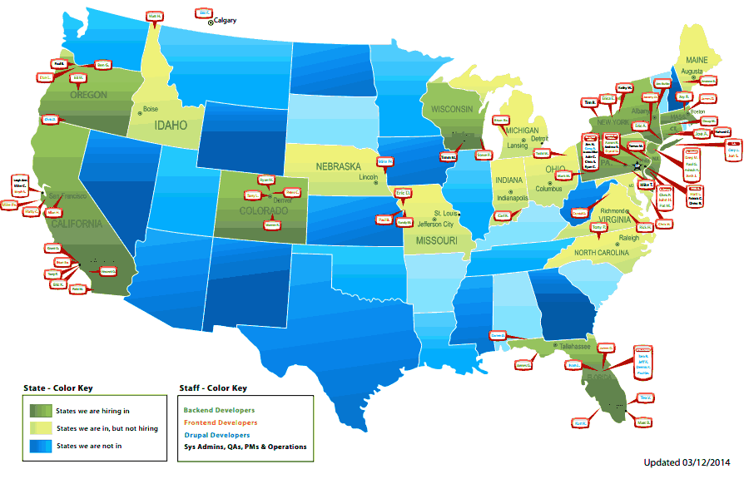
Doubleprime

Slide 4
Quick Taste
Connect to WiFi
Run uav -l ARDrone
  The -l loads the ARDrone library
  Could also type load 'ARDrone'; at prompt
REPL shell loads
takeoff;
flip_left;
land;

Slide 5
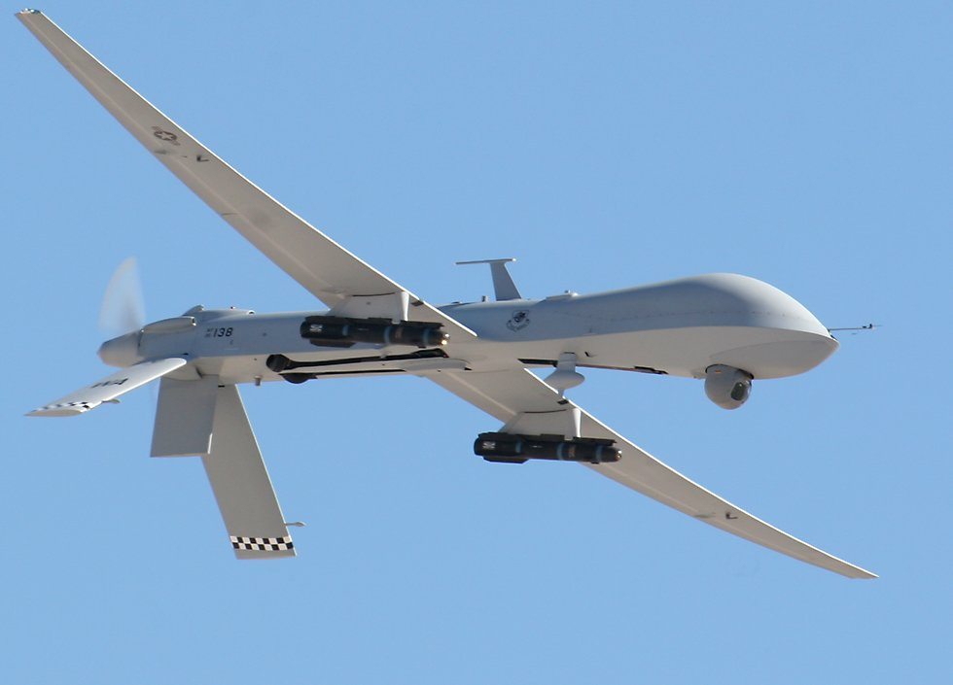
What This is Not All About

Slide 6

Aerial Photography

Slide 7
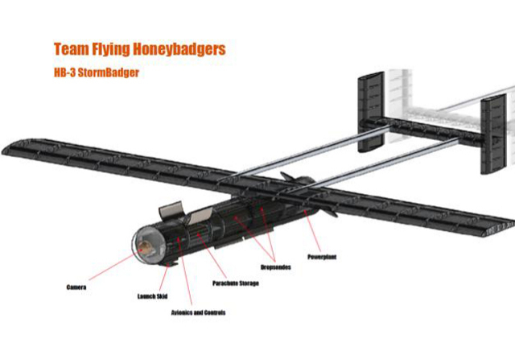
Storm Chasing

Slide 8
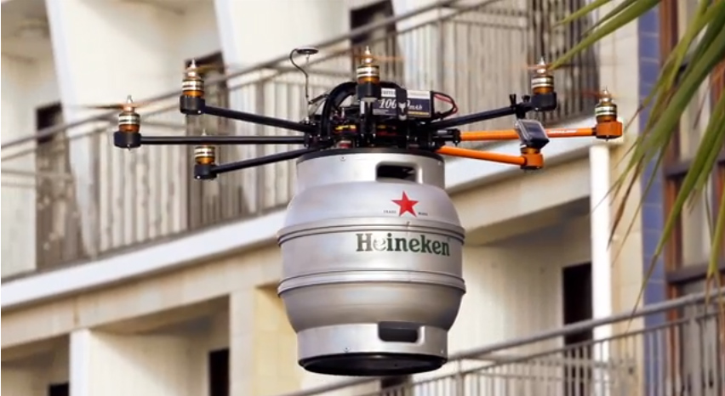
Beer Delivery

Slide 9
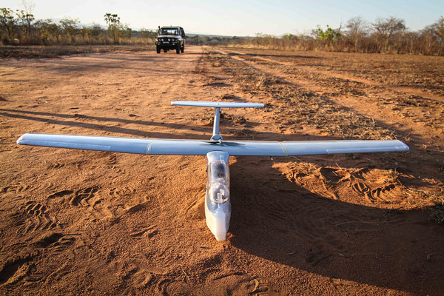
Anti-Poaching

Slide 10
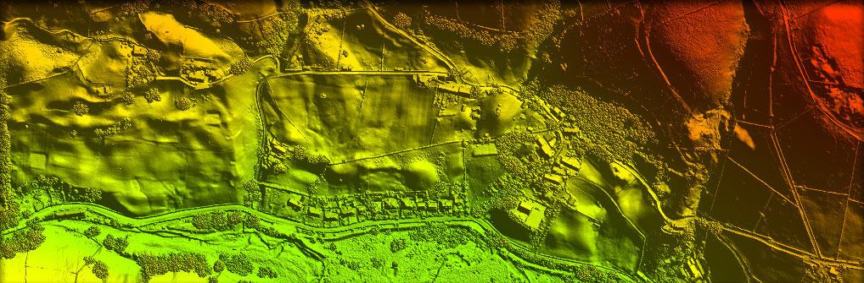
Terrain Mapping (LIDAR)

Slide 11

Search-and-Rescue

Slide 12
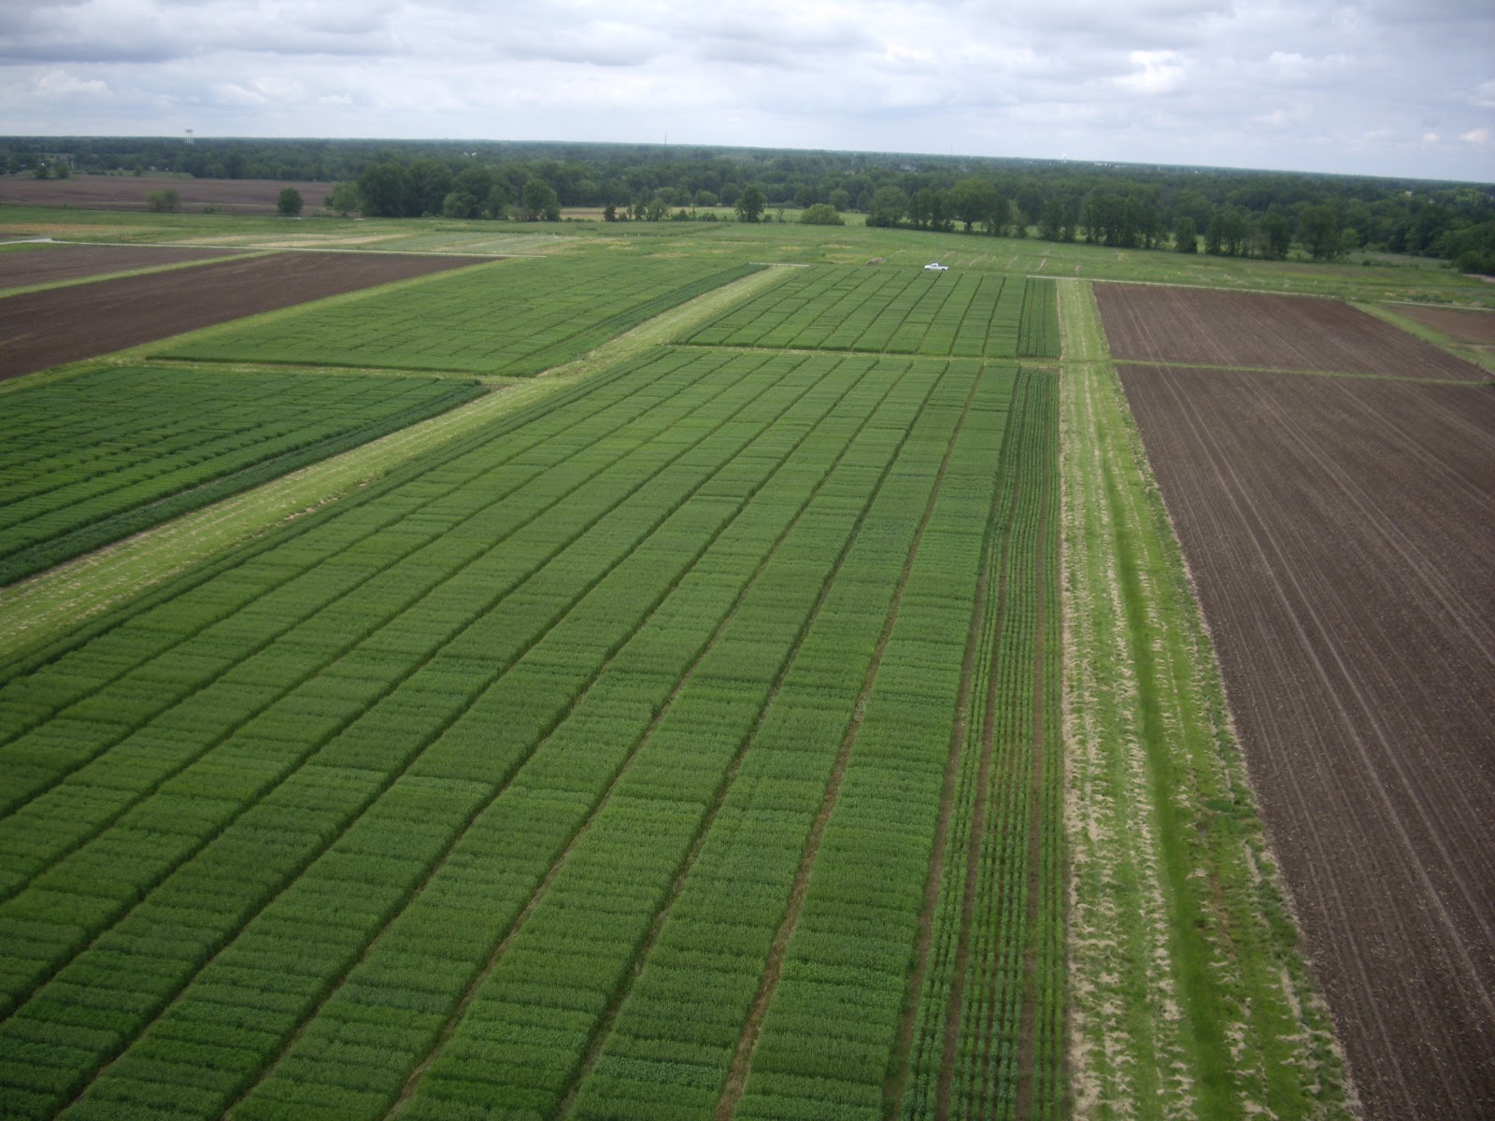
Agriculture

Slide 13
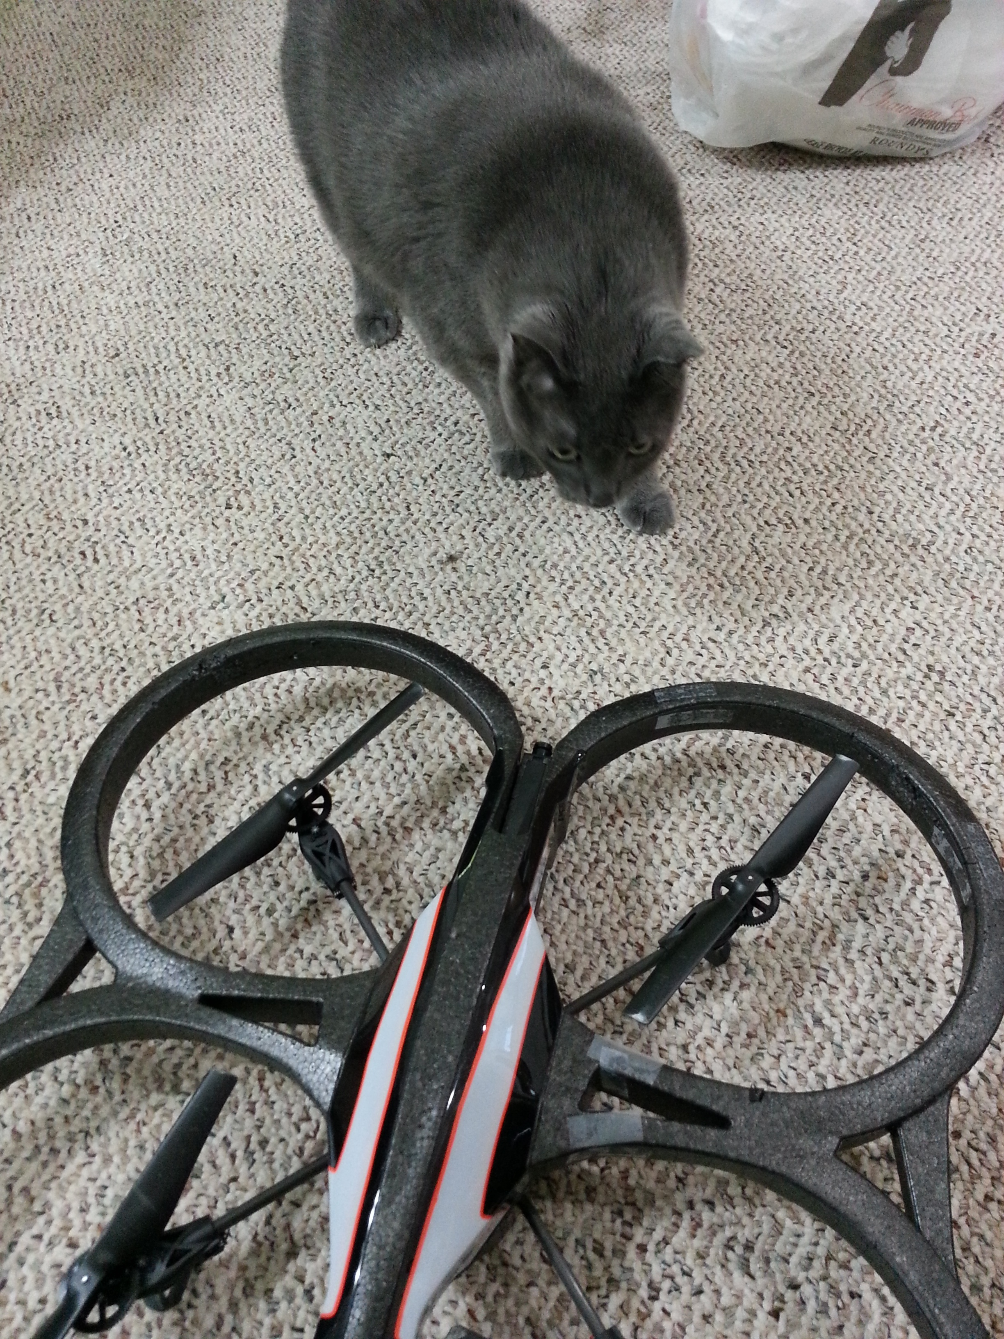
Scaring the Cat

Slide 14
FAA Rules for Model Aircraft
<400 feet above ground level
Away from populated areas, full sized aircraft
Non-commercial
  Waiver exceptions
  (Mostly for local governments)
New rules for commercial use in 2015
  (We hope)

Slide 15
Overview of Parrot AR.Drone
Quad-copter
  Hard to stabilize without a computer
    Which is why helicopters were prefered
Outdoor and indoor hulls
Creates a WiFi adhoc network
  Hacks to connect to open AP

Slide 16
Overview of Parrot AR.Drone
USB Connector
  Save video to flash drive
  GPS Accessory
  Hacking?
Forward and bottom cameras
Ultrasonic sensor for altitude measurement

Slide 17
Overview of Parrot AR.Drone
Built-in maneuvers
  Theta dance!
  Theta 20deg yaw m200!
  Double phi theta mixed!
  Flip behind!
  [Demo time]

Slide 18
Overview of Parrot AR.Drone
Onboard software: Linux, busybox
Telnet, no password [demo]
Flight controls over UDP
Nav data over UDP
Video v2.0 over TCP

Slide 19
Overview of UAV::Pilot
Implements control, nav data, and video
Supports AR.Drone and WumpusRover
  Expand to more in the future?
Structure:
  Drivers implement low-level details
  Controllers implement high-level interface
All UAVs of a simliar type (planes, helicopters, rovers,etc) should have a similar Control interface

Slide 20
Overview of UAV::Pilot--AnyEvent
Lots of AnyEvent usage
AR.Drone needs a command sent every 30ms, or it stops
Also handles non-blocking I/O
Future: “increase throttle until at x alttitude”

Slide 21
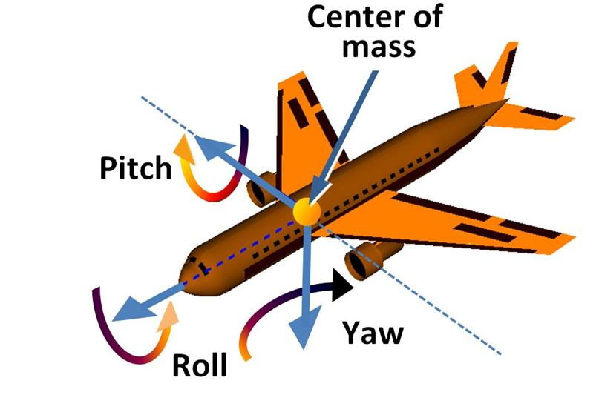
Basic Flight Dynamics

Slide 22
UAV::Pilot::Driver
my $driver = UAV::Pilot::ARDrone::Driver->new({
host => '192.168.1.1',
});
$driver->connect;

Slide 23
UAV::Pilot::Control
my $control = UAV::Pilot::ARDrone::Control::Event
->new({ driver => $driver });
# $event is a UAV::Pilot::EasyEvent object
$control->init_event_loop( $cv, $event );

Slide 24
UAV::Pilot::EasyEvent
my $event = UAV::Pilot::EasyEvent->new({
  condvar => $cv,
});
$event->add_timer({
  duration => 10, duration_units => $event->UNITS_MILLISECOND,
  cb => sub { $control->takeoff },
})->add_timer({
  duration => 10000, duration_units => $event->UNITS_MILLISECOND,
  cb => sub { $control->land; $cv->send; },
});
$event->init_event_loop;
$cv->recv;

Slide 25
The UAV Shell
Start up with uav -l ARDrone
start_nav;
start_joystick;
dump_video_to_file;
start_video 2;
Need '2' above to be compatible w/dump_video_to_file()

Slide 26

What Happens When it All Goes Horribly Wrong?

Slide 27
Programming a Longer Flight
[DEMO]

Slide 28
Video System
Only third-party lib to do real-time output (?)
  Nodecopter cheats w/browser
Start with PaVE stream from AR.Drone
Parse PaVE, get h.264 frame
h.264 decoded into YUV 4:2:2 by ffmpeg
Display on YUV overlay with SDL
Future: OpenCV?

Slide 29
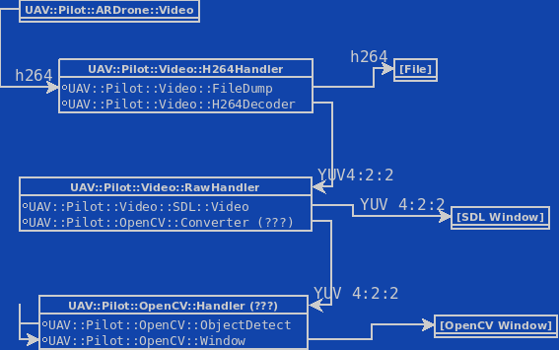
Video System

Slide 30
Video System: Passing Data
All in one process
  No lag, but done on single CPU core
Pipe: Grab video on one process, pipe to another for decoding
  Slight lag, runs on multicore
Fileno: Open stream, pass fh to another process
  No lag, runs on multicore
  But nobody else can use stream, e.g. dump video to file

Slide 31
WumpusRover
RC car as a base
Client: UAV::Pilot::WumpusRover
Server: UAV::Pilot::WumpusRover::Server
Raspberry Pi (WiFi, Camera)
Arduino (control)
Main goal: decoupling UAV::Pilot internals

Slide 32
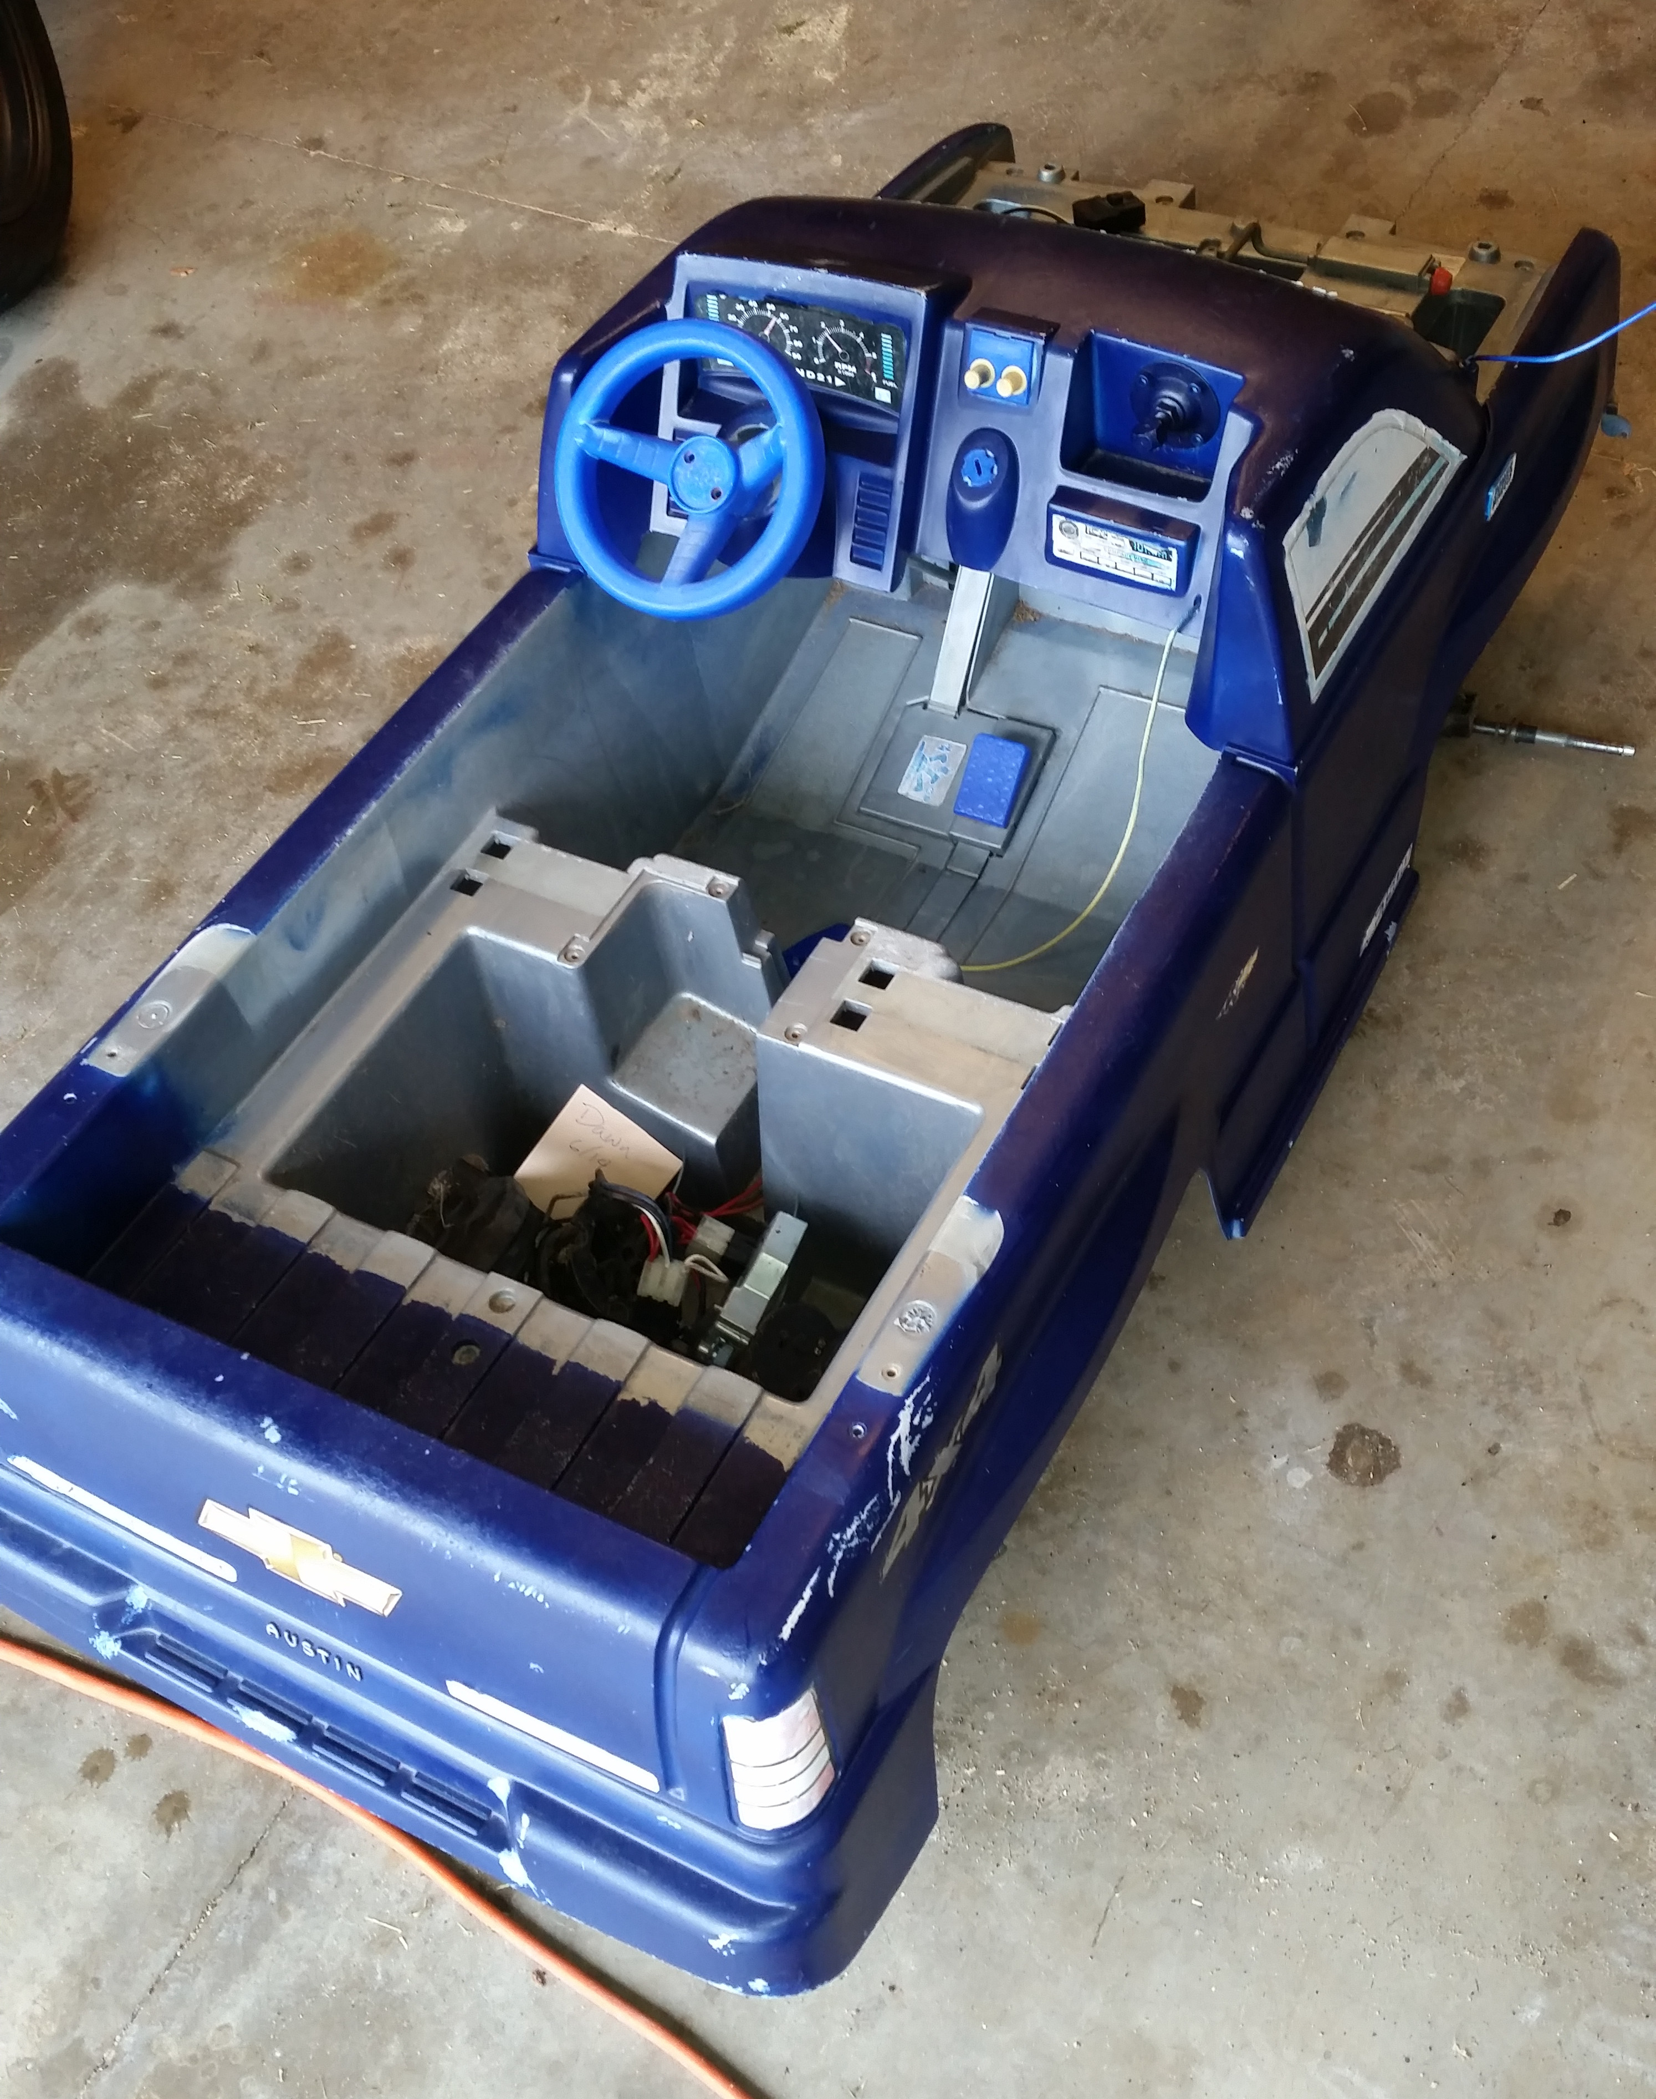
Next: WumpusRover/Boat

Slide 33
Future Hacks
Wiimote Control
  Linux::Input::Wiiuse
  Linux::Input::Wiimote
Google voice recognition
  Not an official Google API, but it works
  Convert to FLAC, post it to URI
  Needs a Perl module made
Automatic stiching of images from bottom camera
Android (Perl 5.20)

Slide 34
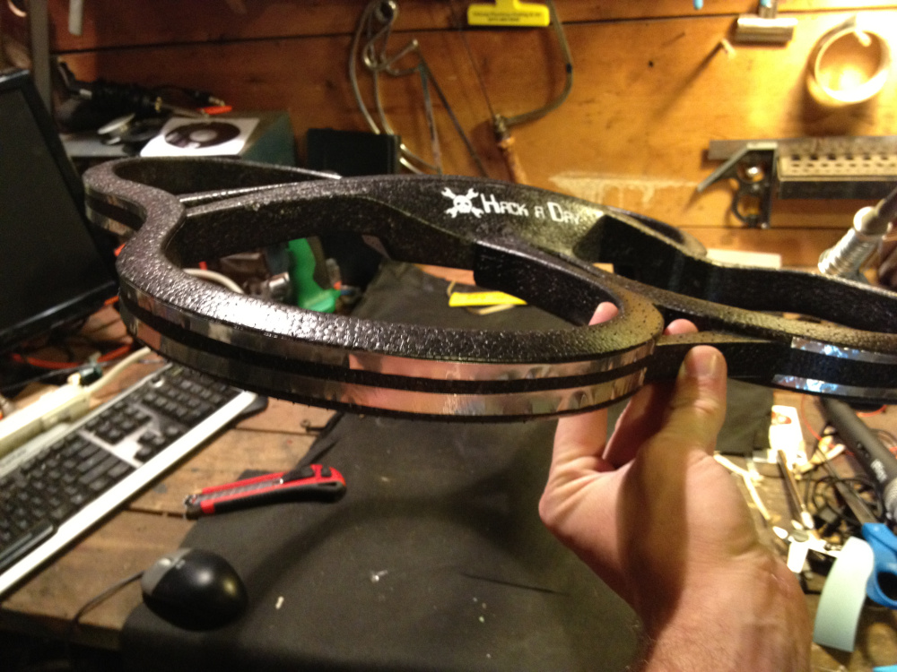
Inspiration: Tazer

Slide 35

Inspiration: Twitter (unwise?)

Slide 36
Other Hacks
Connect to Unsecured Access Point
  killall udhcpd
  iwconfig ath0 mode managed essid [ssid]
  ifconfig ath0 [wanted ip] netmask 255.255.255.0 up
Extend WiFi range (boost AP signal)
RC Radio, 2.4GHz, 1.5-2.5km range

Slide 37
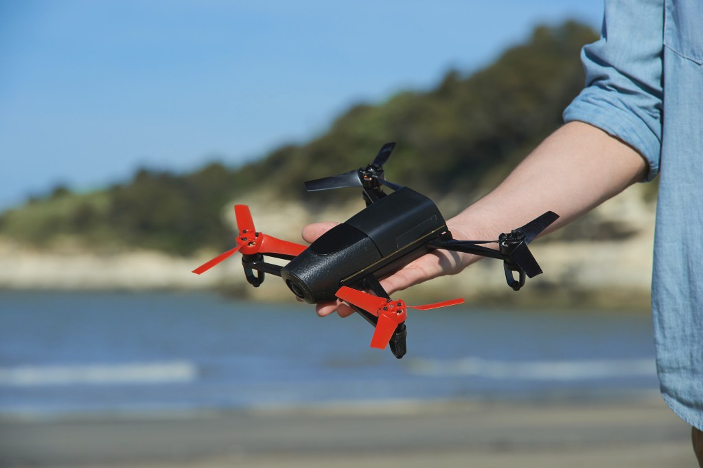
What About This Thing?

Slide 38
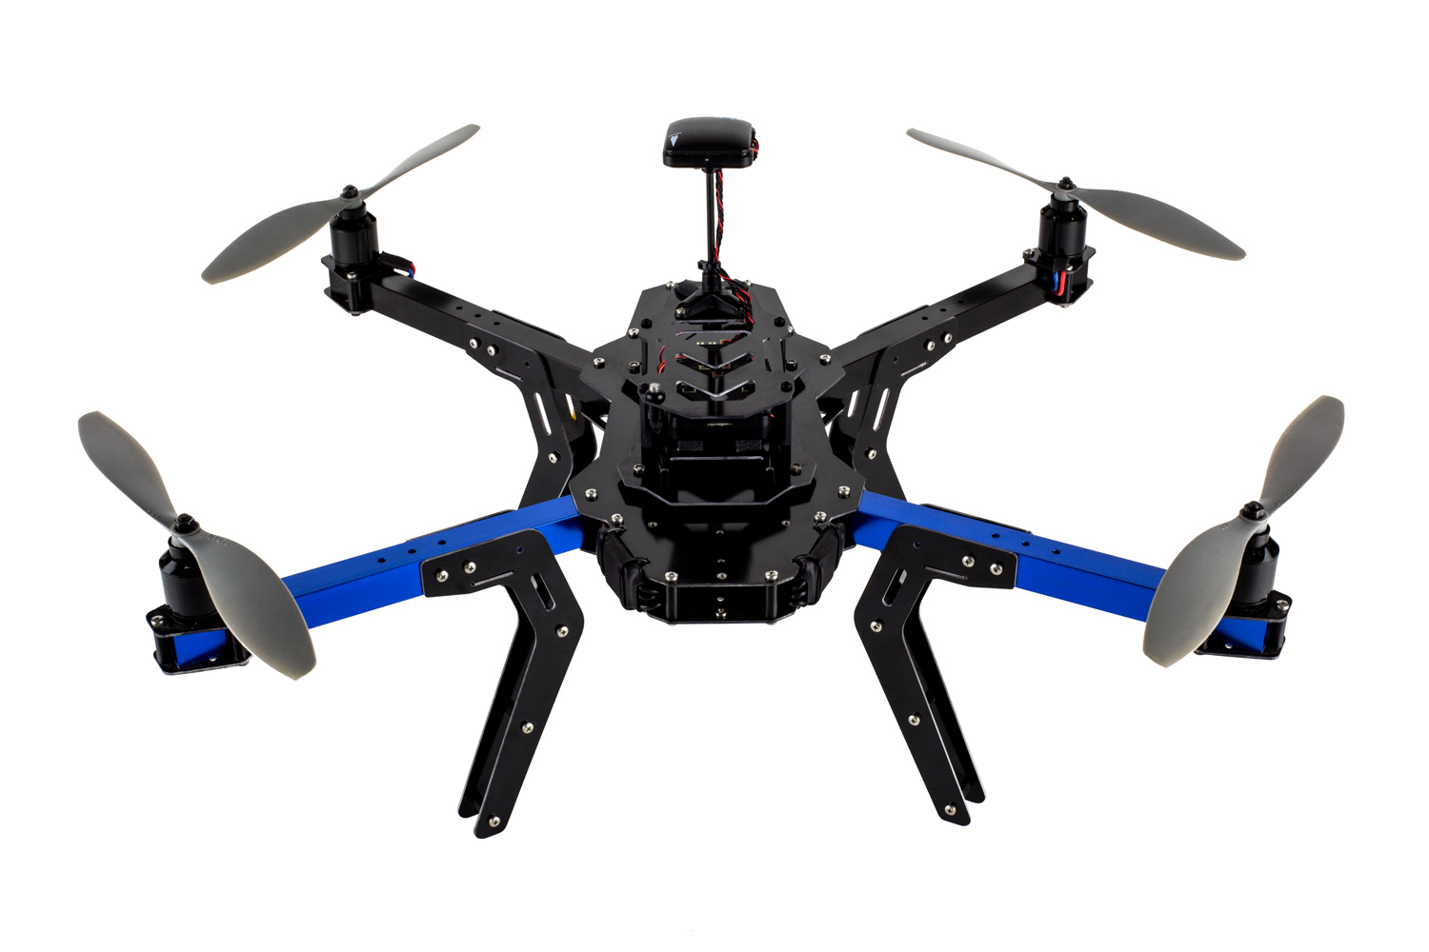
Or This Thing?

Slide 39
Questions?

