Slide 1
REST on your SoC with Device::WebIO

Slide 2
Wanted to Open my Garage

Slide 3
Based on WebIOPi
REST API or Python interface
Specific to Raspberry Pi
“GPIO expanders” (stuff directly hooked to Rpi)
Implements many sensors (temp, humidity, gyro, etc.)

Slide 4
Wanted something that could support many boards (Rpi, Banana Pi, PCDuino, Edison, Firmata/Arduino, etc.), and a video interface

Slide 5
Perl API
my $webio = Device::WebIO->new;
my $rpi = Device::WebIO::RaspberryPi->new;
my $firmata = Device::WebIO::Firmata->new({
port => '/dev/ttyACM0',
});
$webio->register( 'rpi', $rpi );
$webio->register( 'firmata', $firmata );
$webio->set_as_input( 'rpi', 17 );
$webio->set_as_output( 'firmata', 13 );
my $input = $webio->digital_input( 'rpi', 17 );
$webio->digital_output( 'firmata', 13 );

Slide 6
[Demo]

Slide 7
REST API
Val = GET http://localhost:8080/devices/rpi/17/value
POST http://localhost:8080/devices/firmata/13/value/Val

Slide 8
Device::WebIO::Dancer
Implements the REST API
Deploy like any other Dancer (Plack) app

Slide 9
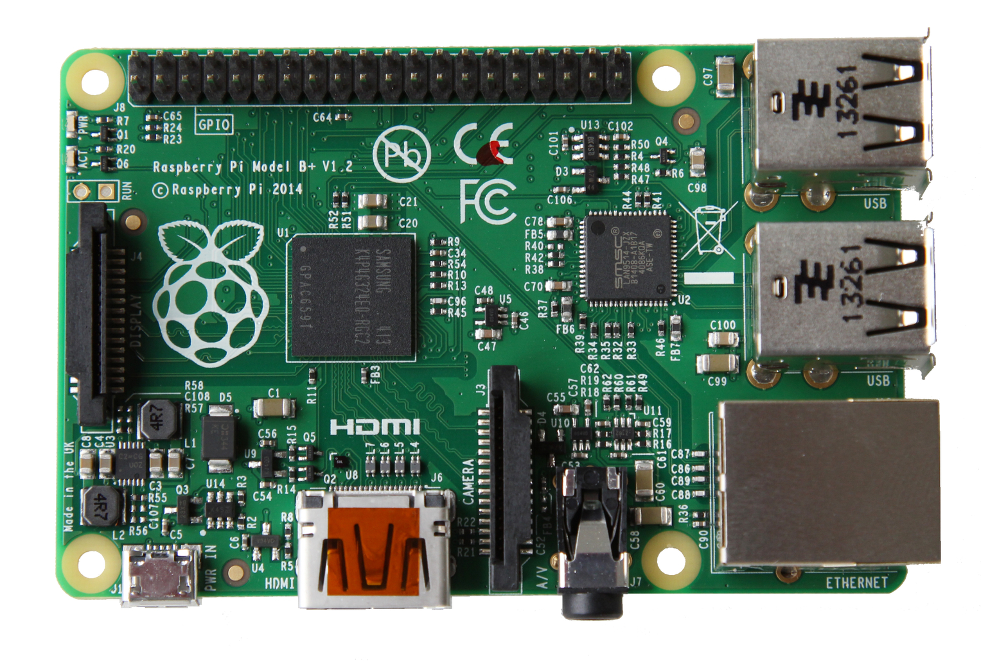
Raspberry Pi (Model B+) – $40
700 MHz Broadcom BCM2835 (ARM)
512MB RAM
4 USB
HDMI
Ethernet
Camera connector
No on-board WiFi, Bluetooth
Runs off micro SD card

Slide 10

Arduino Uno (Firmata) – $25
Atmega328 @16MHz
“Harvard” architecture
32KB flash (program storage)
2KB RAM (data storage)
WiFi/Ethernet shileds available
Firmata can take instructions from Perl over USB

Slide 11
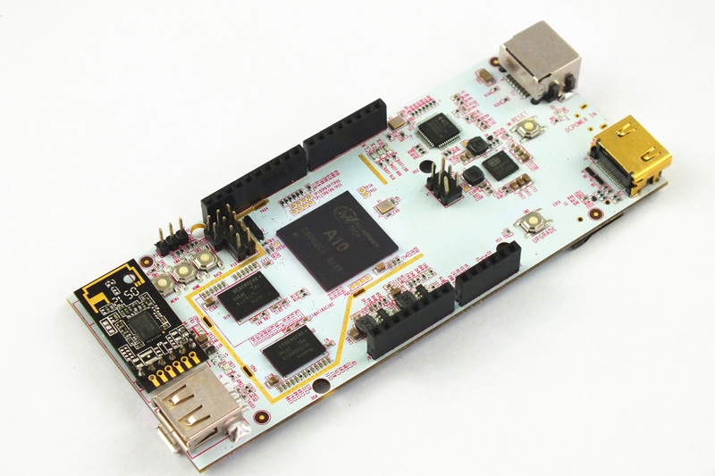
PCDuino2 – $65
1GHz A8
1GB RAM
4GB onboard flash
HDMI
1 USB
Arduino pin compatible
On-board WiFi, ethernet

Slide 12
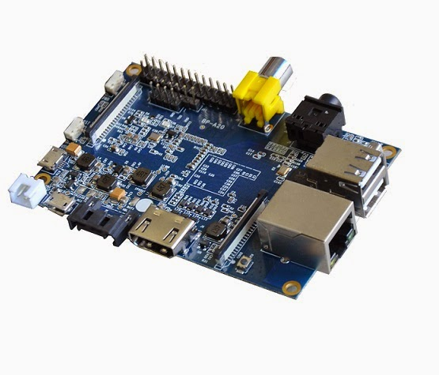
Banana Pi – $60(ish)
1GHz A7 Dual Core
1GB RAM
I/O similar to Raspberry Pi Model B
SATA port

Slide 13
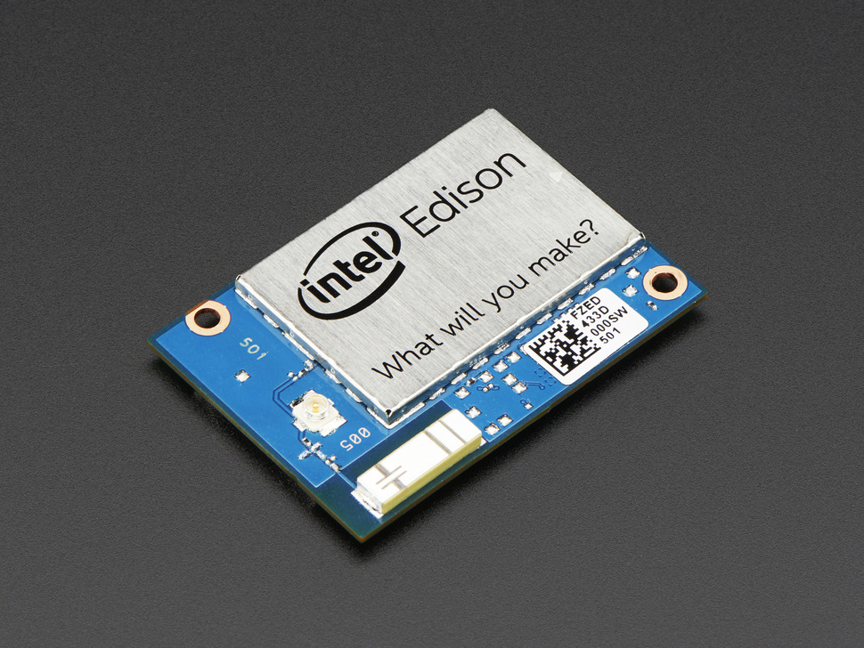
Intel Edison – $50
500MHz Intel Atom
1GB RAM
WiFi, Bluetooth
Seperate cable exposes 40 GPIO pins
Size of an SD card

Slide 14
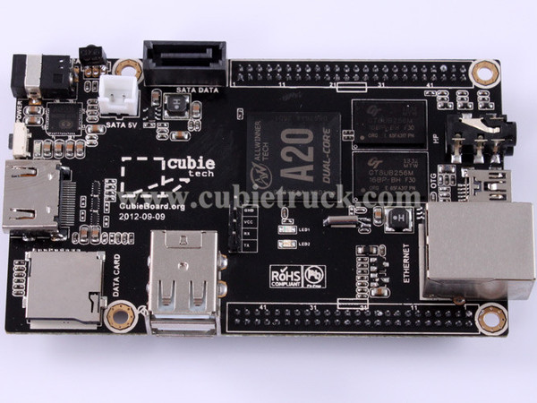
Cubieboard2 – $65
A7 Dual Core
1GB RAM
HDMI
Ethernet
SATA
Tons of I/O pins
Runs off micro SD card

Slide 15
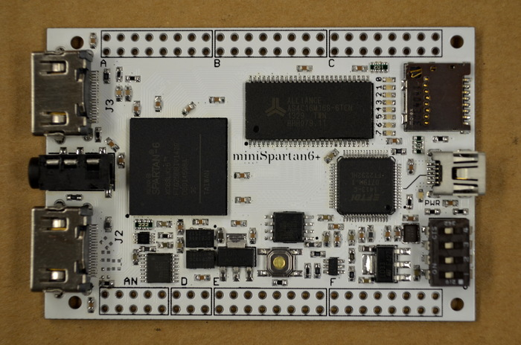
MiniSpartan6+ – $60(ish)
Kickstarter
LX9 FPGA
32MB RAM
2xHDMI (input or output)
MicroSD card

Slide 16
Please use good power adaptors
(>750mA, at least)

Slide 17
How can we run all of these with the
same library?

Slide 18
Abstraction with Moo Roles
Devices have different capabilities, specified by roles
PCDuino can do Analog-to-Digital conversion, so it has ADC role
RaspberryPi doesn't, so it doesn't
Roles for:
  GPIO
  ADC
  I2CProvider
  PWM
  StillImage/Video

Slide 19
I2C Devices
I2CProvider – Something that can read/write i2c devices directly
I2CUser – Implements some specific I2C device
Implement once, run anywhere
  (That's the idea, anyway)

Slide 20
Sensors
Currently: TMP102 temperature sensor
Future:
  Barometric pressure
  Luminosity
  Distance
  Accelerometers
  Gyros
  GPS

Slide 21
Implementing a Sensor
I2C bus
  Two lines: SDA (data) and SCL (clock)
    (Plus power and ground)
Each I2C device has an address
  Allows multiple devices on same bus
  Raspberry Pi, find using “i2cdetect”
    It's probably safe
“Register” can hold or be given values for functions
Find much of this info on the datasheet

Slide 22

Let's all have fun while
reading datasheets!
Obnoxious Slide

Slide 23
We now return you to dreary slides

Slide 24
Implementing TMP102
Do the 'Device::WebIO::Device::TempSensor' role
'temp_celsius()' reads from device
'temp_kelvin()' and 'temp_fahrenheit()' convert from celsius
[See TempSensor code]
[Demo]

Slide 25
REST Interface
Adapted almost-verbatim from WebIOPi
Corrected a few
Added a few others
Full documentation in Device::WebIO::Dancer dist, in pod/rest_api.pod

Slide 26
REST Interface
Most have the form: /devices/[name]/[function]/[channel]
[name]: Name of device registered in $webio
[function]: Kind of thing you're doing (analog, pwm, etc.)
[channel]: A specific thing to connect to, often a pin
Be sure to use GET/POST correctly
  You'll get an unexpected 404 if you confuse them

Slide 27
REST: Deploy to Apache
It's Dancer, so Plack, so deploy like anything else under Plack/Dancer

Slide 28
Raspberry Pi PSGI
use Device::WebIO::Dancer;
use Device::WebIO;
use Device::WebIO::RaspberryPi;
use Plack::Builder;
my $webio = Device::WebIO->new;
my $rpi = Device::WebIO::RaspberryPi->new;
$webio->register( 'rpi', $rpi );
Device::WebIO::Dancer::init( $webio, 'rpi' );
builder {
dance;
};

Slide 29
Apache Config
<Location />
SetHandler perl-script
PerlResponseHandler Plack::Handler::Apache2
PerlSetVar psgi_app /path/to/raspberrypi.psgi
AuthType Basic
AuthName "Restricted"
AuthBasicProvider file
AuthUserFile /path/to/passwd/file
Require valid-user
</Location>
<Location /app>
SetHandler none
</Location>

Slide 30
[Demo GPIO App]

Slide 31
Security? What Security?
Most secure: don't have REST interface
Next best: only respond on localhost
Next best: only respond to internal network
Next best: SSL, client certs, or 20-char password made of 90 possible character codes

Slide 32
Questions?

