Slide 1
Fast Number Crunching Fast Time to Market with Scala
by Richard Gomes

Slide 2
about me
Richard Gomes
Brazilian living in the UK since 2006
Passion for Finance and High Performance Computing ( HPC )
I like photography, go karting and table tennis
rgomes@jquantlib.org
T: frgomes

Slide 3
Objectives
High Performance Computing (HPC) with Scala
Thinking parallel
Introducing ScalaCL
Pros and Cons

Slide 4
Objectives
What it is NOT about
multithreading
multiple core CPUs
What it is about
hundreds of processing elements ( PEs ) or stream processors (SP)
running Scala code in your low cost GPU :)

Slide 5

Thinking Parallel
MIMD
multiple instruction
multiple data
More info
http://nvidia.com/cuda
http://amd.com/stream
http://khronos.org/opencl

Slide 6

Thinking Parallel :: CPU .vs. GPU

Slide 7
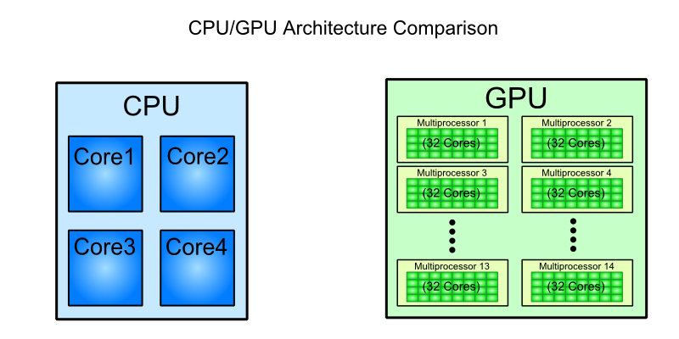
Thinking Parallel :: CPU .vs. GPU

Slide 8
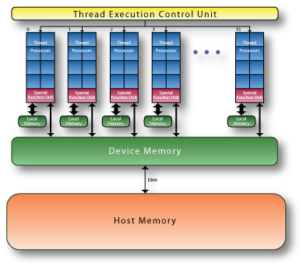
Thinking Parallel :: Direct Memory Access

Slide 9
Thinking Parallel :: parallel sum
How many 'cycles' do I need in order to sum 25 elements?
Answer: 24 cycles (or 24 sums), if serial
Answer: 4 cycles, composed of 'many' sums, if parallel
number of cycles is O(log2(n))

Slide 10
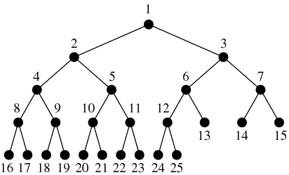
Thinking Parallel :: parallel sum

Slide 11
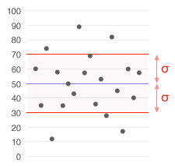

Thinking Parallel
Standard deviation
float sum = 0;
for (int i=0; i<n; i++)
sum += cells[i];
float mean = sum / n;
float sum = 0;
for (int i=0; i<n; i++)
sum += Math.sqr(cells[i] – mean);
float stddev = Math.sqrt(sum / n);

Slide 12
Thinking Parallel
Identify sequential code
Calculation of mean
Calculation of stddev
Identify loops
One loop when mean is calculated
One loop when stddev is calculate
Turn sequential code into parallel code
How loops could be performed in parallel?

Slide 13
Thinking Parallel
Let's suppose we have psum(), a parallel version of sum()
It was
// calculate mean
float sum = 0;
for (int i=0; i<n; i++) sum += cells[i];
float mean = sum / n;
// calculate stddev
float sum = 0;
for (int i=0; i<n; i++)
sum += Math.sqr(cells[i] – mean);
float stddev = Math.sqrt(sum / n);
It now looks like
// calculate mean
int n = cells.length;
float mean = psum(cells) / n;
// calculate stddev
for (int i=0; i<n; i++)
cells[i] += Math.sqr(cells[i] – mean);
float sum = psum(cells);
float stddev = Math.sqrt(sum / n);

Slide 14
Thinking Parallel in Scala
// let's suppose we have already parallel sum
def psum(cells: Array[Float]) : Float = cells.sum;
def mean(cells: Array[Float]) : Float = {
return psum(cells) / cells.length;
}
def $f (cell: Float, mean: Float) : Float = {
val x = cell – mean;
return x * x;
}
def stddev(cells: Array[Float]) : Float = {
return Math.sqrt( psum( cells.zip( $f ) ) / n );
}

Slide 15
Introducing ScalaCL
is a compiler plugin
  provides byte code optimizations
  generates and compiles the kernel code for you
  handles kernel code uploading
  handles data transfers between the CPU and GPUs
is a GPU-aware library
  introduces CLArray
  introduces CLCollection hierarchy
http://code.google.com/p/scalacl

Slide 16
Introducing ScalaCL
Benefits
optimizes Scala constructs, like for loops and ranges
CLArray is an Array which provides DMA to GPU
CLCollection implements sequential and parallel collections
http://code.google.com/p/scalacl

Slide 17
Introducing ScalaCL
import scala.math._
import scalacl._
class Stats {
private implicit val context = Context.best //-- run on GPU
def $mean(v : CLArray[Float]) : Float = v.sum / v.length
def $variance(v : CLArray[Float], m : Float) : Float = {
v.par.map(x => { (x - m) * (x - m) } ).sum / v.length
}
def $stddev(v : CLArray[Float], m : Float) : Float = {
sqrt( $variance(v, m) ).asInstanceOf[Float]
}
http://github.com/frgomes/poc-scalacl

Slide 18
Introducing ScalaCL
// interface with regular Array type
def mean(v : Array[Float]) : Float = { $mean(v.cl) }
def variance(v : Array[Float], m : Float) : Float = { $variance(v.cl, m) }
def stddev(v : Array[Float], m : Float) : Float = { $stddev(v.cl, m) }
}
http://github.com/frgomes/poc-scalacl

Slide 19
Introducing ScalaCL
Benchmarks
Depend on CPU and GPU capabilities
Highly depend on the algorithm and implementation techniques
My benchmarks (compared to serial code)
Easily: 10 faster
With refinemends: something aroung 100 – 300 times faster
Maximum: ~500 times faster
http://code.google.com/p/scalacl

Slide 20
Pros and cons of ScalaCL
Pros
100% Scala : no low level C or low level tooling
Great performance improvements
Try several implementations, easily!
Cons
Still incipient: does contain bugs :(
Missing features
Small community
http://code.google.com/p/scalacl

Slide 21
Thanks
http://github.com/frgomes/poc-scalacl

